Slide 1
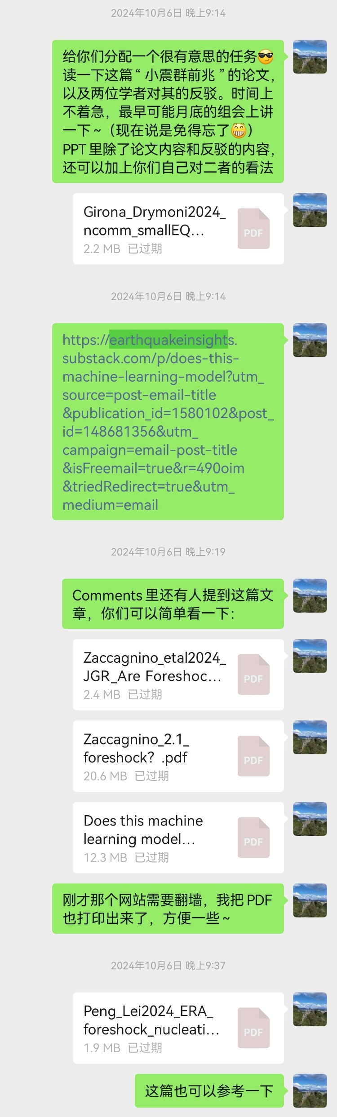
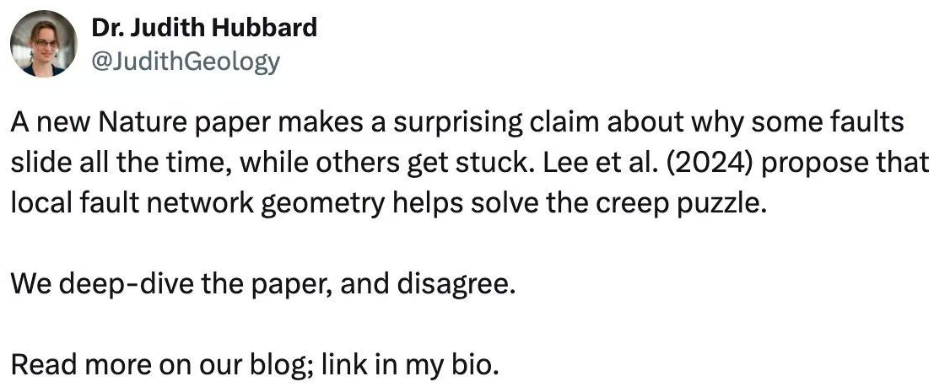
Can we tell if an earthquake is going to be a foreshock?：
https://earthquakeinsights.substack.com/p/can-we-tell-if-an-earthquake-is-going?utm_source=post-email-title&publication_id=1580102&post_id=175161665&utm_campaign=email-post-title&isFreemail=true&r=490oim&triedRedirect=true&_src_ref=mail.google.com&utm_medium=email
https://earthquakeinsights.substack.com/p/why-are-some-faults-so-creepy

