Slide 1
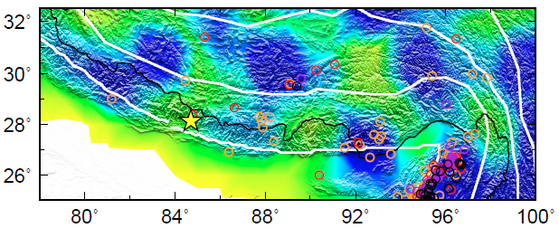
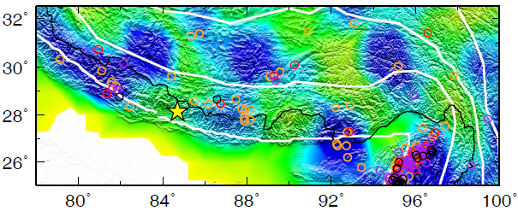
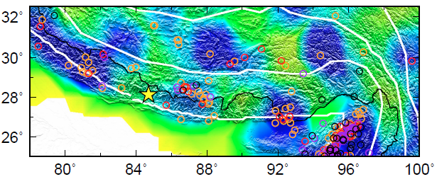
How it started…
(2015.4~5)
CSN
PDE
Grid 1*1
ISC
In “Donuts and Dynamics” weekly discussion at UIUC

Slide 2
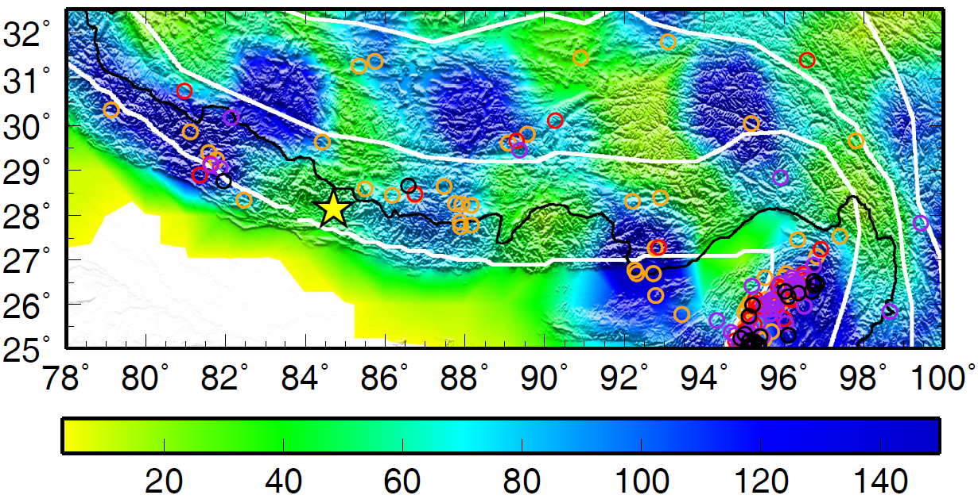
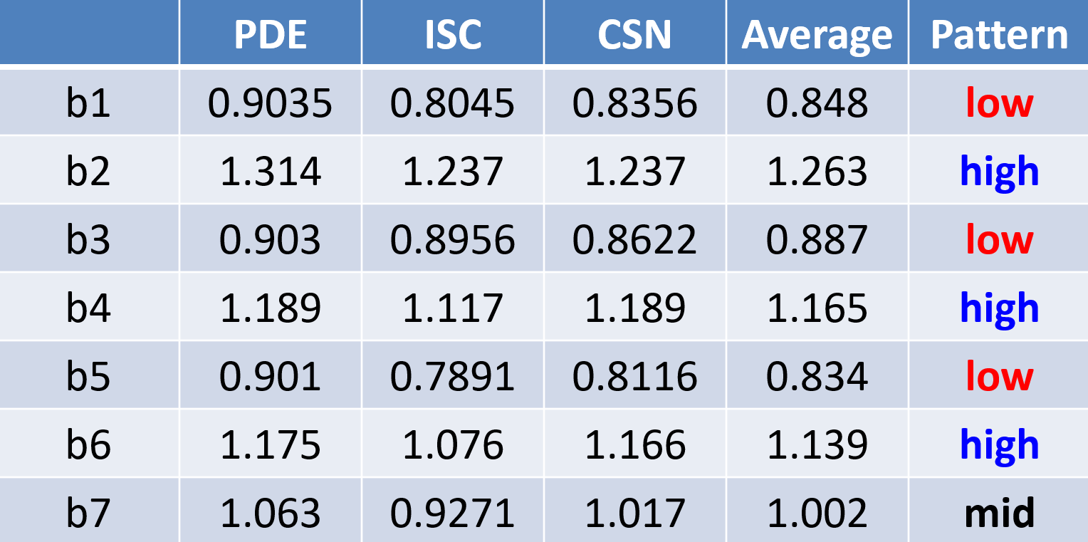
Preliminary b-value of regions 1 to 7

Slide 3
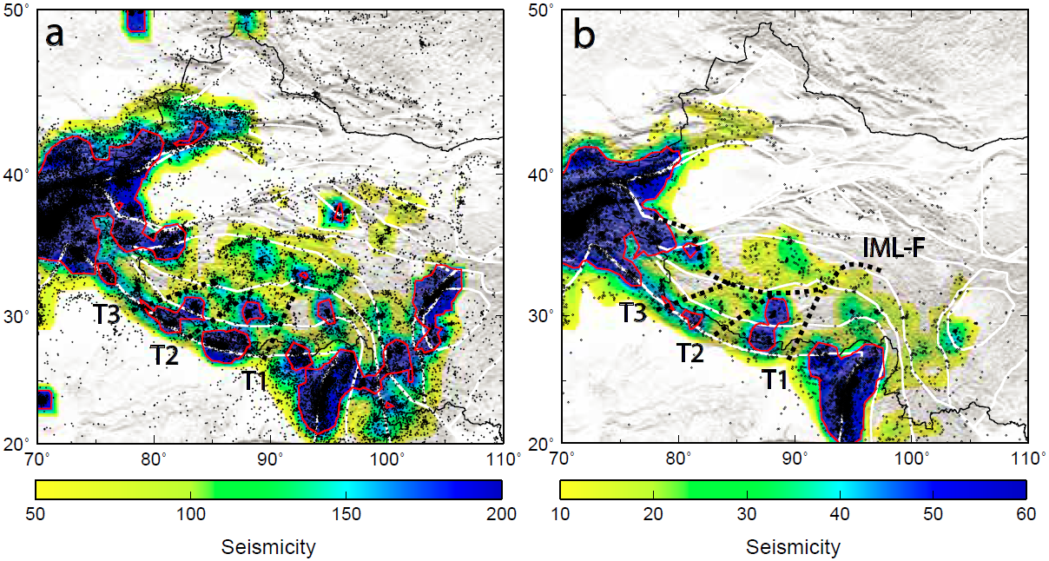
地震活动性统计
All depths Depth>40 km
ISC catalog: 1 by 1º grid, # of M>=4 within 1º, contour of 190 and 50

Slide 4
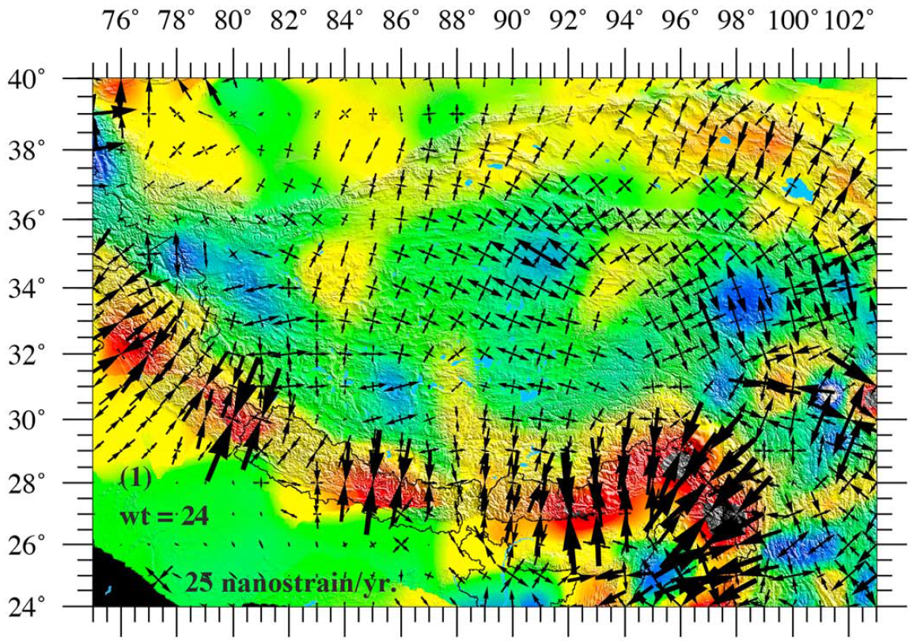
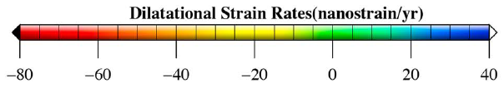
(Ge et al., 2015: GPS应变率结果)

Slide 5
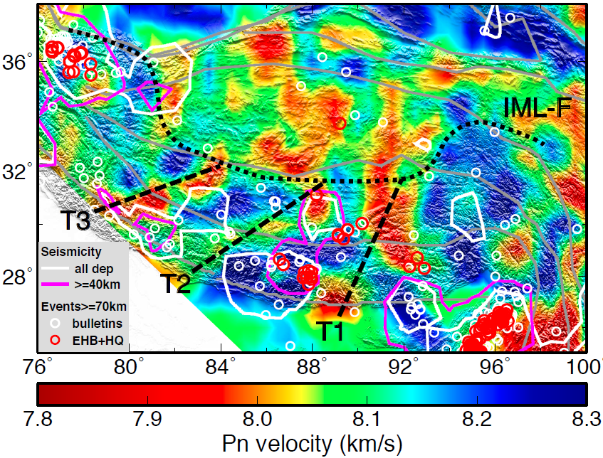
结果和讨论

Slide 6
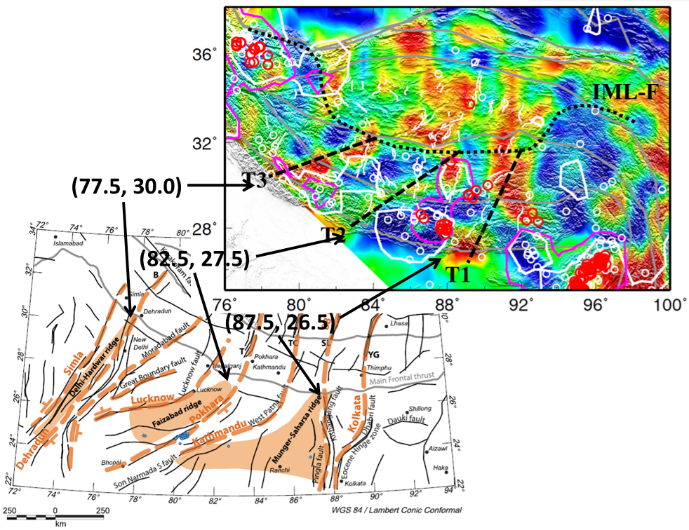
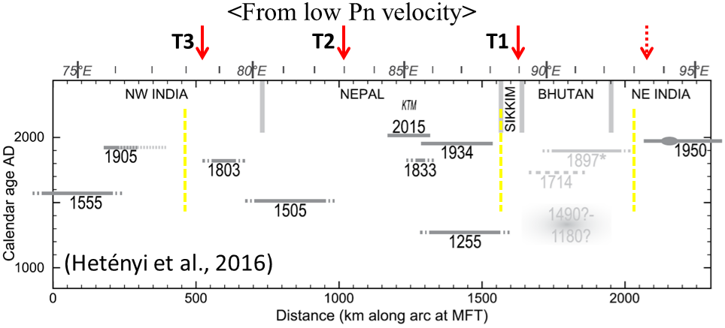
Correlation with Indian basement ridges and megathrust earthquakes
(Godin and Harris, 2014)

Slide 7
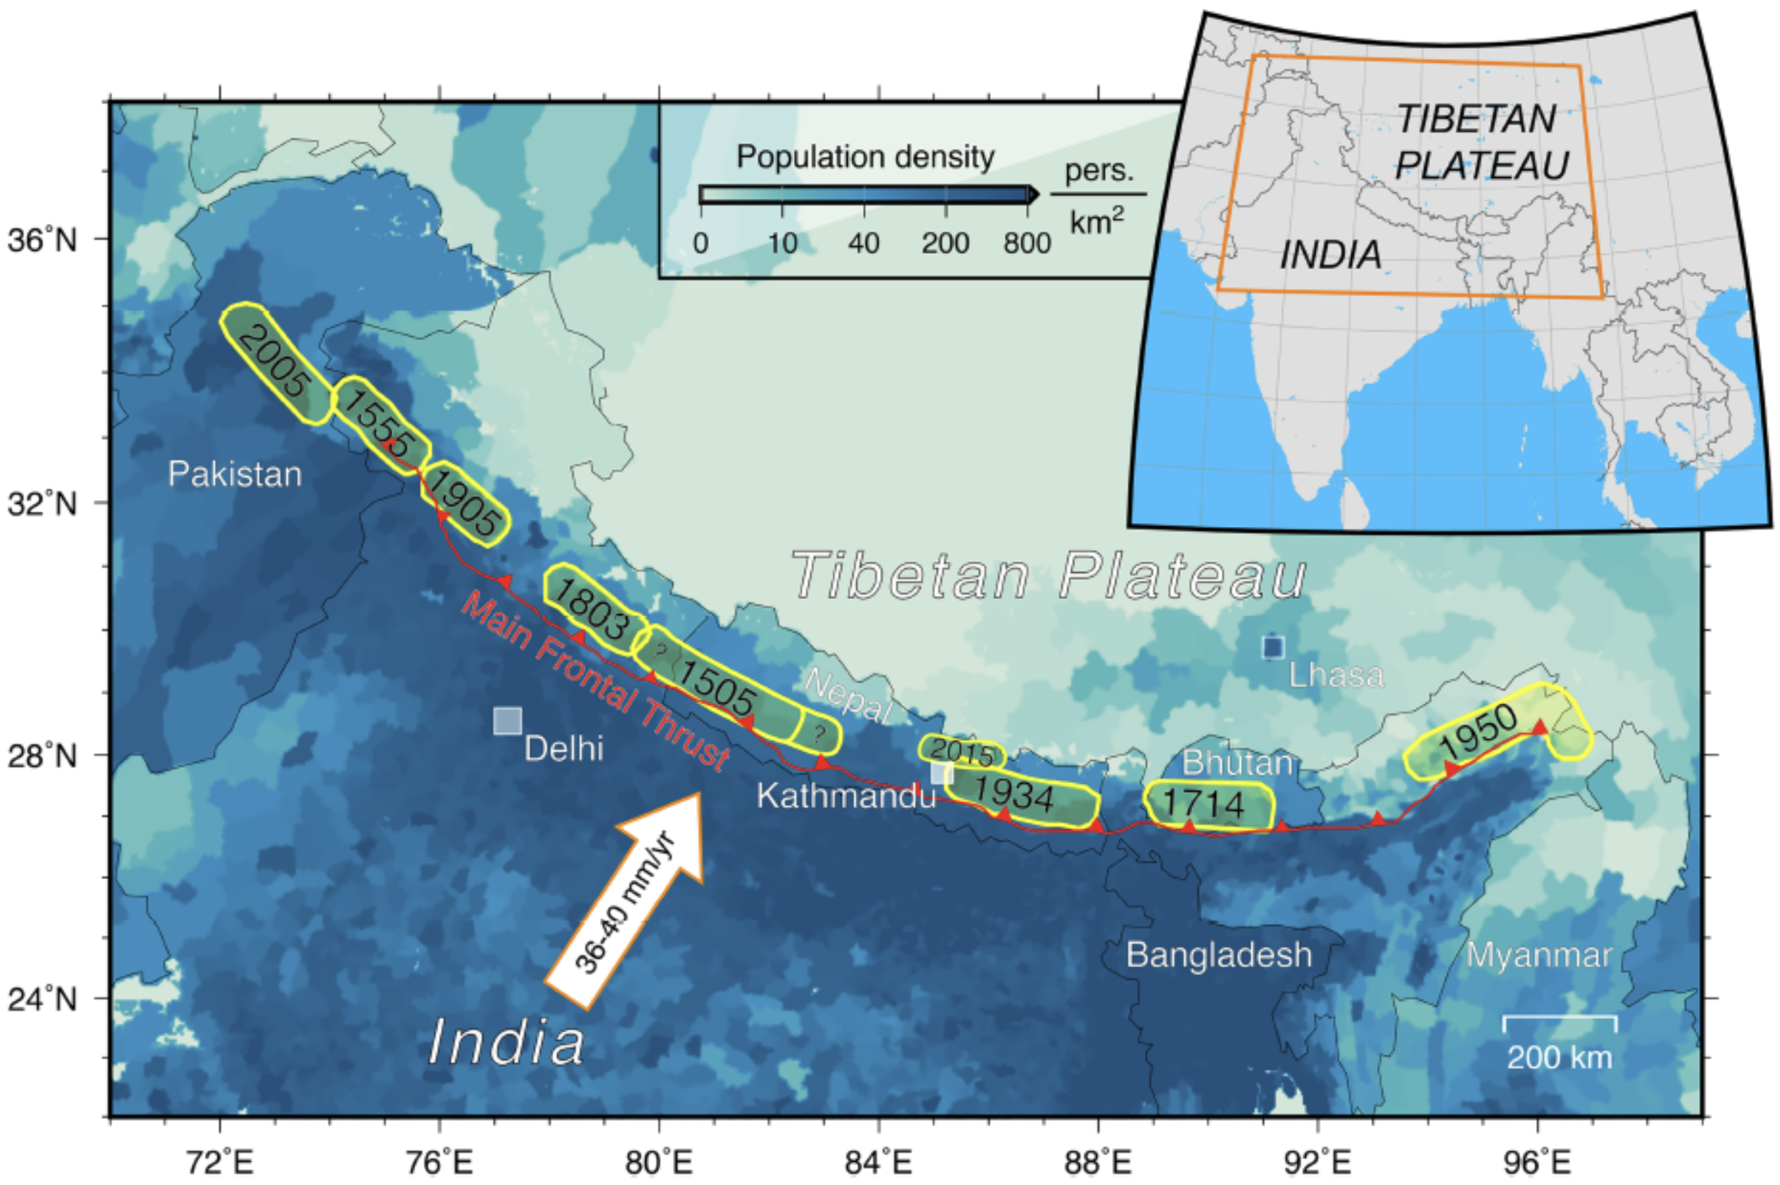
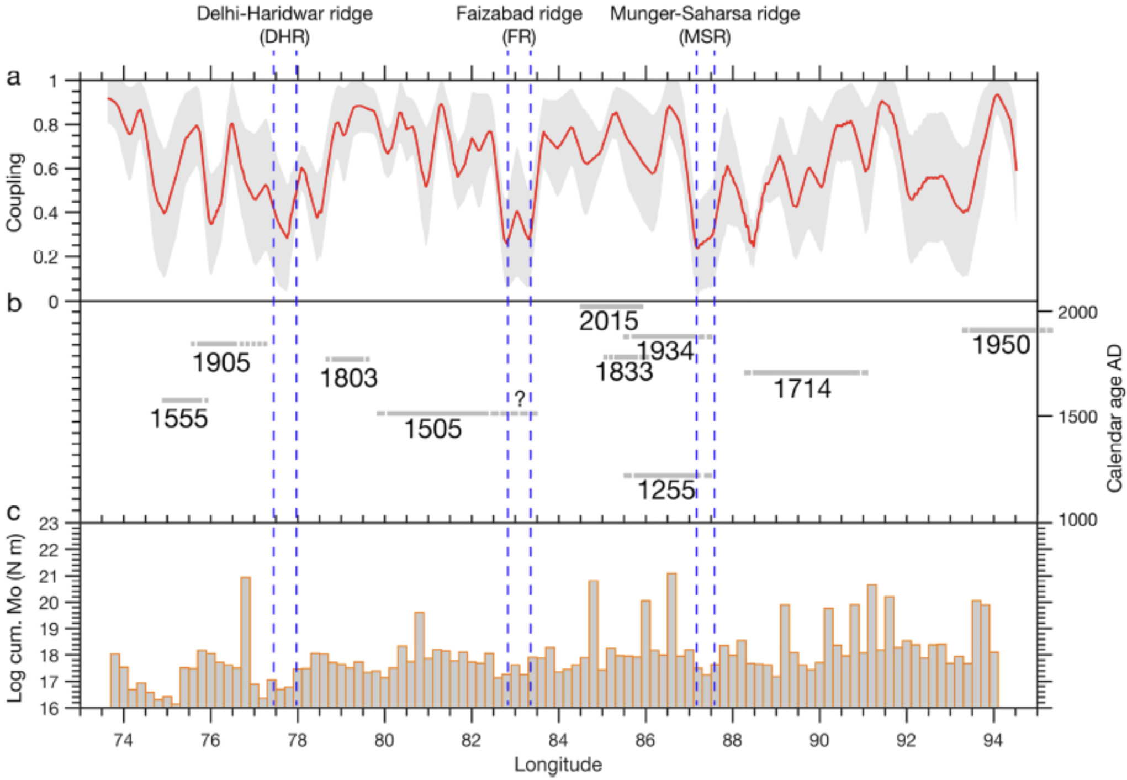
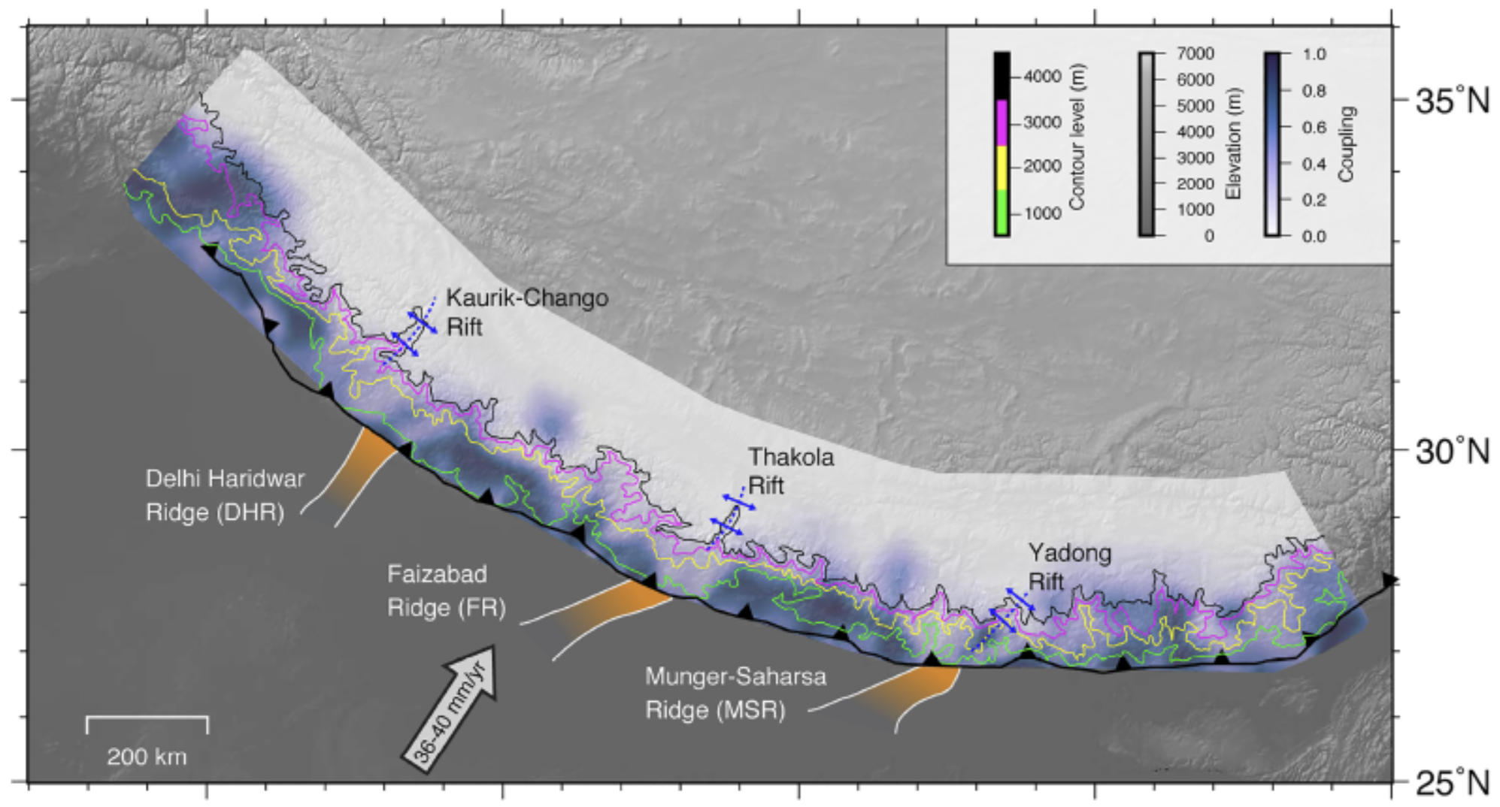
Along-strike segmentation of the MHT with three segments that may act as aseismic barriers (Dal Zilio et al., 2020)
Interseismic coupling: the ratio of interseismic deficit of slip rate to long-term slip rate (1 if the fault is fully locked and 0 if it is creeping at long-term slip rate).
Pattern of interseismic coupling can reveal locked patches where future earthquakes might occur, or aseismic barriers that can arrest earthquake ruptures.
Dal Zilio et al., 2020 (GPS+leveling):
- 4 large, highly coupled patches separated by 3 low
- Locked patches overlap with historical rupture areas
- Segmentation of MHT imposed by inherited structures

Slide 8
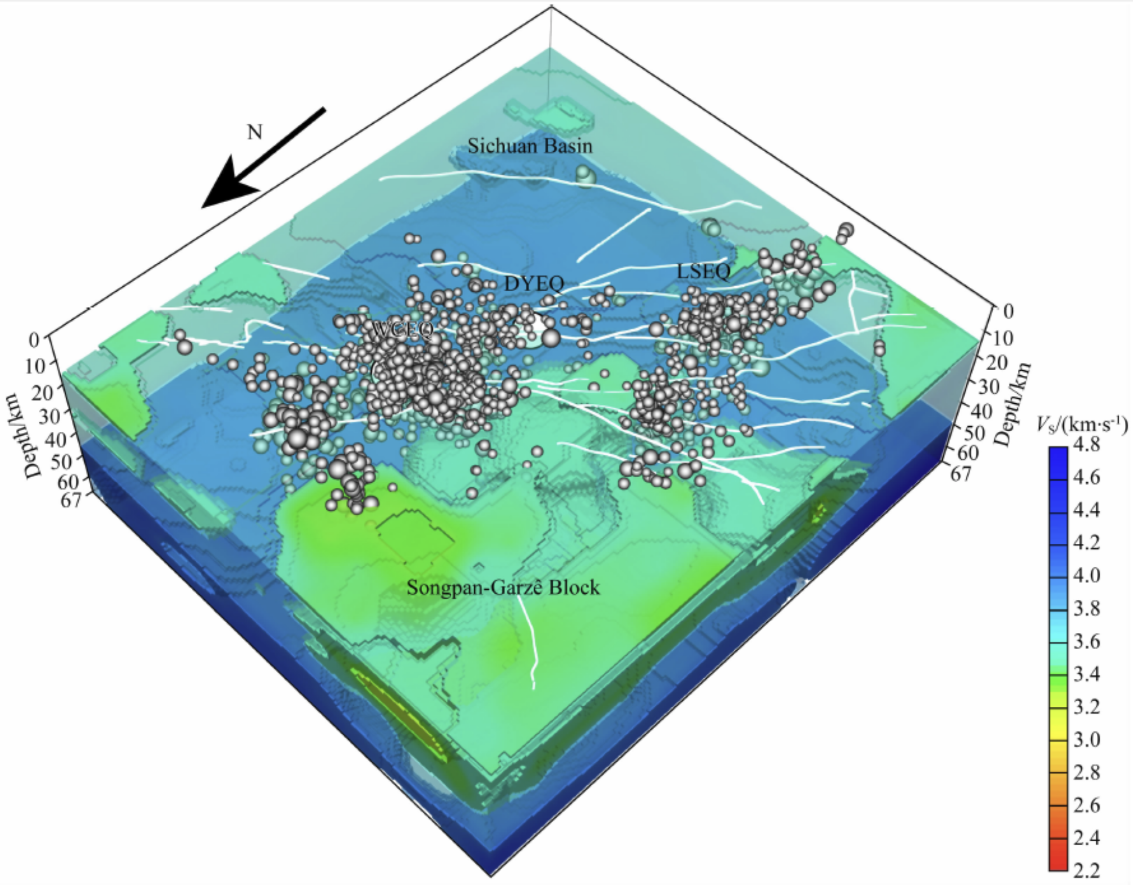
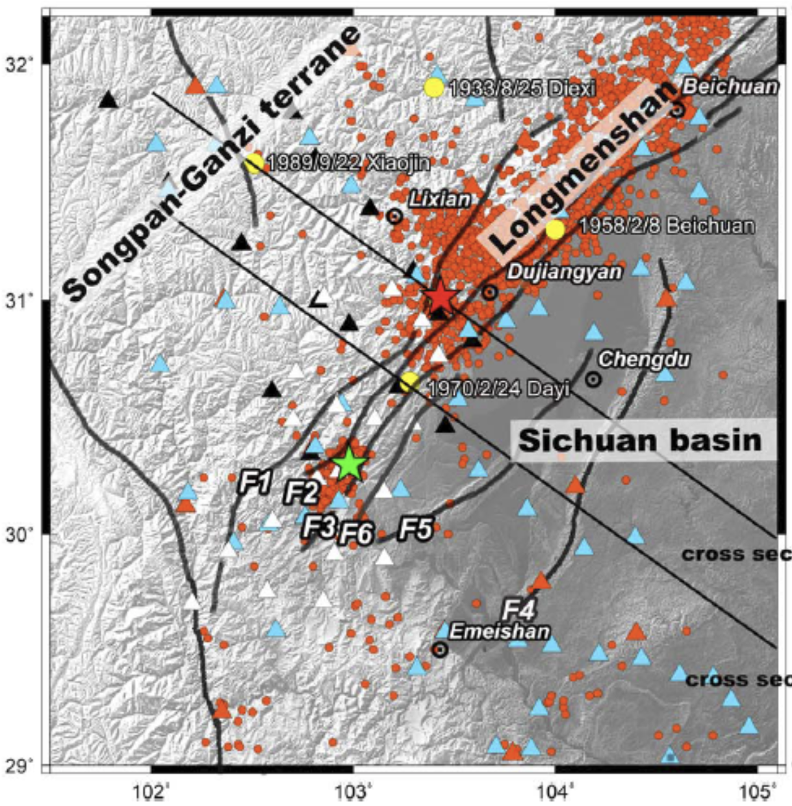
其他组在龙门山的研究
“推测熔融体的加温作用是导致空段内极低的地震活动性的主要原因。”
(Liu et al., 2018)
三维S波速度模型(Liu et al., 2018)与地震重定位结果分布(Huang et al., 2020)

Slide 9
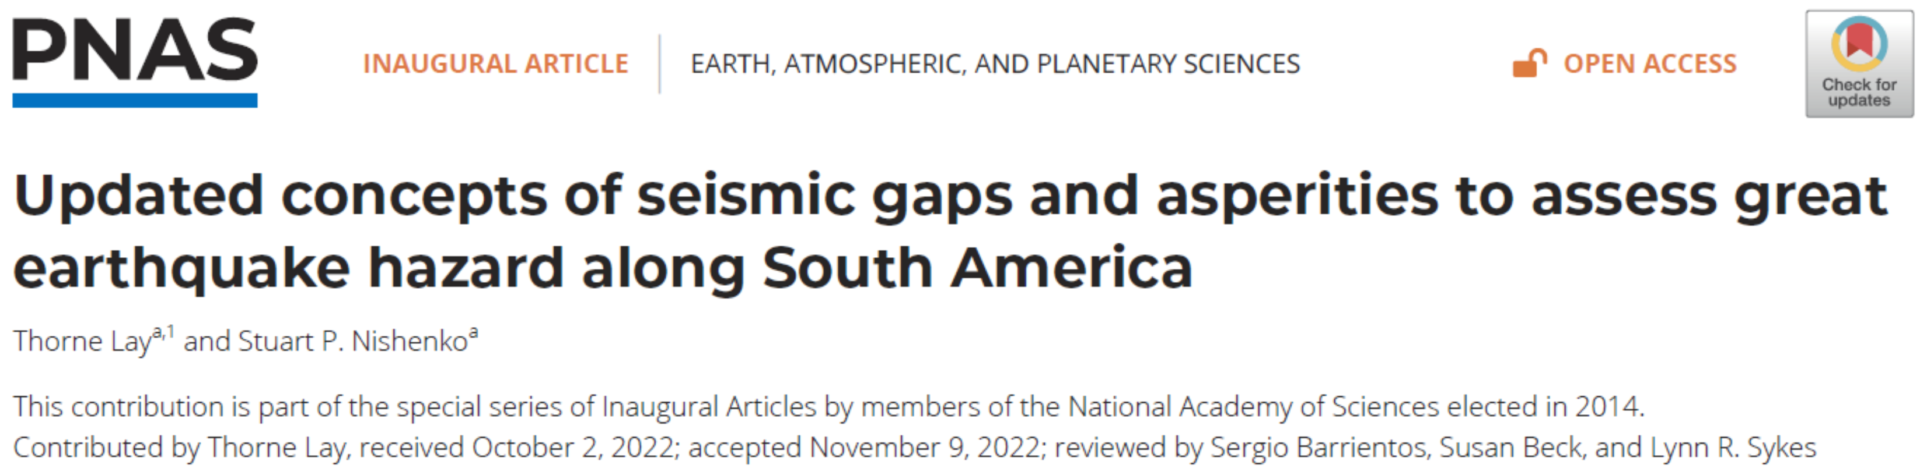
Seismic gap：地震空区
Asperity：凹凸体
Barrier：障碍体

Slide 10
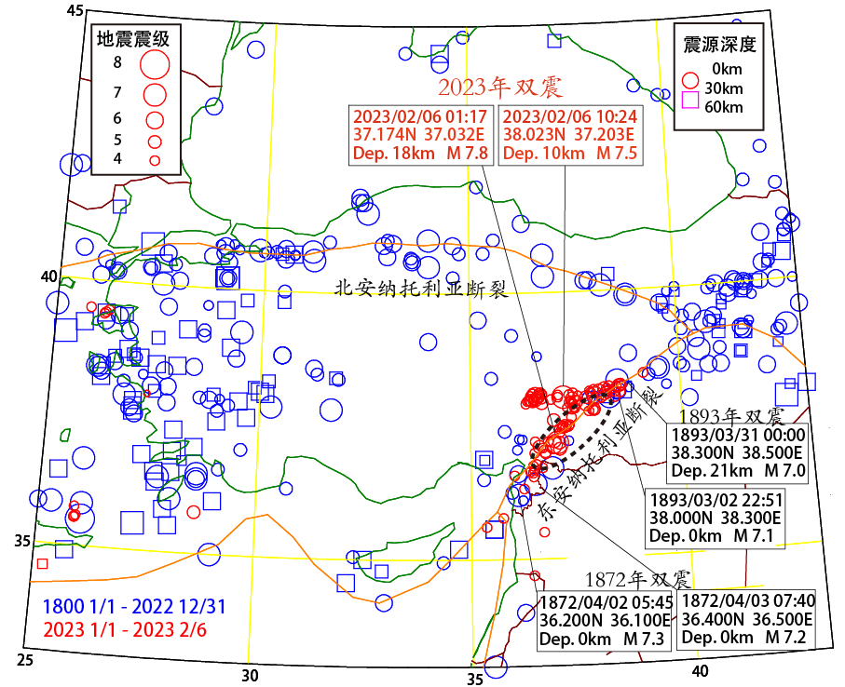
空区
本次土耳其地震的发生位置是近300公里超长地震“空区”，在最近数百年间尚未发生过大地震。
在“空区”西南向，1872年4月2日和4月3日先后发生7.3级和7.2级地震；在“空区”东北向，1893年3月2日和31日先后发生7.1级和7.0级地震。
本次7.8级地震破裂长度在250-300公里之间，恰好位于东安纳托利亚断裂带最近数百年间尚无活动记录的地震“空区”。
土耳其“双震”发生在断裂带活动“空区”
原创 詹慧丽 白玲 等 中科院之声 2023-02-09 11:30
https://mp.weixin.qq.com/s/eZYn9uOTj0maUrh_Y7Ukww

Slide 11
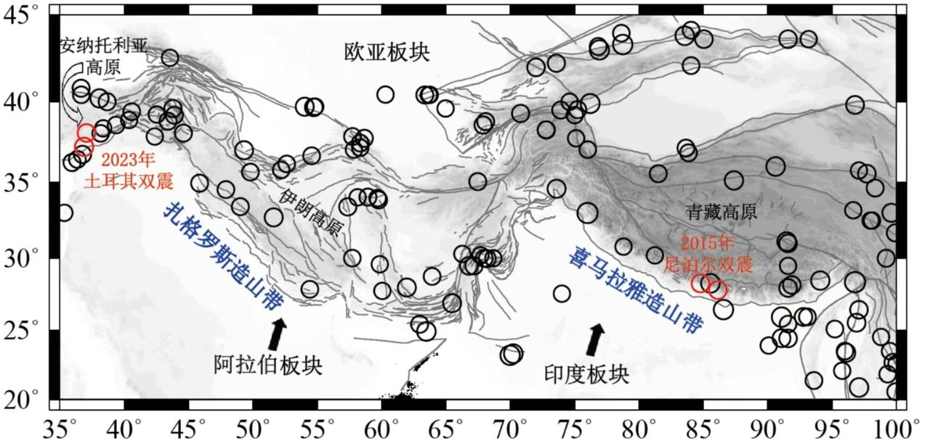
板块边界发生大地震是普遍的自然现象，为什么没有应对措施呢？实际上喜马拉雅山脉中部尼泊尔和不丹地区也有类似的超长地震“空区”（图1），2015年4月25日和5月12日相继发生了7.8级和7.3级地震。然而2015年尼泊尔“双震”并非发生在地震“空区”，7.8级地震发生的起始位置位于尼泊尔“空区”东段，地震发生时沿着喜马拉雅山脉向东侧发生单向破裂，此后的7.3级地震发生在不丹“空区”西侧（Bai et al., 2019）。由此可见，未来大地震将在何处发生、可能有多大震级，很大程度上取决于板块边界断裂的几何形态和地下结构的时空变化特征。
关于2023年土耳其地震还有很多未解之谜，比如边界断裂的几何形态如何影响大地震的发生过程。从震后一天的余震活动情况来看，东安纳托利亚断裂的方向在7.8级地震的东西两侧可能发生突然偏转，震源区东侧以北可能存在近东西方向的不同分支，这些都是以前没有看到的现象。得益于全球地震台网观测精度和波形数据处理技术的不断提高，准确的地震资料分析将使我们看到更加清晰的震源区深部结构图像。
土耳其“双震”发生在断裂带活动“空区”
原创 詹慧丽 白玲 等 中科院之声 2023-02-09 11:30
https://mp.weixin.qq.com/s/eZYn9uOTj0maUrh_Y7Ukww

Slide 12
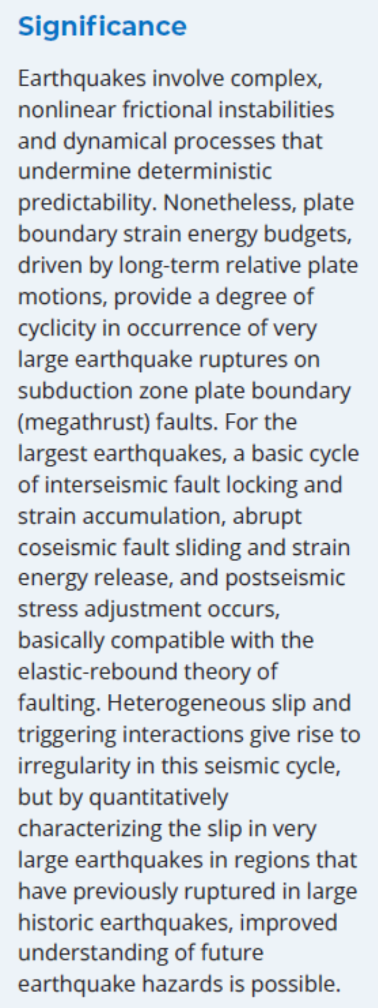
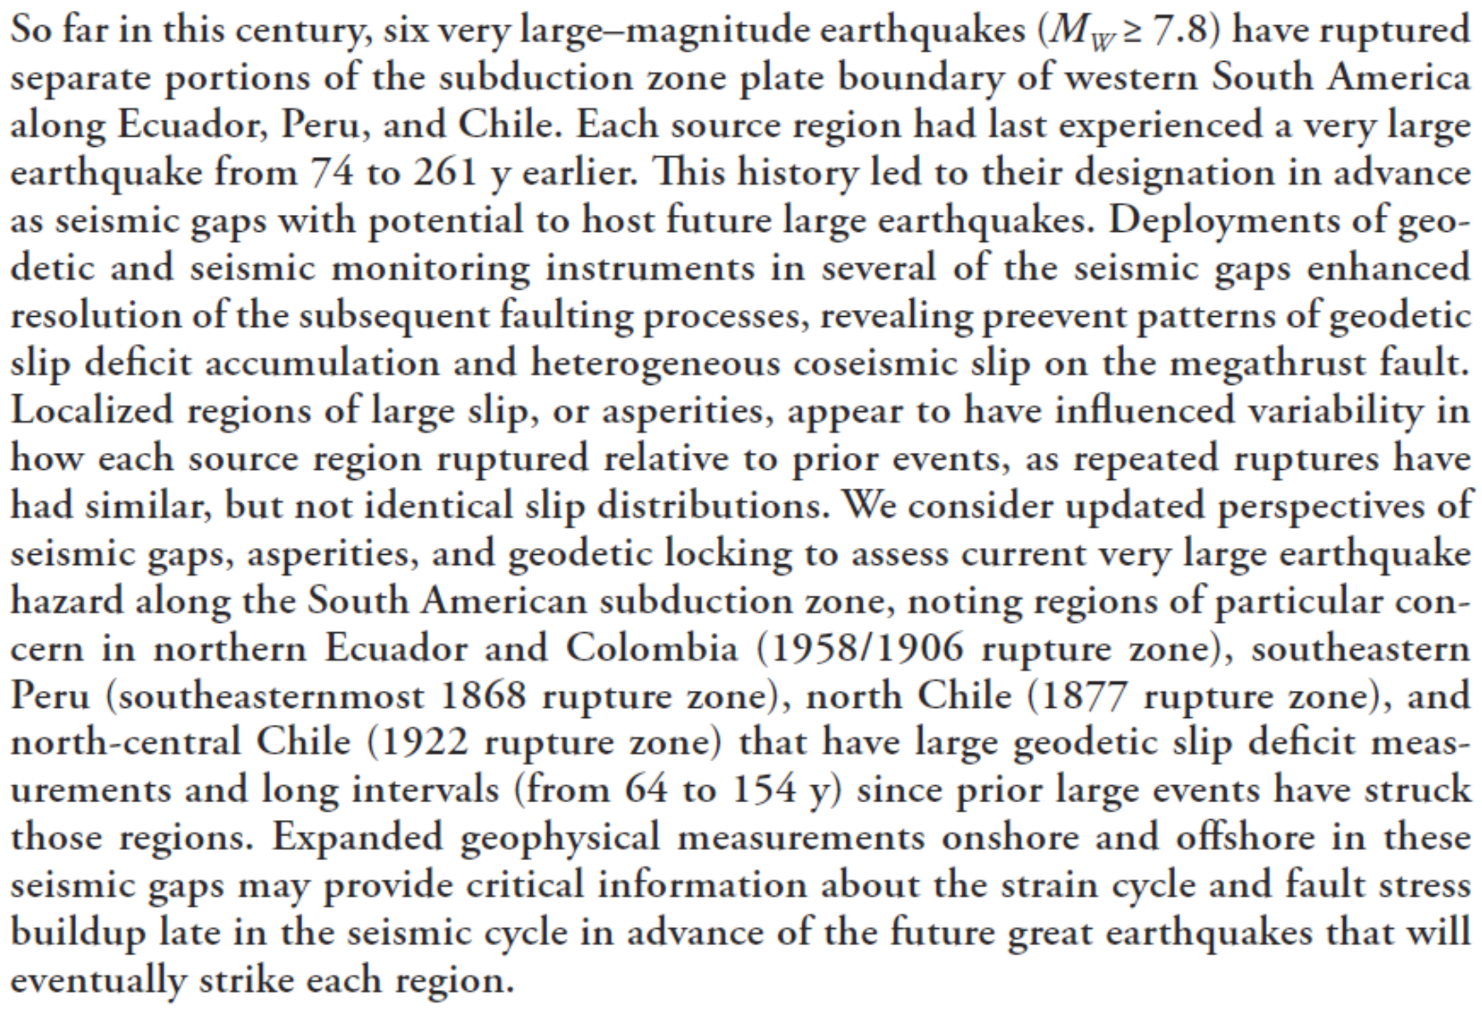

Slide 13
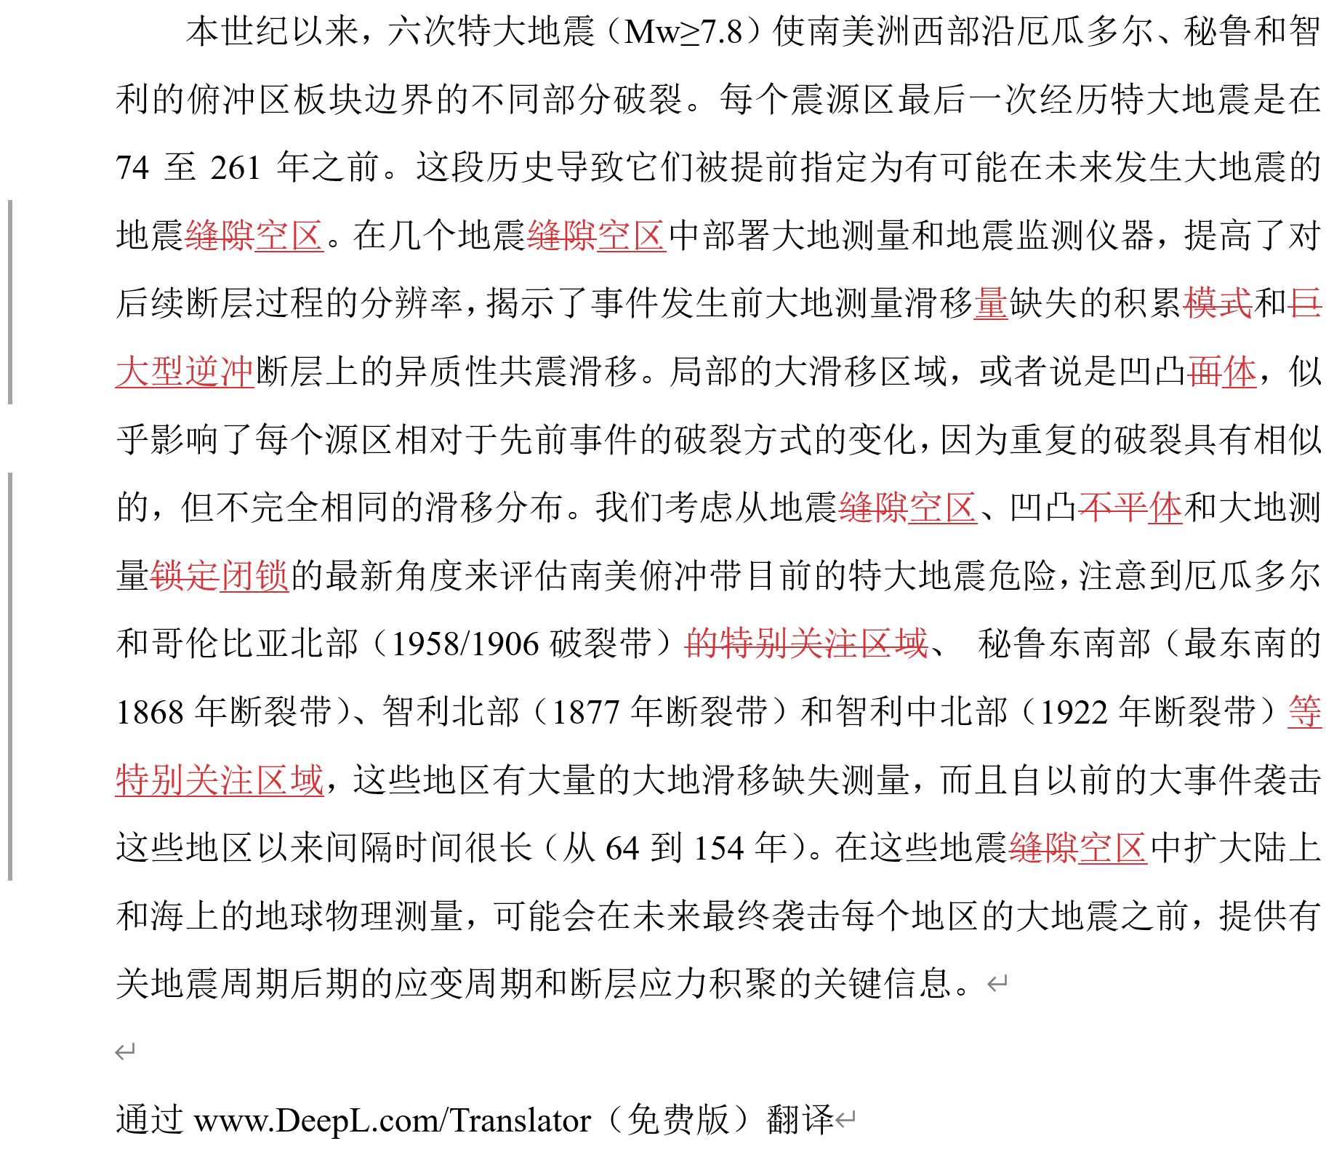
摘要翻译
三个关键：
地震空区
凹凸体分布
大地测量闭锁

Slide 14
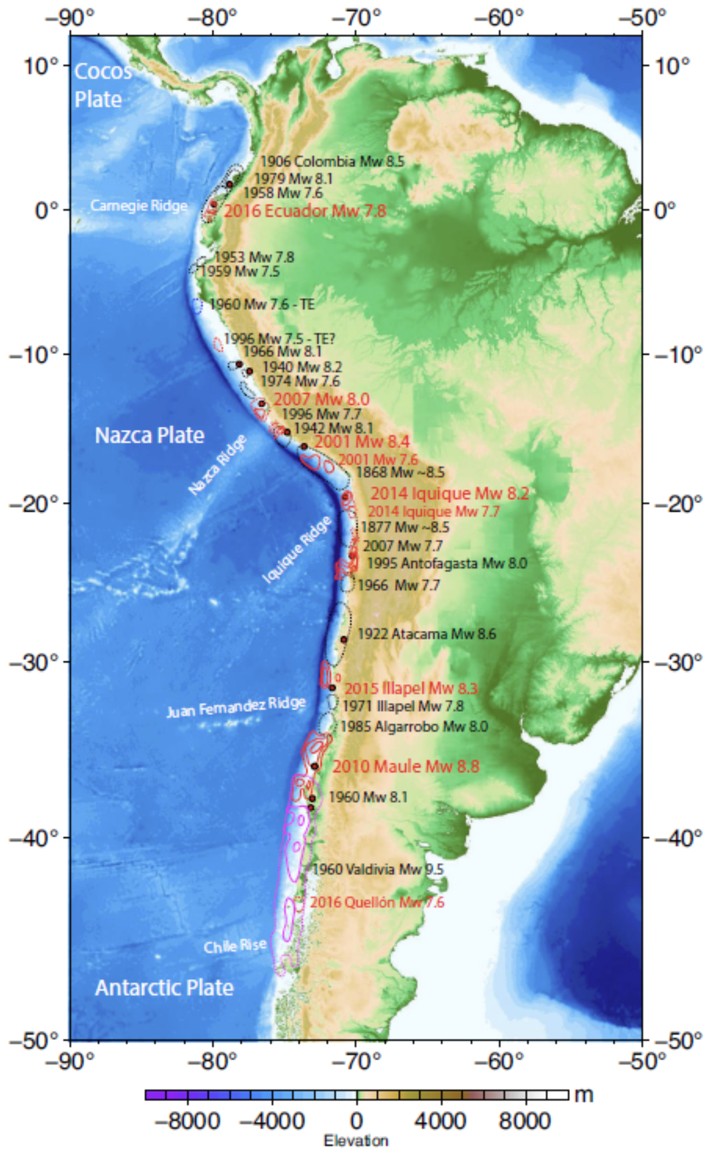
Fig. 1. The most recent large earthquake rupture zones (Mw ≥ 7.5) along each region of the west coast of South America where the Nazca plate is underthrusting the continent. Black dashed regions indicate aftershock zones for older events (black labels); red contours indicate slip distribution for large events in this century (red labels) from references in the supplement; purple contours indicated slip contours (1, 10, and 20 m) for the 1960 Valdivia, Chile, event.

Slide 15
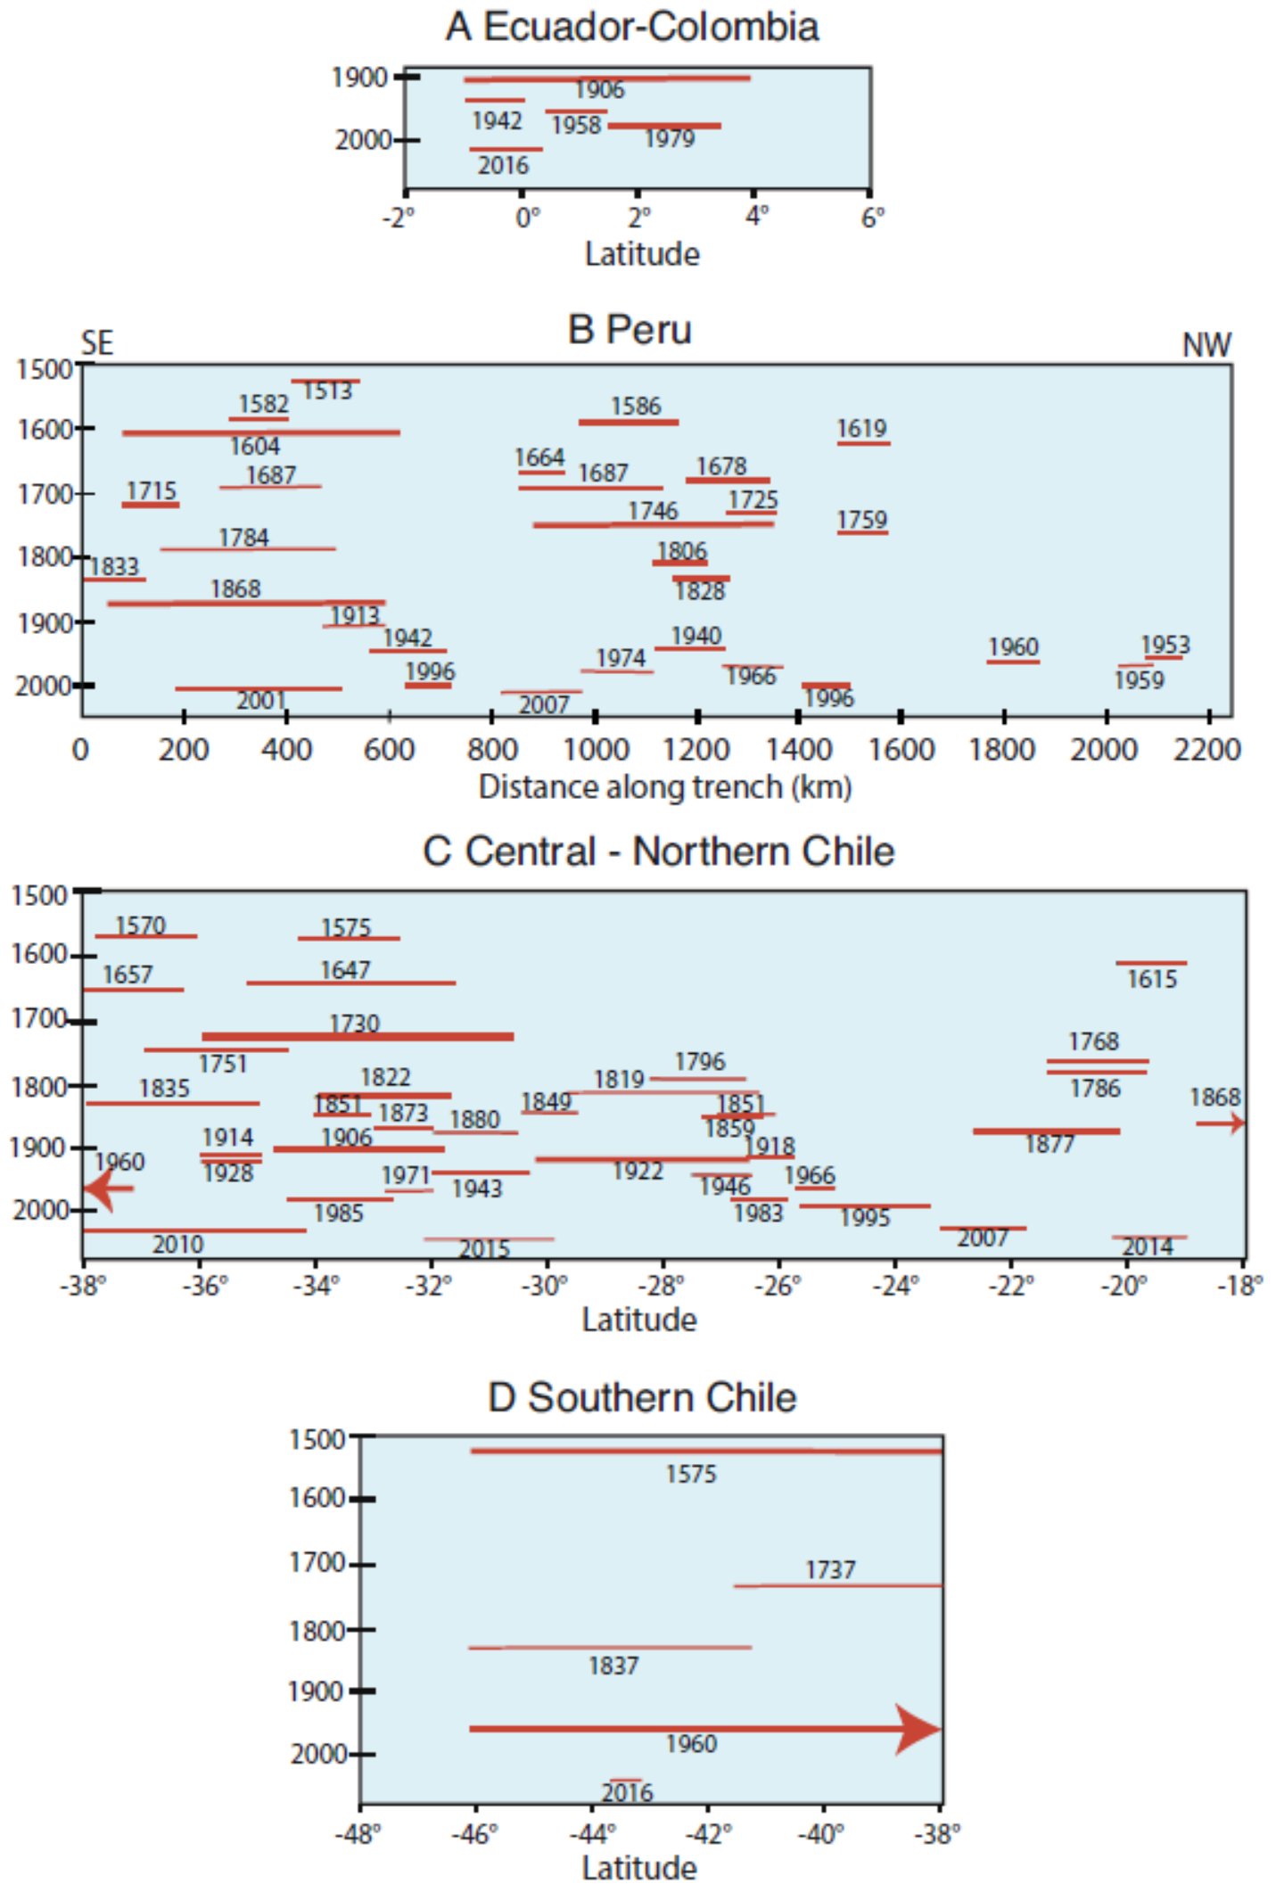
Fig. 2. Along–plate boundary rupture distributions for historic large earthquakes (M ≥ ~7.5) in (A) Ecuador–Colombia, (B) Peru (6), (C) central to northern Chile (7–9), and (D) southern Chile (7, 8). Bolder lines represent Breakthrough Ruptures that likely span the entire width of the plate boundary.

Slide 16
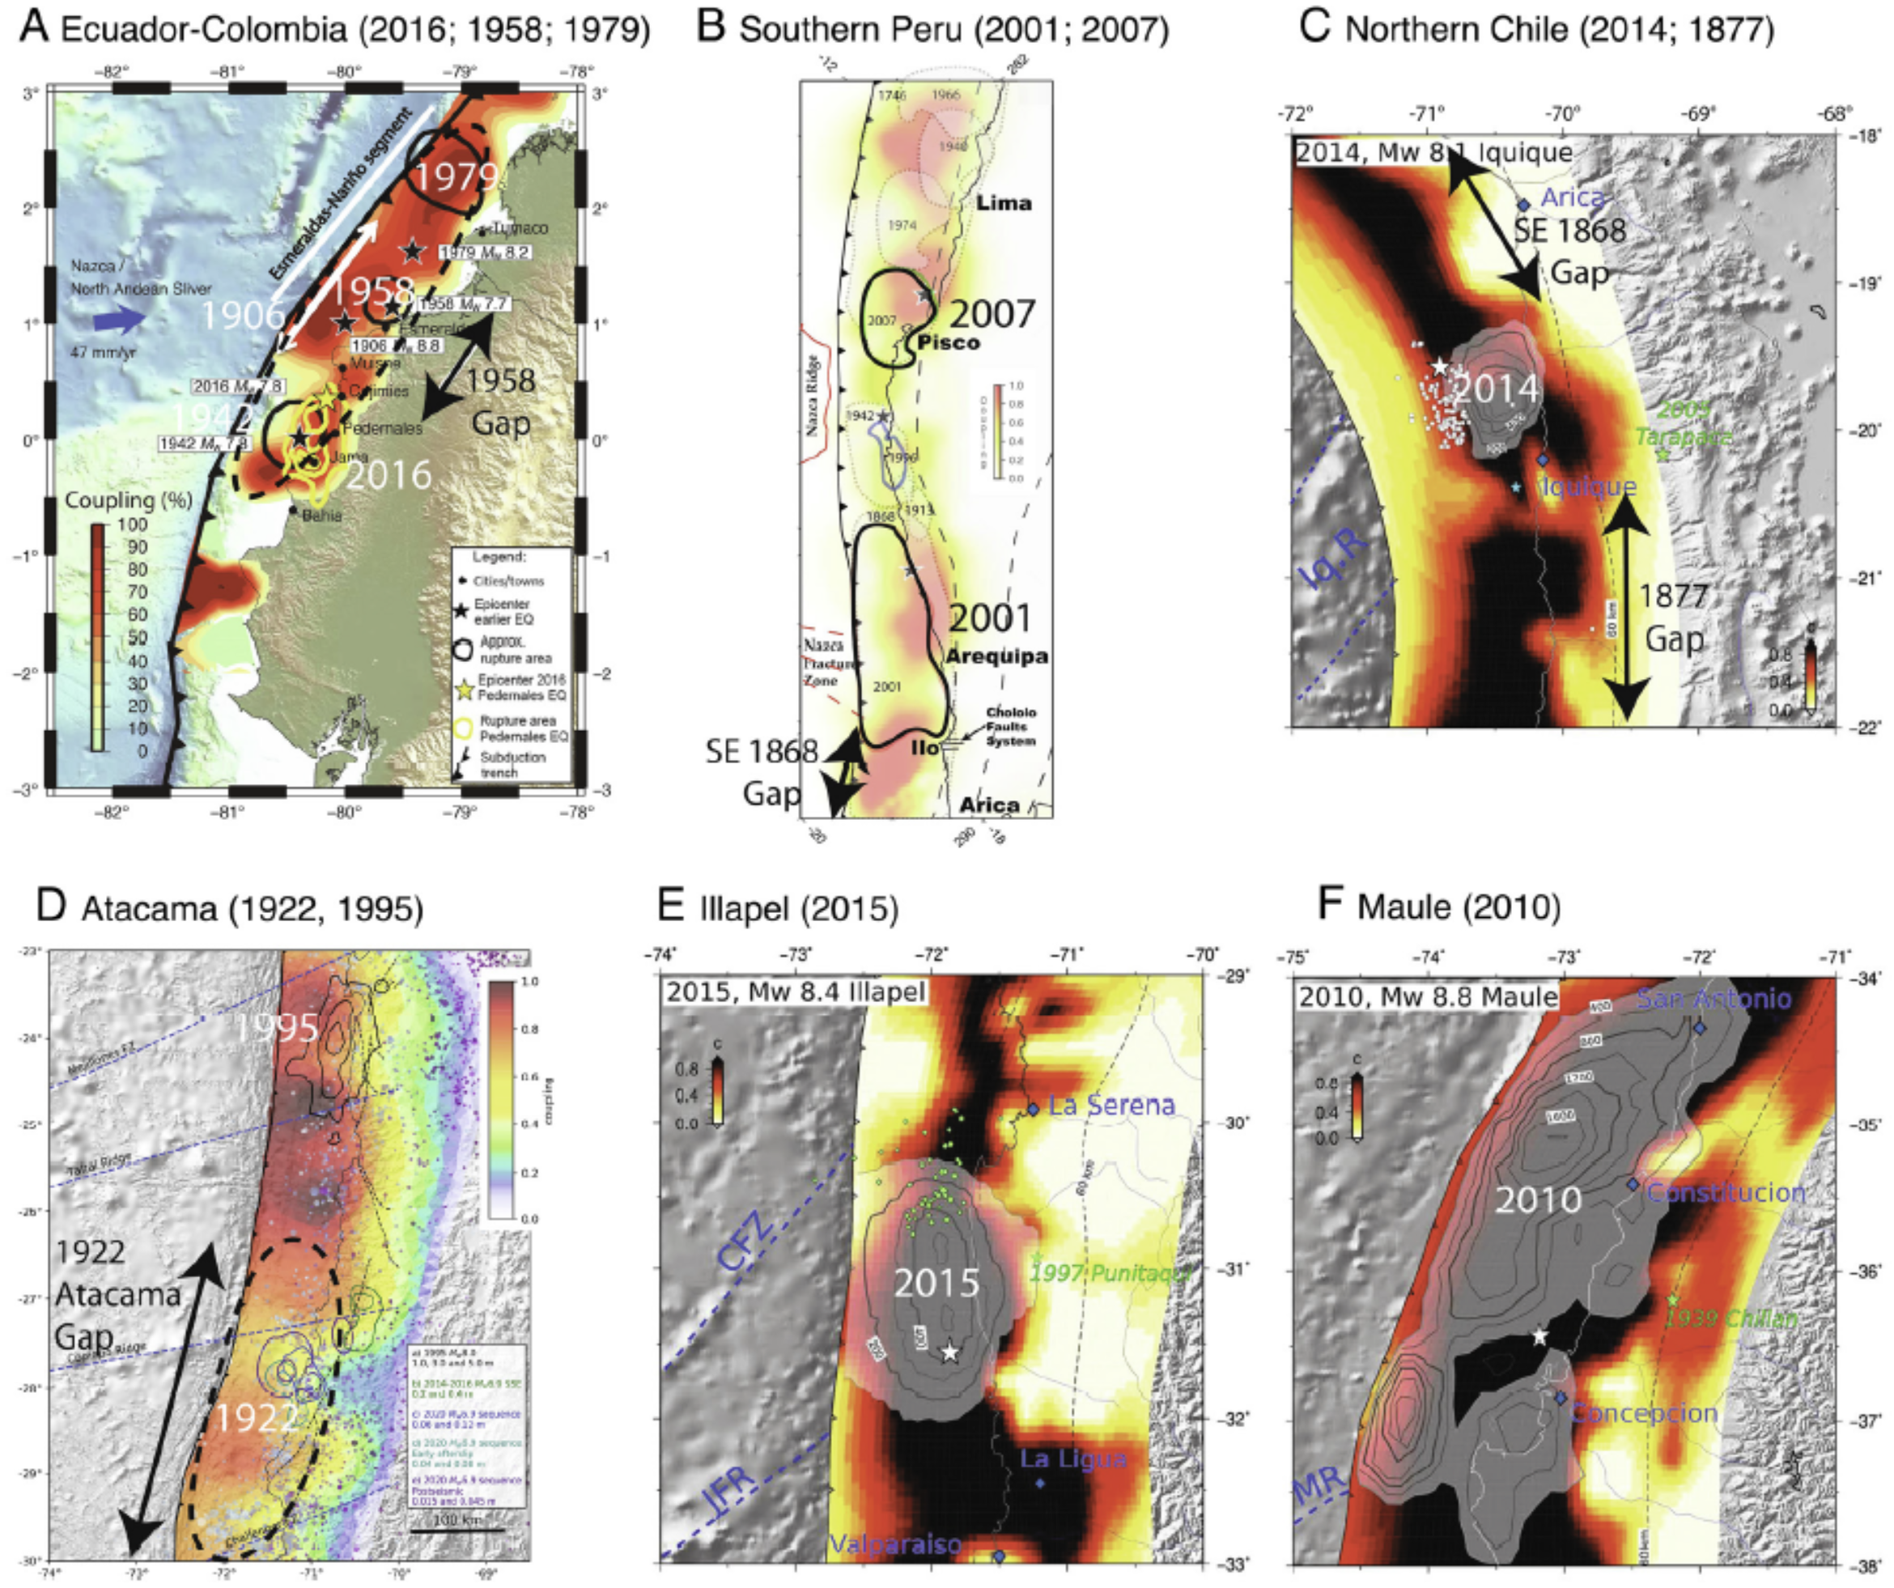
Fig. 3. Very large earthquake rupture zone and prior estimates of geodetic plate boundary coupling (darkest reds correspond to 100% slip deficit relative to plate motion) for (A) the 2016 Ecuador earthquake and 1906, 1942, 1958, and 1979 ruptures (28); (B) the Southern Peru region with the 2007 Pisco and 2001 Arequipa earthquakes (29); (C) the 2014 Iquique, Chile, zone, with 1868 Peru to the north and 1877 Chile to the south (9); (D) the 1922 Atacama event region with the 1995 Antofagasta earthquake to the north (30); (E) the 2015 Illapel earthquake (9); and (F) the 2010 Maule, Chile, earthquake (9).

Slide 17
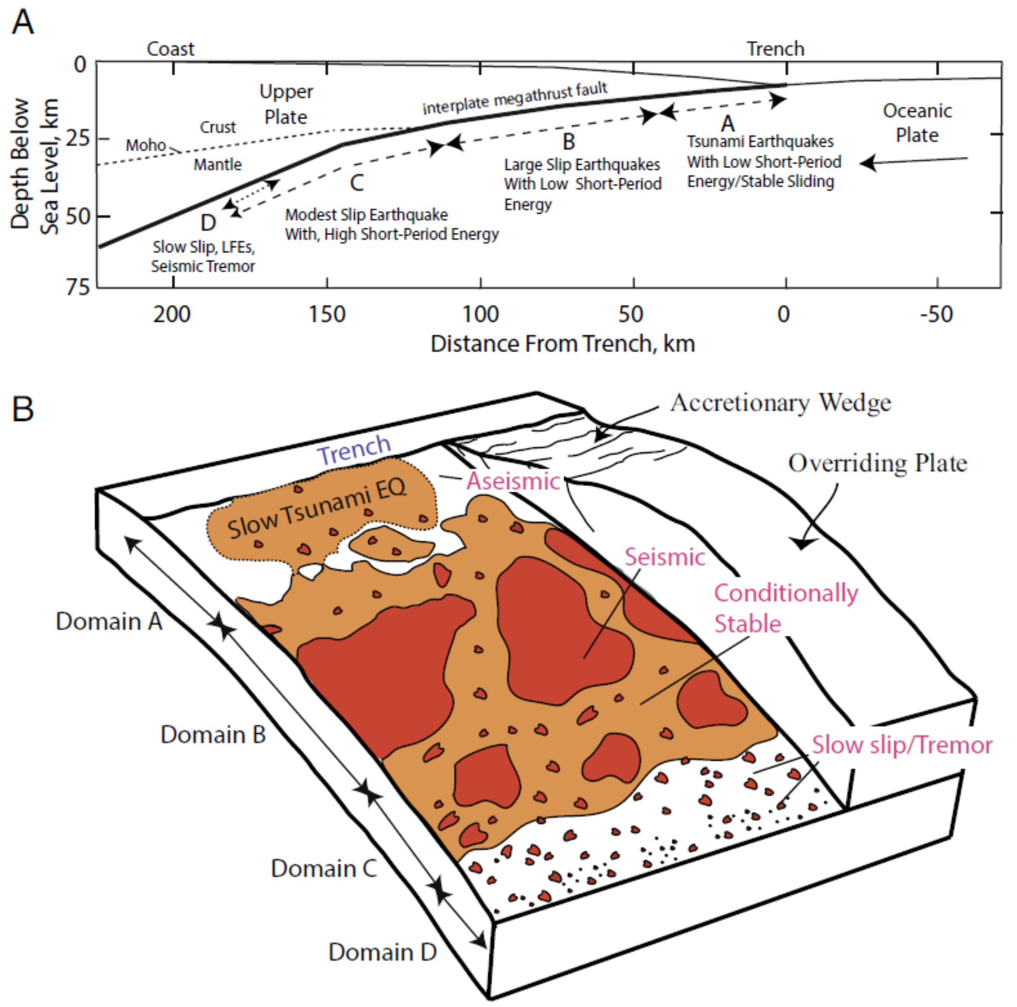
Fig. 4. An updated representation of the asperity model (24). (A) Schematic cross-section indicating four depth-varying domains of megathrust rupture characteristics: A – near-trench domain where tsunami earthquakes or anelastic deformation and stable sliding occur; B – central megathrust domain where large slip occurs with minor short-period seismic radiation; C – down-dip domain where moderate slip occurs with significant coherent short-period seismic radiation; D – transitional domain, only present in some areas, typically with a young subducting plate, where slow slip events, low-frequency earthquakes, and seismic tremor can occur. At yet greater depths, the megathrust slides stably or with episodic slow slip or plastic deformation that does not generate earthquakes. (B) Cutaway schematic characterization of the megathrust frictional environment related to Domains A, B, C, and D defined in (A). Regions of unstable frictional sliding (asperities) are red regions labeled “seismic.” Regions of aseismic stable or episodic slow sliding are white regions labeled “aseismic.” Orange areas are conditional stability regions, which displace aseismically except when accelerated by failure of adjacent seismic patches. Domain A is at shallow depth where low-rigidity sediments and pore fluids cause very slow rupture expansion even if large displacements occur in tsunami earthquakes. Domain B has large, relatively uniform regions of stable sliding that can have large slip but generate modest amounts of short-period radiation upon failure. Domain C has patchy, smaller-scale regions of stable sliding surrounded by conditionally stable areas. When these areas fail, coherent short-period radiation is produced. Small, isolated patches may behave as repeaters when quasistatic sliding of surrounding regions regularly load them to failure. Domain D is dominated by aseismic sliding, but many small unstable patches can rupture in seismic tremor when slow slip events occur.
B: larger EQ, longer-T
C: smaller EQ, short-T
A+B+C: breakthrough ruptures!

Slide 18
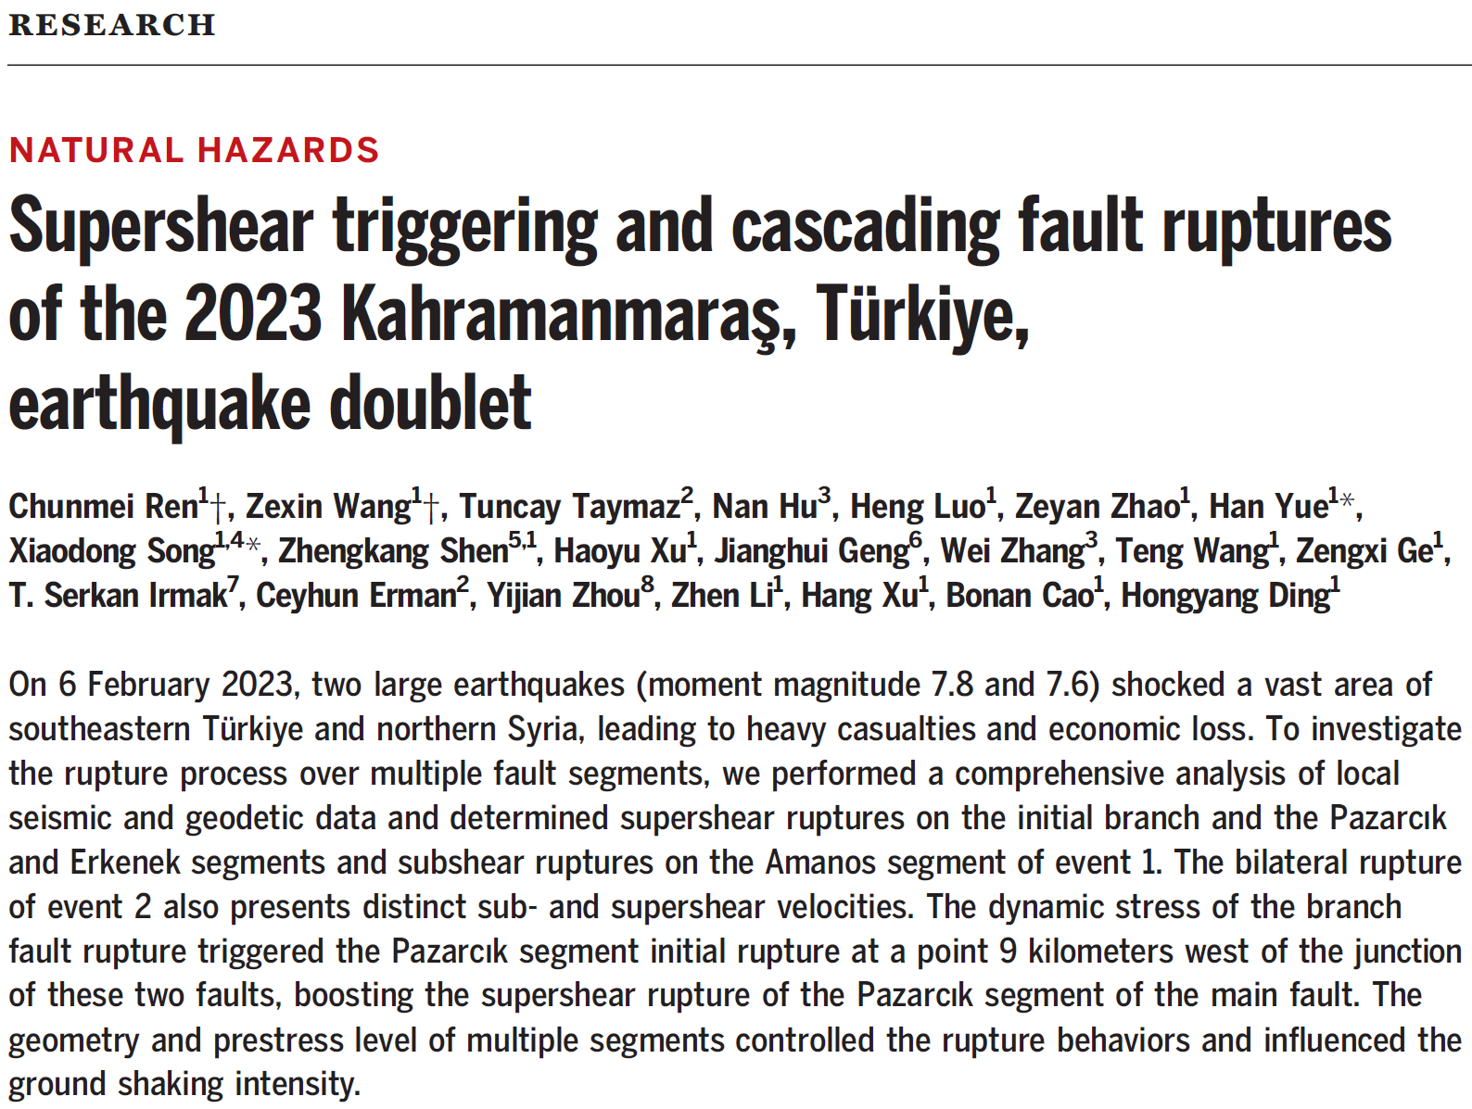
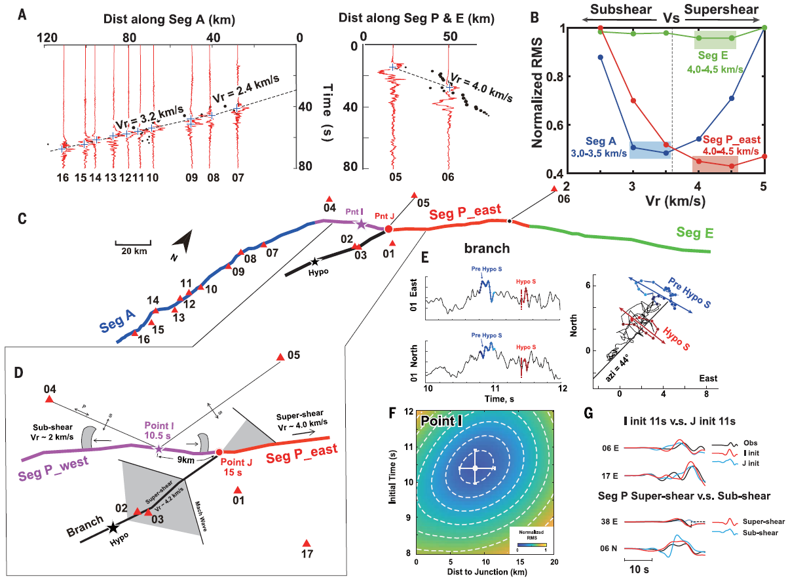

Slide 19
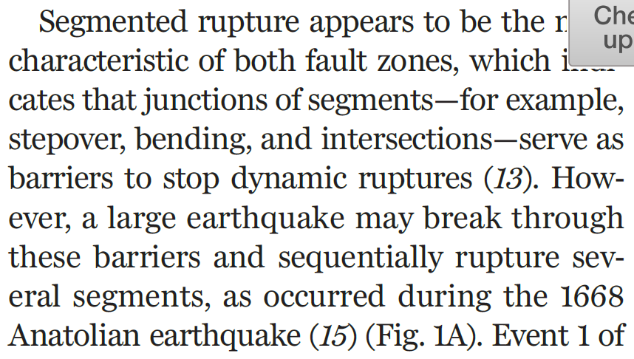
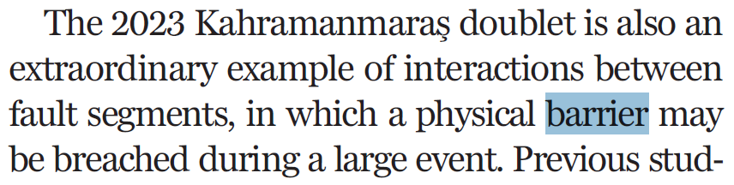
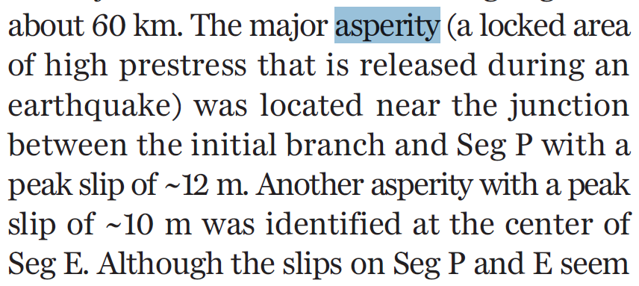

Slide 20
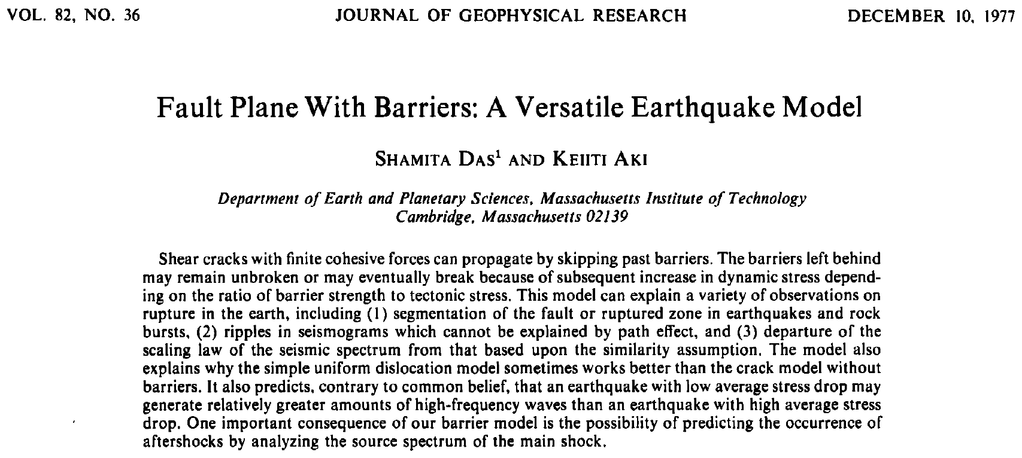
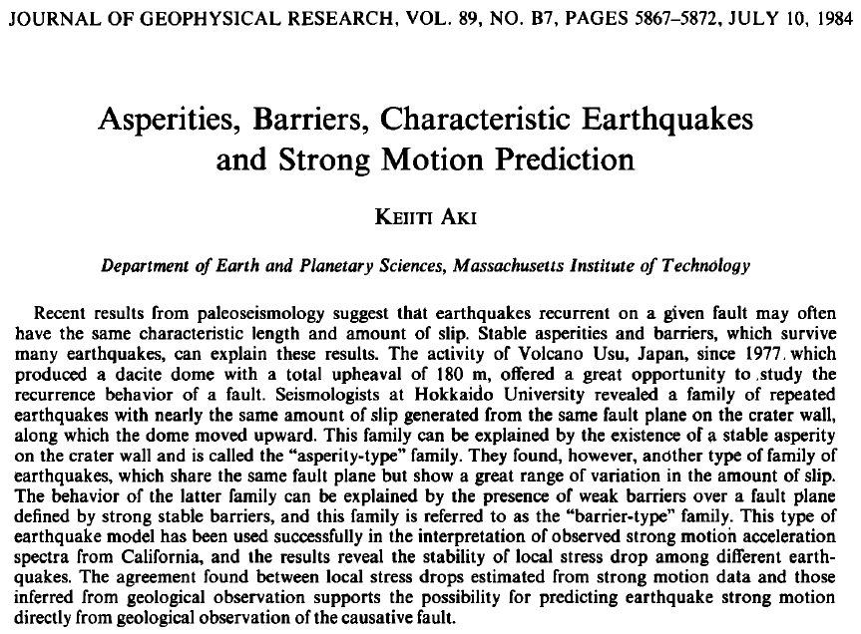
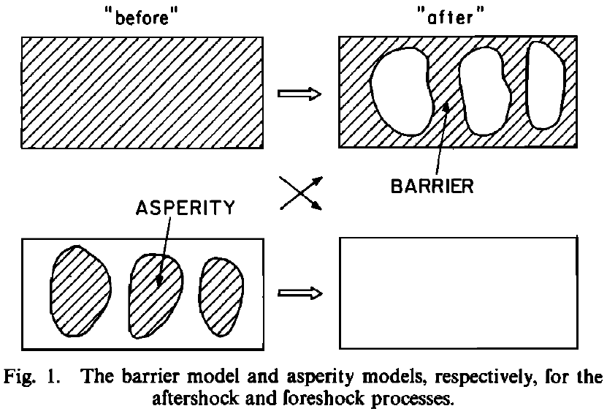
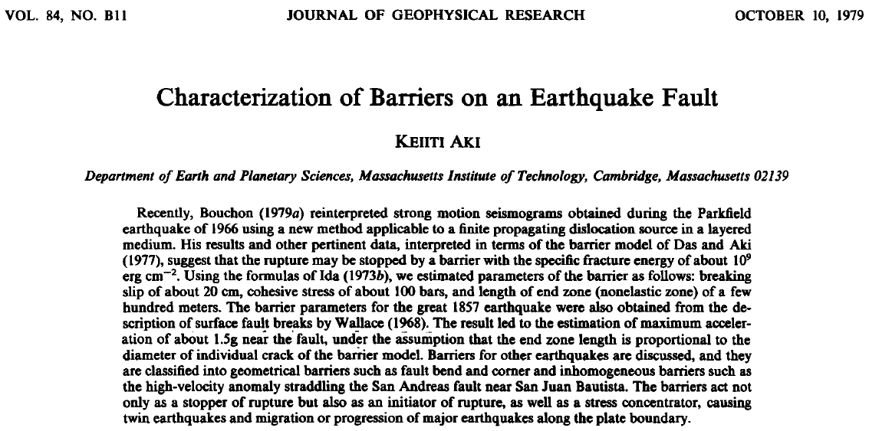

Slide 21
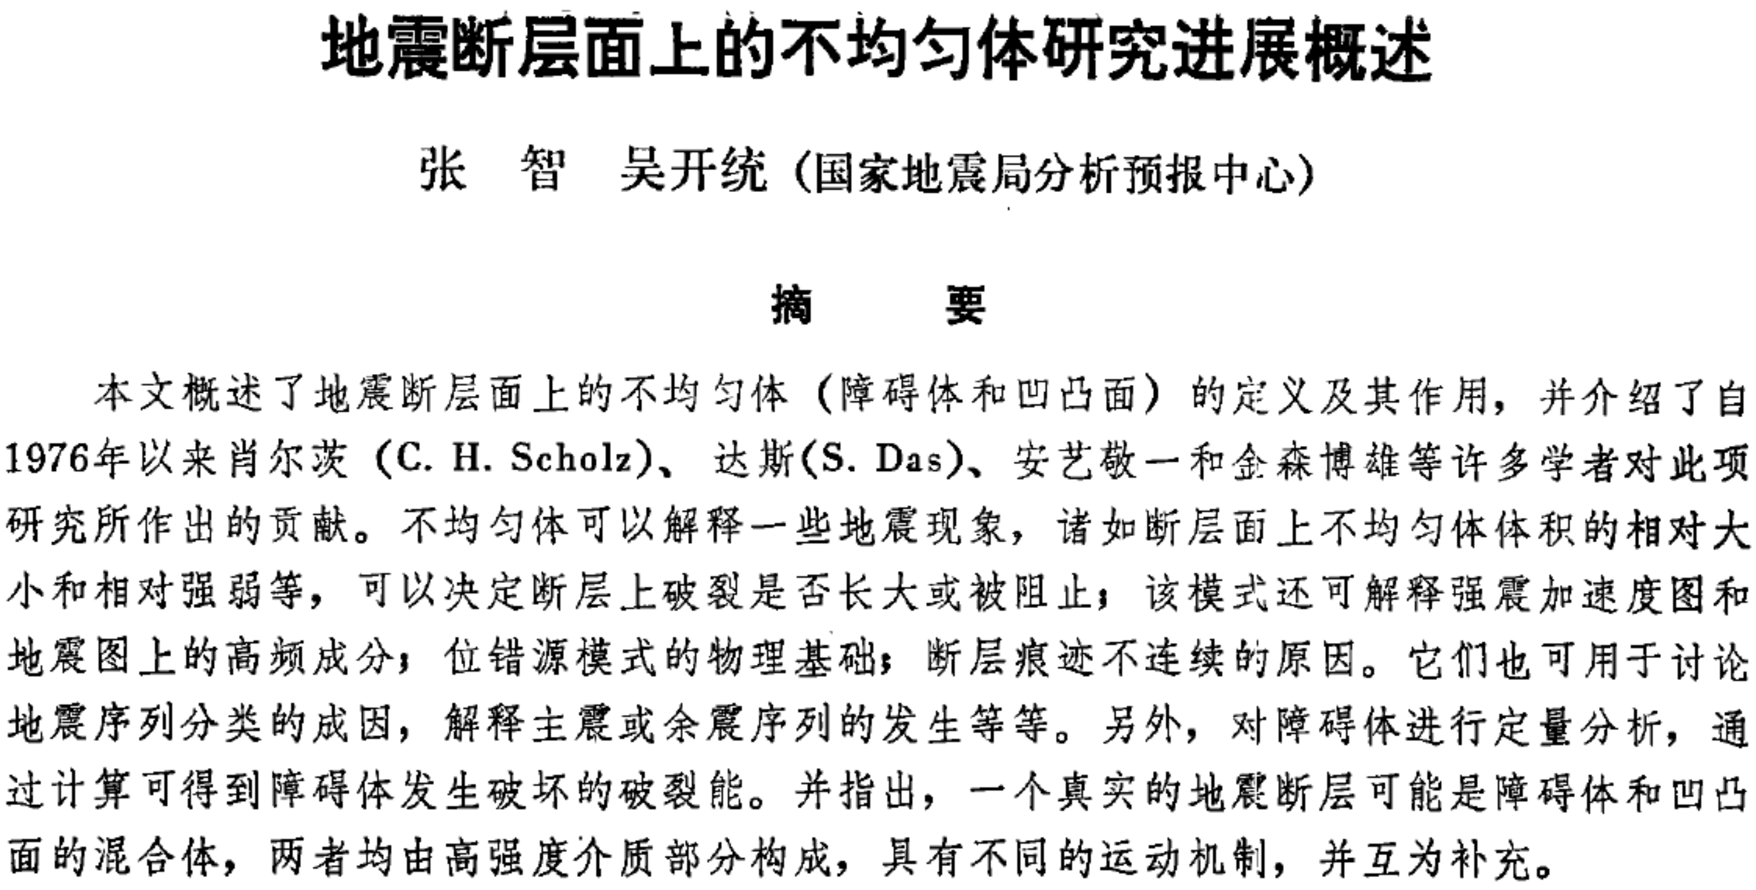

Slide 22
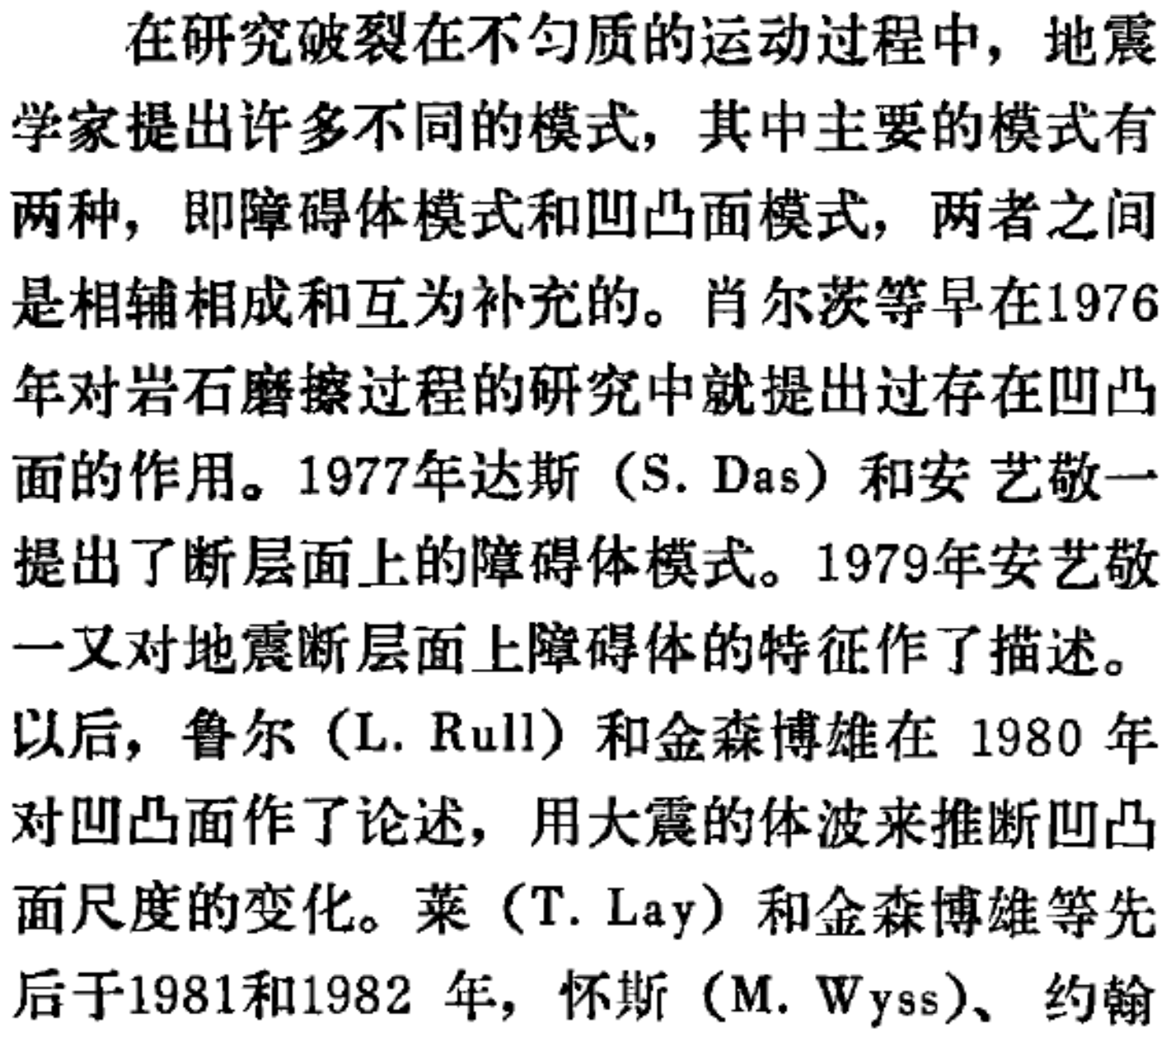
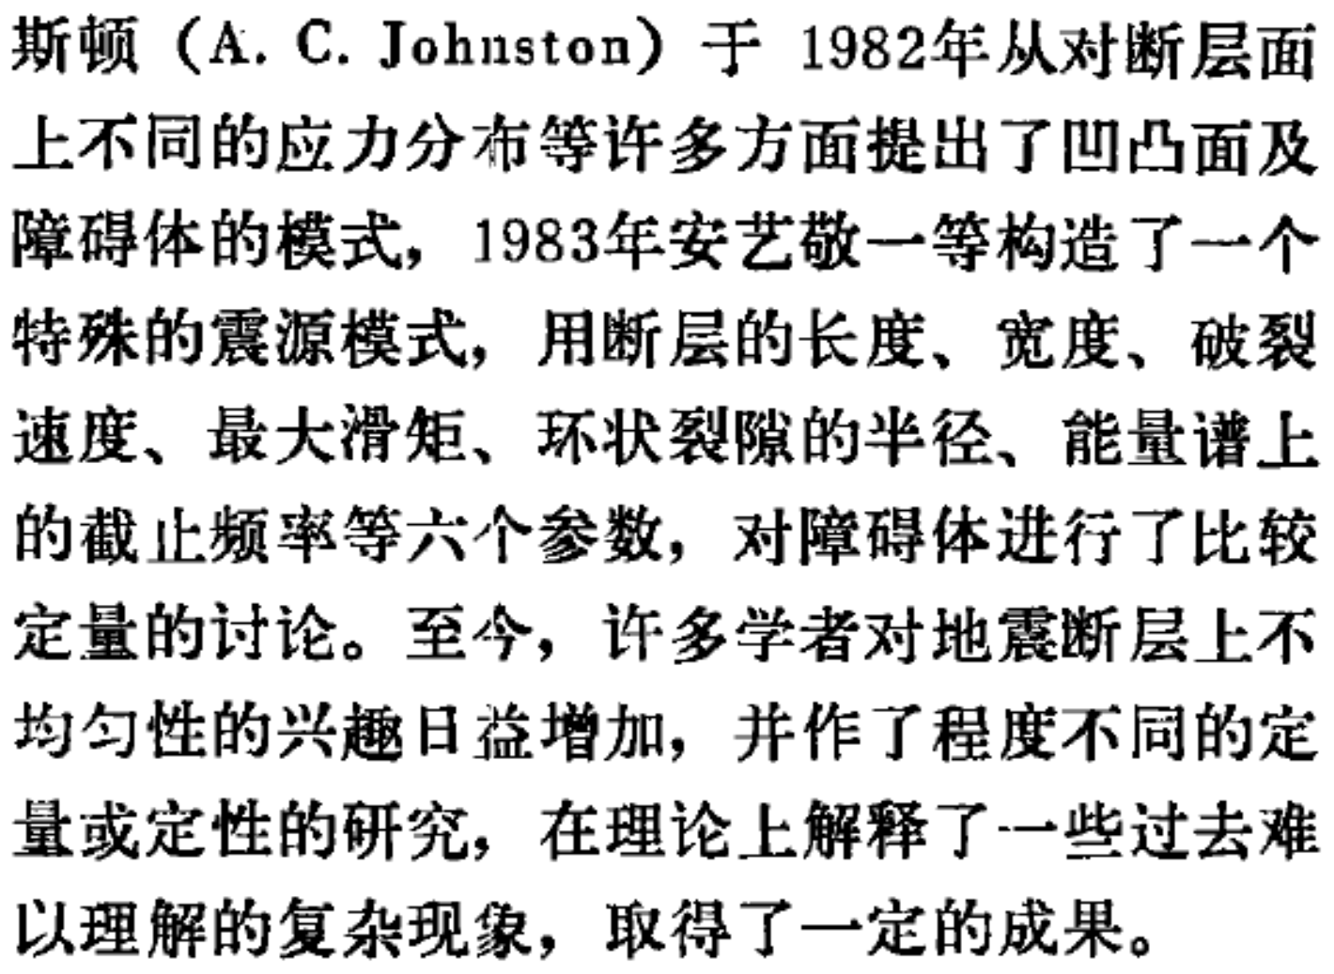

Slide 23

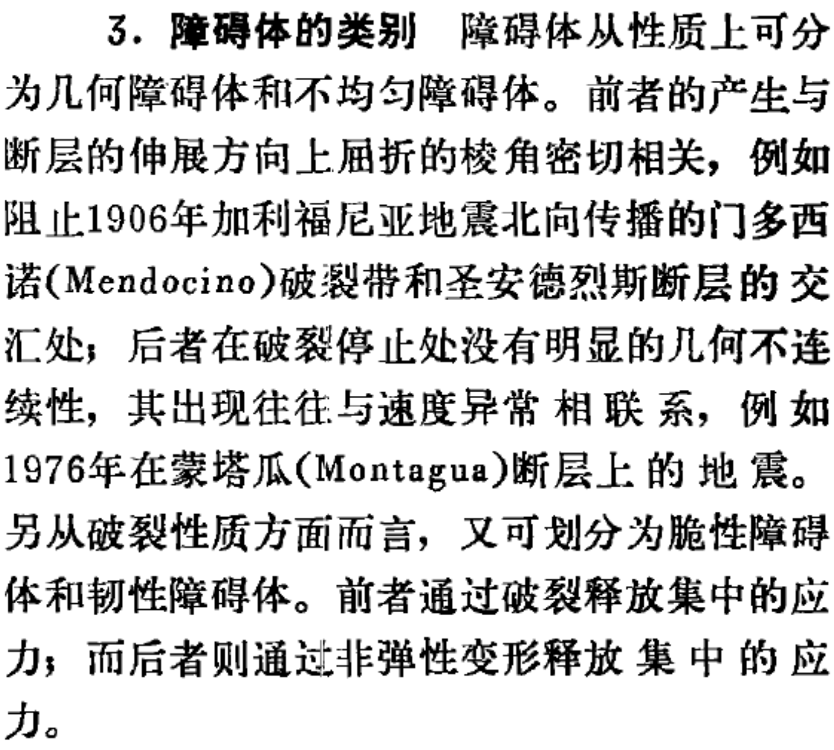

利用障碍体模式可以解释一些复杂的地震现象
为了解释强震加速度图以及工程地震在地震一阻抗设计中的要求，需了解强震运动在频率域内的情况

Slide 24

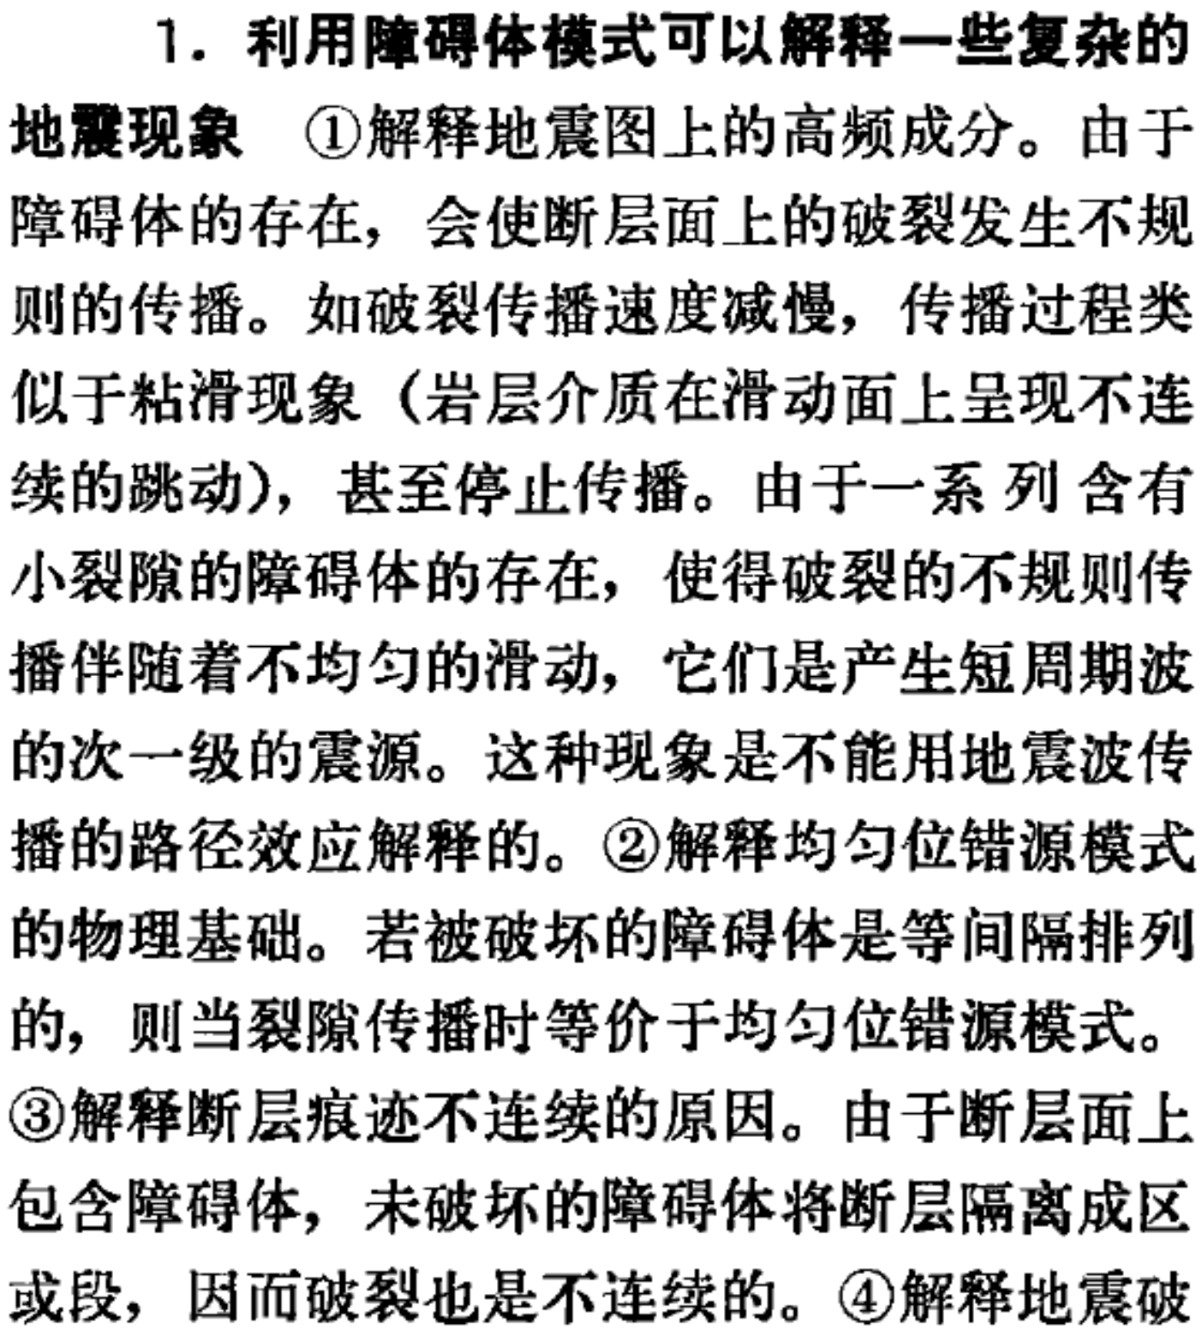
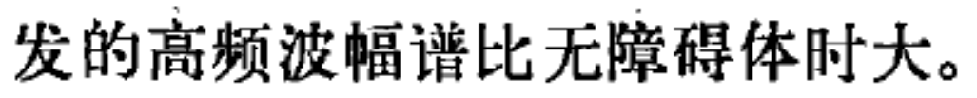

Slide 25



Slide 26
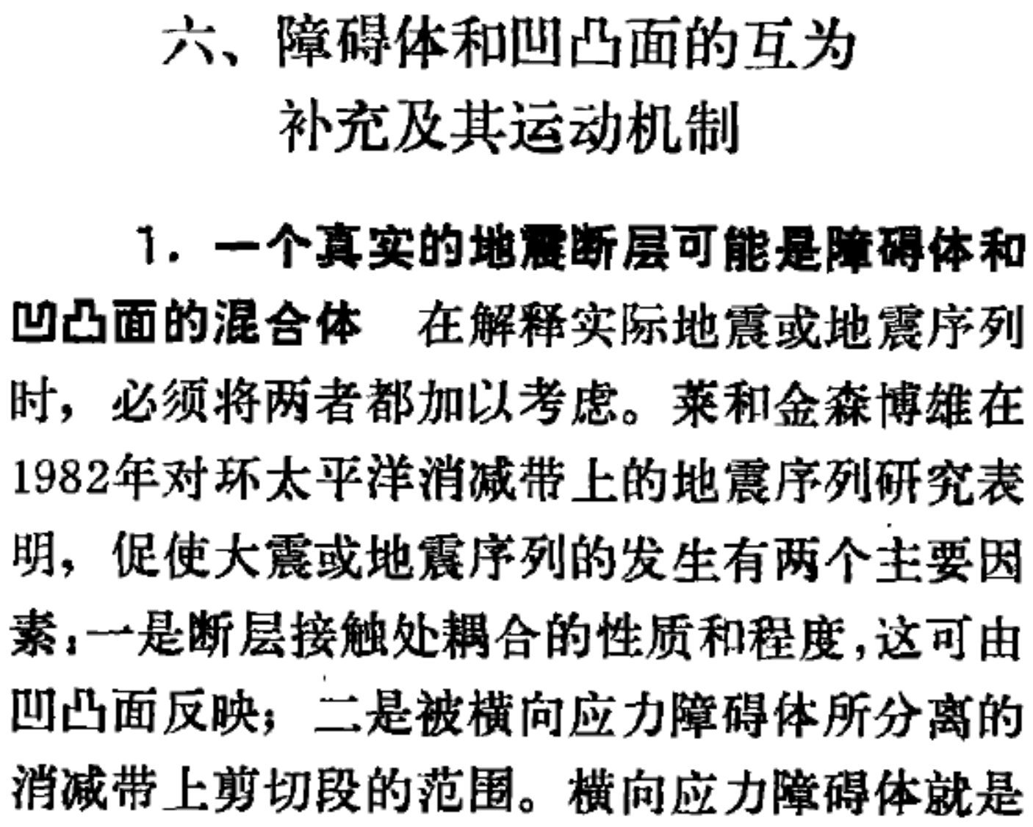
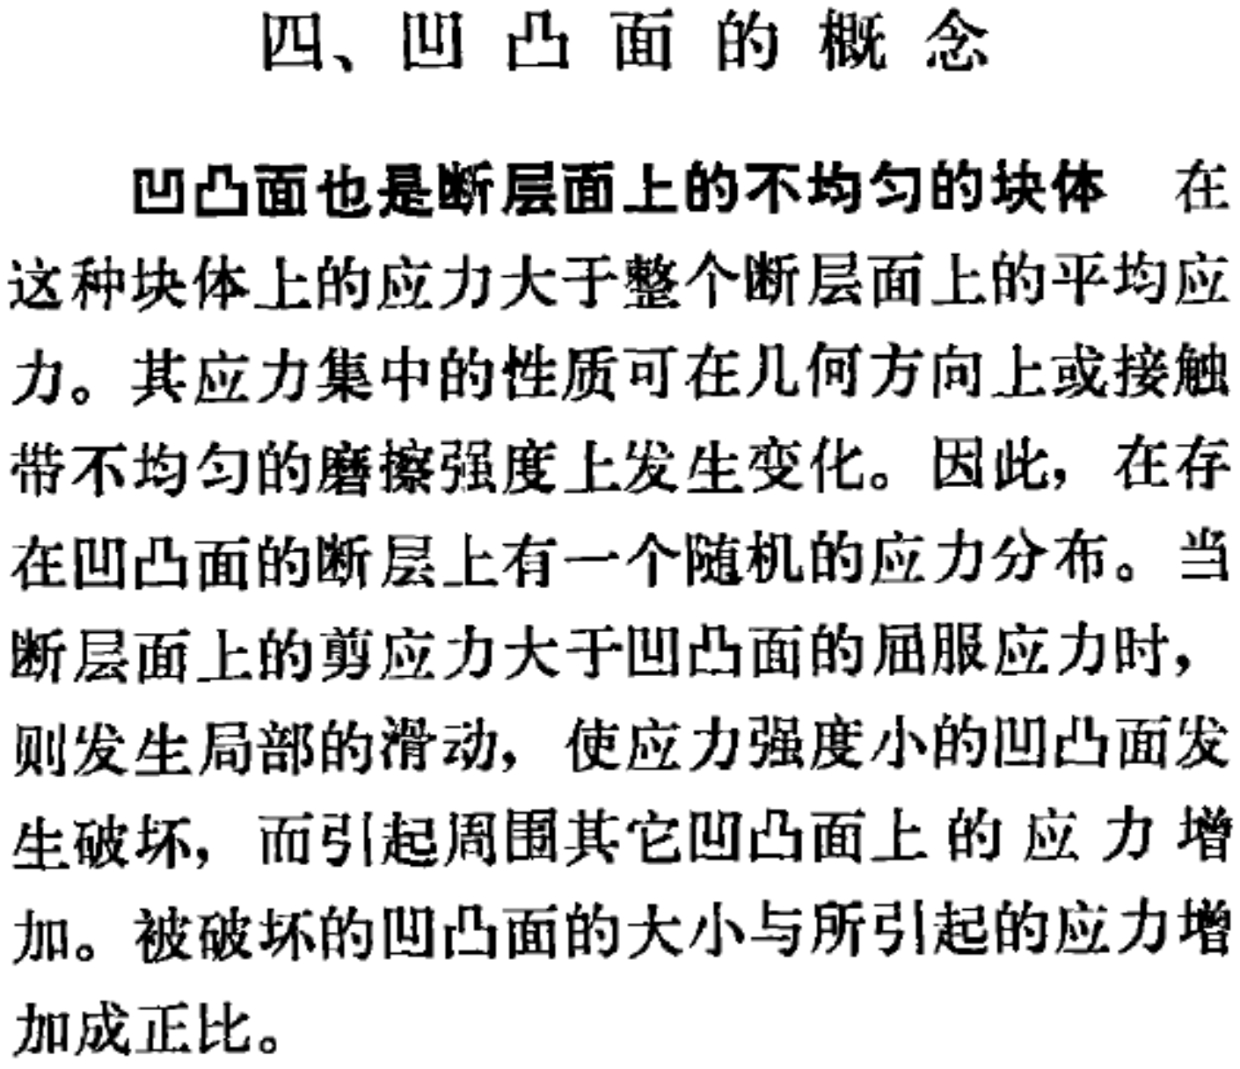



Slide 27

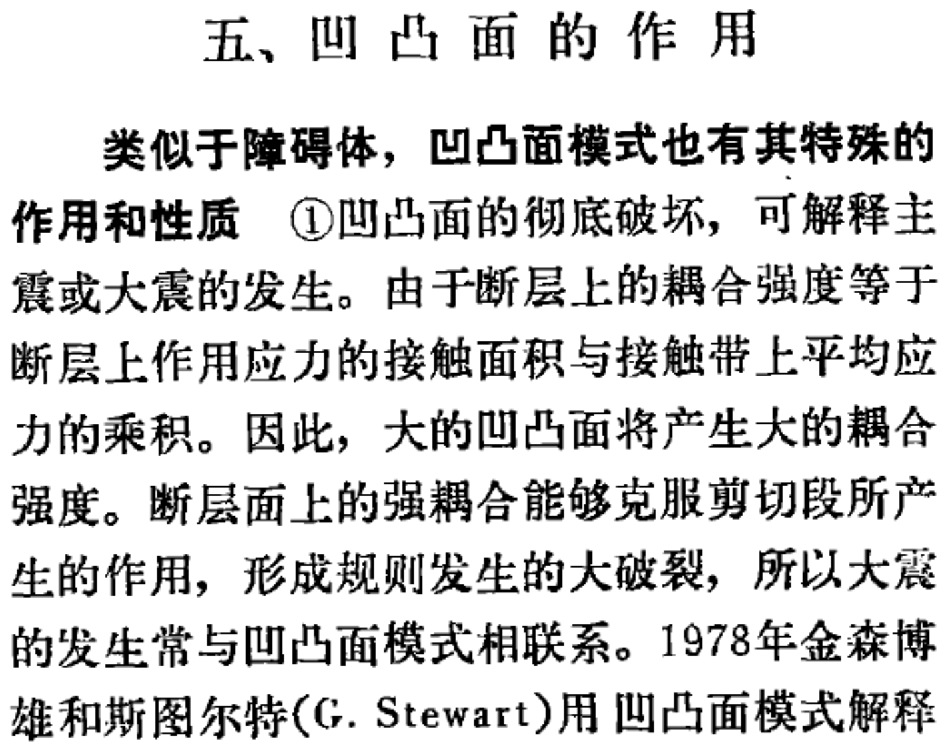

Slide 28
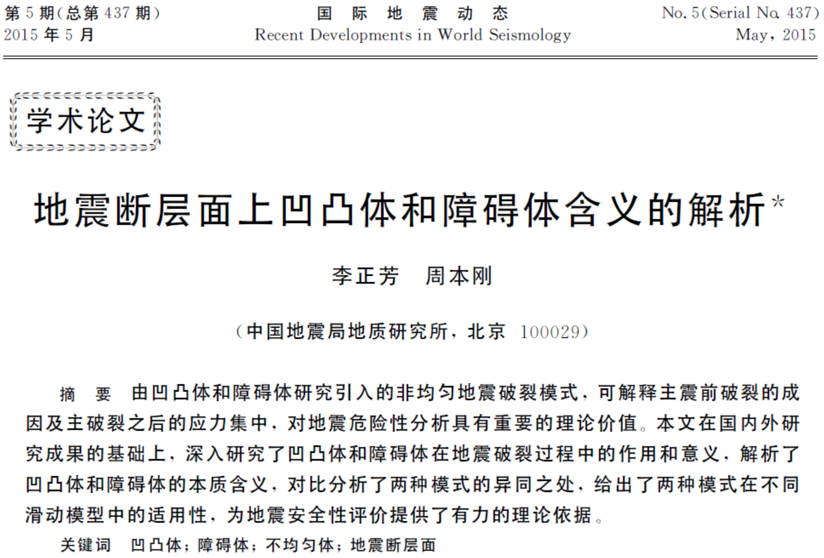

Slide 29
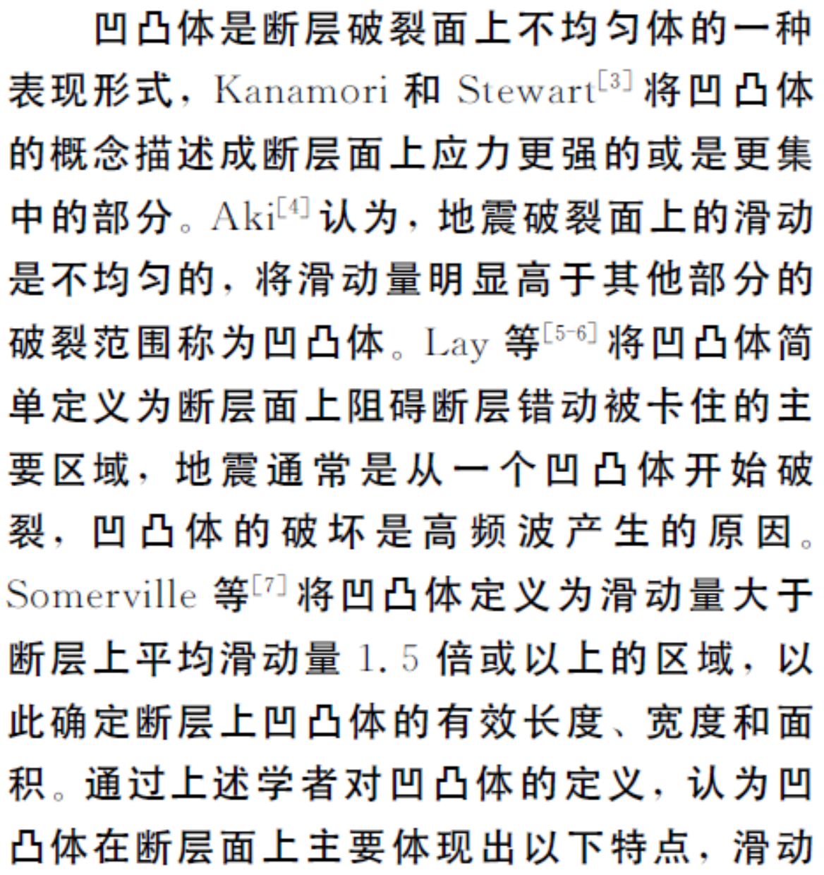



Slide 30



Slide 31

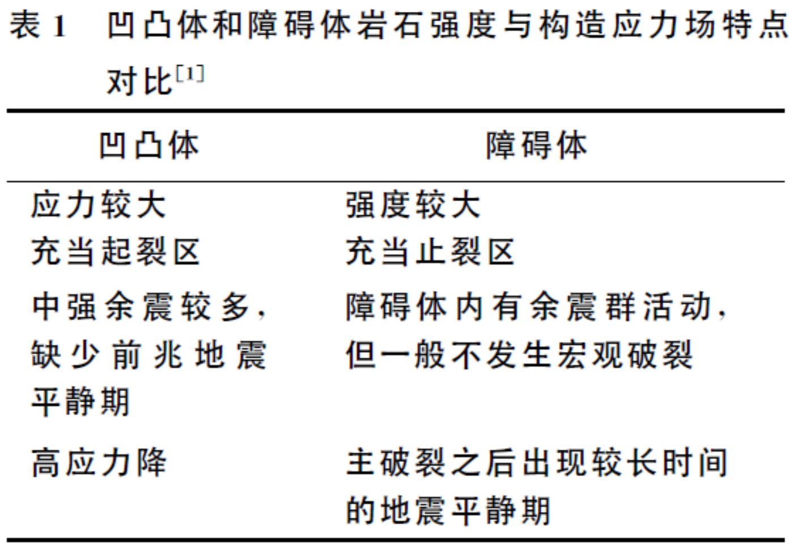

Slide 32



无论是凹凸体模式还是障碍体模式都是在某一特定条件下，特殊断层面上的模式，它们不可能对断层面上发生的任一地震都给出较好地解释，更甚至一个真实的断层面可能是一个同时具有凹凸体和障碍体的综合体，在利用其解释主震的发生或余震的序列时，应该同时将两者纳入考虑范围。

Slide 33
密集台阵+DAS+机器学习+方法改进 → 凹凸体和障碍体 → ？？
地震研究和地球结构研究的一个结合点

