Slide 1
Isolated Crustal Partial Melting along the Yarlung-Zangbo Suture
and Distinct Central Lhasa Block from H-κ-c method
Junyi Gong, Jiangtao Li, Mengkui Li
Discussion
2023/03/24

Slide 2
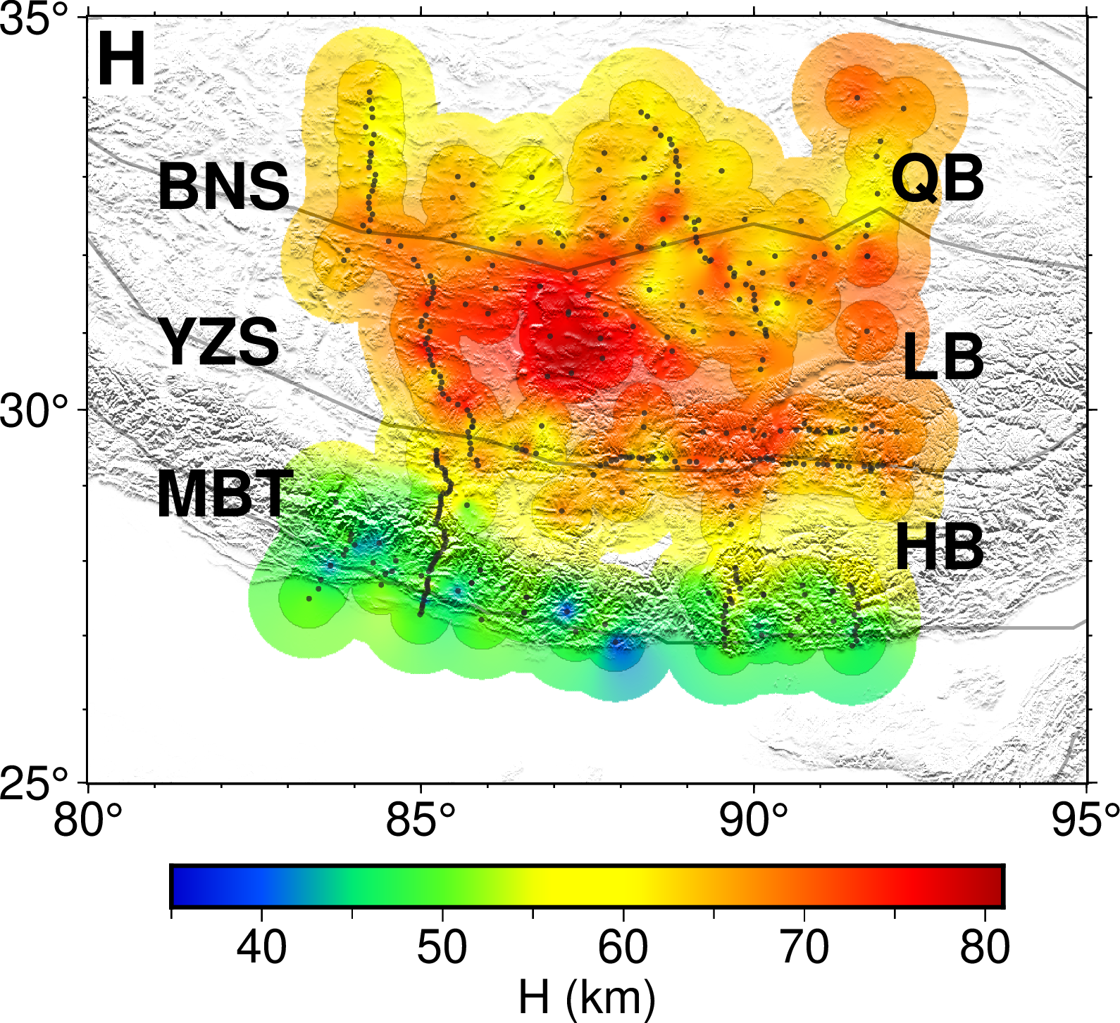
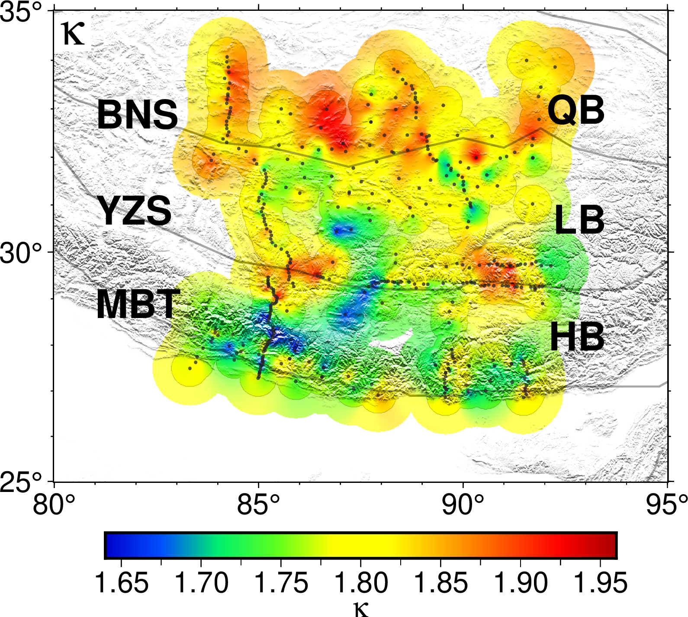

Slide 3
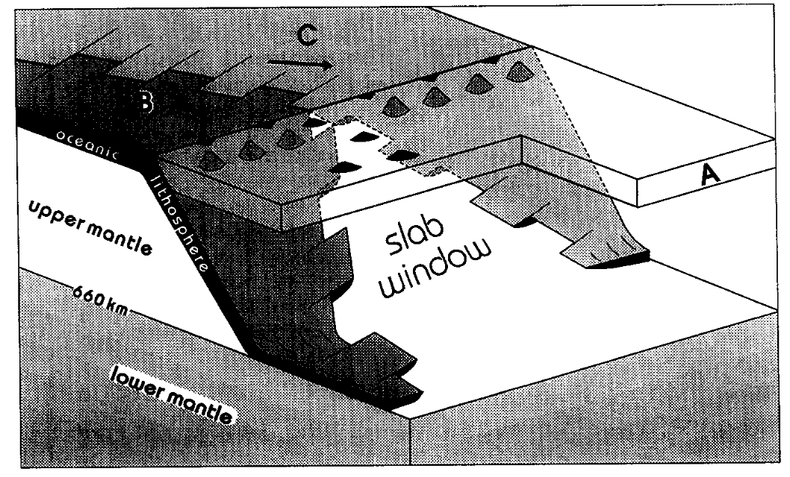
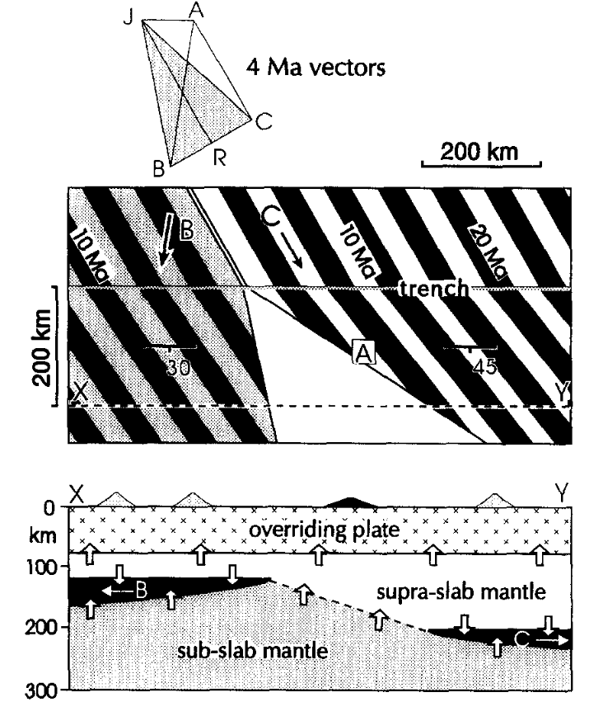
板片俯冲后，与软流圈的相互作用：
使周围的软流圈变冷
释放水，导致软流圈发生榴辉岩化变质作用
（板片下方的软流圈通常不会受到这些过程影响，仍然保持热且干燥的性质）
存在window的俯冲板片：
在撕裂区，俯冲板片上覆软流圈直接与下覆的软流圈接触，导致软流圈hydration停止，热流增加，温度升高
这种化学&温度异常，在俯冲浅且地幔楔薄的区域尤其明显
俯冲板片Divergence意味着上覆板片下的岩石圈体积减少，这种减少由地幔流来补偿
Fore-arc region：由于rigid fore-arc lithosphere覆盖，补偿流通常被限制在下垫软流圈
Window：软流圈上涌，很可能减压熔融。在靠近trench部分，熔融性质类似于洋中脊玄武岩；在前弧下方，产生更加碱性（alkalic）的岩浆 [blow-torch effect]
(Thorkelson, 1996, Tectonophysics)
Subduction of diverging plates and the principles of slab window formation

Slide 4
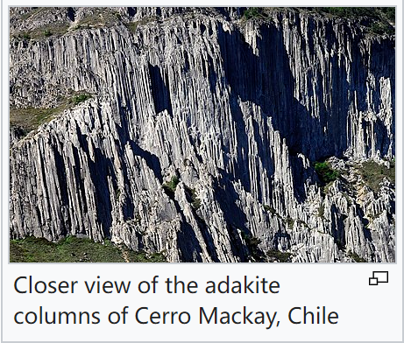
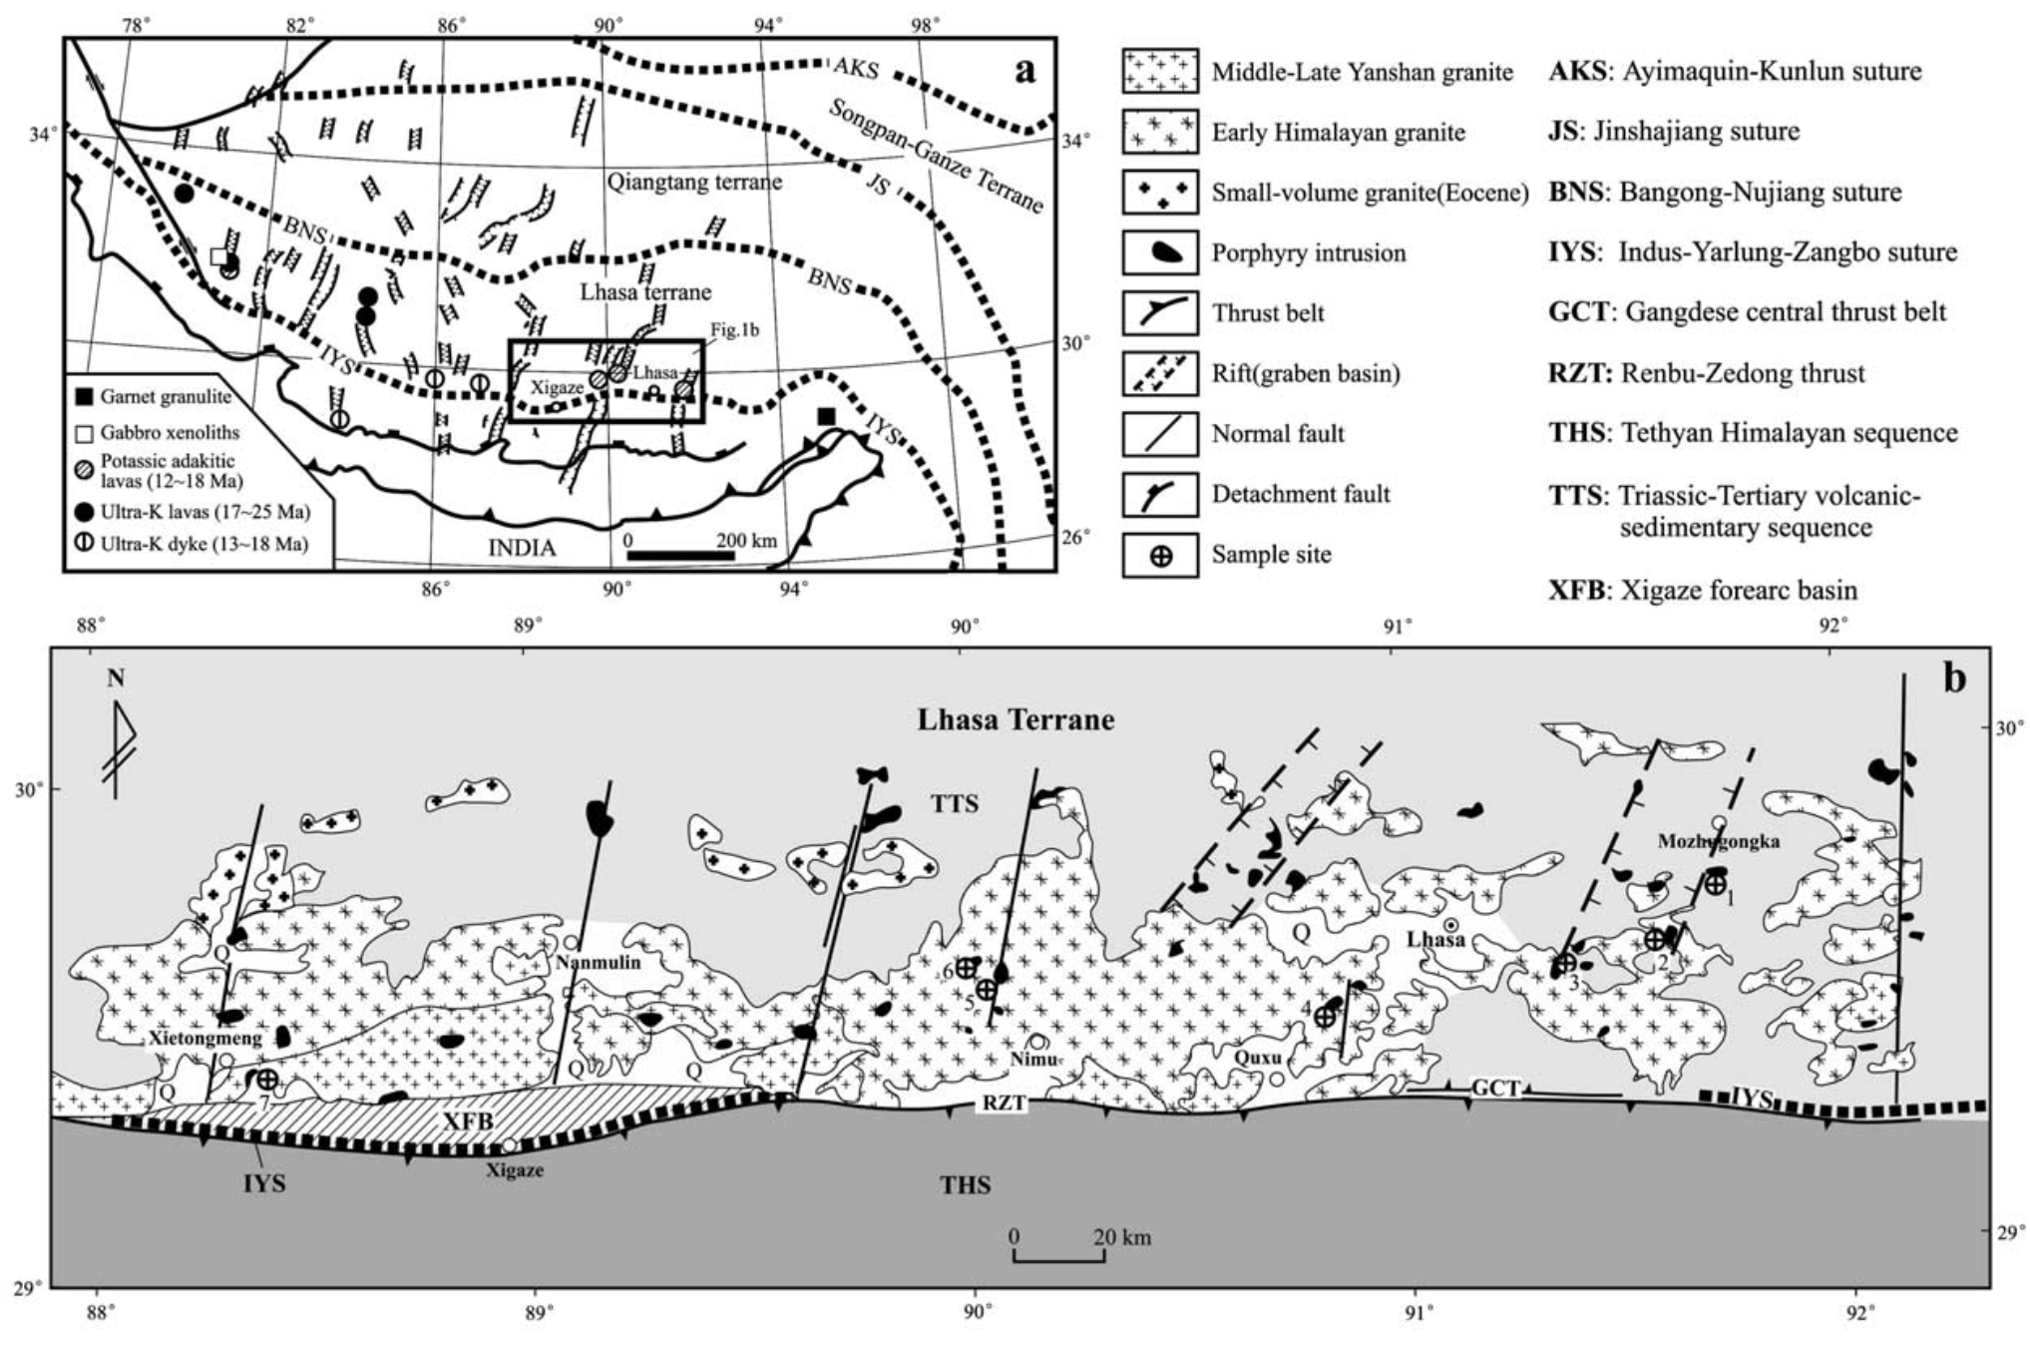
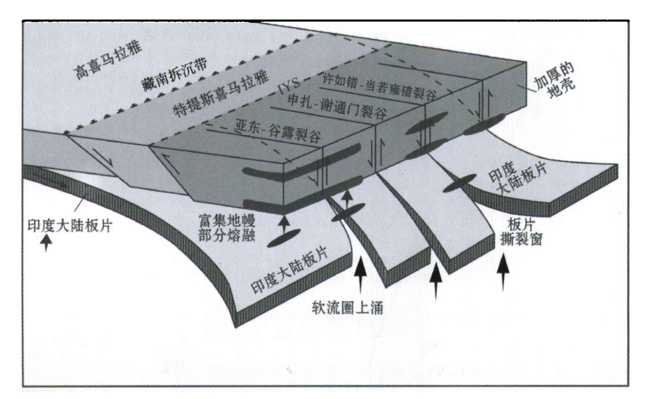
埃达克岩：与俯冲板块深熔作用联系
高硅含量，高铝含量，intermediate to felsic
可能是板片熔融后，在上升时与地幔楔橄榄石作用的产物
（侯增谦等，2006，岩石学报）
（Hou et al.，2004，EPSL）
印度大陆板片前缘撕裂与分段俯冲：来自冈底斯新生代火山-岩浆作用证据
Origin of adakitic intrusives generated during mid-Miocene east–west extension in southern Tibet

Slide 5
构造解释：拉萨地体

Slide 6
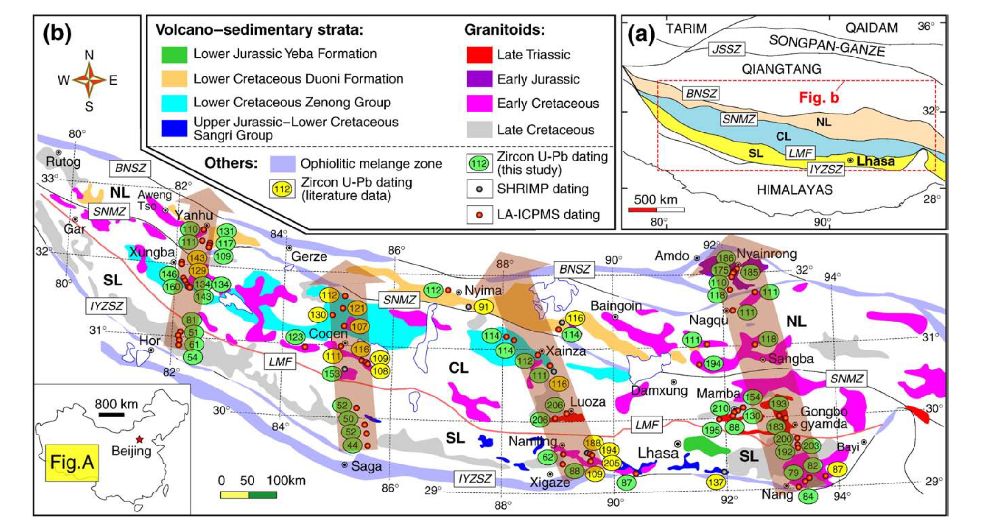
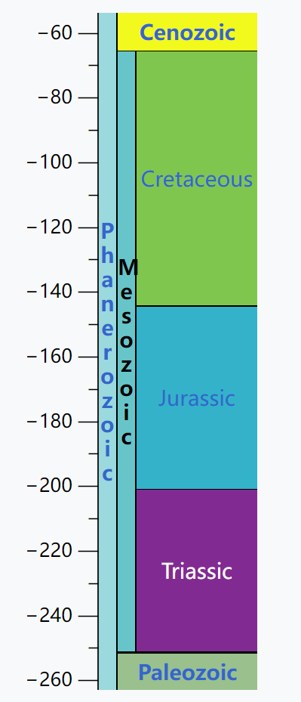
构造解释：拉萨地体
Mesozoic中生代：
(252-66 Ma)
白垩纪
侏罗纪
三叠纪
BNSZ：班公湖-怒江缝合带
SNMZ：狮泉河-纳木错蛇绿混杂岩带（Mélange）
LMF：洛巴堆-米拉山断裂带
IYZSZ：印度河-雅鲁藏布江缝合带
The Lhasa Terrane: Record of a microcontinent and its histories of drift and growth
中译来源：《西藏林周盆地设兴组玄武岩地球化学特征及意义》岩石学报
（Zhu et al., 2011, EPSL）

Slide 7
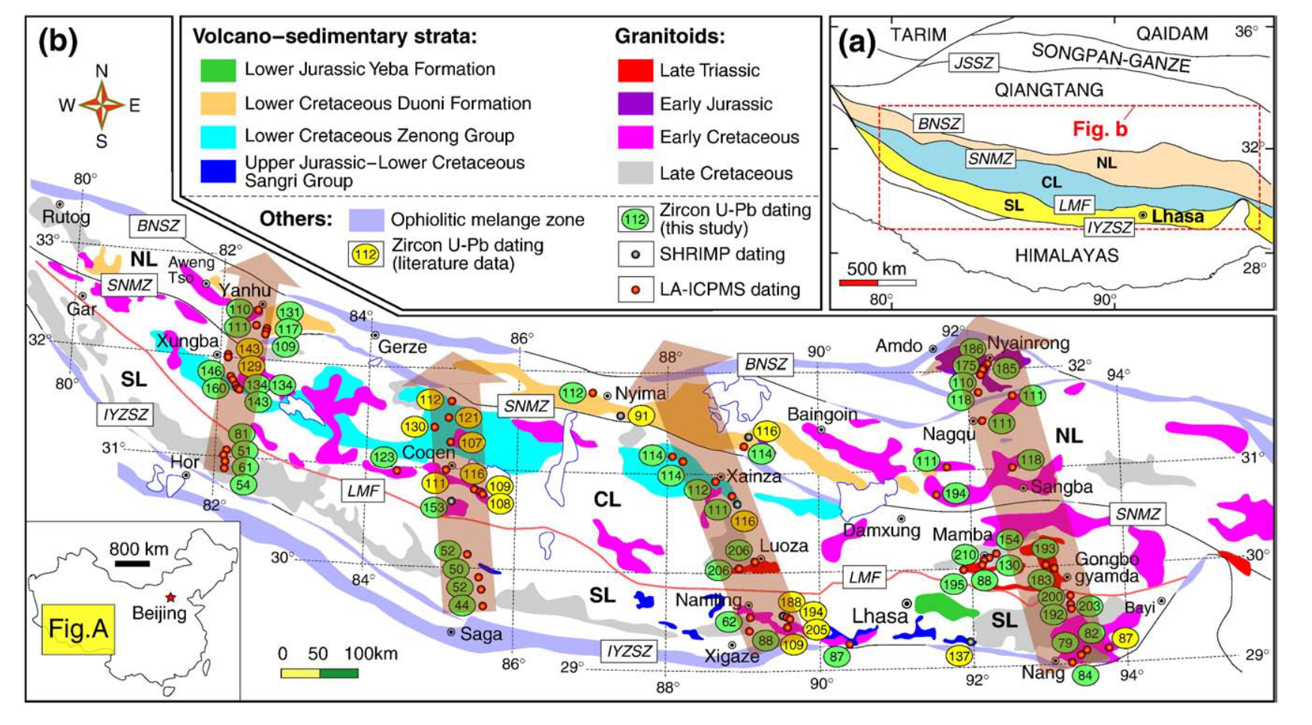
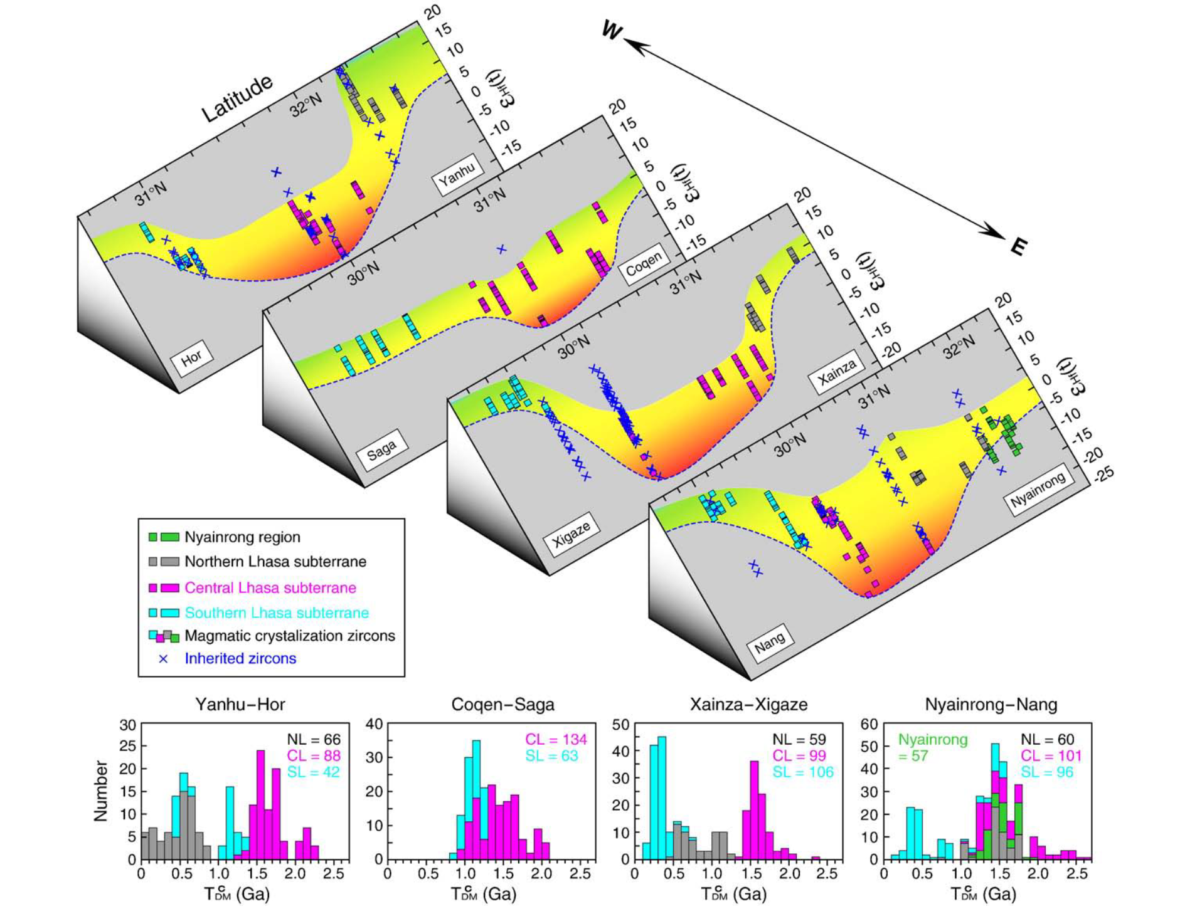
构造解释：拉萨地体
（Zhu et al., 2011, EPSL）
The central Lhasa subterrane was once a microcontinent with Archean(太古宙) basement whereas the southern and northern portions are more recently accreted subterranes during its journey of drift across the Tethyan Ocean basins.
推断1：中拉萨基底，形成时间最多可推至2877Ma
推断2：中拉萨曾经是微陆块；后续在拉萨地块的形成中，扮演了“核心”的作用（新生地壳不断附着在其周围）

Slide 8
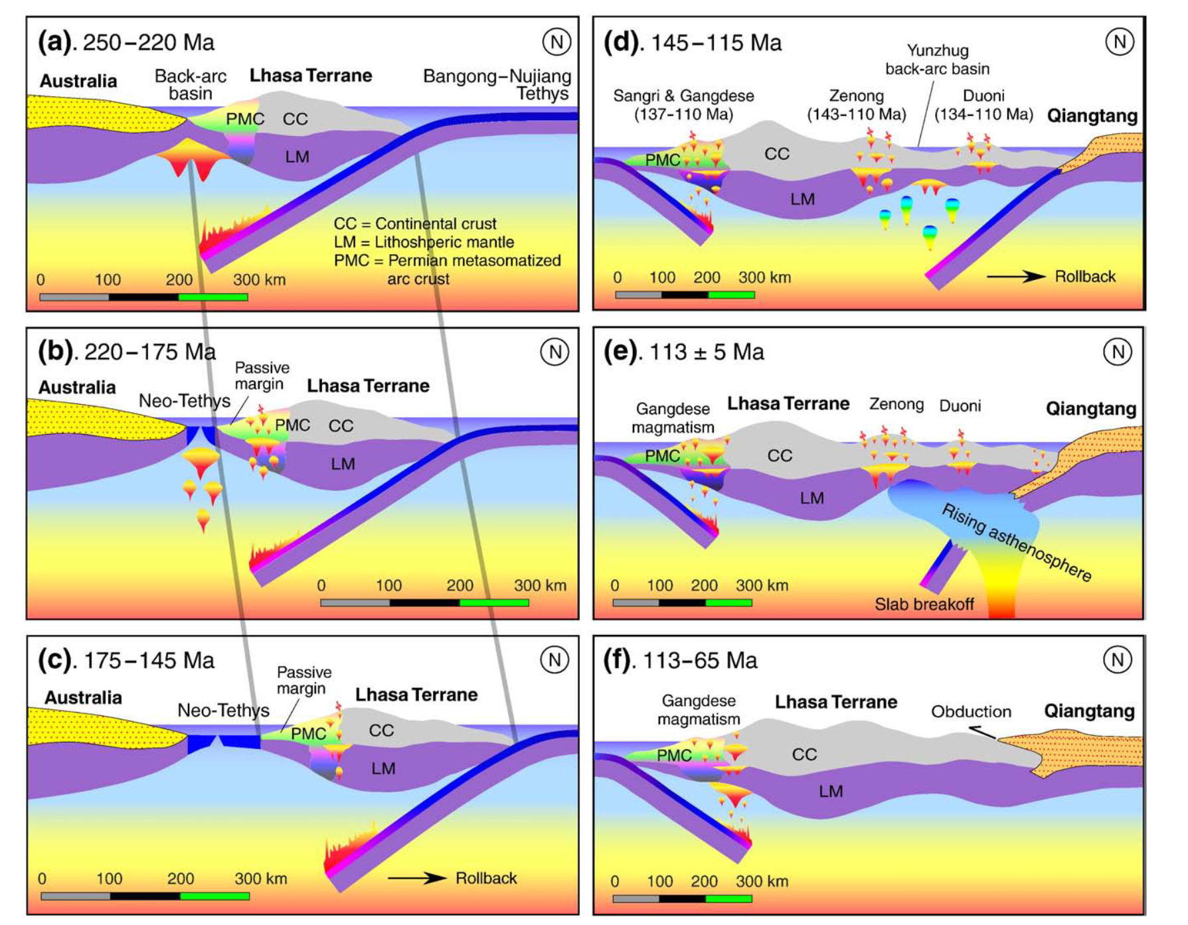
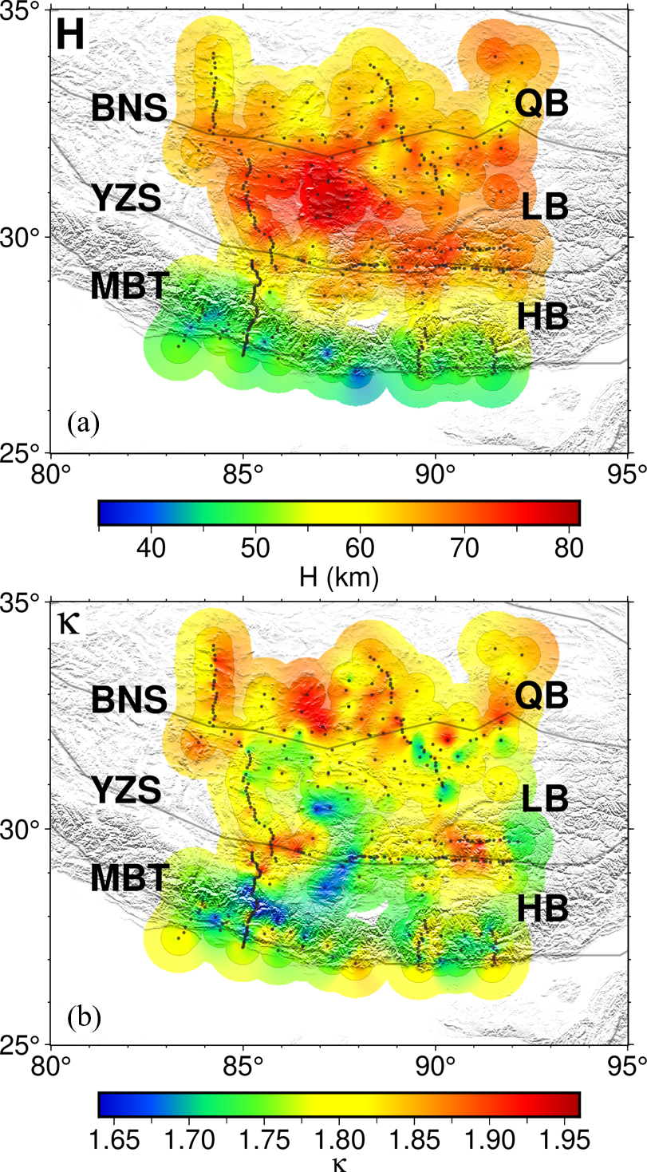
构造解释：拉萨地体
中拉萨厚地壳（以及少数低波速比）区域，可以被解释为残留的中拉萨微陆块吗？
二叠纪
增强的岩浆活动
新生
地壳
幔源
贡献
减少
拉萨-羌塘合并
（Zhu et al., 2011, EPSL）

Slide 9
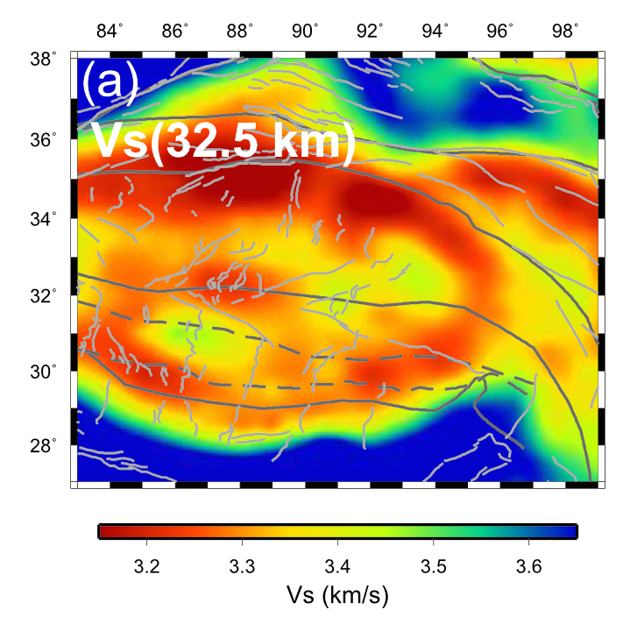

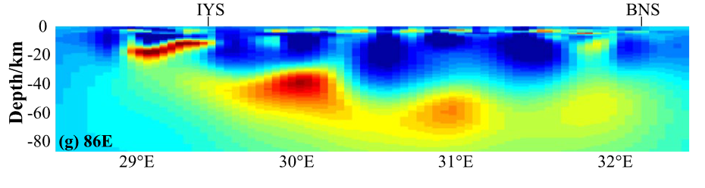
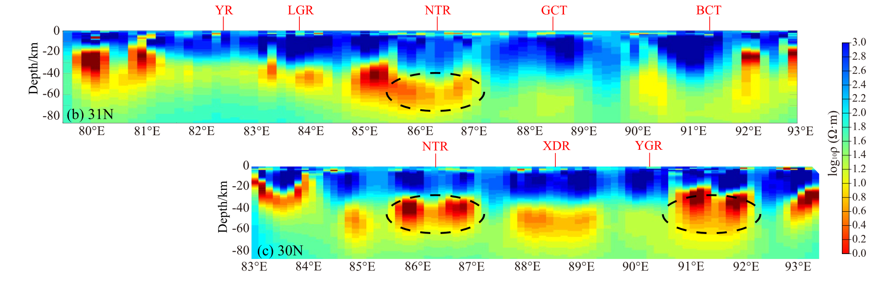
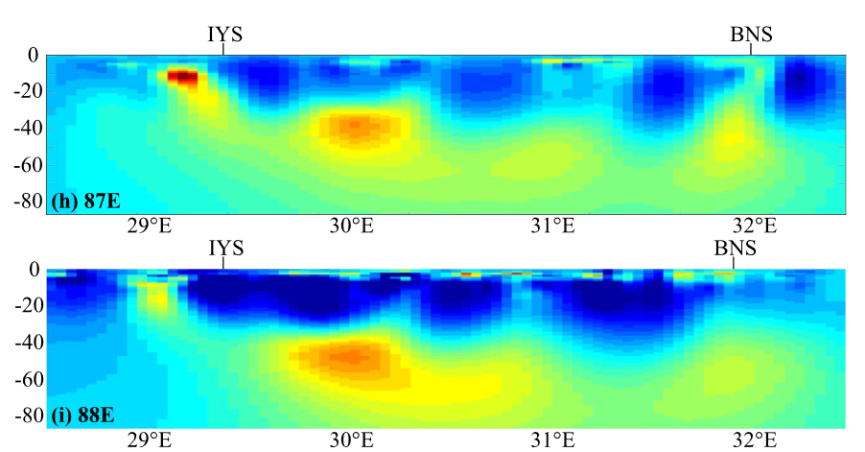
构造解释：拉萨地体
（Bao et al., 2015 EPSL; replotted by Huang et al. 2020）
（Jin et al., 2022, JGR）

Slide 10
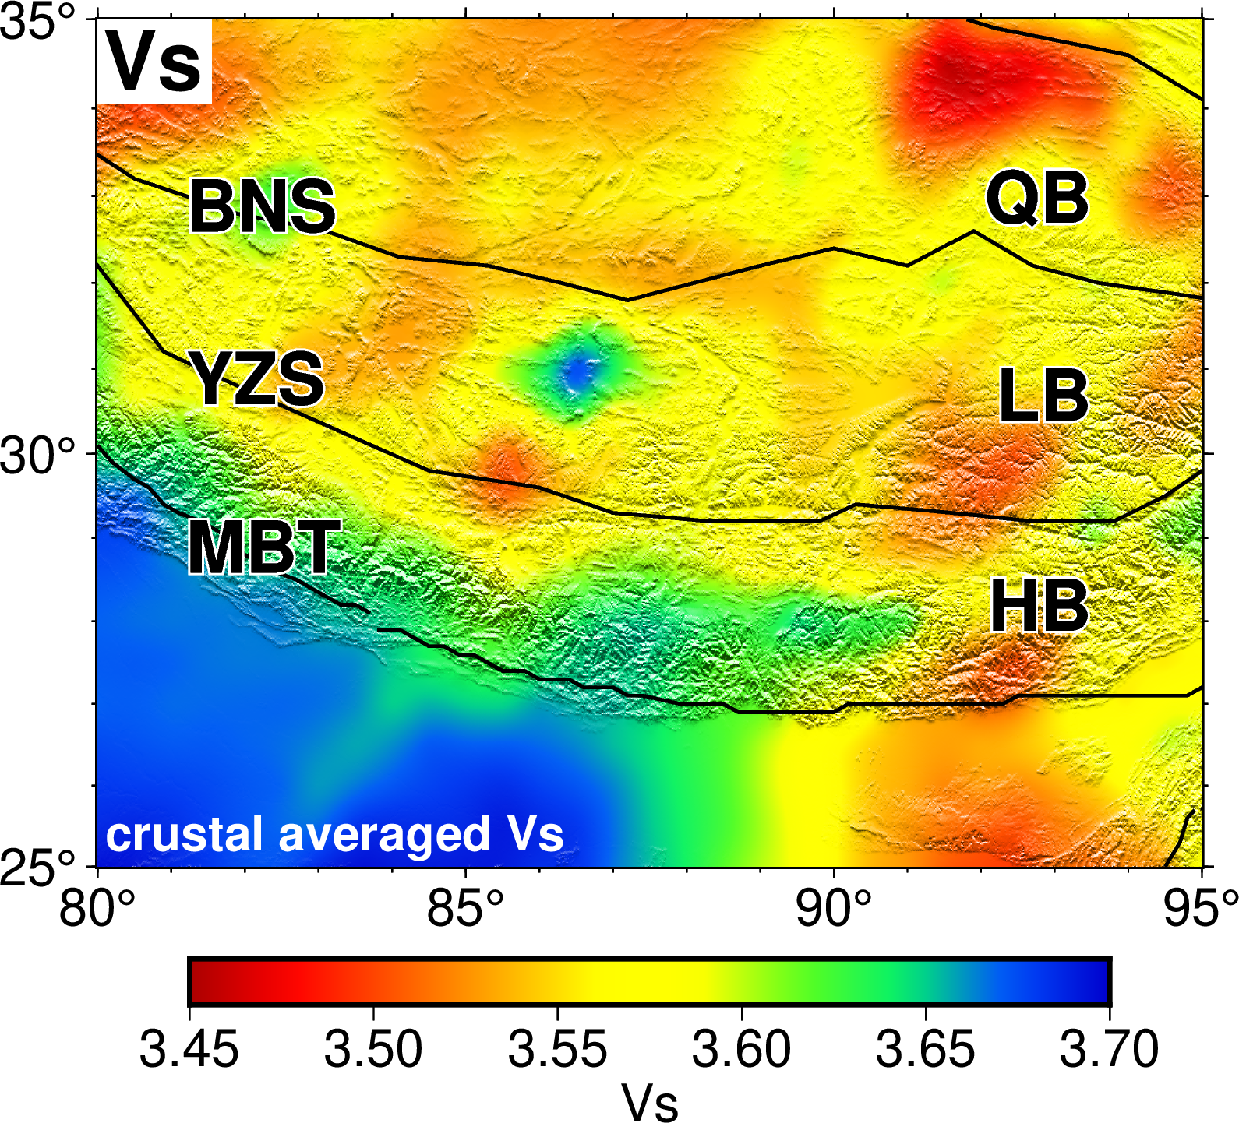
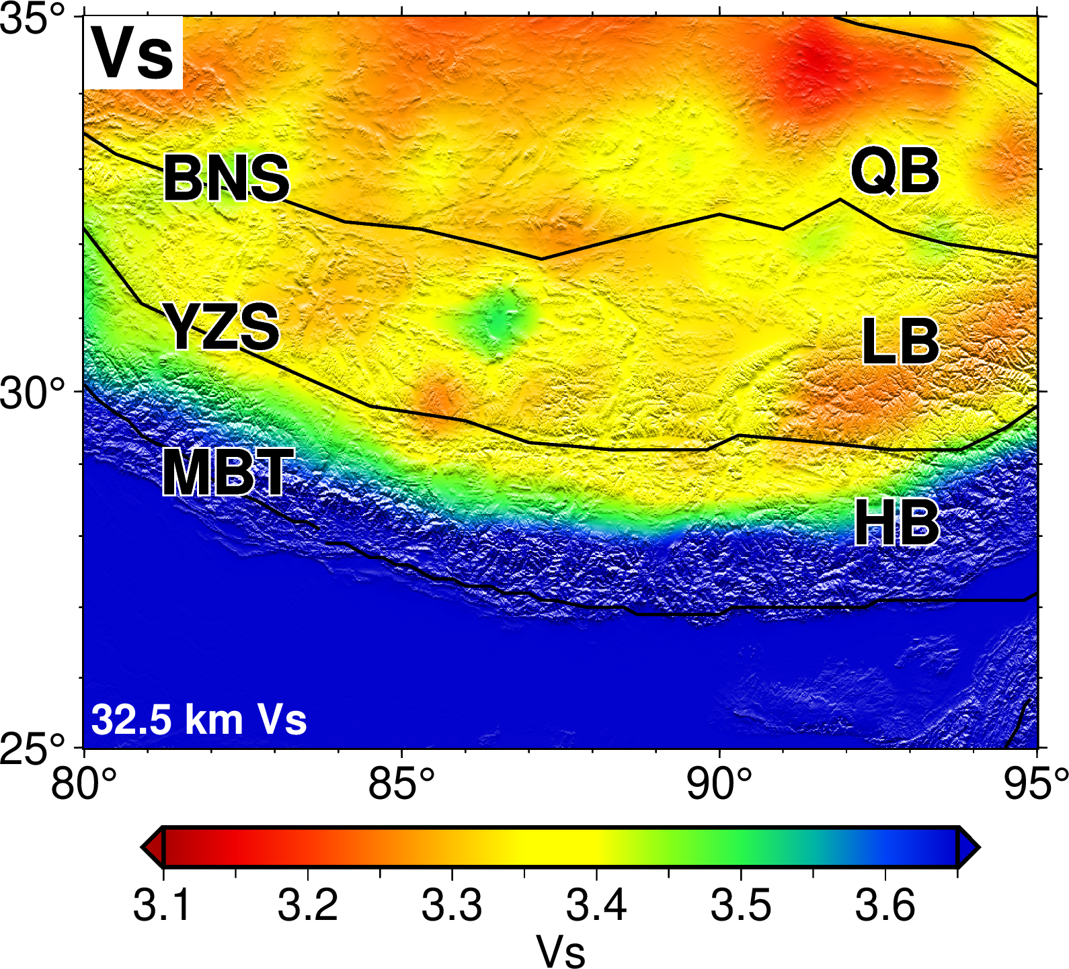
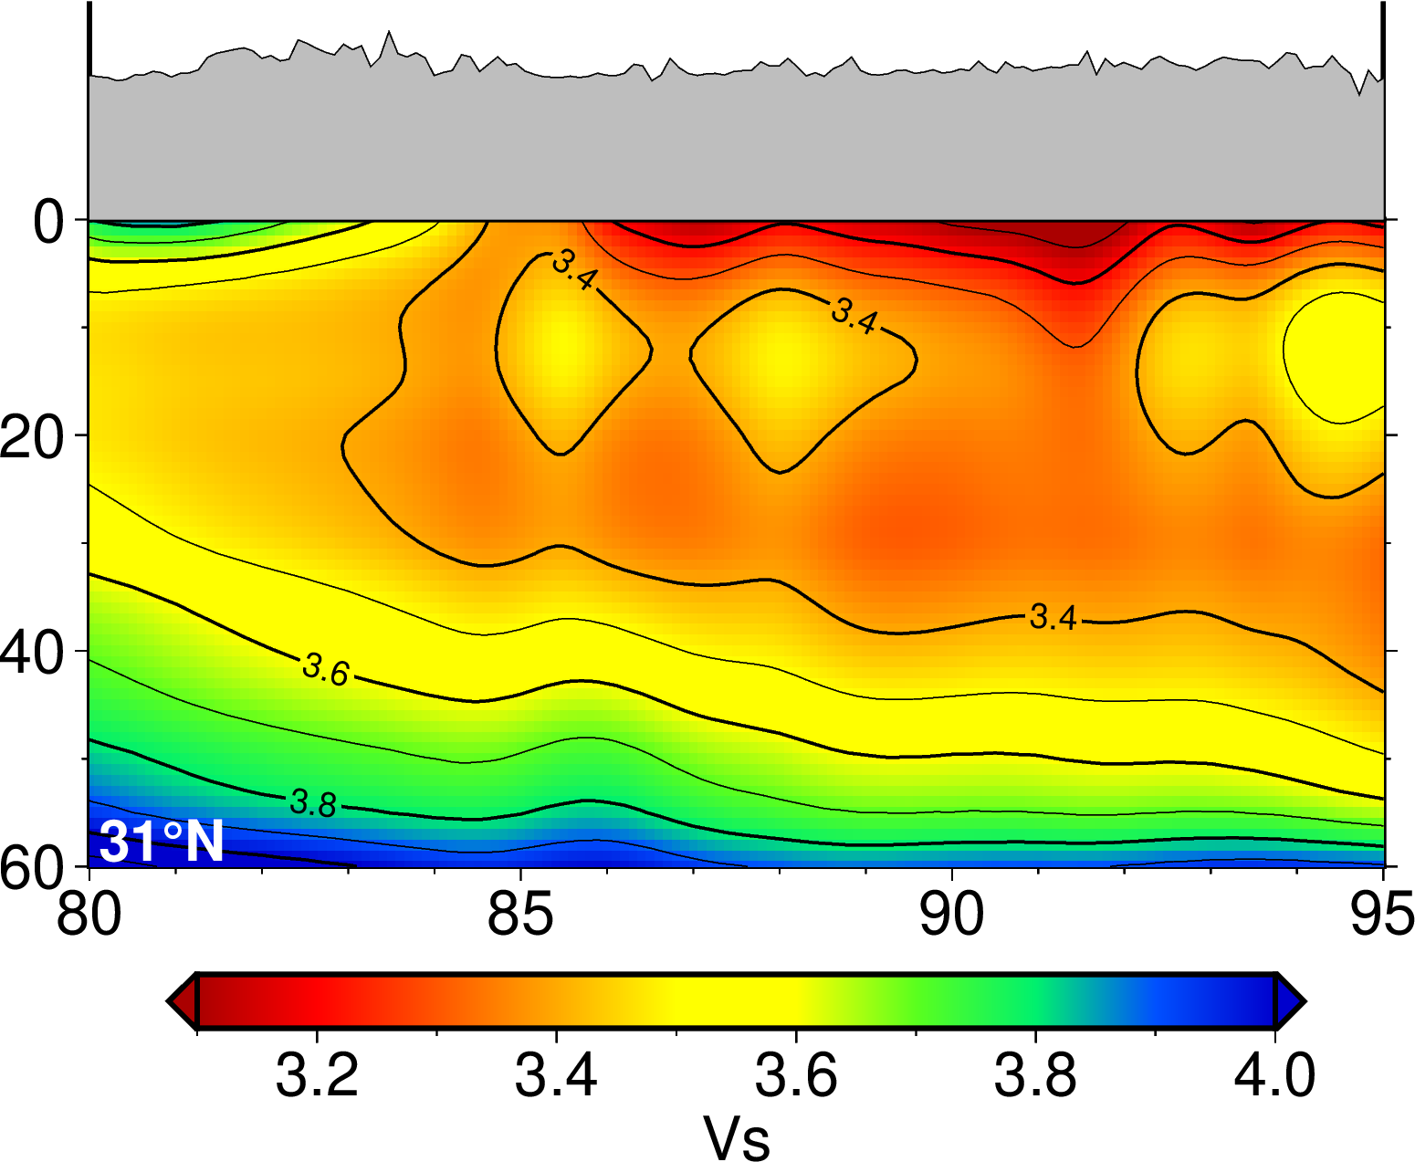
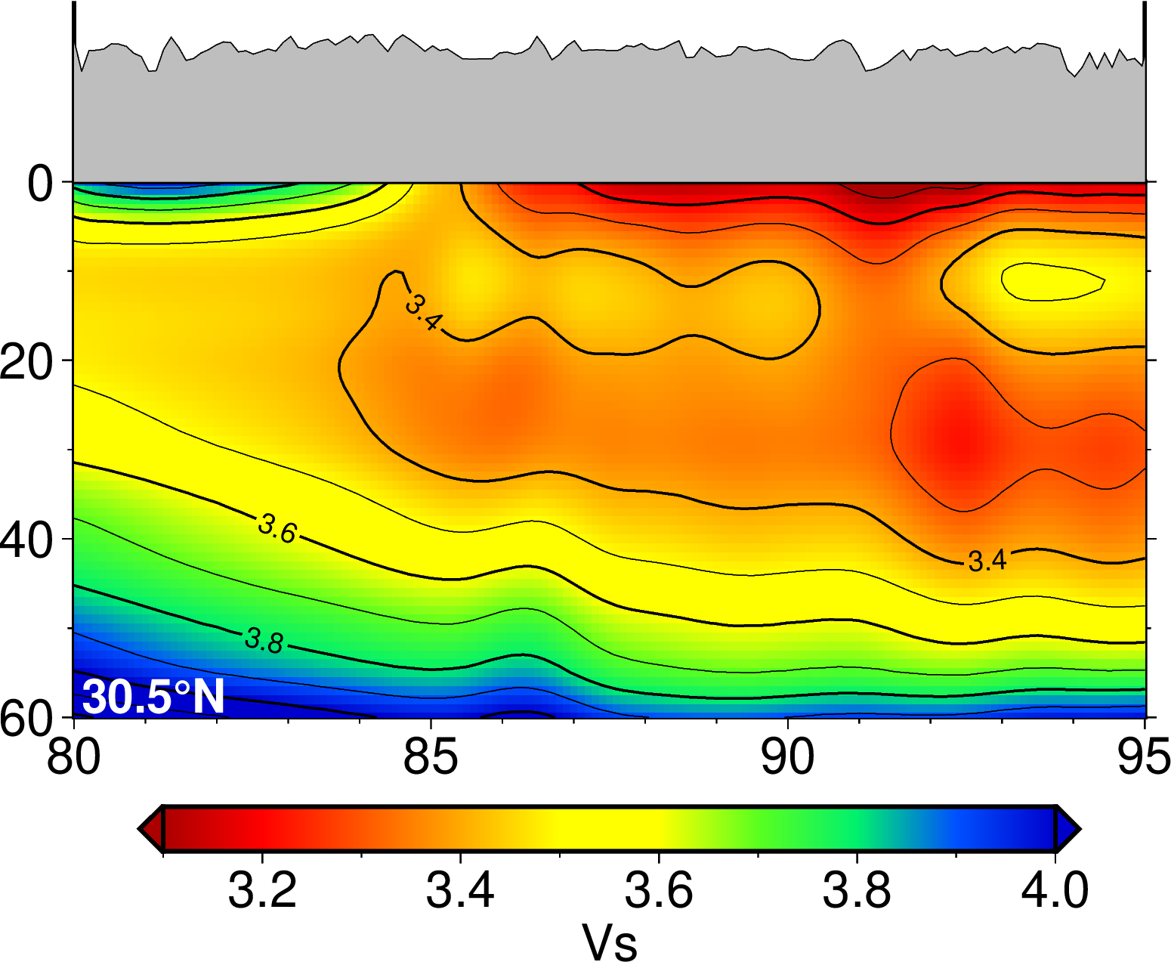
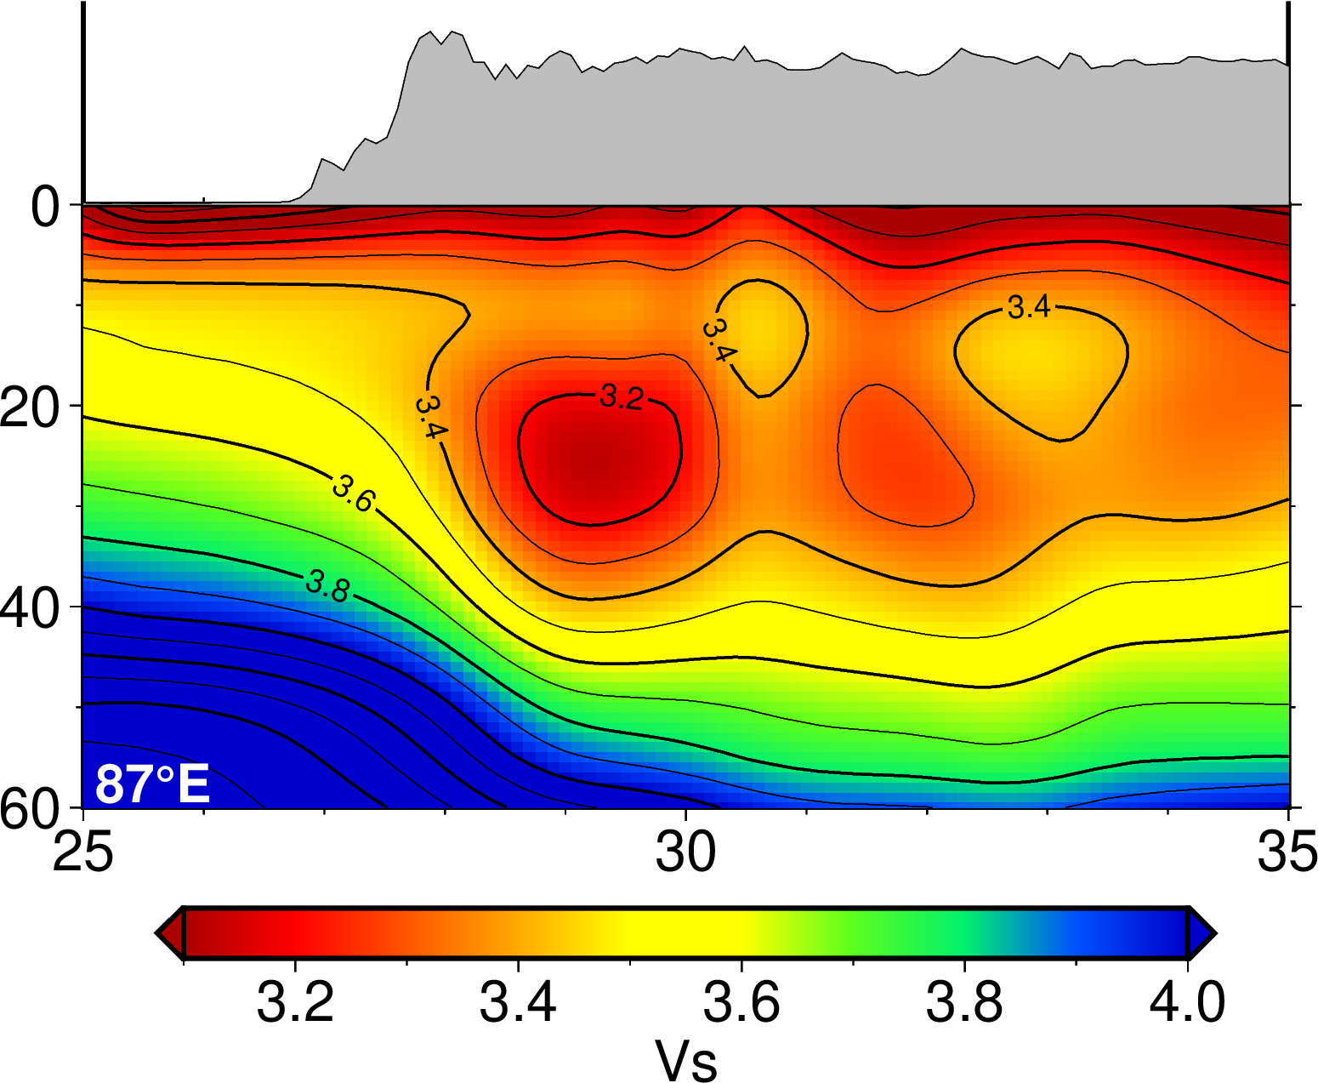
构造解释：拉萨地体
（data sourced from: Li et al., 2022, EQS）
（data sourced from: Li et al., 2022, EQS）
（data sourced from: Huang et al. 2020, JGR）

Slide 11
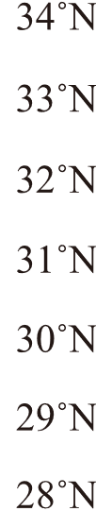
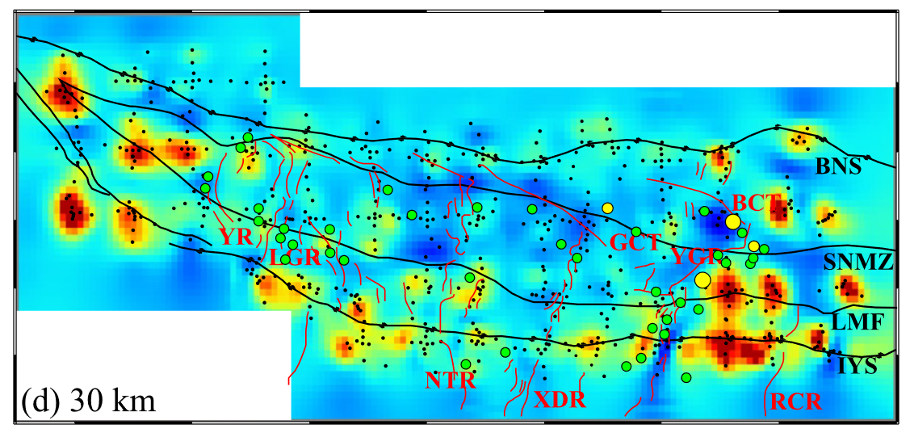
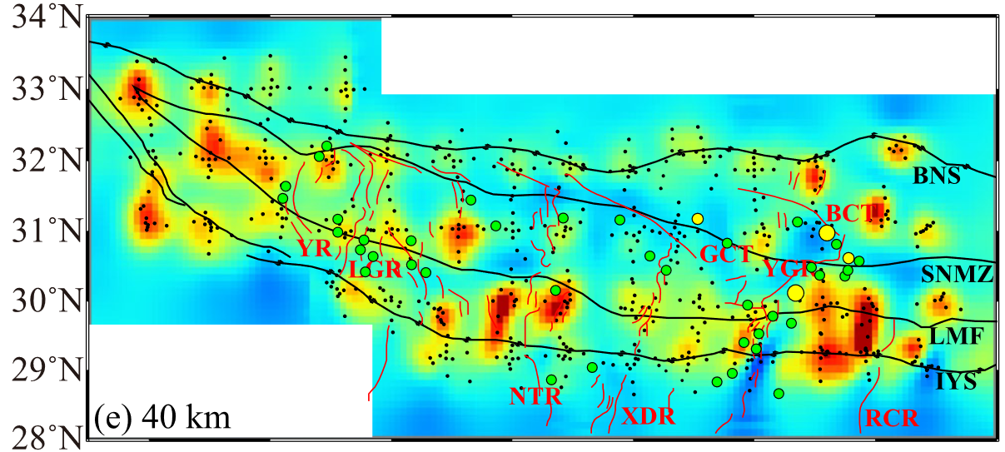
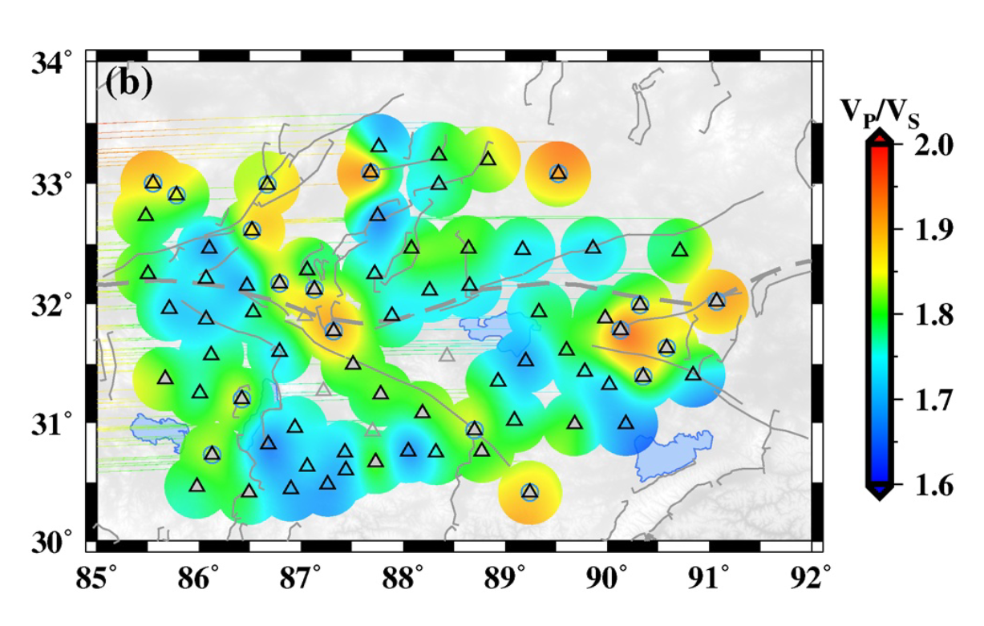

Slide 12
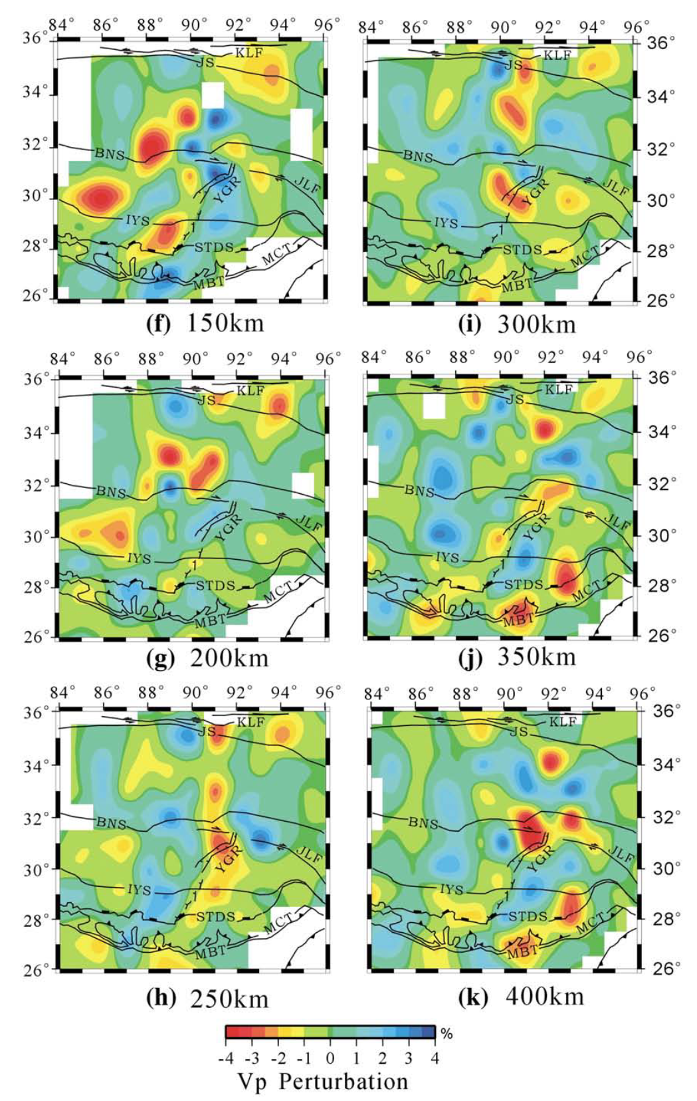
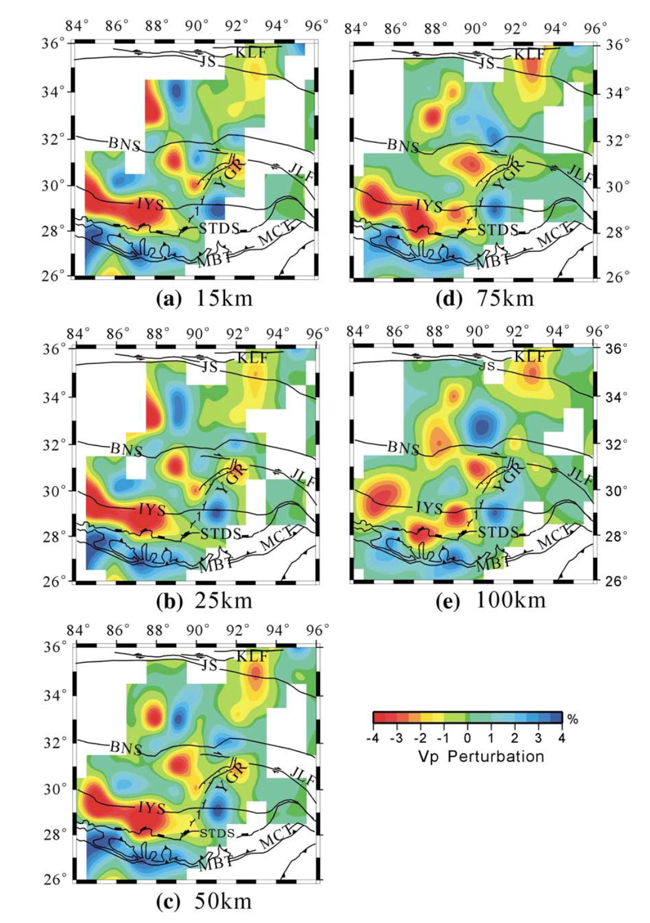
构造解释：拉萨地体
（He et al., 2010, Tectonophysics）
（一个老一些的成像结果）
Vp高速异常：出现在50km-
（与电阻率异常对应较好？）
但是该结果中，YZS 90-92部分高速的异常，与Hkc结果、大地电磁结果等等对应不是特别好
Tracing the Indian lithospheric mantle beneath central Tibetan Plateau using teleseismic tomography

Slide 13
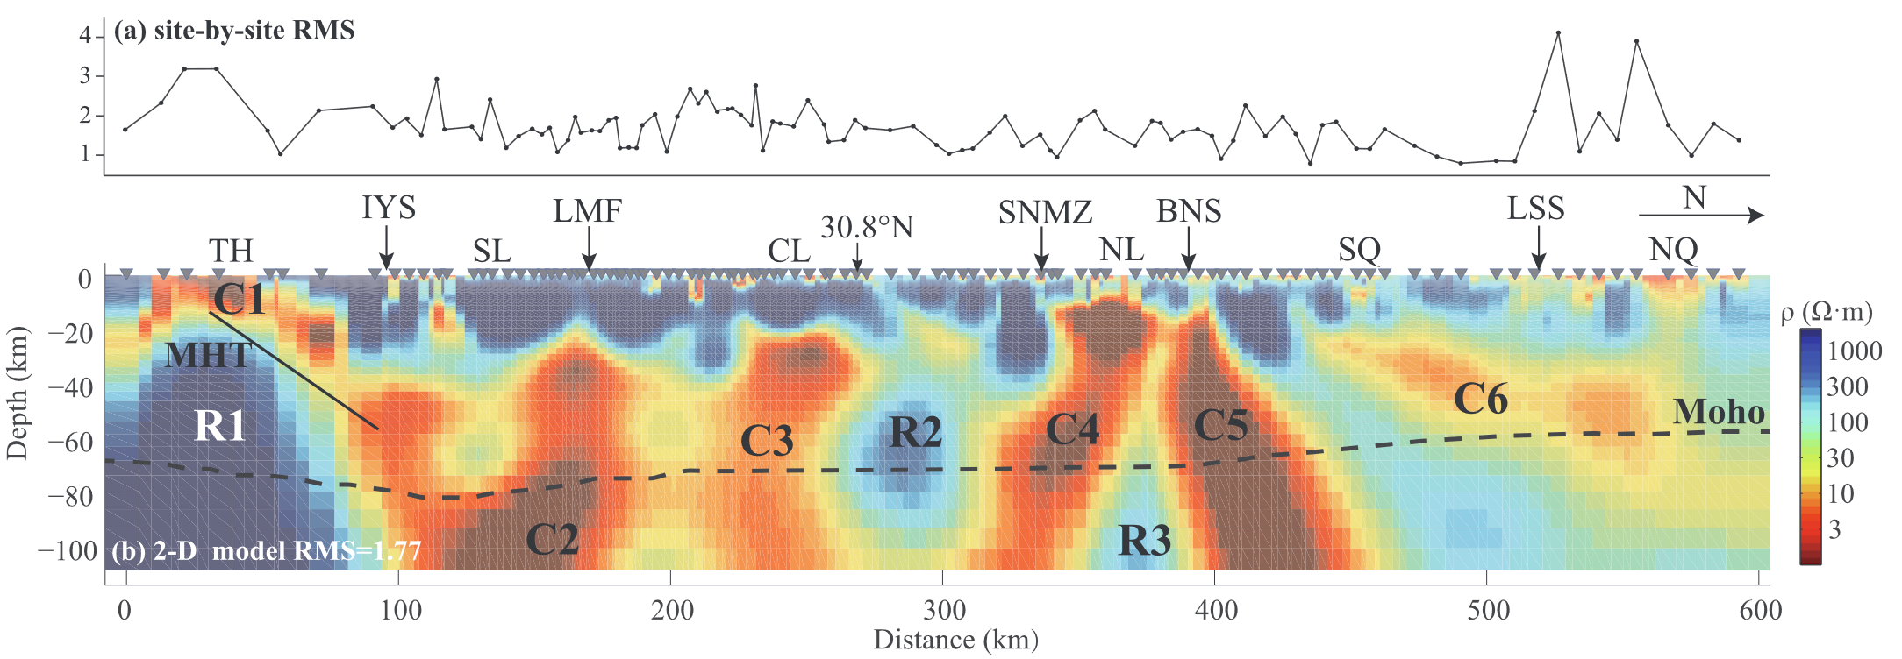
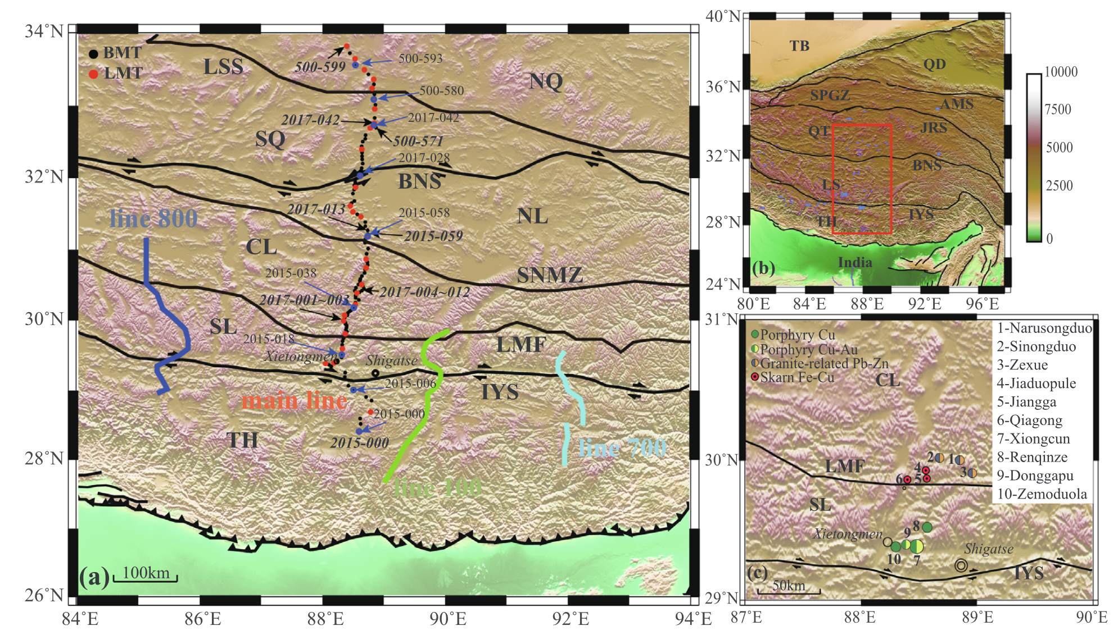
构造解释：拉萨地体
（Sheng et al., 2019, JAES）
“The resistor R2 represents the ancient crystallization basement.”
Lithospheric electrical structure in the central Tibetan Plateau and its tectonic significance

Slide 14
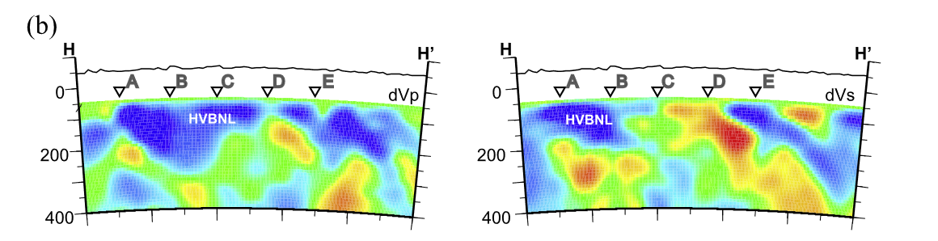
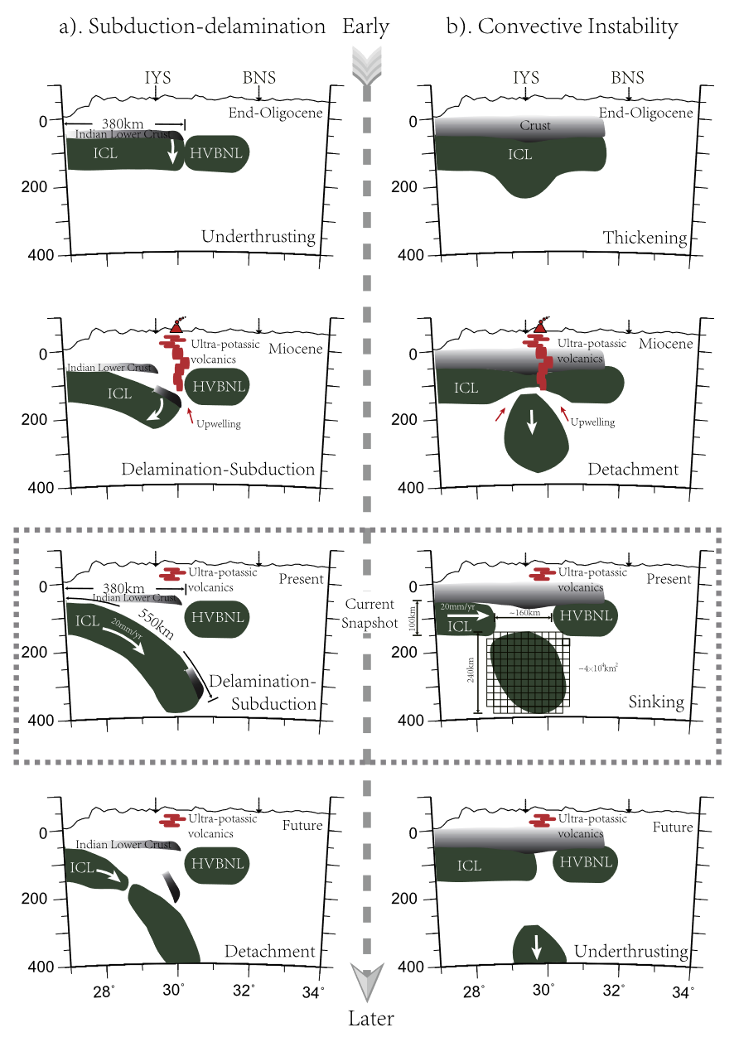
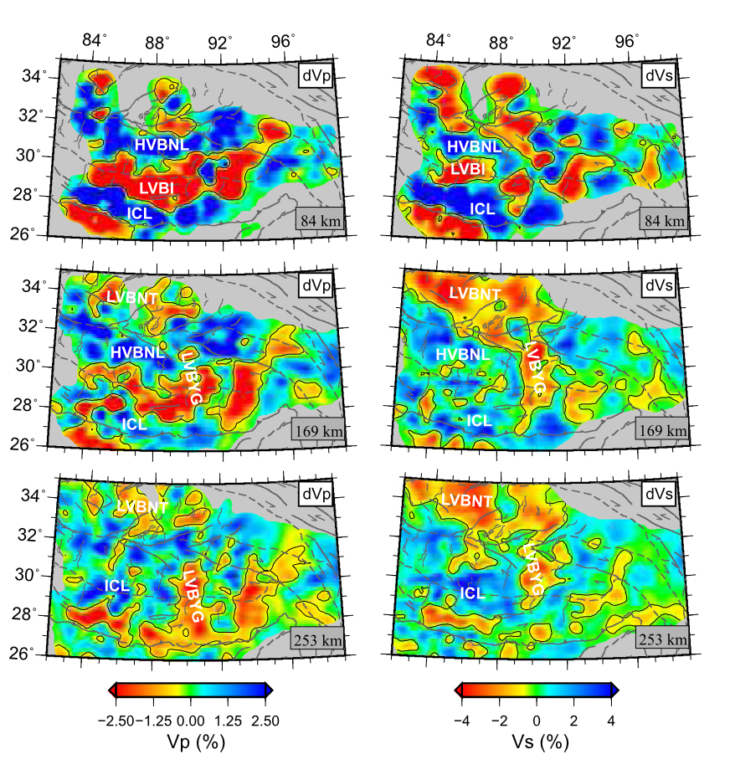
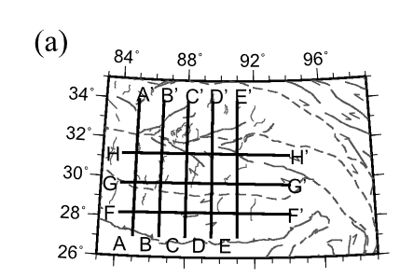
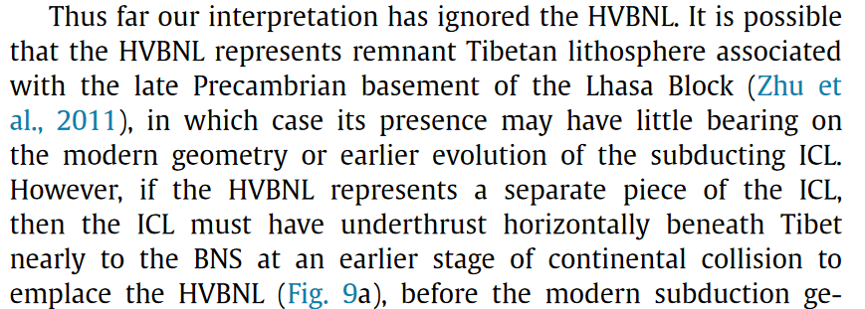
构造解释：拉萨地体
(Liang et al., 2016, EPSL)
3D imaging of subducting and fragmenting Indian continental lithosphere beneath southern and central Tibet using body-wave finite-frequency tomography

Slide 15
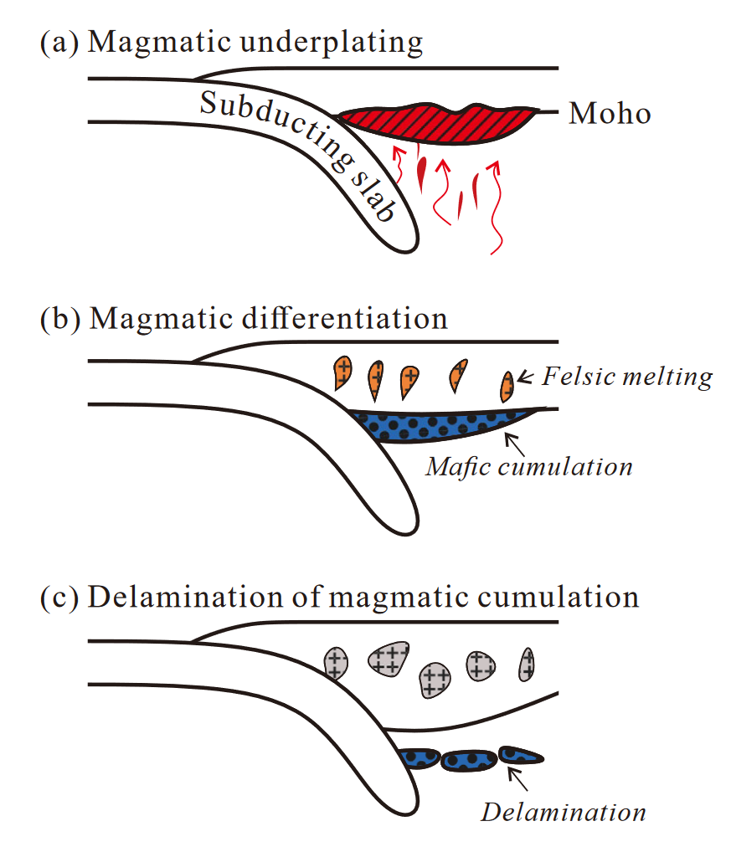
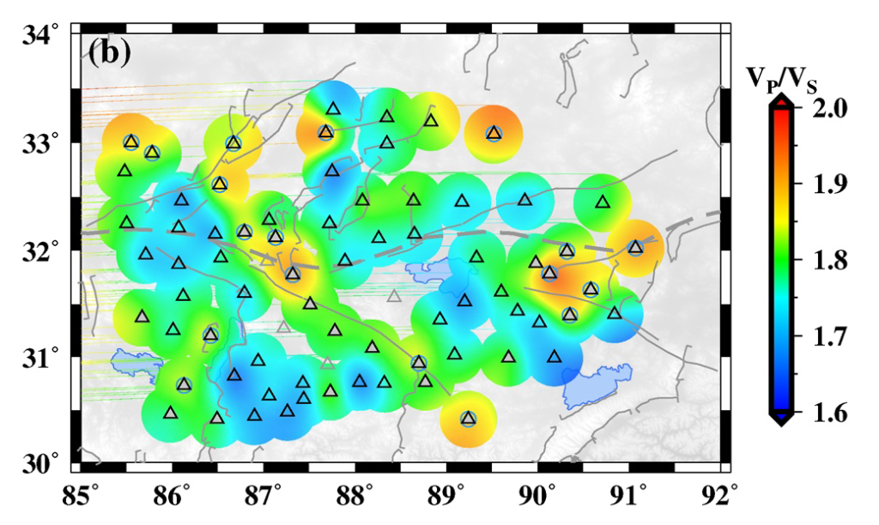
构造解释：拉萨地体
新生代（Cenozoic）岩浆作用
新特提斯洋&印度岩石圈板片俯冲→地幔楔融化，物质分异。母玄武岩岩浆分异成两部分：长英质（felsic）岩浆留在地壳，而镁铁质（mafic）残留物较重下沉。
10-30 Ma（如果地幔楔持续熔融）
更高的硅含量，导致波速比降低
（Liu et al., 2021, GRL）
Magmatic Underplating Thickening of the Crust of the Southern Tibetan Plateau Inferred From Receiver Function Analysis

Slide 16
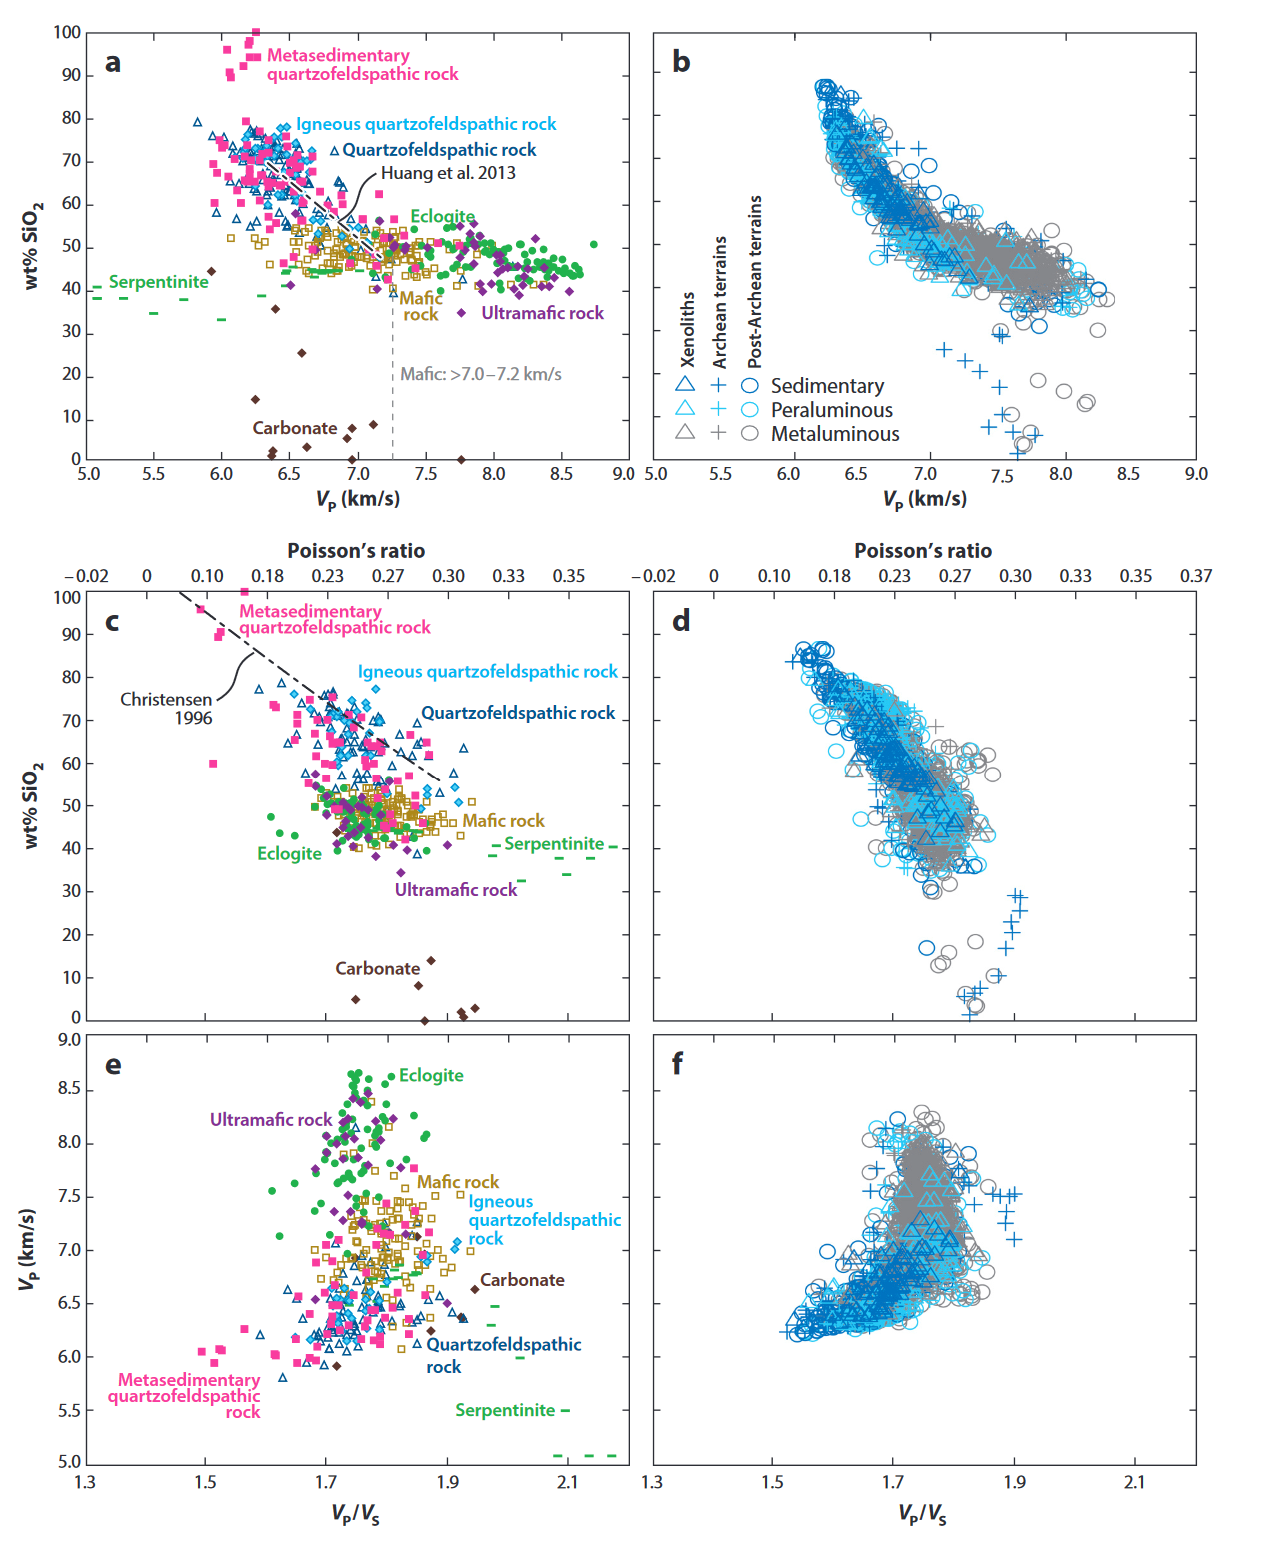
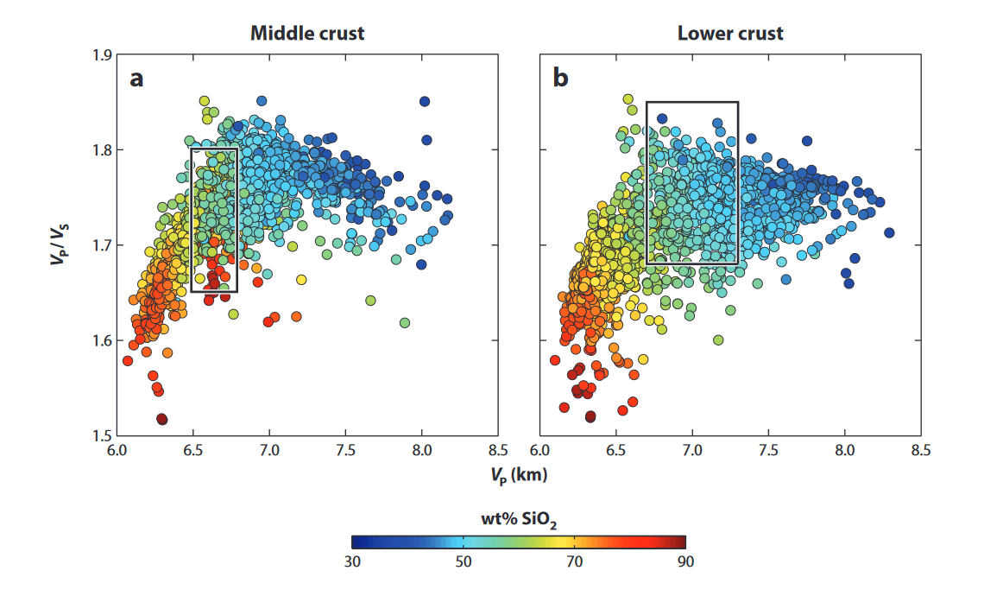
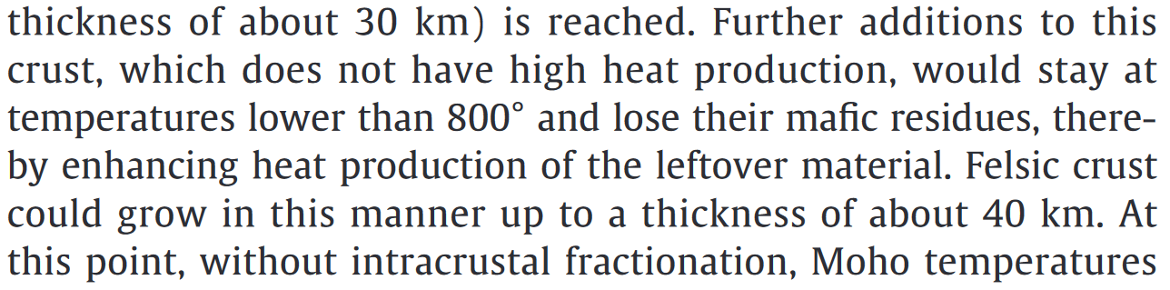
构造解释：拉萨地体
(Hacker et al., 2015) Continental Lower Crust
(Jaupart et al., 2016, Lithos)
Radiogenic heat production in the continental crust

Slide 17
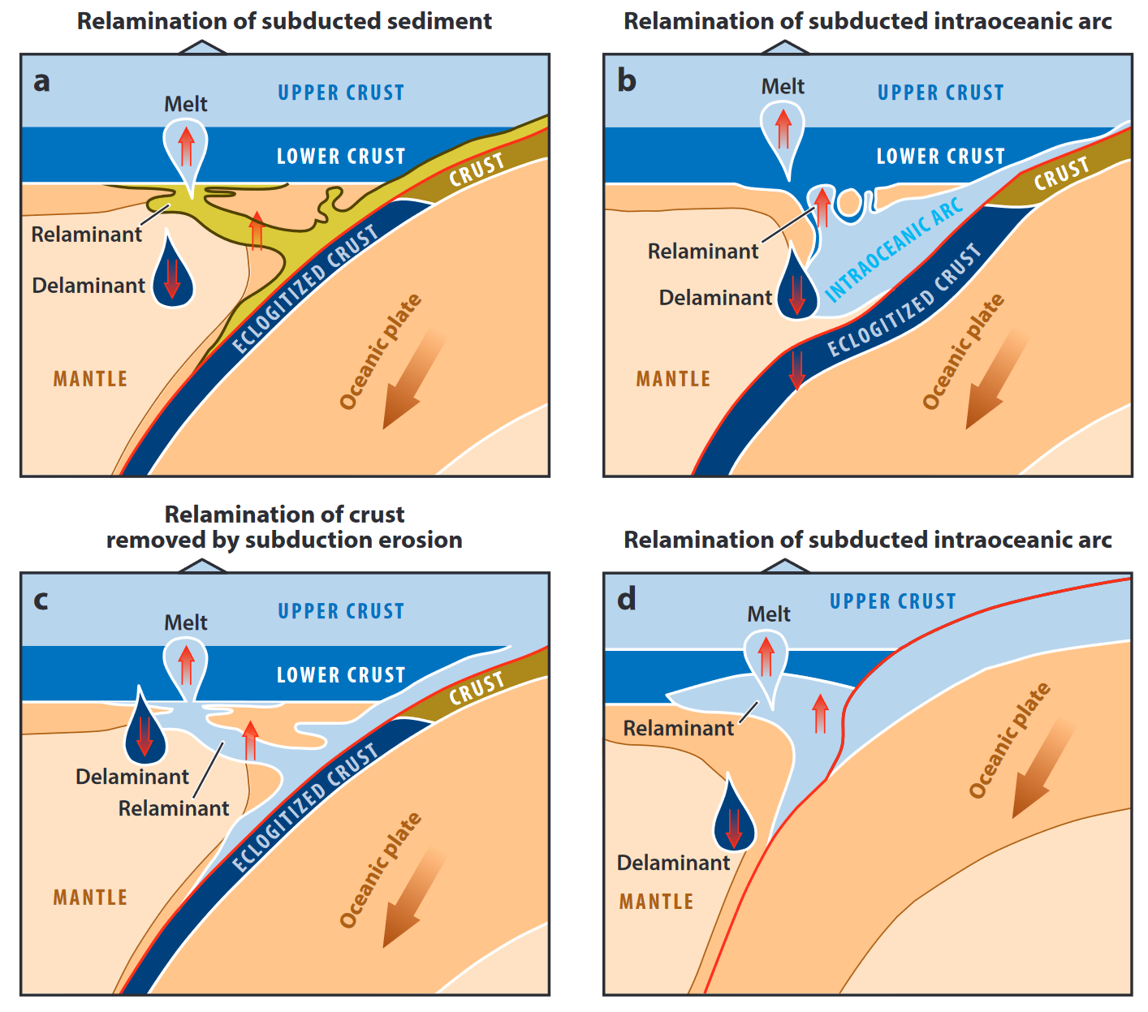
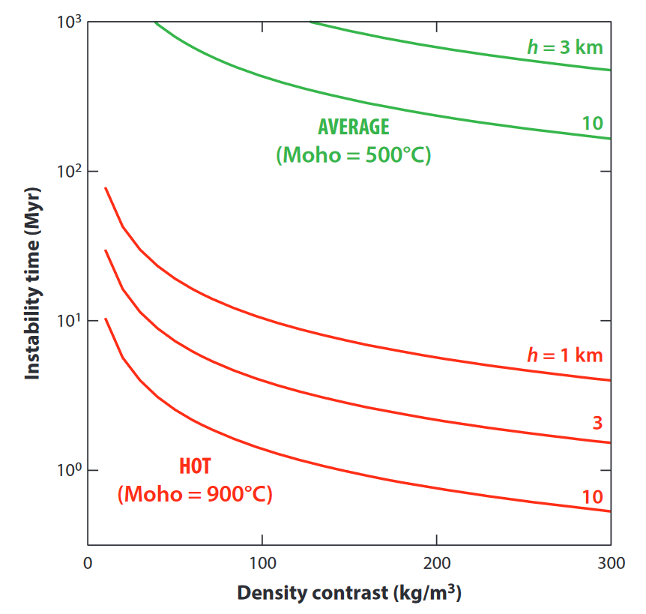
构造解释：拉萨地体
(Hacker et al., 2015) Continental Lower Crust

Slide 18
构造解释：拉萨地体

Slide 19
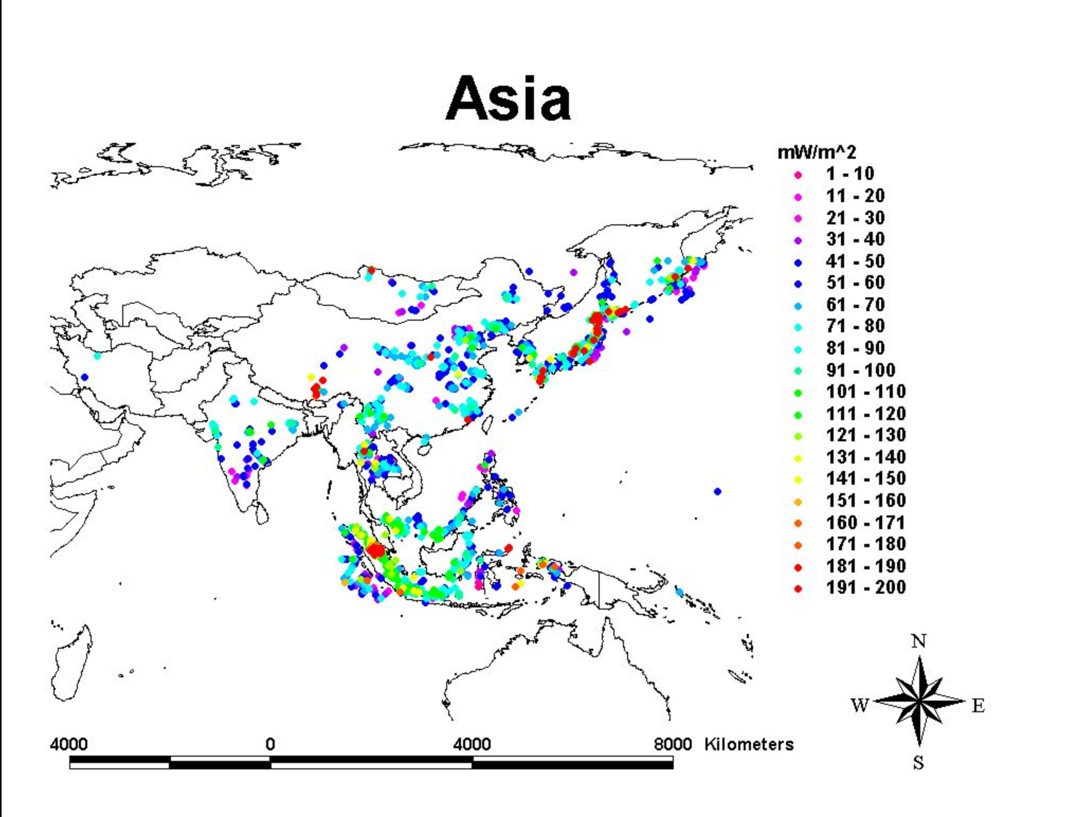
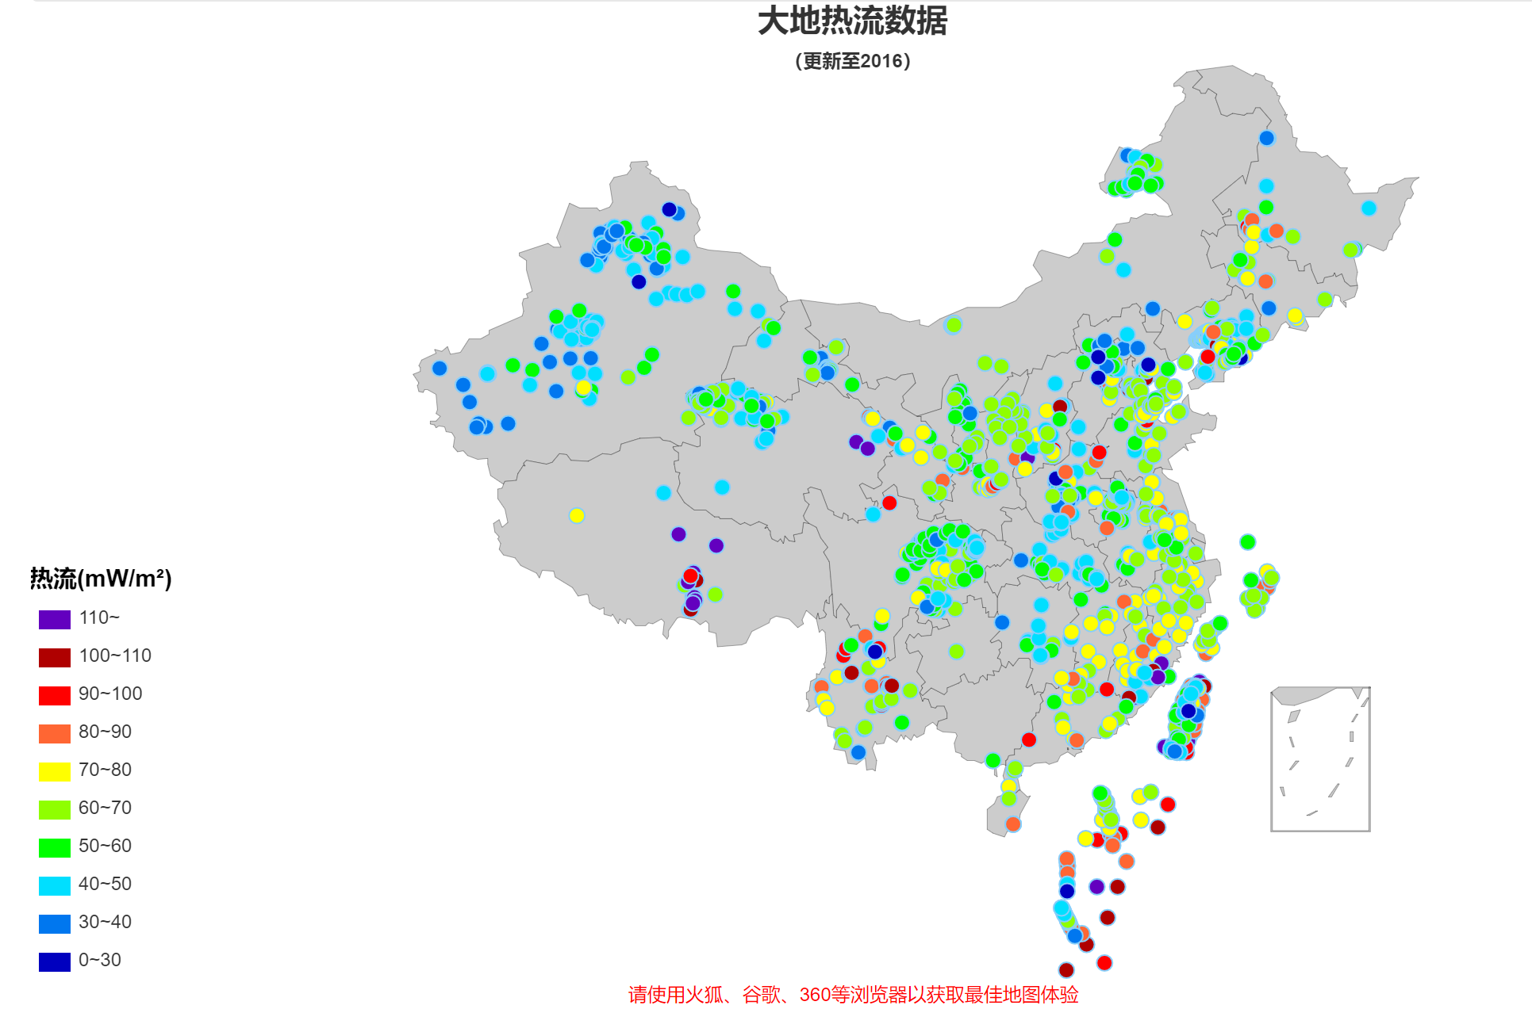
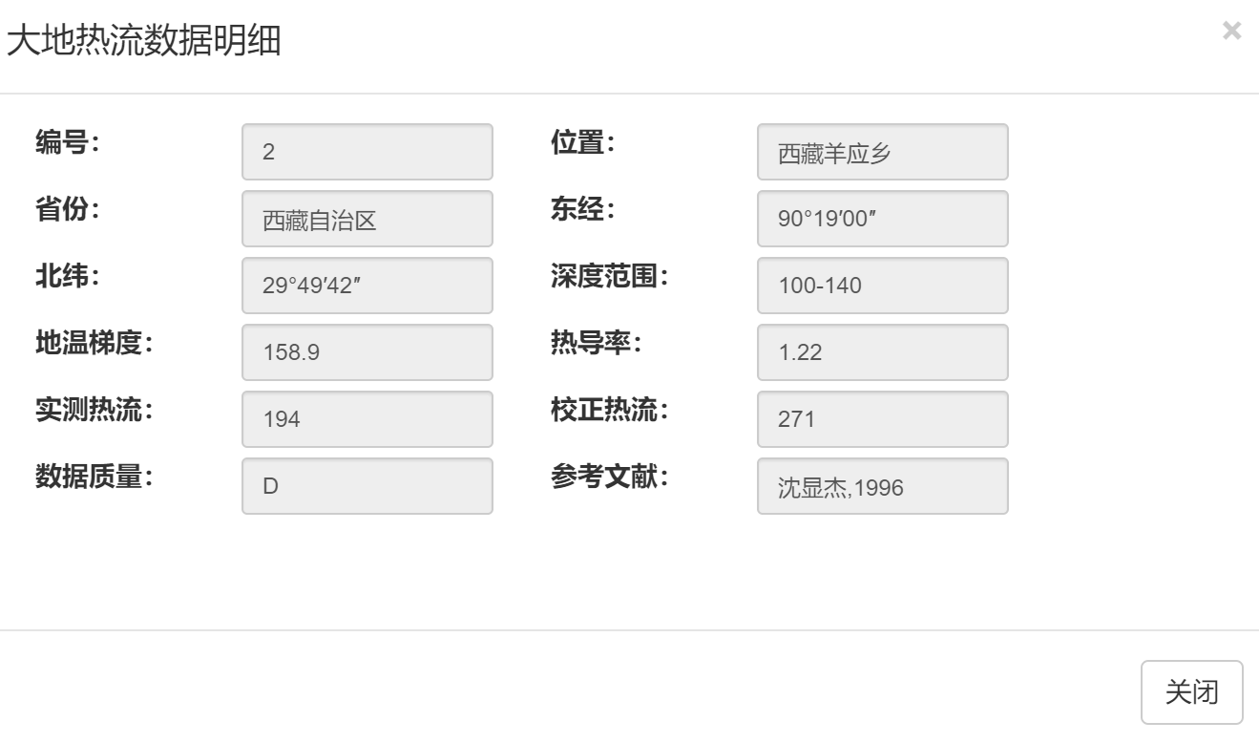
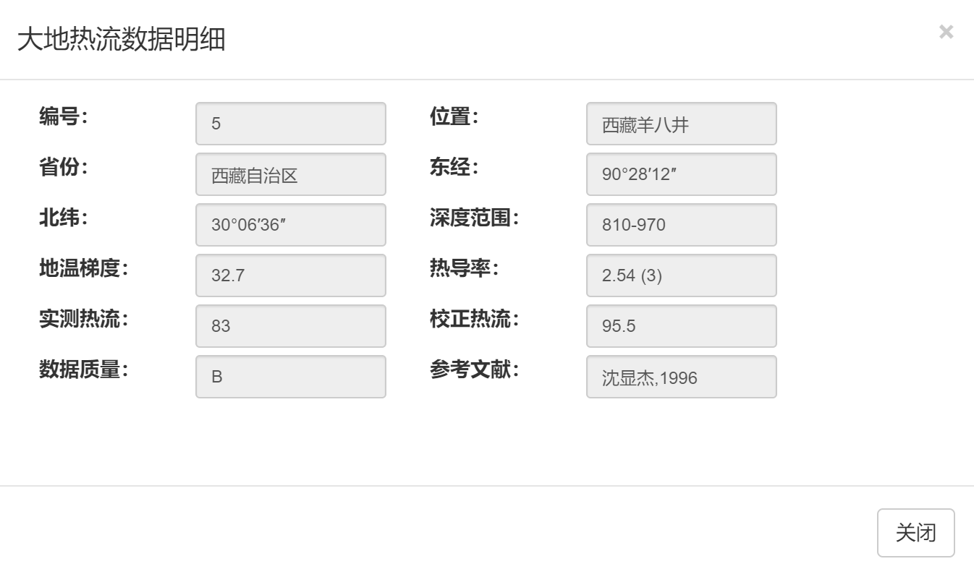

构造解释：YZS
Global heat flux data base
（https://engineering.und.edu/research/global-heat-flow-database/about.html）
中国大地热流数据库
（https://chfdb.xyz/）

Slide 20
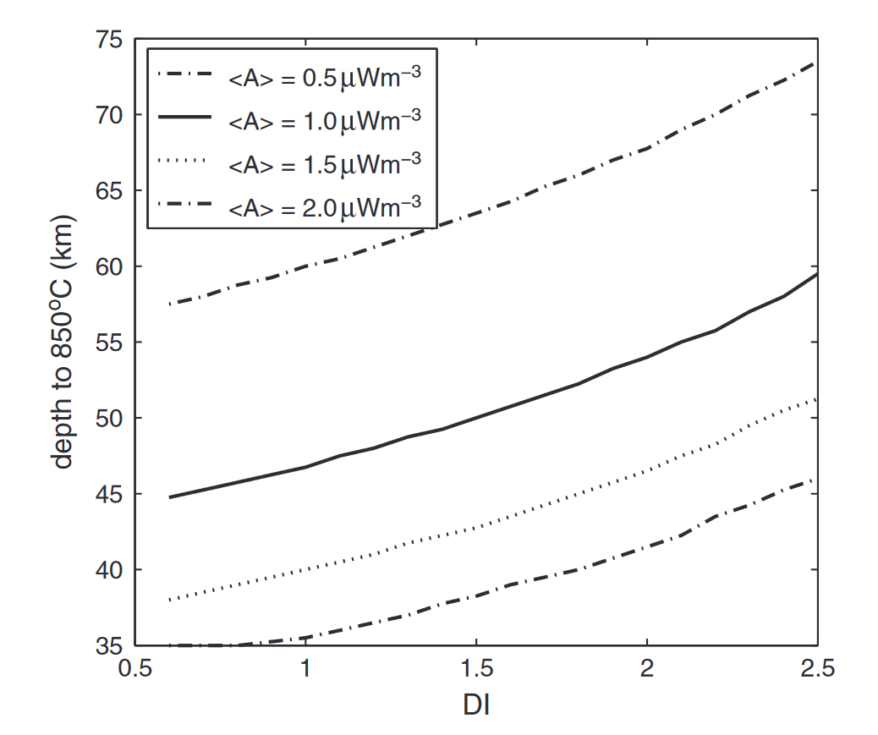
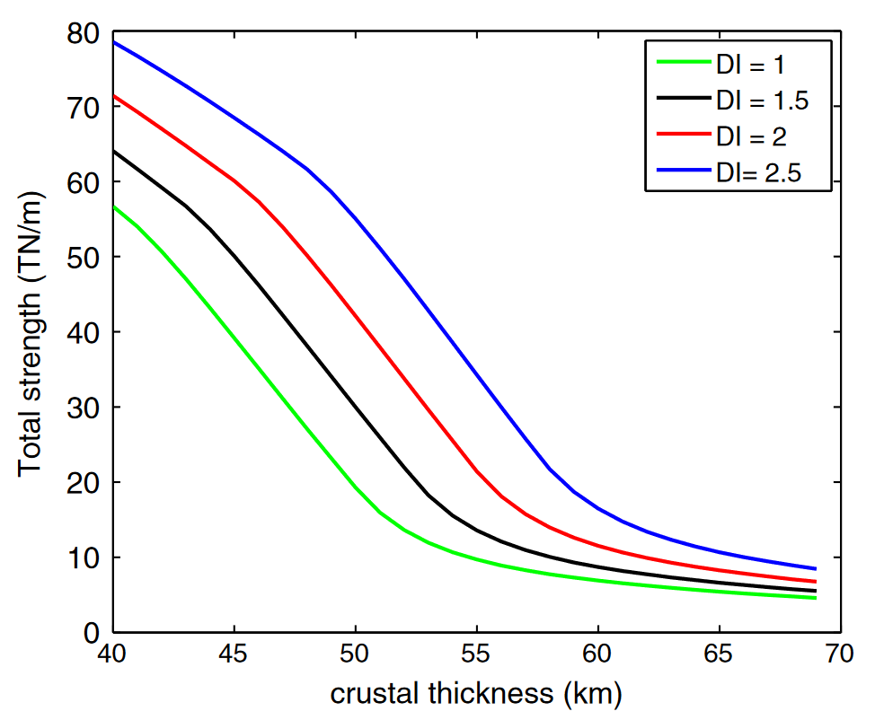
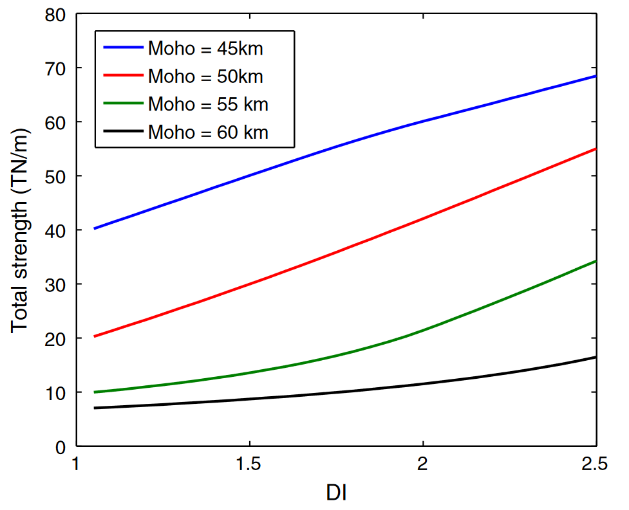
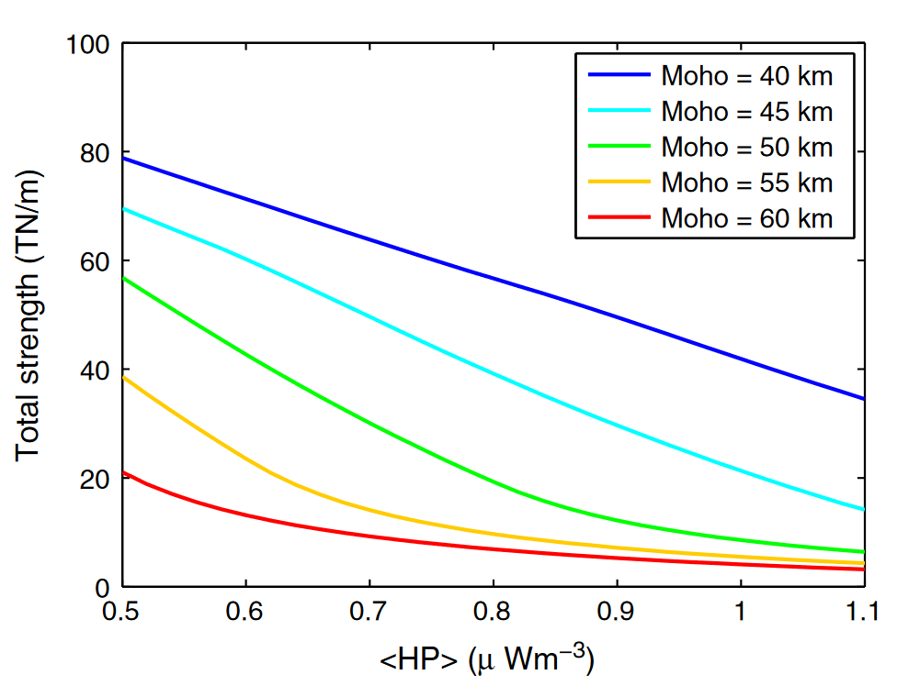
构造解释：拉萨地体
(Mareschal&Jaupart, 2013, Tectonophysics)
average
Crustal thickening by thrusting and creep deformation requires the resultant stress (difference between the compressional tectonic stress and the tensile stress due to crustal thickening) to be sufficiently large to overcome the total strength of the lithosphere.
The strength of the lithosphere drops below the level where it can sustain the increase in gravitational potential energy due to crustal thickening. Survival of a thick crustal root is possible only if the concentration in HPEs and the surface heat flux are very low.
<A>:average crustal heat production measured on surface samples
DI:differentiation index, <A>/vertically averaged crustal heat production
纵轴850℃：假设的熔融温度
热流强度增加，会导致更容易熔融
Radiogenic heat production, thermal regime and evolution of continental crust

Slide 21




Total strength of lithosphere vs crustal thickness
$$1.5μWm^{−3}$$
$$1.1μWm^{−3}$$
(Jaupart et al., 2016, Lithos)
Radiogenic heat production in the continental crust

Slide 22



Origin of adakitic intrusives generated during mid-Miocene east–west extension in southern Tibet
Radiogenic heat production in the continental crust
Timing of Tibetan uplift constrained by analysis of volcanic rocks

Slide 23

构造解释：拉萨地体
（Sheng et al., 2019, JAES）
Lithospheric electrical structure in the central Tibetan Plateau and its tectonic significance

Slide 24





构造解释：拉萨地体
（Shi et al., 2020, PNAS）
（Wang et al., 2017, EPSL）
（Wang et al., 2018, GRL）
3-D electrical structure across the Yadong-Gulu rift revealed by magnetotelluric data: New insights on the extension of the upper crust and the geometry of the underthrusting Indian lithospheric slab in southern Tibet
On the Role of Lower Crust and Midlithosphere Discontinuity for Cratonic Lithosphere Delamination and Recycling
Localized foundering of Indian lower crust in the India–Tibet collision zone

Slide 25
构造解释：拉萨地体

Slide 26





构造解释：拉萨地体
(Tian et al., 2015, EPSL)
(Liu et al., 2011, EQS)
Receiver function study of the crustal structure of Northeast China: Seismic evidence for a mantle upwelling beneath the eastern flank of the Songliao Basin and the Changbaishan region
Weakly coupled lithospheric extension in southern Tibet

Slide 27
谢 谢！

Slide 28

构造解释：拉萨地体
(van Keken, 2003, EPSL)
（Shi et al., 2020, PNAS）：印度下地壳下垫导致地壳增厚
The structure and dynamics of the mantle wedge

