Slide 1

科技写作中的“KIDs”思维
杨宏峰
致谢：五刊联盟，我的学生/博士后
香港城市大学颜爱华教授
五刊联盟系列讲座
5月21日, 2020

Slide 2
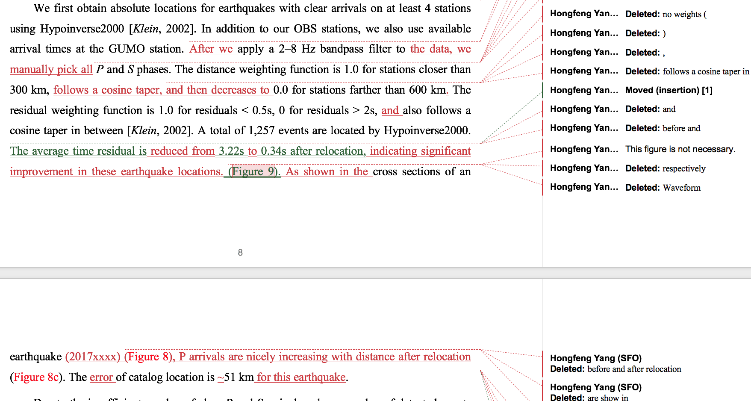
应该怎么写？为什么？
老师：你为什么这么改？
我已经很努力的写了…
针对科技论文写作，如何“授人以渔”？

Slide 3
提纲
为何科技论文写作公认很难？
  对于“如何写论文”存在的思维误区
  到底难在哪里？
KIDs 思维
  什么是KIDs思维
  如何运用到论文写作中
  科技论文不同部分承载的功能
  几个关键部分写法

Slide 4
科技论文的组成部分
大家擅长哪些？短板又在哪里？
标题 (Title)
摘要 (Abstract)
引言 (Introduction)
数据与方法 (Data and Methods)
结果 (Results)
讨论 (Discussion)
结论 (Conclusions)
相辅相成，缺一不可

Slide 5
哪部分最容易写呢？
问卷调查数据
(2020-05-06, 402 人)

Slide 6
短文章中的Data and Method
Science 发表的论文中，Methods and Data在附件中
Nature 发表的论文中，Methods and Data放在文章的最后

Slide 7
最有可能被读者忽略不读的部分是？
问卷调查结果显示：最容易被忽略不读的部分，数据与方法高居第二
(2020-05-11, 403 人)

Slide 8
数据与方法 Data and Method
很可惜，这也是读者最容易略过不读的部分。
  这部分很重要！！！没有数据与方法，何谈研究？
为什么这样？
  我是外行，反正也读不懂。
  我对这个方法和数据很熟悉，不用读了。
  除非这篇文章是介绍一个新方法。应该在哪里体现出来？
  建立在作者可信、评审靠谱的基础上，这部分内容对于理解文章的结论、了解创新点和重要性的帮助有限。
Notes:
比如我展示的问卷调查数据，你们不会怀疑我造假吧。

Slide 9
问卷调查数据:最难写的部分
可“万事开头难”！没有人会在写一篇文章时第一件事儿去写“讨论”，通常都在写完了其他部分之后，才开始写“讨论”，却依然觉得难。是讨论真的很难？
是不是我们对“讨论”及其他部分的功能认识有所偏差或局限？
问卷调查数据
(2020-05-06, 402 人)

Slide 10
最难写 VS 最容易略过不读
你觉得论文写作时，最难的部分是？
你觉得一篇发表的论文，最有可能被读者忽略不读的部分是？(无阅读时间限制)
为什么每个人辛辛苦苦写出来，却容易被忽略呢？
或者因为没有仔细读这三个部分，导致不大会写呢？

Slide 11
为何写作公认很难？
科技论文的使命是展现研究成果，传递知识给学术界以及人类社会。
研究的本质是探索未知，所以科技论文的写作，必然包含了对某些未知知识的描述。
因此写作本身是一个自我学习、提升的过程，是科研过程的一部分。在写作时，作者要拓宽自己的知识面、直面及补充自己的知识盲区，而不是简单的记录“我都做了哪些工作”。写作当然很难。
那么，如何应对这个难题呢？

Slide 12
KIDs 思维
科技论文的使命是展现研究成果，传递知识。知识从哪里来？
论文三要素：KID
Data: raw or simply processed.
Information: patterns inferred from the data. May be subjective. Needs to consider data attributes
Knowledge: need context and background. Implicit and explicit
Succinct
Knowledge
Information
Data
39.9042° N, 116.4074° E
It might be data for lots of us, but could mean information for some of you.

Slide 13
Knowledge-Information-Data
Knowledge: ??? Context
  Context 1: station coverage has been improved
  Context 2: this is within the Sichuan basin, shale gas field
Data (processed):
Daily number of earthquakes (grey)
Accumulated seismic moment (red)
Information:
Daily number of earthquakes increases drastically since 2015
Accumulated seismic moment increases since 2018

Slide 14
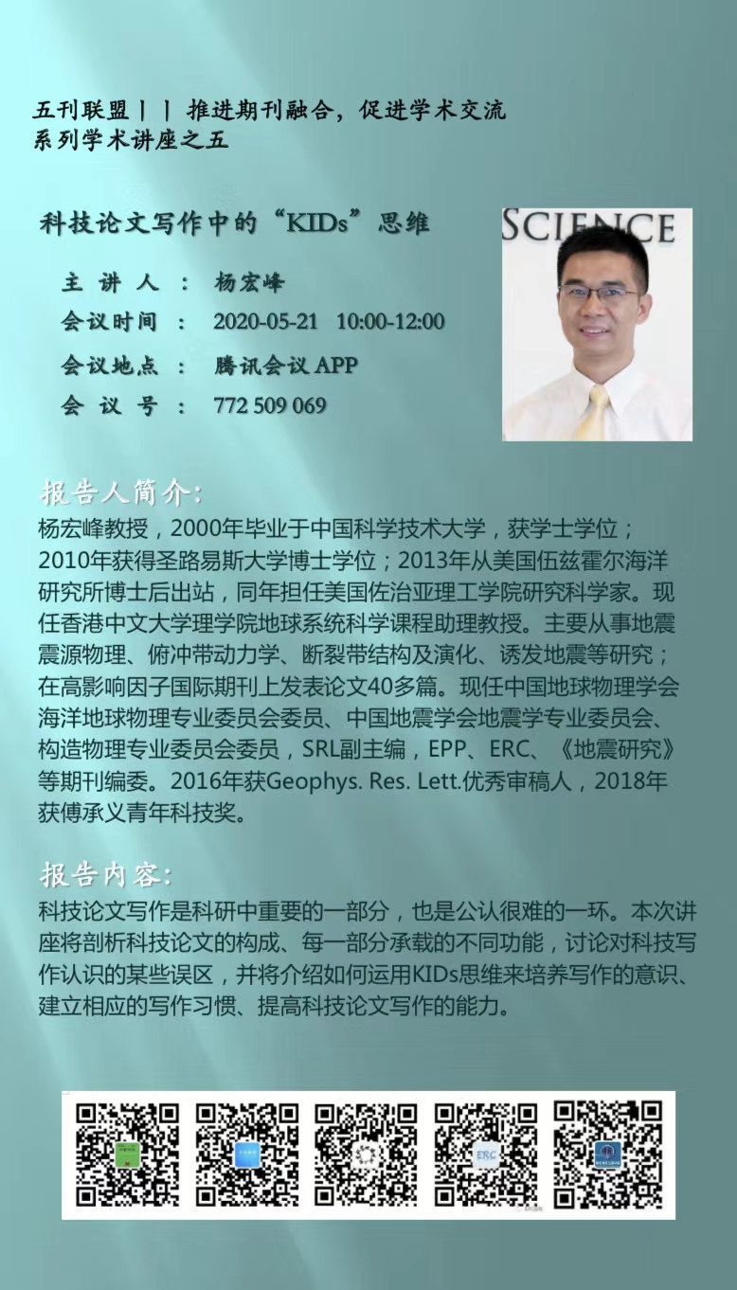
三要素：数据
数据 (raw data) 本身是客观独立的。
  数据有不同的属性 (attributes)。
  这张海报的底色，“绿”还是“蓝”？
  数据是否携带信息、携带多少信息，取决于不同的人群。
  如果现在某地发生一个5级地震
    相关地震局人员
    科研人员
    吃瓜群众
Notes:
假如某地发生一个5级地震，相关地震局同事要准备应急；部分人员可能准备开展相关信息收集；吃瓜群众就呵呵。

Slide 15
三要素：信息与知识
信息从数据分析中获得，需要context
  同样的数据，不同的分析方式会得到不同的信息。
  同样的数据，不同的表达方式会传递不同的信息。
  要正确识别数据属性，准确传达信息。
信息转化为知识，需要背景知识
  对于缺乏背景知识的群体，是无用信息，无法转化为知识。
知识应该是普适的
  对大众、相近领域、同行。
Notes:
假如某地发生一个5级地震，相关地震局同事要准备应急；部分人员可能准备开展相关信息收集；吃瓜群众就呵呵。

Slide 16
科技写作/科研的过程：化隐为显
从ideas到paper
Idea/hypothesis: 这些地震可能是诱发地震
Paper: 如果是诱发地震，什么机制诱发？如果不是，哪些数据、信息可以证明？
Ideas: 隐性知识
Paper: 显性知识
Ideas
Papers

Slide 17
科技写作：怎么写？
论文三要素：KID
这些过程对应着论文中哪一（几）部分？
我的草稿（论文）都会被哪些人读呢？
Succinct
如何从数据（data）提取信息(information) ？
如何验证提取的信息准确、可靠？
如何结合不同的背景知识，从不同的信息中归纳、凝练出知识？
如何利用已有的知识，学习、产生新的知识？

Slide 18





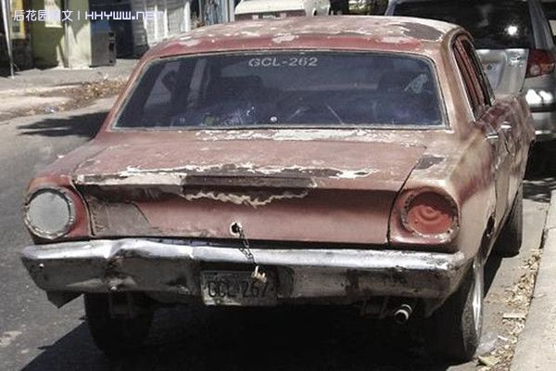



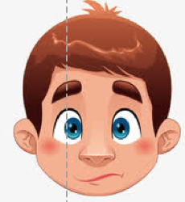

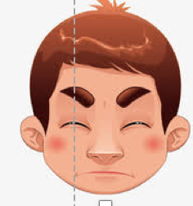
期刊编辑
期刊编辑
情形一
契合期刊还有创新性，关注热点问题，好文章啊！赶紧送审！
情形二
有一定的创新和贡献，送审吧看看审稿人的意见。
情形三
方法和科学问题都没有创新，不适合在我们期刊发表。拒了拒了。
这样改会更严谨些 ………
合作者
合作者
我期待的:
导师
导师
S600
我看到的:
paper
manuscript
审稿人
审稿人
情形一
好文章！赶紧发表！
情形二
有一定的工作量，但是平平无奇，看不出重点和贡献。
情形三
这么差，居然还能送审？
普通读者们
耶，终于写完啦！发给老师和合作者看看
耶，文章终于发表啦！
终于把文章改好投出去啦！
审稿意见出来了！赶紧改文章写意见回应！
导师和合作者说的有道理，抓紧改文章。
这篇文章的方法很好啊，我也可以试试吗…
情形一
这篇文章论证方法足够严谨，角度新颖，对这个科学问题的认识有突破性的贡献！好文章啊！
情形二
这篇文章创新度很高，提出的新方法，有结合到实际生产中的潜力。好文章！
情形三
论证和方法都很常规。缺少了闪光点……
作者（学生）
这篇文章和我关注的同一个问题，用的不同方法。对比一下结果，好像有点不同。咦，这个假设成立吗？重要吗 …
作者（学生）
评估者
方法技术方面的看不太懂，但是这个结果好像很有说服力，对我的研究有所启发啊，可以支持（反对）某个论点。

Slide 19
合作者/导师的视角
标题 (Title)
摘要 (Abstract)
引言 (Introduction)
数据与方法 (Data and Methods)
结果 (Results)
讨论 (Discussion)
结论 (Conclusions)
相辅相成，缺一不可
我们原本说好的……
现实看到的……
哪个部分会导致如此差距？

Slide 20
评审/编辑的视角
如果你曾作为评审，你最看重文章的哪个部分?

Slide 21
评审/编辑的视角
如果你曾作为评审，文章的哪一部分写得差会导致你拒稿？

Slide 22
发表一篇文章必要的部分
合作者/导师/评审/编辑
引言 Introduction
结果 Results
讨论 Discussion
数据和方法 Methods and Data (这个我们在行耶)

Slide 23
如何写引言？
引言的功能: 有机地组合现有知识，传达简单易懂且关键的信息，让读者能够理解科学问题以及重要性，并了解该研究的创新之处。
漏斗外缘：科学问题适用范围广并重要
待解决的问题
为何这个问题重要（科学+社会意义）？
前人做了哪些尝试？存在哪些不足？
为何存在这些不足？
你如何解决这个问题？（如何克服瓶颈）
  新方法？
  新数据？
  新思路？
综述现有知识要聚焦，并汇聚于“瓶颈”问题—你的创新之处！

Slide 24
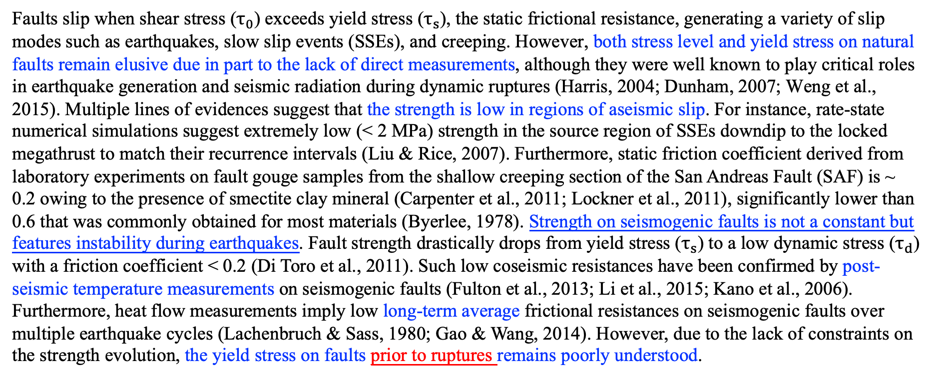
引言的例子—全新的研究
Faults slip when shear stress ($τ_{0}$) exceeds yield stress ($τ_{s}$), the static frictional resistance, generating a variety of slip modes such as earthquakes, slow slip events (SSEs), and creeping. However, both stress level and yield stress on natural faults remain elusive due in part to the lack of direct measurements, although they were well known to play critical roles in earthquake generation and seismic radiation during dynamic ruptures (Harris, 2004; Dunham, 2007; Weng et al., 2015). Multiple lines of evidences suggest that the strength is low in regions of aseismic slip. For instance, rate-state numerical simulations suggest extremely low (< 2 MPa) strength in the source region of SSEs downdip to the locked megathrust to match their recurrence intervals (Liu & Rice, 2007). Furthermore, static friction coefficient derived from laboratory experiments on fault gouge samples from the shallow creeping section of the San Andreas Fault (SAF) is ~ 0.2 owing to the presence of smectite clay mineral (Carpenter et al., 2011; Lockner et al., 2011), significantly lower than 0.6 that was commonly obtained for most materials (Byerlee, 1978). Strength on seismogenic faults is not a constant but features instability during earthquakes. Fault strength drastically drops from yield stress ($τ_{s}$) to a low dynamic stress ($τ_{d}$) with a friction coefficient < 0.2 (Di Toro et al., 2011). Such low coseismic resistances have been confirmed by post-seismic temperature measurements on seismogenic faults (Fulton et al., 2013; Li et al., 2015; Kano et al., 2006). Furthermore, heat flow measurements imply low long-term average frictional resistances on seismogenic faults over multiple earthquake cycles (Lachenbruch & Sass, 1980; Gao & Wang, 2014). However, due to the lack of constraints on the strength evolution, the yield stress on faults prior to ruptures remains poorly understood.
Yao and Yang, 2020, GRL

Slide 25
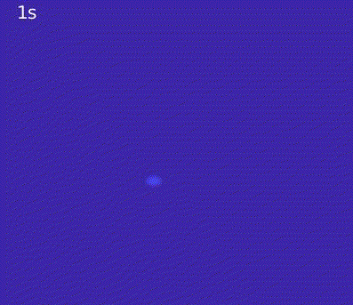
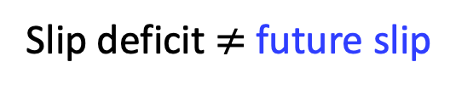
引言的例子—结合不同学科的研究
2015 Mw 8.3
2010 Mw 8.8
Metois et al., 2016
Slip deficit $≠$ future slip
利用大地测量数据，可以得到断层震间闭锁分布，用来指示未来地震危险区。但是只有震间闭锁分布，无法预测未来地震的大小（如南美俯冲带、喜马拉雅山前等等）。结合震间闭锁与破裂动力学则可以实现目标
Notes:
If we look at the southern Chile segment where the 2010 Maule earthquake occurred. It is intriguing to see the remarkable consistency between the locking and coseismic slip, despite the different locking models. However, it is mysterious that the northern portion was ruptured by the 2015 Illapel earthquake and the rupture stopped, leaving a seismic gap between the two events. The question is how we can infer future rupture segmentation and earthquake magnitude? This also poses a challenge in evaluating earthquake hazard for other subduction zones such as Cascadia a megathrust earthquake is anticipated, but we do not know how large it will be. Two locking models also show clearly the difference.

Slide 26
引言的例子—结合不同学科的研究
什么问题
前人的尝试
Yang et al., 2019, EPSL

Slide 27
引言的例子—结合不同学科的研究
卡脖子的问题：即使已知断层上能量积累，不知道未来震源在哪里，能否预测未来地震大小？
Yang et al., 2019, EPSL

Slide 28
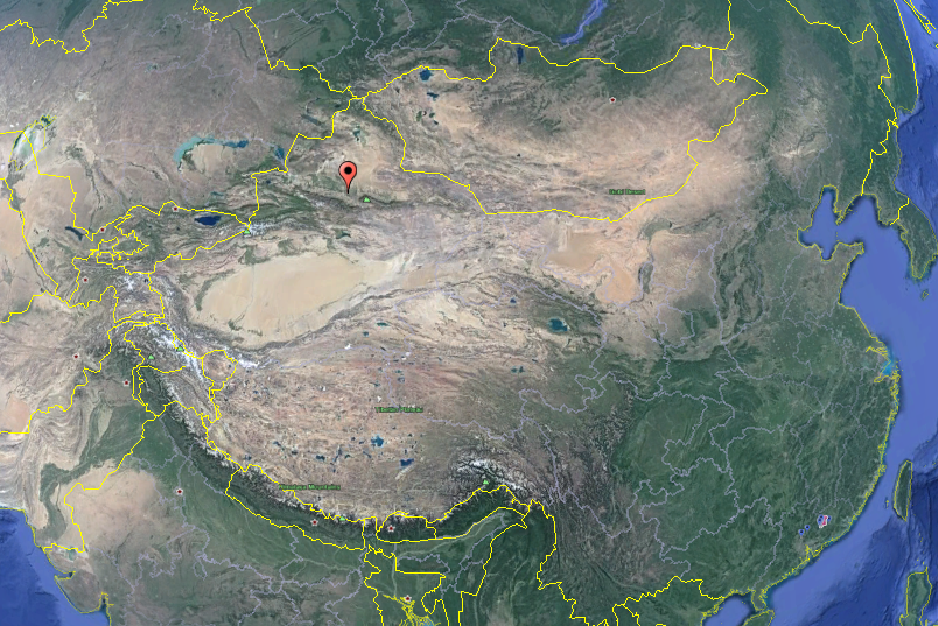
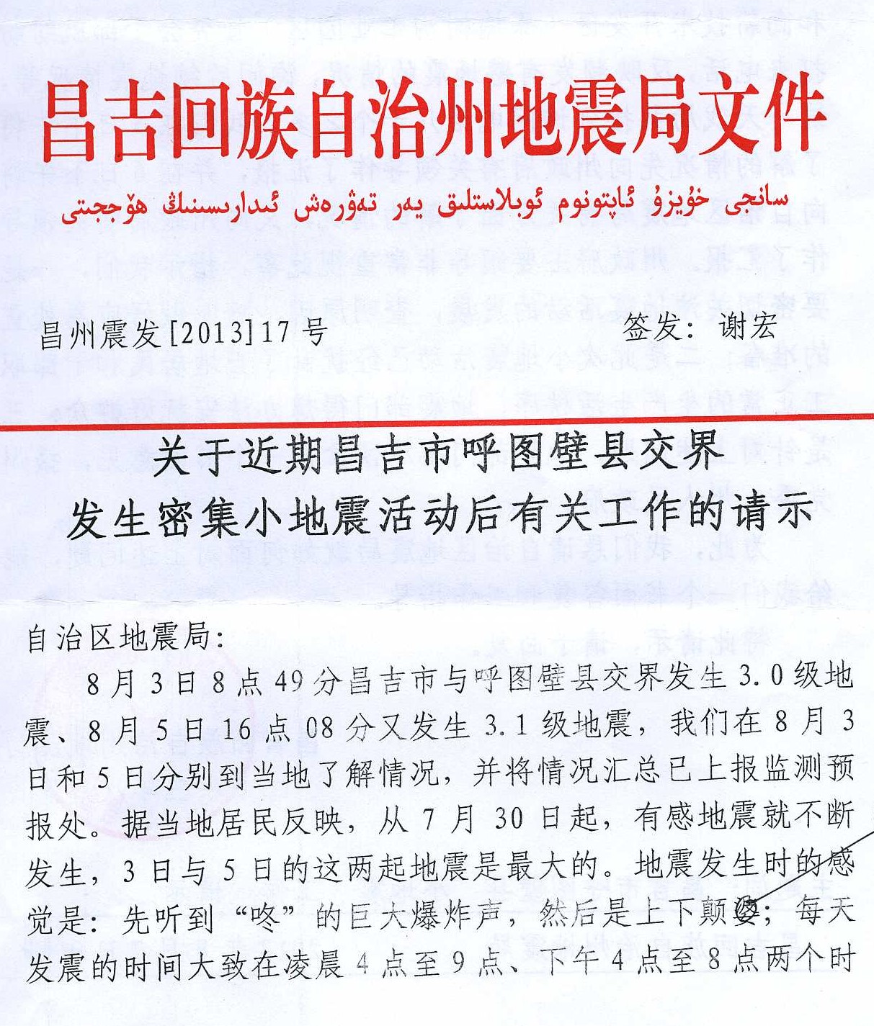
引言的例子—已有前人类似研究
The Hutubi storage facility (呼图壁储气库)is built with a total storage capacity of 10.7 billion m³.
It is the largest of its kind in China, and the first large-scale auxiliary system associated with the West-East Gas Pipeline Network.
First injection: June 2013,
Earthquakes: July 28th, M_{L} 2.9 – Aug. 21st, M_{L} 2.2
新疆呼图壁储气库诱发地震

Slide 29
1st paragraph, scientific questions and impacts
2019 JGR
It has long been known that the injection and extraction of fluid can induce earthquakes [Healy et al., 1968; Raleigh et al., 1976; Segall, 1989; Suckale, 2009; Ellsworth, 2013; Yang et al., 2017]. Numerous cases associated with liquid injection (e.g., waste water disposal and hydraulic fracturing) have been globally documented in recent years [e.g., Holland, 2013; Keranen et al., 2013; Lei et al., 2013; McGarr, 2014; Atkinson et al., 2016; Chen et al., 2018; Keranen & Weingarten, 2018]. Although gas extraction may possibly induce earthquakes through poroelastic stress perturbation [e.g., Segall, 1989; Suckale, 2009; Zbinden et al., 2017], relatively fewer cases of earthquakes induced by gas injection have been documented [Foulger et al., 2017; Wilson et al., 2017], probably because only a small number of gas injection cases have been seismically monitored. A notable case was the Castor project in Spain. This project was shut down after triggering hundreds of small earthquakes [Cesca et al., 2014; Juanes et al., 2017], although it is still debated whether its sudden suspension ‘unexpectedly’ promoted the occurrence of the largest Mw 4.3 earthquake [Grigoli et al., 2017]. Understanding how gas injections may cause earthquakes is not only important for earthquake physics [Galis et al., 2017], but will also enable underground gas storage (UGS) facilities, where the annual cyclic injection and extraction is conducted to meet seasonal variation in demand for gas, to be operated more safely [Yang et al., 2017]. To meet the rapidly growing demand for natural gas, an attractive green energy source, large UGSs have been constructed in many countries, and it is therefore important to understand how they might be damaged or affected by induced earthquakes. Here we systematically investigate earthquakes which occurred near a UGS facility in Hutubi, Xinjiang, combining a newly installed dense seismic network with permanent stations, to distinguish seismicity related to the UGS facility and to assess the seismic hazards.

Slide 30
2nd paragraph, previous studies and existing problems
2019 JGR
Located in the southern margin of the Junggar Basin, the Hutubi UGS facility was originally a natural gas field that was depleted in 2009. It was subsequently converted into a UGS with a capacity of 10.7 billion m³, the largest of its kind in China. Shortly after the first injection on 9 June 2013, a sequence of earthquakes occurred in the vicinity of the UGS, including two earthquakes with local magnitudes (M_{L}) larger than 3 (Figure 1) [Yang et al., 2017]. Tang et al. [2018] have detected and located earthquakes from 2013 to 2015 in the region using the sparse Xinjiang Seismic Network (XJSN), and found that most of the earthquakes occurred in the first two injection periods, and were distributed in two shallow clusters (focal depth <2 km). Based on the delay time between the occurrences of the earthquakes and the abrupt changes in the gas injection rate and well pressure, Tang et al. [2018] concluded that these earthquakes were induced by both pore pressure changes and a poroelastic response, which led to the failure on nearby faults that were governed by the rate- and state-dependent friction law [Dieterich, 1979]. However, in the rate-state-frictional formulation, velocity strengthening (aseismic) behaviour is often found at shallow depths (<2km) [Blanpied et al., 1998; Marone, 1998], where earthquakes are not anticipated to occur and faults presumably slip aseismically. If indeed earthquakes are shallower than 2 km and are induced as suggested by Tang et al. [2018], pore pressure changes can not be the responsible mechanism because the injected gas is sealed by the cap rock that is located at ~ 3km in depth (Hu et al., 2010; Pang et al., 2012). Furthermore, the Hutubi UGS is located in the Junggar Basin with low seismicity levels, but earthquakes are quite active in the Tianshan tectonic belt adjacent to the Hutubi UGS. It is therefore by no means certain that these earthquakes were directly induced by gas injection or extraction.

Slide 31
3rd paragraph, why we think we can do better
2019 JGR

Slide 32
引言中的常见问题：杂乱无章
明明每个字/每句话/每一段都认识，就是读不懂！

Slide 33
First version of our Hutubi manuscript
1st paragraph, Hutubi UGS
The Hutubi underground gas storage (UGS) is located on the depleted Hutubi gas reservoir (HGR), 60 km distance from Urumqi, Xinjiang, China. It was initially operated on June 9th, 2013 and was designed to balance the gas demand and supply through injecting gas into or withdrawal of gas from the subsurface rock formation. The Hutubi UGS is the largest of its kind in China with its designed maximum gas storage capacity as large as 10.7 billion m3 (bcm). It serves as the westernmost UGS facility along the economically developed East-West gas pipeline, which has significance for coordinating the gas production and gas consumption areas in China. UGS has been a routine way worldwide to balance the seasonal fluctuated gas demands and could economically declining the buying gas during winters or at times of supply when gas price is high. However, the annually cycled injection and extraction of high pressure gas may cause observable ground deformation and change the stress state resulting in alteration of seismic hazard in this area. The observed uplift and subsidence values caused by gas extraction and injection vary from -13.7mm and 15.5mm, respectively and the estimated monthly pore‐pressure changes range from -0.071 to 0.093 MPa, which are beyond the critical thresholds to induce small earthquakes (Keranen et al., 2014; McGarr, 2014; Qiao et al., 2018; Tang et al., 2018). During the first injection phase, a sequence of earthquakes with maximum magnitude M 3.1 occurred nearby in August 2013 within 10 km distance to the Hutubi UGS, where magnitude larger than M 3 earthquakes were absent in the historical earthquake catalog.

Slide 34
First version of our Hutubi manuscript
2nd paragraph, Induced Earthquakes
It is widely observed and accepted that injection of liquid into or extraction of liquid/gas from underground formations could induce earthquakes, some of which are large enough to be recorded or felt regionally (Segall, 1989; Shapiro and Dinske, 2009; Ellsworth, 2013; Clarke et al., 2014; Skoumal et al., 2015; Chang and Segall, 2016; Rutqvist et al., 2016), though some are still in debate (Bossu et al., 1996; Odonne et al., 1999; Adushkin et al.,2002; Bardainne et al., 2008; Ge et al, 2009; Zoback and Gorelick, 2012; Deng et al., 2013; Snee and Zoback, 2016). The most recently reported damaging anthropogenic earthquake is the Mw 5.5 earthquake that struck South Korea in November 2017 (Grigoli et al., 2018). The occurrence of this earthquake was possible related with high pressure hydraulic injection activities near an Enhanced Geothermal Systems site, where the seismic hazard is potentially increased due to the static stress changes on the nearby fault (Grigoli et al., 2018). Anthropogenic earthquake sequences induced by fluid injection or withdrawal may provide opportunities to advance our physical understandings of earthquake processes, to deepen our insights into the propagation and stop of earthquake ruptures and accordingly to mitigate and manage the induced seismicity risk with best practices (Gali et al., 2017; Schoenball and Ellsworth, 2017; Yang et al., 2017). The industry and government regulators developed a seismic hazard management protocol called “traffic light” system to make proper decisions in response to anthropogenic related earthquake occurrences (Kao et al., 2016; Yang et al., 2017).

Slide 35
First version of our Hutubi manuscript
3rd paragraph, network coverage and statistical method
Generally, near field observations are challengeable for fluid injection/extraction sites. The whole seismicity patterns cannot be fully and reliably characterized under limitations of seismological observations either with not enough time periods or not satisfactory space distribution of monitoring systems. It is noteworthy that high resolution local seismicity near injection/extraction sites are crucial to determine what mechanisms dominate in induced earthquakes (Yang et al., 2017). Although the seismic network coverage can be rapidly improved after significant earthquakes are reported near the industrial sites, the waveforms recorded on the seismic network may still likely to suffer from bad signal-to-noise ratios. To tackle this challenge, event detection algorithms such as the matched filter technique (Yang et al., 2009) can detect a significant portion of small earthquakes that are missing in the catalog.
Additionally, to investigate induced seismicity, both statistical and physics-based seismicity models have been proposed. In addition to the efforts to discriminate induced and natural earthquakes from their source properties and seismicity pattern analysis, the epidemic-type aftershock sequence (ETAS) model (Ogata, 1988) is utilized to study induced seismicity and distinguish between natural and anthropogenic earthquake rate changes. ETAS is a stochastic model combining the empirical Omori law and the Gutenberg–Richter magnitude distribution to attribute the probabilities of the rate changes to background seismicity and triggering events (Ogata, 1988; Zhuang et al., 2002; Llenos and Michael, 2013).
与最终发表的版本相比，所有的元素都在，只是排列的顺序不同。
把顺序重新排就可以了？

Slide 36
引言中的常见问题：隔靴搔痒
2019 GRL
隔靴搔痒：知道问题所在，但是没有聚焦到瓶颈问题。
Currently research reveals that the interactions of earthquakes can be summarized into three categories according to different stress transfer modes: static, quasi-static and dynamic triggering (Freed, 2005; Hill & Prejean, 2007). The permanent stress change produced by fault displacement can trigger earthquakes by directly disturbing the stress field or viscoelastic release. These two cases are called static triggering and quasi-static triggering respectively. Because the static and quasi-static stress changes decay quickly with distance, these two kinds of triggering mostly occur within a few times the rupture zone (e.g., Hill & Prejean, 2007). In many recent studies, however, an amount of evidence show that large earthquakes can cause significant seismic activity enhancement at locations several hundreds to thousands of kms away. This inter-seismic interaction is called dynamic earthquake triggering, associating with dynamic stresses during the passage of seismic waves. Dynamic triggering can be used as a natural experimental process to investigate the response of a fault to stress disturbance. It will enhance our understanding of the underlying mechanism of the earthquakes occurrence and help analysis the seismic hazard (Brodsky & Elst, 2014).
我是草稿

Slide 37
引言中的常见问题：隔靴搔痒
2019 GRL
我们提出新方法，所以先调研已有方法。但是缺乏关键点
Most traditional detection methods mainly consist of two steps. // They are picking local earthquakes before and after the arrival of main shock from high-pass filtered seismograms and evaluating the significance of seismicity rate changes based on the earthquake catalog. // In the first step, visual observation is the most direct way (e.g. Aiken et al., 2014). In addition, some programs that automatically detect microseisms, like M&L (Zhang & Wen, 2015), are also applied to get a more complete catalog. // In the second step, almost all researches using β statistic test, a kind of hypothesis test method, in the second step. The methodology of β statistic test is calculating the expected number of local earthquakes and standard deviation after the main shock based on the average seismic activity before the main shock, and then comparing them with the actual numbers of local earthquakes (Matthews & Reasenberg, 1988; Reasenberg & Simpson, 1992). There are also many studies that propose modified original β statistic test, such as Pankow et al. (2004), Gomberg et al. (2001), Kilb et al. (2002), Hough (2005) and Aron & Hardebeck (2009). // It is obviously that the traditional detection methods for dynamic triggering rely heavily on the earthquake catalog. Nevertheless, manual picking microearthquakes is time consuming and subjective and the M&L needs templates that is not easy to get. Although, Miyazawa & Mori (2005) replace the number of earthquakes with the amplitude of band-pass-filtered envelopes in β statistic test, it is greatly affected by near-surface noises.
我是草稿

Slide 38
引言中的常见问题：隔靴搔痒
2019 GRL
发表版

Slide 39
引言中的常见问题：缺乏连接
早期草稿
具备科学问题的描述，也清楚自身的优势和创新来源，但是两者之间缺乏连接，读者无法知晓哪些问题能够被解决，也不知道新的数据能产生哪些结果，而这些结果如何帮助解决问题也不清楚。

Slide 40
引言中的常见问题：信息罗列
回收站：只有信息，没有知识
“Wang had performed an analysis …. Thomas had done this … Yuki had tried … ”
  读者需要知道的不仅是谁做了什么，而是发现了什么，存在哪些问题？
“XXX is an important problem and has been extensively investigated (reference1, reference 2, ……, reference N).”
  很多人做过，可能说明这是个good topic。但这么多人做过了，还有哪些问题？如何解决？

Slide 41
引言中的常见问题：信息罗列
2012 GRL
早期草稿的第一段：列举了有关海山俯冲的三个模型，指出有debate，但是没有跟进的说明
Traditionally subducted seamounts were suggested to be strong asperities on the thrust interface [Cloos, 1992], which led to generation of megathrust earthquakes and strong coupling between the overriding and subducting plates [Scholz and Small, 1997]. The strong interplate coupling may also inhibit coseismic rupture propagations as barriers when megathrust earthquakes occurred [Kodaira et al., 2000]. However, recent investigations associated subducted seamounts to weak coupling because of entrained ﬂuid-rich sediments [Mochizuki et al., 2008; Singh et al., 2011], which may also stop coseismic ruptures but do not generate large earthquakes. Instead of changing frictional properties on the thrust interface, Wang and Bilek [2011] argued that the subducted seamount must have generated a complex network of heterogeneous fractures in order to overcome the geometrical incompatibility during subduction. The fracture network in the vicinity of a subducted seamount is unfavorable for large earthquake generation and rupture propagation, as most tectonic stresses will be released by repeating small earthquakes. Therefore, it is still unclear what controls whether seamounts will enhance or impede the generation of megathrust earthquakes and how they will interact with coseismic ruptures during such seismic events.

Slide 42
引言
引言的功能: 有机地组合现有知识，传达简单易懂且关键的信息，让读者能够理解科学问题以及重要性，并了解该研究的创新之处。
科学问题适用范围广并重要
杜绝如下常见问题
杂乱无章
缺乏连接
信息罗列
隔靴搔痒
综述现有知识要聚焦，并汇聚于“瓶颈”问题—你的创新之处！
读文章时，到引言中去找科学问题、重要性、以及现在的瓶颈

Slide 43
如何写“结果”？
最难写的部分
你说神马？
我明明很尽力了，写的就是马，为啥别人看成了鹿？

Slide 44
如何写“结果”？
结果的功能：展示数据分析过程、整理通过数据分析得到的信息或知识。
  数据分析：必要过程及参数—保证结果可以重复
  结果要稳定可靠：分辨率测试、误差分析…
  抓住数据的核心属性，传达与待解决的科学问题密切相关的信息。
  通过信息的有机整合，获取新的知识（结论）。
What do you see from this picture?
  同样的数据，其蕴含的不同属性结合不同的背景知识及读者心理，会传递截然不同的信息。

Slide 45
展现的视角及属性
爸爸带着女儿漫步在夕阳的小路上
一男一女夕阳下漫步
老公带着别人的老婆去看夕阳
我们原本说好的……
展示的数据属性不对
传递的信息不直接/明显
传递的信息不完备
传递的信息彼此离散
传递的信息次序颠倒
现实看到的……

Slide 46
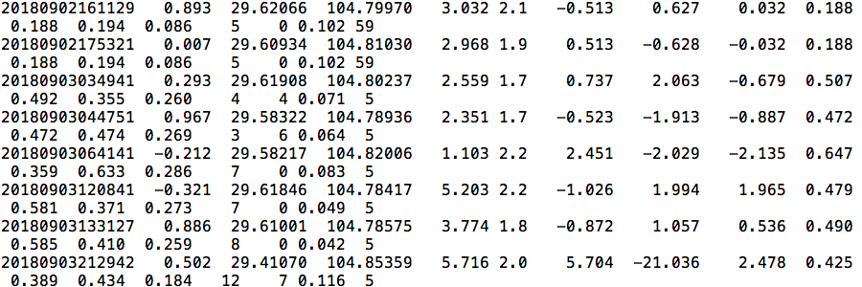
数据的属性要与科学问题密切相关
我是地震目录
An earthquake catalog:
Delineating fault and inferring seismotectonics: location uncertainties
An analysis of b value: complete magnitude and time span
Earthquake triggering and nucleation: spatial-temporal pattern

Slide 47
结果中的常见问题：次序揉杂
我们会习惯性的按照自己画图或者最初分析结果的顺序来写，但这个过程读者没有经历，所以未必能够跟从你的脑回路。
我是先画出来的图
The resultant 216 rupture scenarios are dependent on the location of nucleation within the grid due to the heterogeneous stress distribution. Even for two ruptures that started in neighbouring locations at the same depth with nearly identical initial stress level, the eventual slip distributions and earthquake magnitudes are distinctly different (Fig.2). For instance, the rupture nucleated relatively north (blue star in Fig.2a) …
Yang et al., 2019 EPSL
Notes:
先画出来的图非常抽象，而且没有展示背景，即使读懂结果，也不知道为什么。

Slide 48
结果中的常见问题：为图所困
传递的信息不直接/明显
Old version
New version
通常是先画图，再写文章。但有时候图不对题，或者图的细节不够明显，导致文不对题
右图是cross section：目的想说明选取最大振幅的到时，可能导致震相不一致
问卷调查中没有把图作为独立选项，因为图虽然很重要，但不是独立的一部分。

Slide 49
结果中的常见问题：避重就轻
只描述数据/模型(technical)，没有指向结论（新知识）的信息
Figure 1b shows the daily number of earthquakes and accumulated seismic moment from 2009 to 2019.
The daily number of earthquakes and accumulated seismic moments increase drastically since 2018 (Figure 1b).
传递的信息不直接/明显

Slide 50
结果中的常见问题：群龙无首
For the parameters described above, simulation results of a reference case without the effect of the barrier show that the rupture propagates spontaneously along the x axis after nucleation, asymptotically approaches V_{R} and remains in the sub Rayleigh regime (Figure 2a). However when the rupture tip advances into a strong barrier described above, the rupture speed begins to slow down continuously. As the rupture tip get close to the far side boundary of the barrier, the daughter rupture begins to emerge on the normal fault nearest to the far side boundary of the barrier but the rupture speed is still very low in the beginning (Figure 2a; Figure S1). Meanwhile the main rupture is still slowing down with more and more energy transmitting forward (Figure S1). After the nucleation of the daughter rupture complete, the daughter rupture accelerates from subshear speed into supershear speed sharply (Figure 2a; Figure S1).
草稿
发表版本
Leading sentence rule

Slide 51
结果中的常见问题：喧宾夺主
过度叙述前人工作。
Due to the serious deficiency of local earthquakes in global catalogs, we detect missing local earthquakes by cross-correlating seismic waveform data with waveform records of template events. That is also called the matched-filter detector or sliding-window cross-correlation (SCC) detection technique [Yang et al., 2009]. We conduct the SCC detection technique using three components of waveforms on single station to maximize detected earthquakes. Using three components of waveform data simultaneously can reduce false detections by combining all phase information from three channels and obtain same detection time on three components [Yang et al., 2009].
初始版本
发表版本

Slide 52
结果中的常见问题：信息缺失
忽略了部分关键中间步骤，别人无法理解，也无法重复
For the earthquakes with clear waveforms on at least 4 stations, we firstly locate earthquakes using Hypoinverse2000 [Klein, 2002]. P and S phases are manually picked using Seismic Analysis Code (SAC). We also use the arrival times of Guam station if clear P or S phase are observed. The velocity model we used is modified based on the crust1.0 velocity model and the 2D velocity model (Figure 8). A total of 1257 events are located using Hypoinverse2000.
初始版本
1. 部分工作未显示：我们根据当地主动源的结果建立了一个新速度模型。
2. 结果的可重复性：定位的关键参数？
3. 结果的可靠性：定位的结果误差如何？

Slide 53
结果中的常见问题：画蛇添足
与主题无关
不要过多的“解释”数据/信息。
数据是固定的，“解释”取决于你的视角、额外的数据或信息以及背景知识。
“结果”中包含的信息是指向新知识的关键

Slide 54
如何写“结果”？
结果的功能：展示数据分析过程、整理通过数据分析得到的信息或知识。
  数据分析：必要过程及参数—保证结果可以重复
  结果要稳定可靠：分辨率测试、误差分析…
  抓住数据的核心属性，传达与待解决的科学问题密切相关的信息。
  通过信息的有机整合，获取新的知识（结论）。
杜绝如下问题
次序揉杂
群龙无首
为图所困
避重就轻
喧宾夺主
信息缺失
画蛇添足
对照“引言”中的问题来组织结果，根据结果来修改“引言”和“图”

Slide 55
发表一篇文章必要的部分
发现新知识
合作者/导师/评审/编辑
引言 Introduction
结果 Results
讨论 Discussion
New
Knowledge
Data
Information
Specific knowledge
General
knowledge
根据已有知识，总结归纳出关键信息，指引数据处理、新方法的发展…

Slide 56
讨论的功能
Specific knowledge to General knowledge
  该研究成果的获得，使用了某种方法、处理了某些数据、在某地得到了验证。
  在获取该研究成果的过程中，应用了哪些关键假设及模型？这些假设或模型是否唯一？若不是，哪些关键因素会影响你的结果，为什么这项研究中不考虑？
  从获得的结果，到解决“引言”中提出的科学问题，中间是否需要其他假设/条件？
  把获得的科研成果应用到社会活动中，是否需要其他条件？
  ……

Slide 57
Specific to General
Initial stress distribution
Location and magnitude
这是数值模拟的结果，取决于初始条件。是不是“人为”的啊？
我俩初始条件相同，震级不同
即使我们知道应力状态，最终地震震级与震中位置密切相关。
Yang et al., 2019, EPSL
Notes:
Not only yourself needs to be high stress, but also depends on your neighborhood.

Slide 58
Specific to General
Initial stress distribution
Location and magnitude
这是数值模拟的结果，取决于初始条件。是不是“人为”的啊？
这个结果很好，但为什么会这样呢？
即使我们知道应力状态，最终地震震级与震中位置密切相关。
Yang et al., 2019, EPSL
Notes:
Not only yourself needs to be high stress, but also depends on your neighborhood.

Slide 59
Specific to General
Initial stress distribution
Location and magnitude
这是数值模拟的结果，取决于初始条件。是不是“人为”的啊？
这个结果很好，但为什么会这样呢？
这个结果很好，如何用到防震减灾上呢？
即使我们知道应力状态，最终地震震级与震中位置密切相关。
Yang et al., 2019, EPSL
Notes:
Not only yourself needs to be high stress, but also depends on your neighborhood.

Slide 60
有图为证
Rupture directivity plays critical roles in ground shaking and tsunami generation
Yang et al., 2019, EPSL

Slide 61
Specific to General
Initial stress distribution
Location and magnitude
这是数值模拟的结果，取决于初始条件。是不是“人为”的啊？
这个结果很好，但为什么会这样呢？
这个结果很好，如何用到防震减灾上呢？
这个结果还对哪些相关问题有启示意义呢？
即使我们知道应力状态，最终地震震级与震中位置密切相关。
Yang et al., 2019, EPSL
Notes:
Not only yourself needs to be high stress, but also depends on your neighborhood.

Slide 62
Specific to General
Initial stress distribution
Location and magnitude
这是数值模拟的结果，取决于初始条件。是不是“人为”的啊？
这个结果很好，但为什么会这样呢？
这个结果很好，如何用到防震减灾上呢？
这个结果还对哪些相关问题有启示意义呢？
为何前震没能变成主震？
2011.03.09 M 7.3
2011.03.11 M 9.0 日本
2014.03.16 M 6.7
2014.04.01 M 8.2 智利
即使我们知道应力状态，最终地震震级与震中位置密切相关。
Yang et al., 2019, EPSL
Notes:
Not only yourself needs to be high stress, but also depends on your neighborhood.

Slide 63
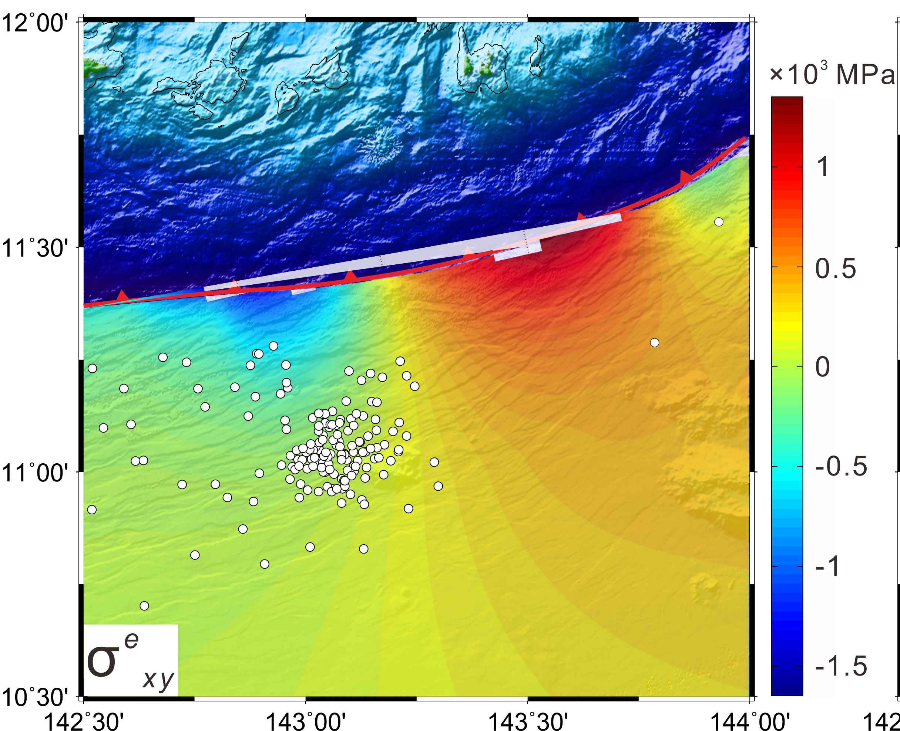
讨论的常见问题：不合时宜
应该出现在“讨论”里的内容，跑到“结果”部分。过多的“解释”数据/信息
We found that the stress distribution associated with the plate bending is heterogeneous which is correspondences with the uneven distribution of the outer rise earthquakes identified by Zhu et al. (2019) and the historic earthquakes from the USGS in this area (Figure 4a). In addition, it is found that the σexx increases gradually from the outer rise to the trench and reaches the maximum at the Challenger Deep, which is consistent with previous studies (Zhang et al., 2014, 2019). Both the σeyy and the σexy showed stress variations from extension to compression (or the opposite) at ~143°E, 11-11.5°N. Among the stress components, the σexx is the largest, reaching the maximum of ~5GPa. Therefore the variation of σe1 is mainly controlled by the variation of the σexx with the maximum exceeding 6GPa, which indicates that the preferential direction of the strike of bending-related normal faults is parallel to the trench.
Zhang et al., 2020

Slide 64
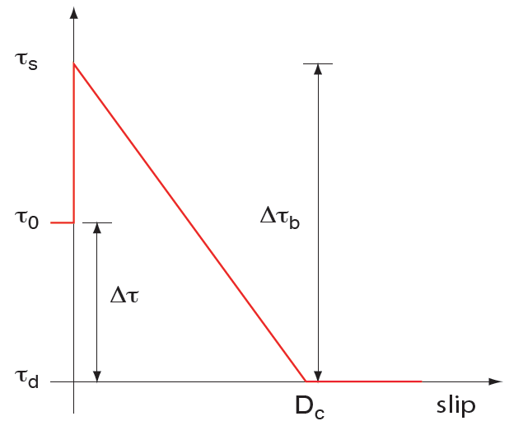
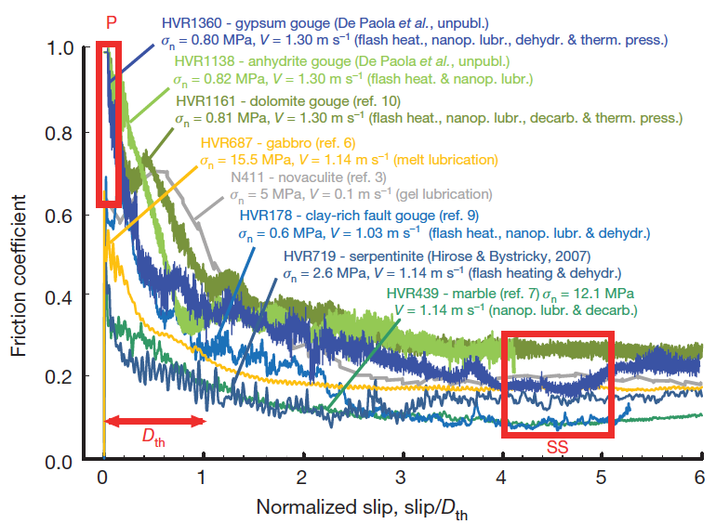
讨论的常见问题：不合时宜
与“结果”密切相关的假设。“讨论”还是“结果”？
Our results are based on the linear slip-weakening law (LSW). Beside the slip-dependent phenomena, friction has been observed to depend on slip velocity (Di Toro et al., 2011; Dieterich, 1979; Beeler et al., 2008). The friction coefficient exponentially decreases with the sliding velocities close to typical seismic slip rate (m/s). Such exponential decay of rate-weakening friction leads to an exponential slip-weakening curve, rather than being linear. It has been found that models using rate-weakening laws do not qualitatively differ with those using the LSW (Bizzarri et al., 2001; Luo & Duan, 2018). However, friction laws with exponential weakening curves result in faster energy release at the onset of slip, and therefore may produce slightly more energetic ruptures than those based on the LSW (Dunham, 2017; Luo & Duan, 2018; Ryan & Oglesby, 2014). If we adopt rate-weakening friction to reproduce the rupture process of the 2012 Nicoya Mw7.6 earthquake, a slightly higher yield stress may be inferred.
Yao and Yang, 2020

Slide 65
讨论的常见问题：漫无目的
回想自己写的引言
  瓶颈问题是否完美的到了解决？
  如果这项研究结果没有完全解决，是否有了进步？
  如何才能更进一步？
回看自己的结果
  是否达成了既定目标？
  研究结果对于引言中提出的科学问题是否需要其他条件才能进行论证？
  除了达成了既定目标，是否也解决了其他相关问题？
如果真的不知道写什么？
  与合作者/导师/小伙伴交流
  Less is more
再唠十块钱的

Slide 66
科技论文的组成部分
新知识哪里找？
标题 (Title)
摘要 (Abstract)
引言 (Introduction)
数据与方法 (Data and Methods)
结果 (Results)
讨论 (Discussion)
结论 (Conclusions)
相辅相成，缺一不可
相关问题的瓶颈在哪里？
结果是否可靠？
与自己工作相关的启示，可能的新方向？

Slide 67
给学生的建议
积极主动的与导师/合作者/同行交流：
  “信息”传递需要有来有回，不能是单向的
  与其听“工作汇报”，不如听“认识、疑惑、思想”
  通过“信息”的有效交流，凝练“知识”
自己设立截止日期与目标
  主人翁精神（ownership）
  老师要写、要做的事情很多，不会记得你一个项目的所有细节
常见的误区
  我的结果都有了，只是没有写出来…
不妨与外行（比如家人）也交流一下

Slide 68
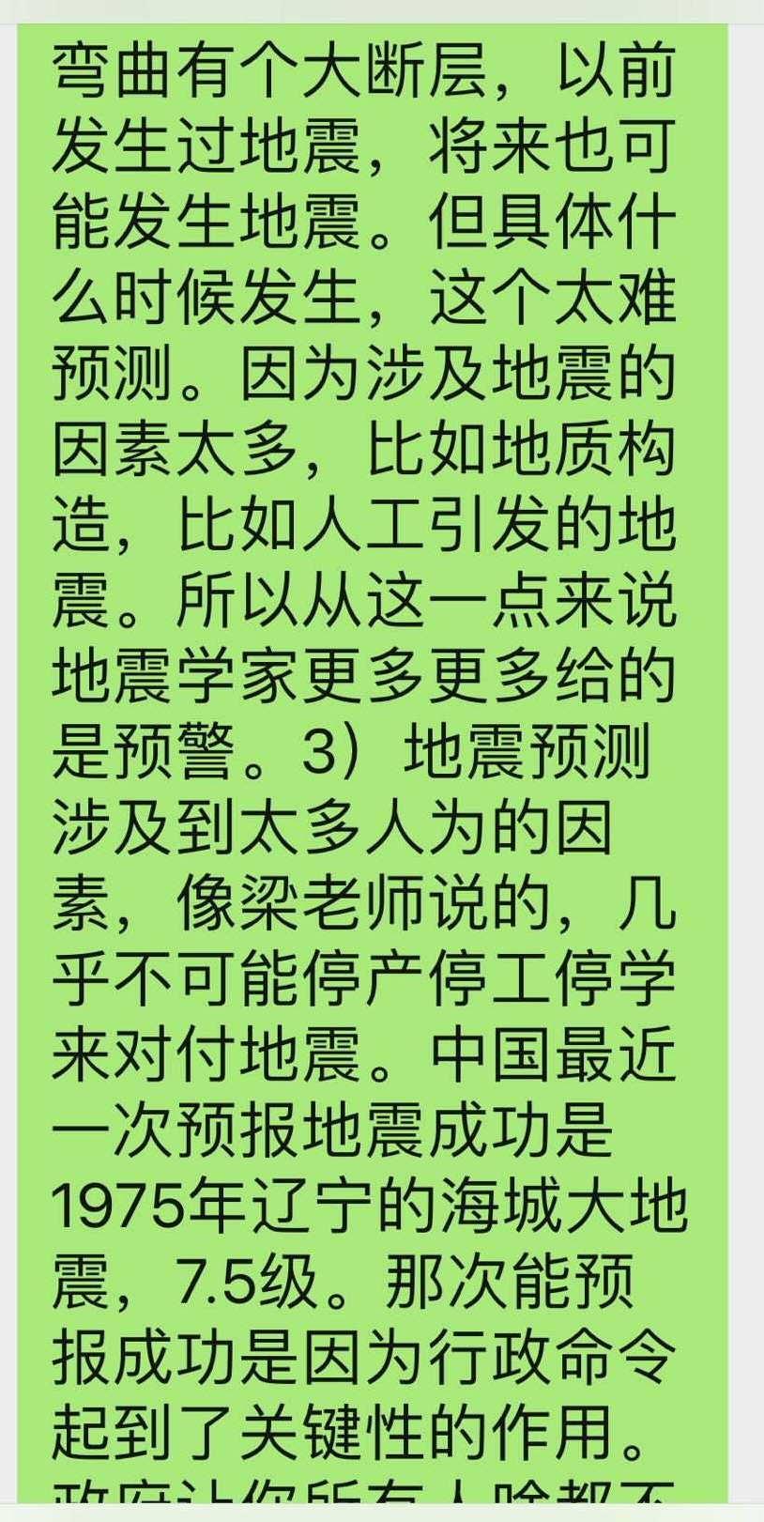
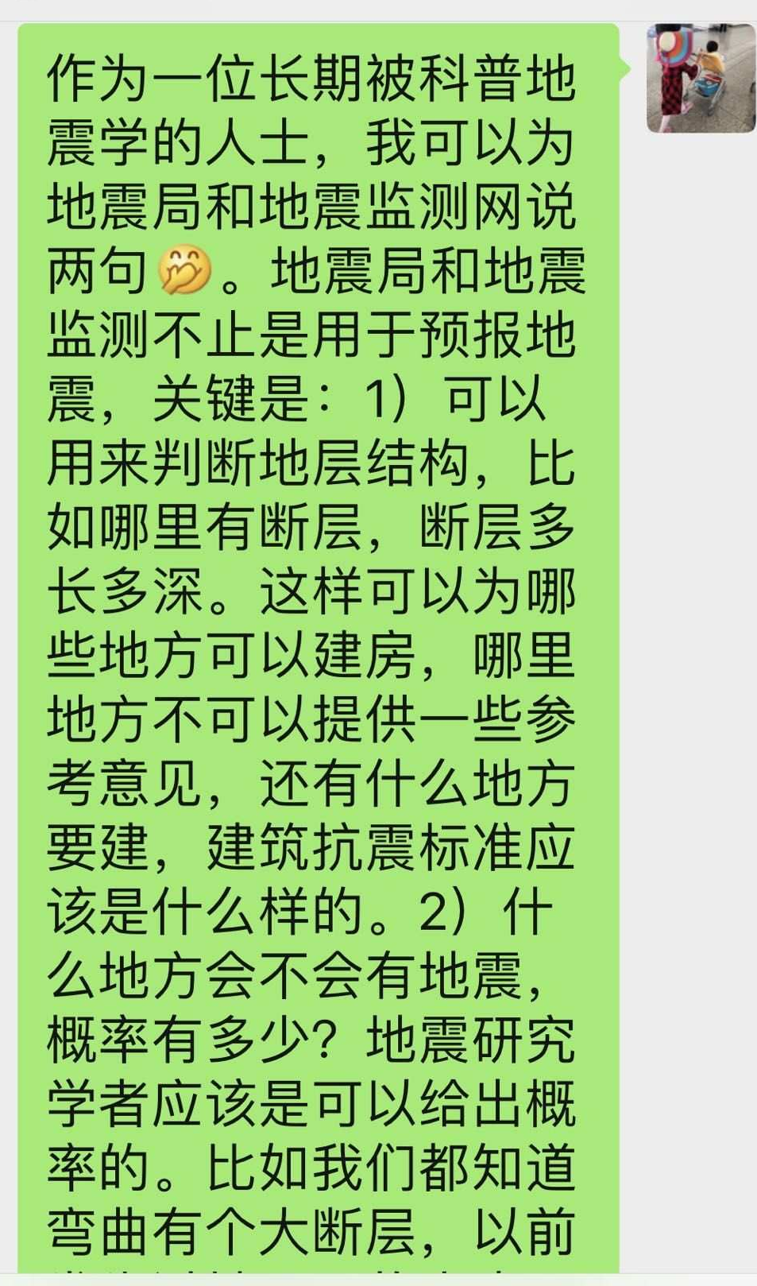
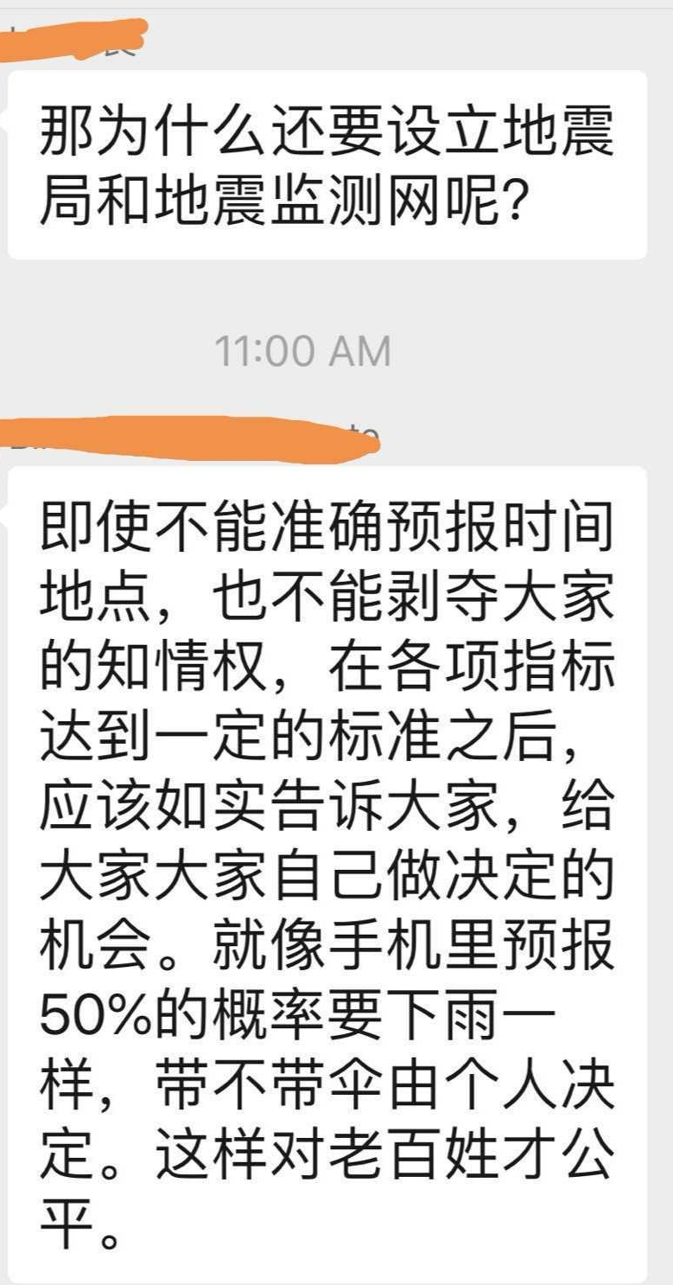
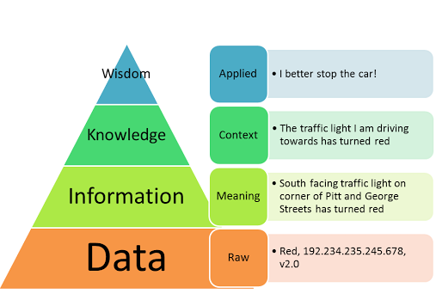
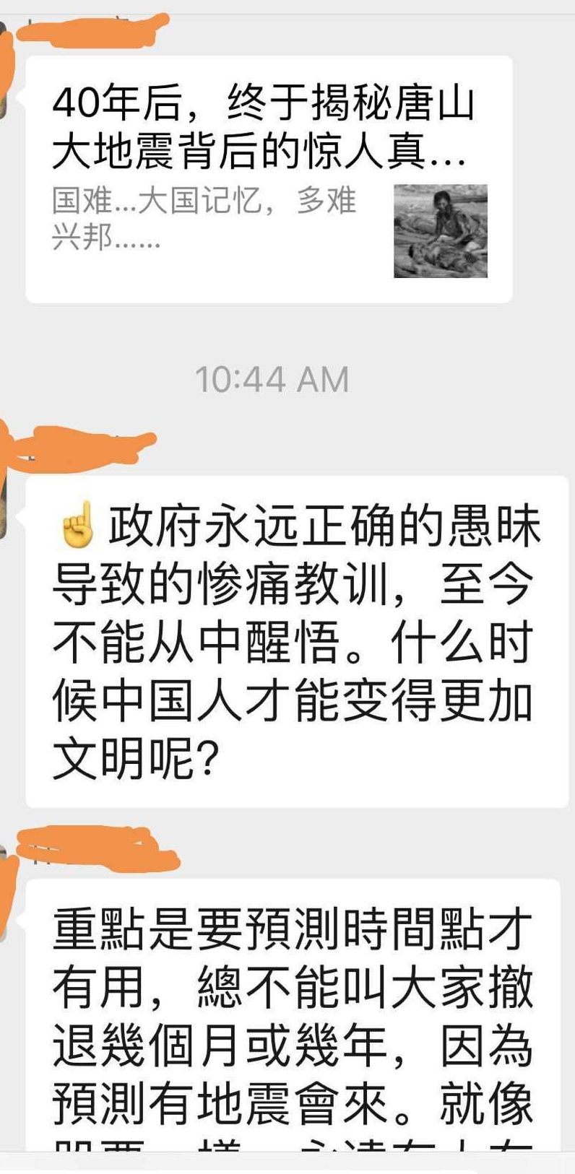
致谢：香港城市大学颜爱华教授
与“外行”交流的收获

Slide 69

为何叫KIDs？
DIKW
小孩子自然就会分析数据、整合信息、凝练知识，并勇于尝试，常常“语出惊人”！
爸爸，我不想“传染”你的工作
How to write it succinctly needs practice and training. But keeping KID in mind is important to conduct research and scientific communications.
祝大家：不忘初心，快乐科研

