Slide 1
How to read, write a scientific paper
-- Quick tips from Xiaodong Song

Slide 2
Structure of a paper (when you read)
Abstract: it’s a summary: what the paper is about, why they are interested in the problem （what’s the importance), how they did it, what they found, and what’s the relevance to the field.
Introduction: provides motivation (importance) and background: what is the problem and prior understanding
Methods and data: provides details of methodology. Should be detailed enough that they can reproduce and your may be able to reproduce too!
Results: describe what they found and the bases of the findings. Figures and tables make data/analysis compact and the paper easy to understand.
Discussion: their interpretation of the data: what do the findings mean, what are larger implications.
Conclusion: draw major conclusions of the paper.
Acknowledgment: acknowledge sources that contribute to the paper.
References: list sources of info for readers to trace, judge, and give credit to others.

Slide 3
Some tips: How to read scientific papers
Don’t read straight through
Highlight important ideas, concepts, conclusions, ..
Make notes
Check dictionary every now and then if you have to.
Talk to others about the paper
Order: authors and affiliations, abstract, conclusion, introduction, figures, methods/data/results/more figures, evaluation strengths of evidence, identify problems.
Try: title, intro, figures, and make inferences yourself, and compare with their conclusions …

Slide 4
How to write a scientific paper
Learn how others write (and from learning how to read)
Don’t write from beginning to end. Write abstract last.
It’s mostly about ideas. You should feel you have something to write.
Write down whatever comes to mind: ideas, precious spark of ideas, topics, references… Organize later.
Be logical, precise, careful, thorough, rigorous, …; back up your claims with evidence; state your assumptions,

Slide 6
How to write Nature / Science papers?
How to write Nature/Science/PNAS/Nature Geoscience papers?
How to write scientific papers?
Xiaodong Song （宋晓东）
University of Illinois at Urbana-Champaign
Wuhan University
Peking University
Jilin University, May 31, 2019

Slide 7
Structure of a paper (“IMRaD”)
Abstract: it’s a summary: what the paper is about, why you are interested in the problem, how you did it, what you found, and what’s the relevance to the field.
Introduction: provides motivation and background: what is the problem and prior understanding
Methods and data: provides details of methodology. Should be detailed enough that they can reproduce and your may be able to reproduce too!
Results: describe what you found and the bases of the findings. Figures and tables make data/analysis compact and the paper easy to understand.
and Discussion: interpretation of the data: what do the findings mean, what are larger implications.
Conclusion: draw major conclusions of the paper.
Acknowledgment: acknowledge sources that contribute to the paper.
References: list sources of info for readers to trace, judge, and give credit to others.

Slide 8
How to write scientific papers: miscellaneous tips
Step 1. Build a “story” line
your main audience is your peers and science community.
“IMRaD”:
What’s the motivation (why was it done)?
What’s the problem (question)?
What’s the hypothesis?
How was it done?
What was achieved?
Why is it important?
Write and revise highlights. This is your storyline.
List figures. Build story with figures.
看图说话。A picture is worth a thousand words.
论点 / 论据。Claims / Support. Don’t over-interpret.
Literature search is critical.
Tentative title.

Slide 9
Step 2. Draft
Don’t write from beginning to end. Write abstract last. Writing is an interactive process.
It’s really about ideas. You should feel you have something (or compel) to write.
Write down whatever comes to mind: ideas, precious spark of ideas, topics, references, conclusions…
Keep writing: write easy parts first, descriptive parts (Data, Method, Results, Captions). Figure caps. One piece at a time.
Write in paragraphs: one main idea each.
Not everything worth writing. Don’t tell what you did – People don’t really care. Tell them what is important.

Slide 10
Step 3. Organize
Be logical, precise, careful, thorough, rigorous, … and yes, succinct.
Back up your claims with evidence
State your assumptions
Add figures
Use tables
Add supplementary materials
Write abstract
Title
Step 4. Clean up
Add references
Polish before sending out: Don’t try your luck and hope to rely on reviewers.
Anticipate questions and address them
Ask others to review

Slide 11
Step 5. Other thoughts
Learn from others (classical papers, reviews, important papers, and learn how to read).
Make nice figures. Self explanatory. Contrast.
Don’t mix results with interpretations.
Explain – Why people should care. Simplify. Different wording.
Talk to yourself / others, like conversation.
Some does good research, but cannot write. Don’t be a mere worker. Be a researcher. Practice.
Research results come first regardless.

Slide 12
Science: Information for authors
significant original scientific research.
influential in their fields or across fields and that will substantially advance scientific understanding.
present novel and broadly important data, syntheses, or concepts.
Reports
present important new research results of broad significance.
Research Articles
present a major advance.

Slide 13
Science Manuscript Template Instructions
Abstract: The abstract should be 100-125 words, and organized in this structure: An opening sentence that sets the question that you address and is comprehensible to the general reader, background content specific to this study, results, and a concluding sentence. It should be a single paragraph.
One Sentence Summary: A brief teaser statement highlighting main result of the paper, understandable by a scientist not in your field, without jargon or abbreviations.
Main Text: In general, this should include a brief (1-2 paragraph) introduction, followed by a statement of the specific scope of the study, followed by results and then interpretations. Please avoid statements of future work or claims of priority, and avoid repeating the conclusions at the end.

Slide 14
Abstracts of Research Articles and Reports
explain to the general reader
why the research was done,
what was found and
why the results are important.
start with some brief BACKGROUND information: a sentence giving a broad introduction to the field comprehensible to the general reader, and then a sentence of more detailed background specific to your study.
followed by an explanation of the OBJECTIVES/METHODS and then the RESULTS. The final sentence should outline the main CONCLUSIONS of the study, in terms that will be comprehensible to all our readers.
The Abstract is distinct from the main body of the text, and thus should not be the only source of background information critical to understanding the manuscript.

Slide 15
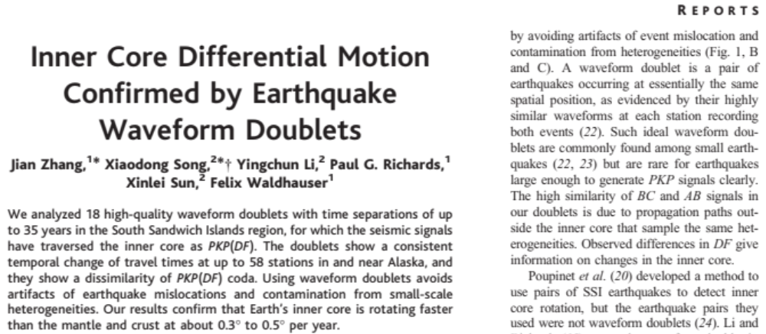
Science, 2015

Slide 16
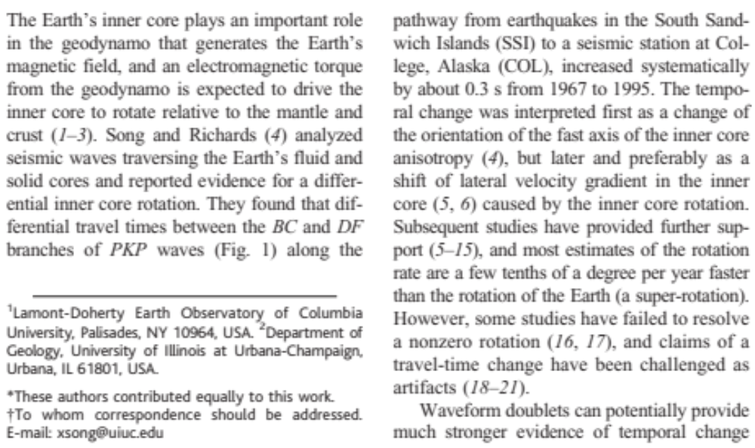

Slide 17
Nature
The criteria for Nature papers (Articles and Letters):
report original scientific research
are of outstanding scientific importance
reach a conclusion of interest to an interdisciplinary readership.

Slide 18
Letters
Short reports of original research focused on an outstanding finding whose importance means that it will be of interest to scientists in other fields.
The beginning paragraph aims at readers in other
disciplines. This paragraph starts with a 2-3 sentence basic introduction to the field; followed by a one-sentence statement of the main conclusions starting 'Here we show' or equivalent phrase; and finally, 2-3 sentences putting the main findings into general context so it is clear how the results described in the paper have moved the field forwards.

Slide 19
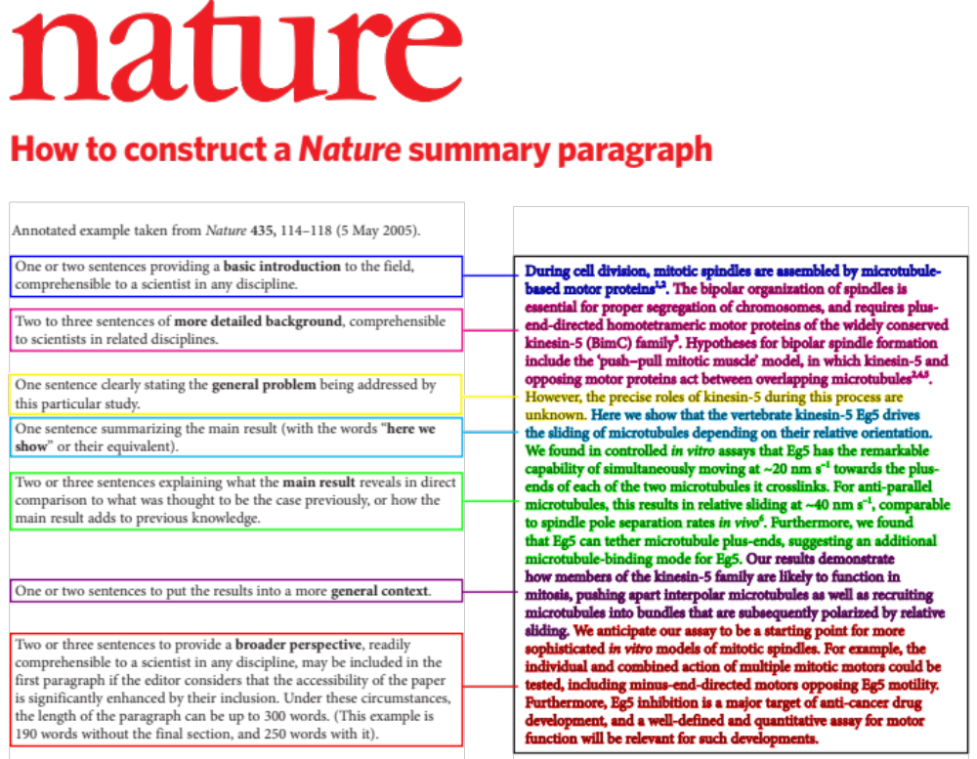

Slide 20
Articles
Original reports whose conclusions represent a substantial advance in understanding of an important problem and
have immediate, far-reaching implications.
Separate summary: aimed at readers outside the discipline.
a paragraph (2-3 sentences) of basic-level introduction to the field; a brief account of the background and rationale of the work; a statement of the main conclusions (introduced by the phrase 'Here we show' or its equivalent); and finally, 2-3 sentences putting the main findings into general context so it is clear how the results described in the paper have moved the field forwards.

Slide 21
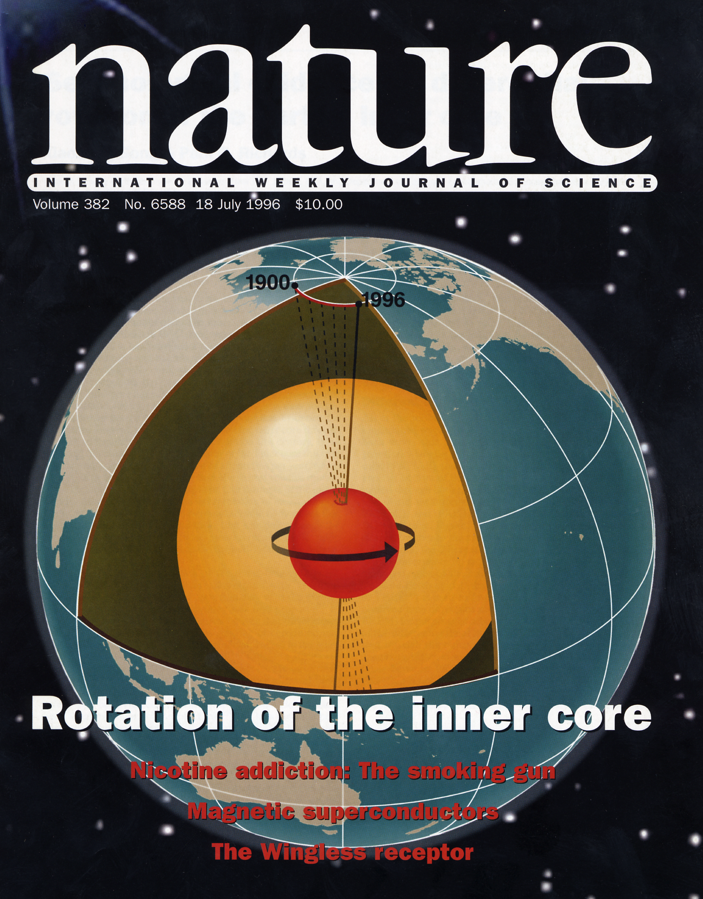
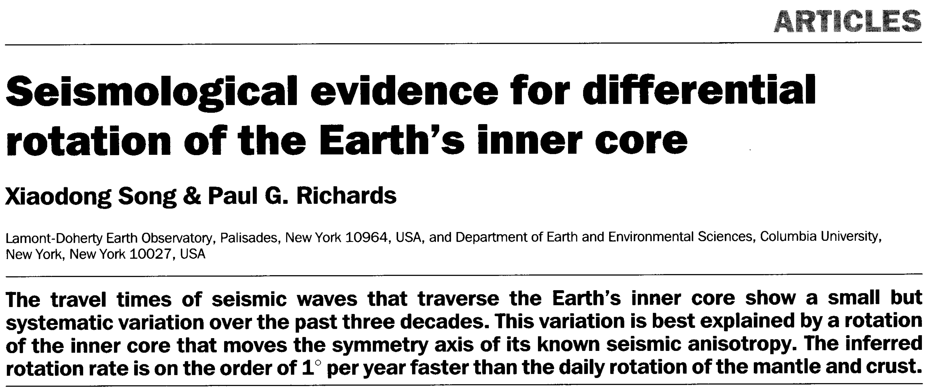

Slide 22
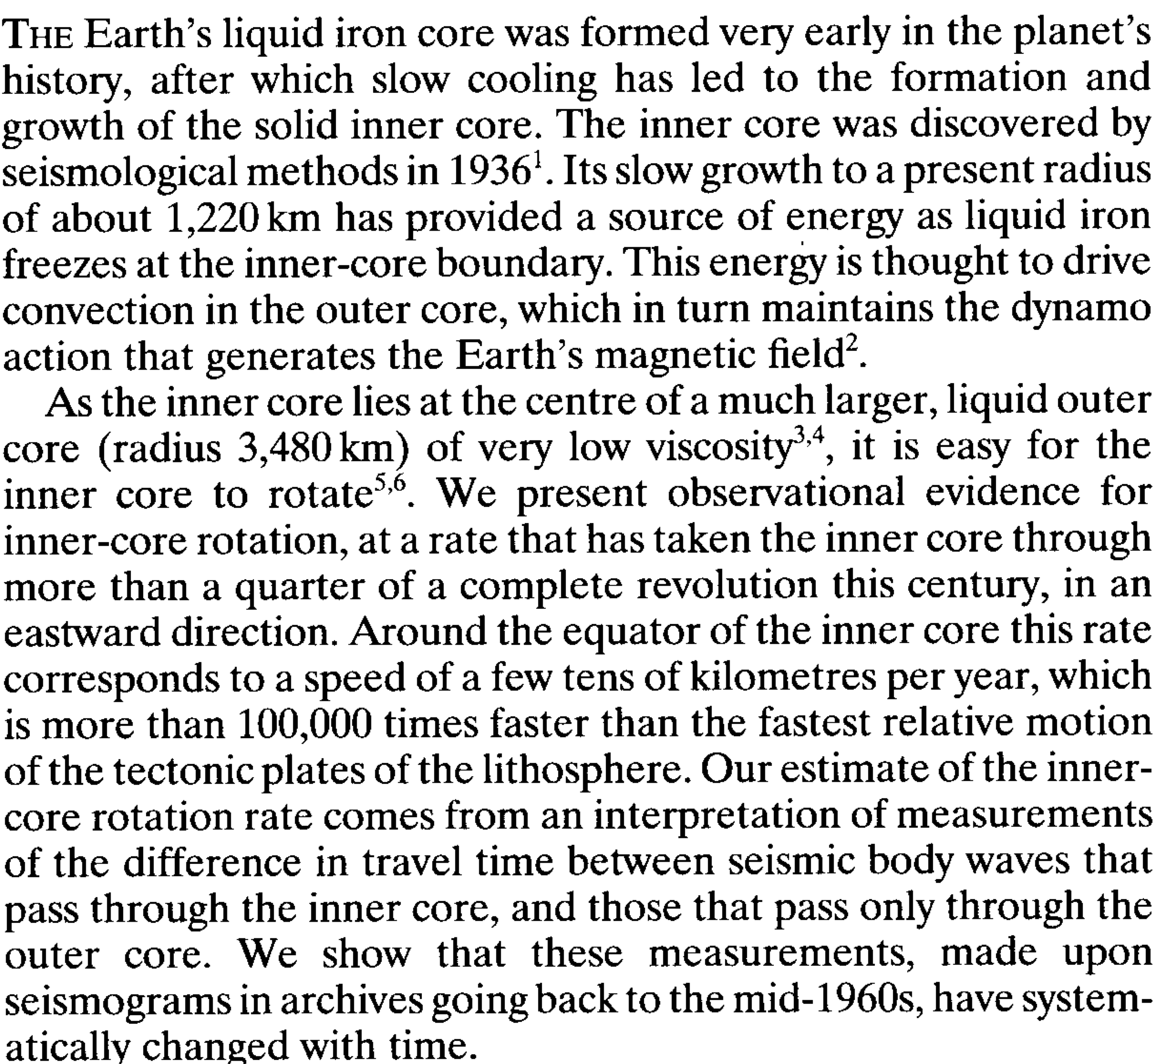

Slide 23
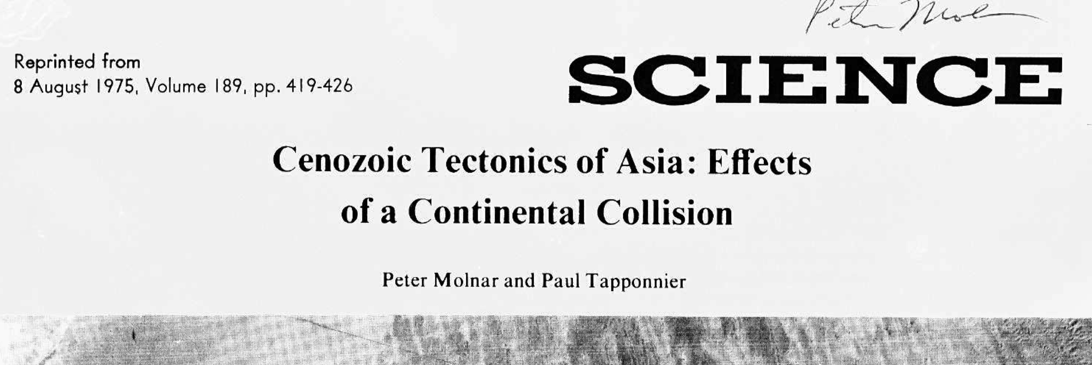
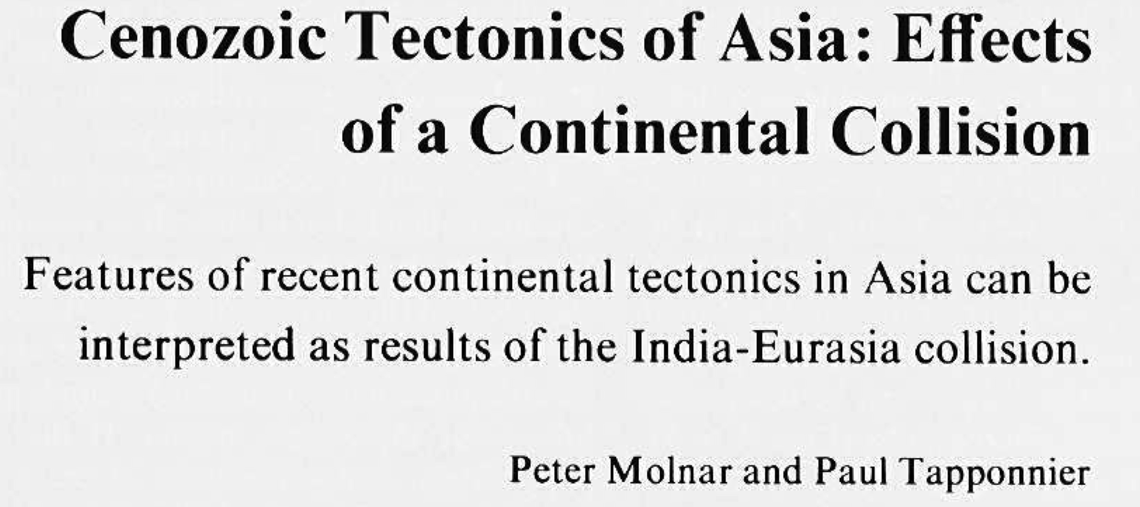

Slide 24
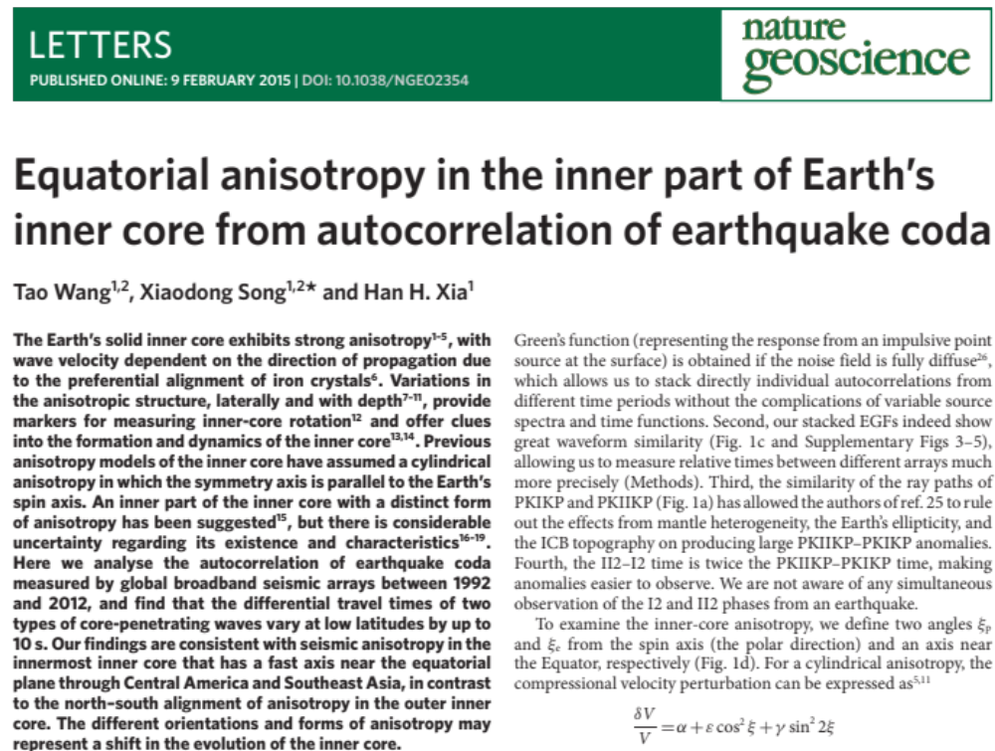

Slide 25
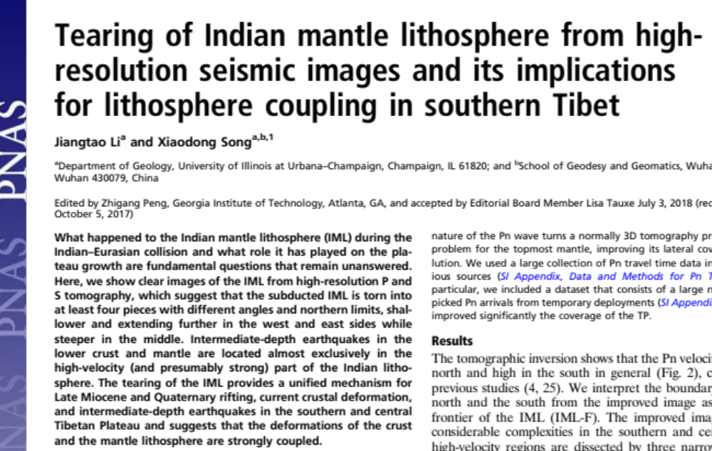

Slide 26
尹安自称文章像“懒婆娘的裹脚，又长又臭”（毛泽东《反对党八股》）.
Hiroo Kanamori said he didn’t like to write (Nature/Science) papers. They are too short to explain and expand.
Do the opposite
for Nature / Science.
Simplify.
Extraordinary claims require extraordinary evidence.

Slide 27
Common writing mistakes
not logical
one idea per paragraph
Ambiguous
Not precise
Not thoughtful
Out of blue – no references
Too wordy

Slide 28
2 Data
We revisited the SSI doublets with significant time-varying CD arrivals reported by previous studies (Wen, 2006; Cao et al., 2007; Song and Dai, 2008) and augmented the database with more doublets of similar or even better quality in the SSI region. The detailed information of all doublets used in this study is documented in Table S1. We focused on the temporal changes of the ICB under Southern Africa and Central America, which are sampled by the SSI doublets recorded by some seismic stations (e.g., ARU and AAK) around Central Asia and the Yellowknife array (YKA) in Canada, respectively. The array data from YKA are linearly stacked to enhance the signal-to-noise ratio (SNR) using the same master station for each pair of SSI doublets.

Slide 29
We used two data sets of waveform doublets to examine the temporal changes of DF and CD arrivals at the distance range between 128° and 142°. One is a global data set of high-quality waveform doublets with magnitude at least 5.0 (Table S1). It is a subset of our recent systematic global search (Yang & Song, 2020), with clear target phases and time lapse of at least 6 years between the two events of the doublet imposed to ensure temporal changes could be observed if any (Song & Dai, 2008). The non-IC (including mantle and outer-core) phases (Fig. 1) of the doublets recorded by all available seismic stations should be nearly identical, with average cross-correlation coefficient (CC) at least 0.95 over a 15-s window. The total number of doublets is 39 using data from 1992 to 2017. The number of non-IC phases ranges from 8 to 197 with the median of 43. The doublet quality under such criteria is extremely high. For example, the 1993 and 2003 SSI doublet (ID 1993335_2003249 in Table S2 or simply referred as 9303 hereafter), which is among the best of previous studies (Zhang et al., 2005; Wen, 2006; Cao et al., 2007), has an average CC of only 0.919 with 9 non-IC phases.
Another data set is waveform doublets of slightly inferior quality in the SSI region (a total of 25 pairs, Table S2). We slightly lowered down the cut-off CC to 0.90 and cut-off magnitude to 4.7 to include some old pairs reported by previous studies and also many new pairs of similar quality. Like above, all pairs have time lapses of at least 6 years, except for a few old pairs from Song and Dai (2008) with lapses close to 6 years.
We used broadband high-gain vertical-component (BHZ) channels only, except some short-period (SHZ) data from the Yellowknife array (YKA) in Canada from the SSI doublets, sampling the anomalous ICB beneath Central America. The array data from YKA were linearly stacked to enhance the signal-to-noise ratio (SNR). The procedure to stack the YKA data is the same for either event of the doublet to ensure consistency between the two events. In addition, the waveform data were preprocessed in a series of procedures as in Xin et al. (2015): (1) removing the mean and trend, (2) integrating from velocity to displacement records, (3) convolving with the WWSSN Short-Period (WWSP) response, and (4) bandpass filtering from 0.6 to 3.0 hz.

Slide 31
How to conduct scientific research
Planning:
Choose a topic.
Identify a problem.
Perform literature search.
Revise research question.
Design experiments
Perform experiments
Analyze data
Write and publish results

