Slide 1
Sharing for CGU and Deep 2024
Elwin Chorse
2024.10

Slide 2
Contents
Talks by Topic
  for Seismic Imaging
  Geodesy(?)
  Tectonics and Geodynamics
Muses
  “The PICTURE”
  Trivial, Episodes
Slices of Travel

Slide 3
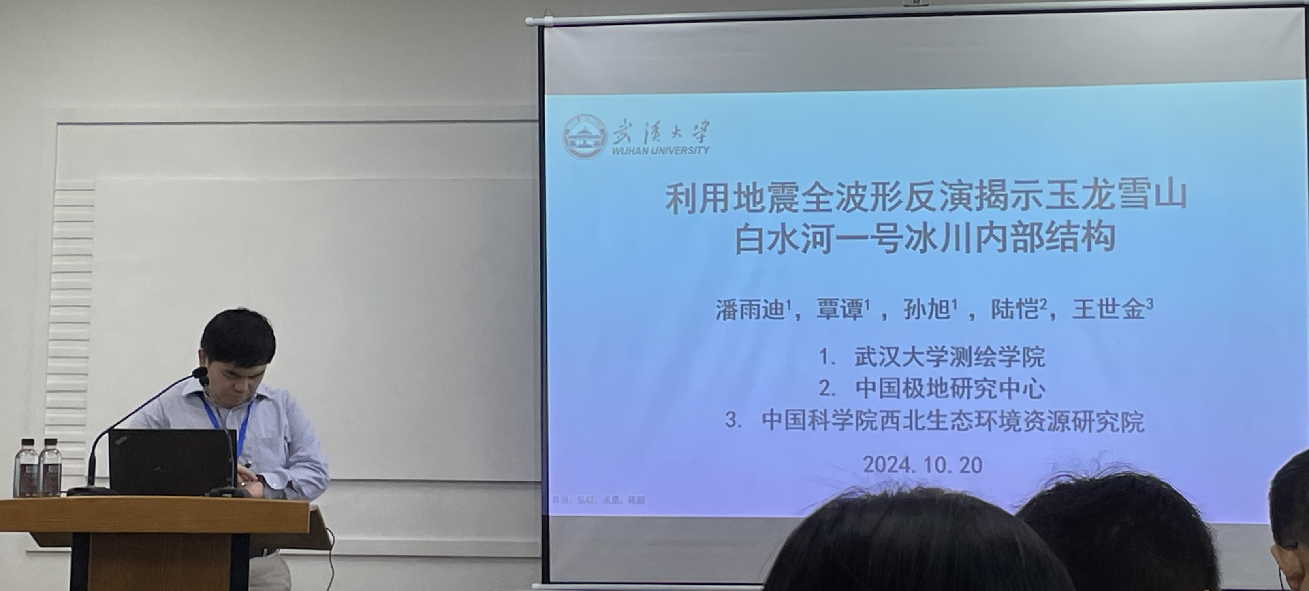
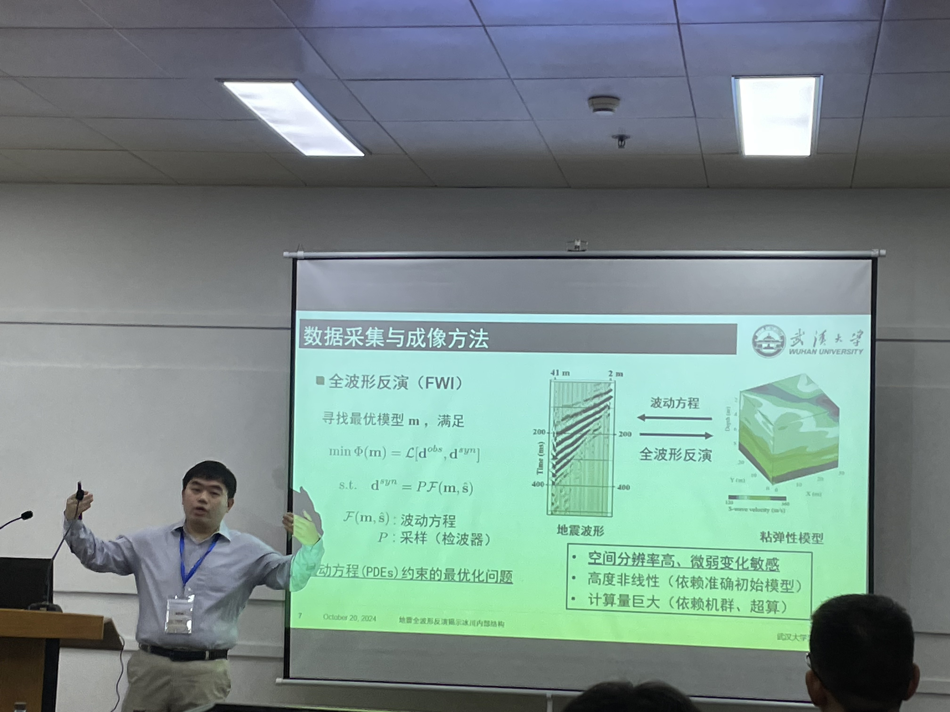
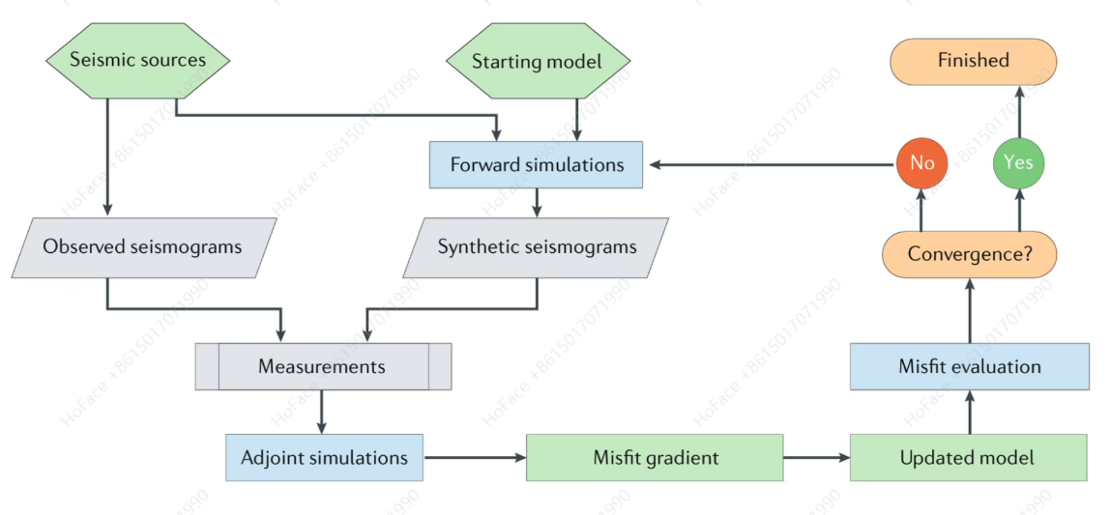
Talks by Topic
Full Waveform Inversion
Starting model -> Forward PDEs -> Adjust -> Update -> Simulations -> ...

Slide 4
Talks by Topic
with Receiver Functions
= revert(?) structure from waveform signal
joint inversion was introduced(->LS
as sensitivity:
P arri-deep and dense
Surf-shallow
Recei-interfaces

Slide 5
Talks by Topic
about Sensitivity Kernel
perturbation
validity in great depth?

Slide 6
Talks by Topic
about Sensitivity Kernel
perturbation

Slide 7
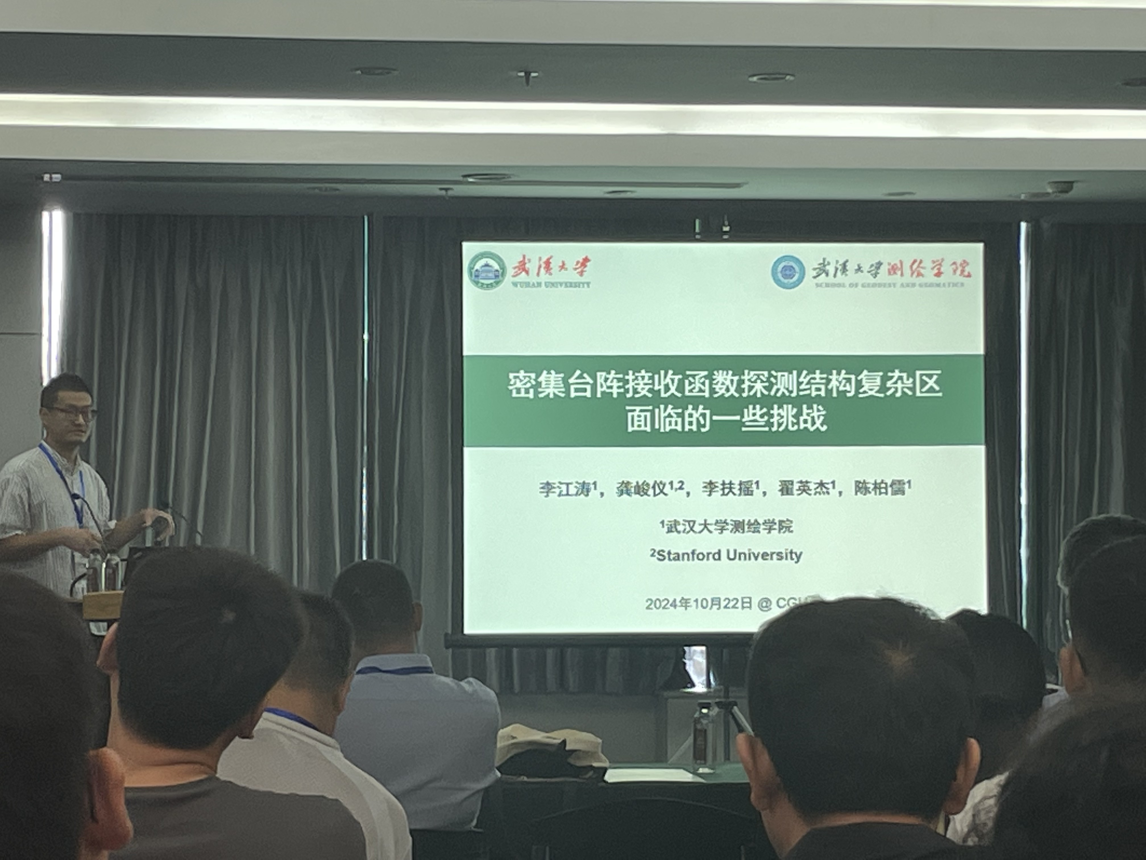
Talks by Topic
Dense Array
...

Slide 8
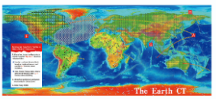
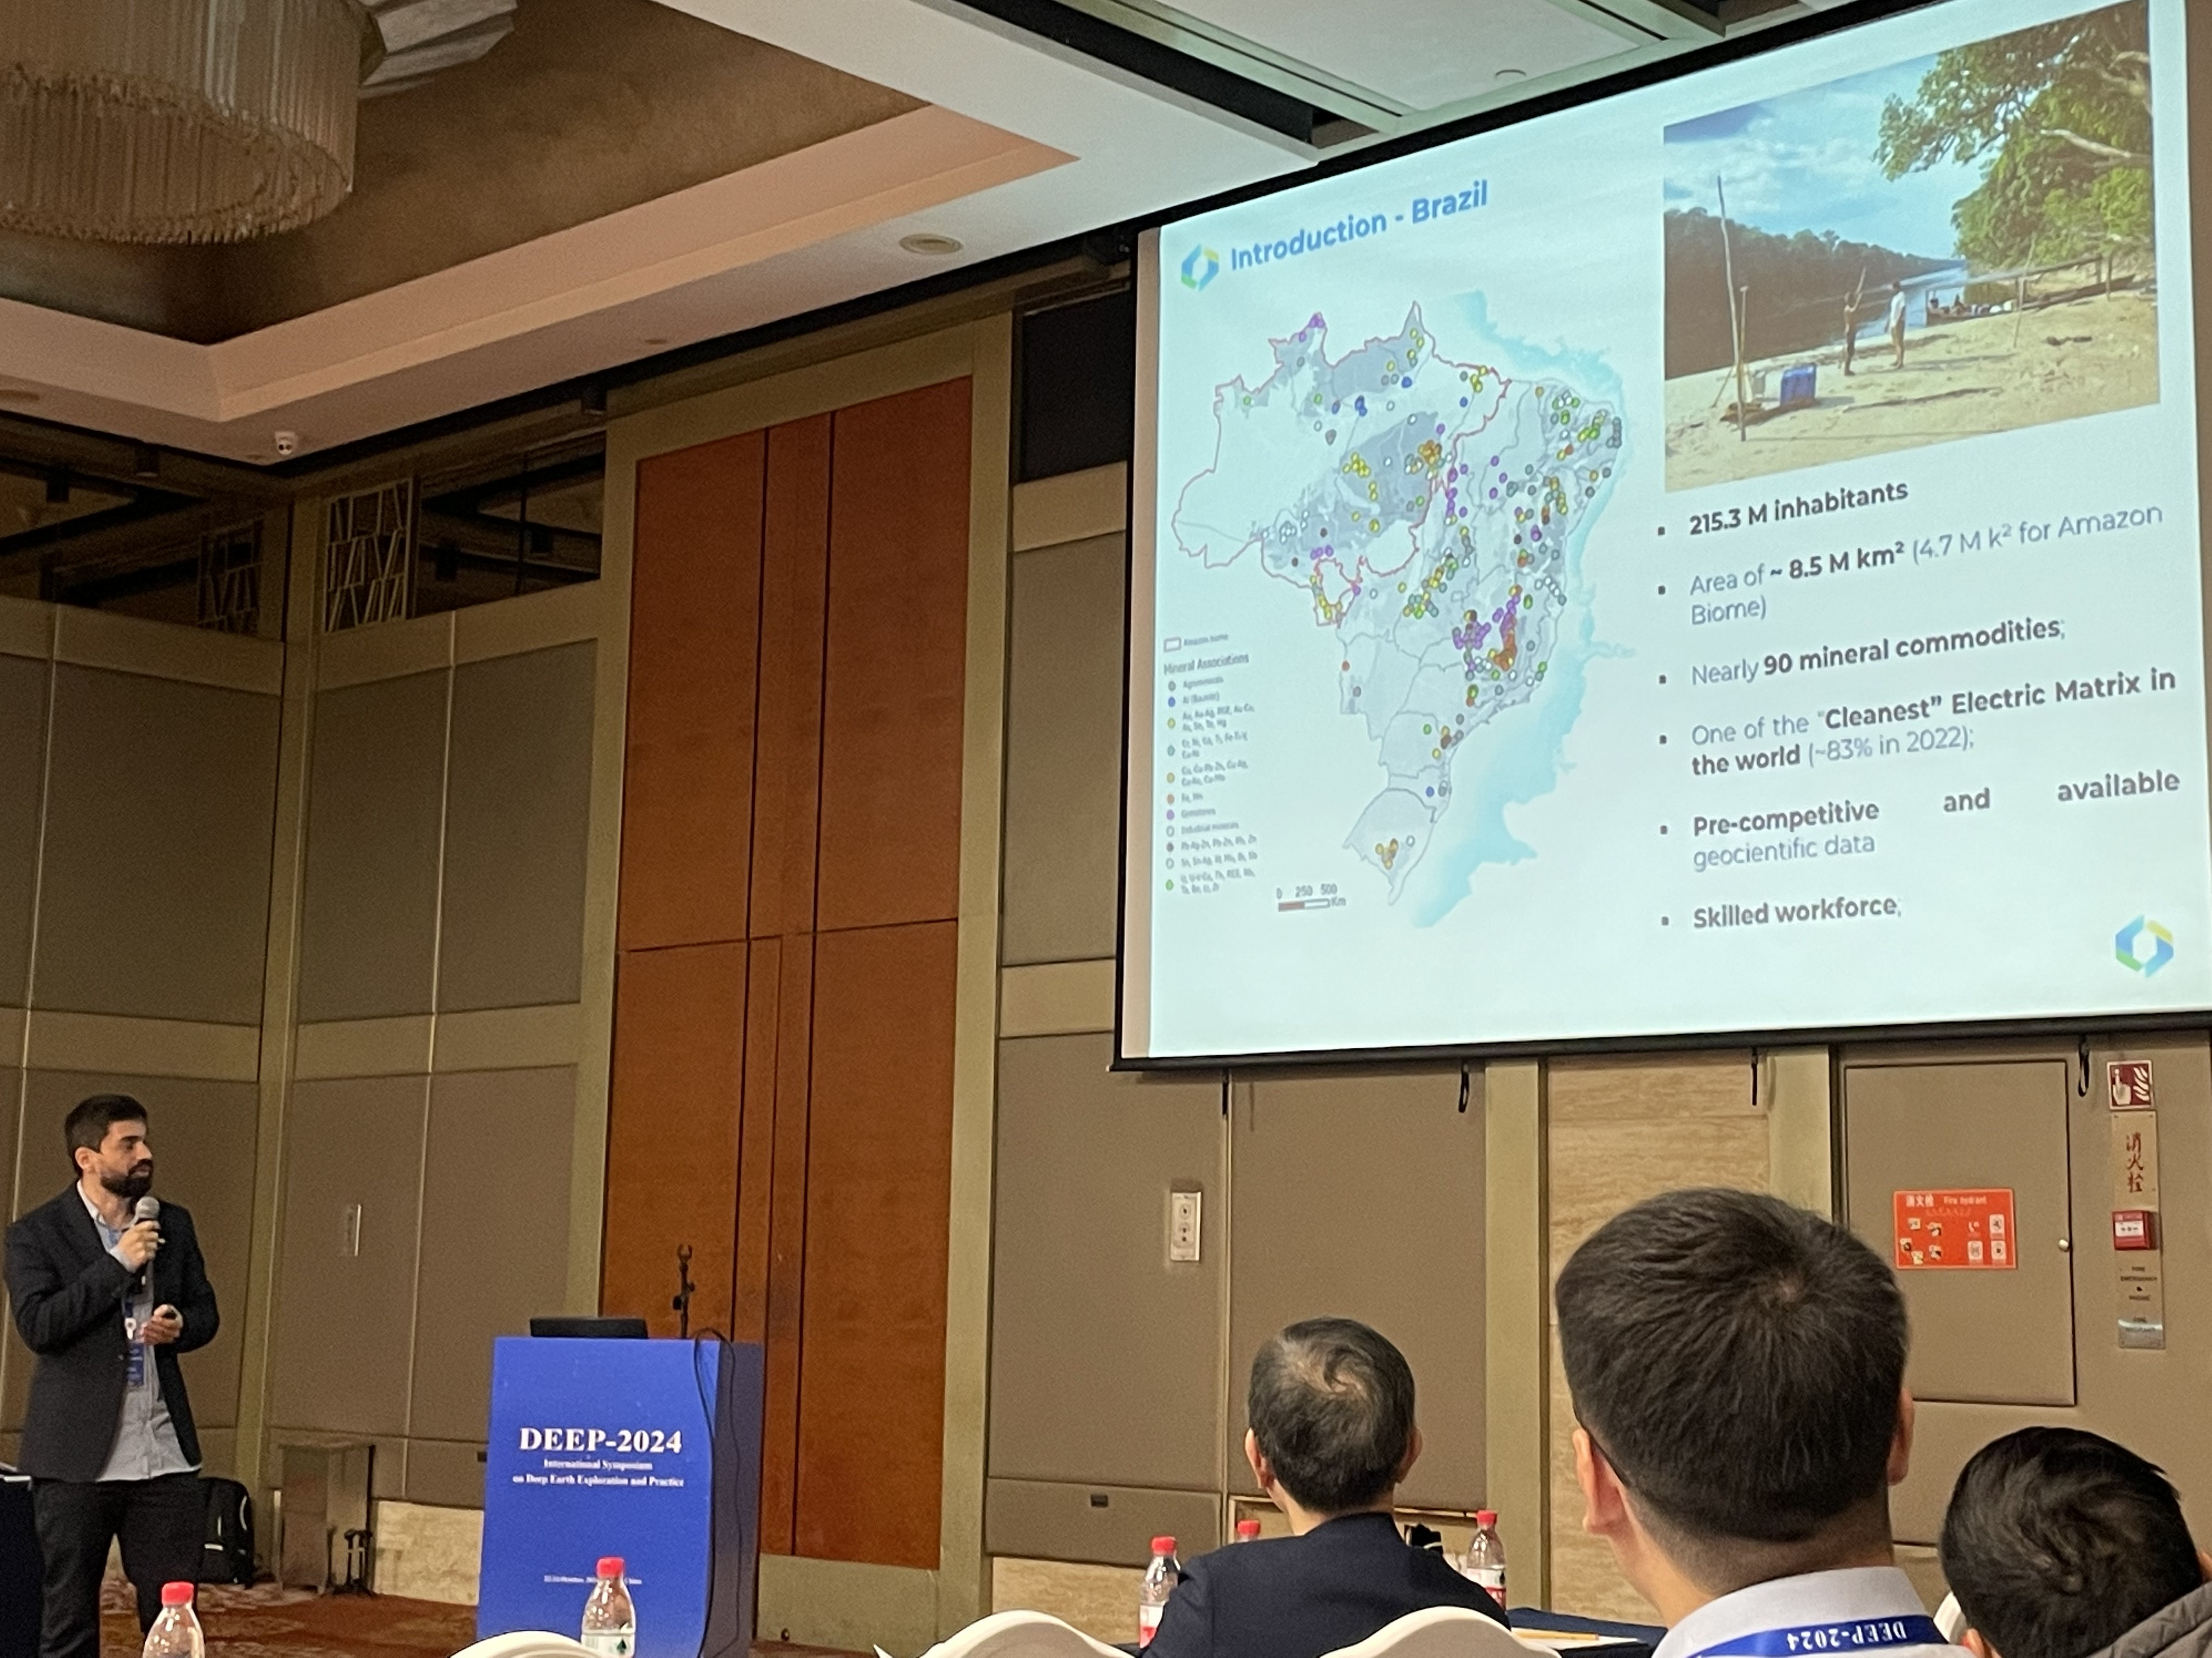
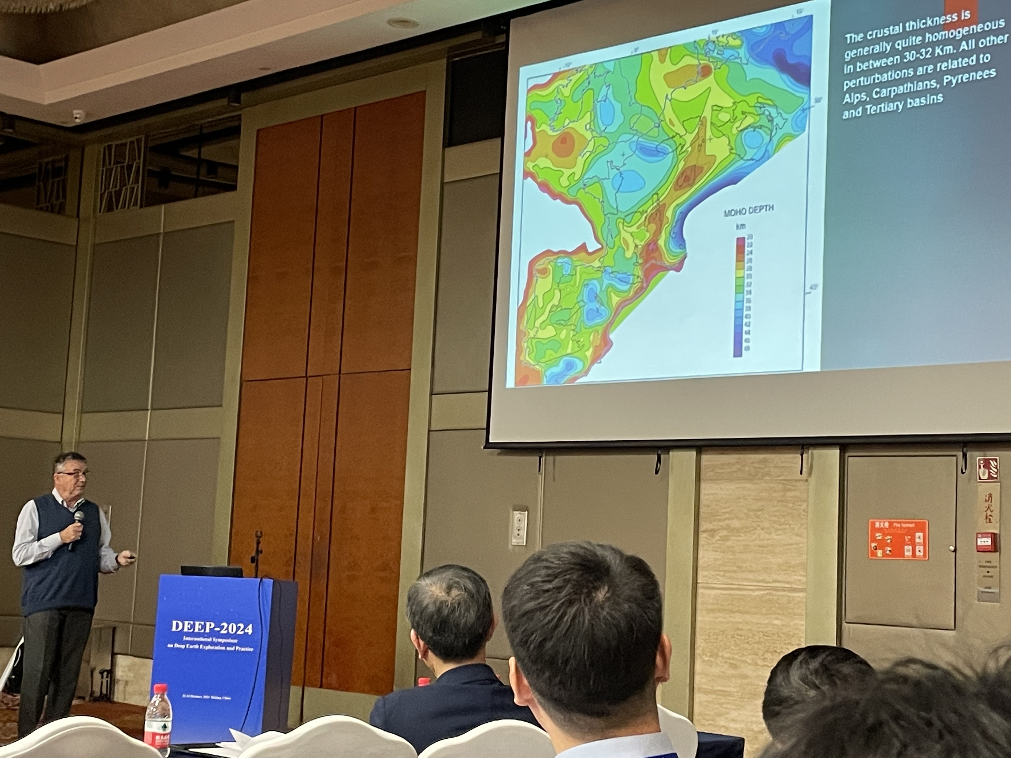
Talks by Topic
International Collaborations
Brazil
India
Iran
Indonesia
...

Slide 9
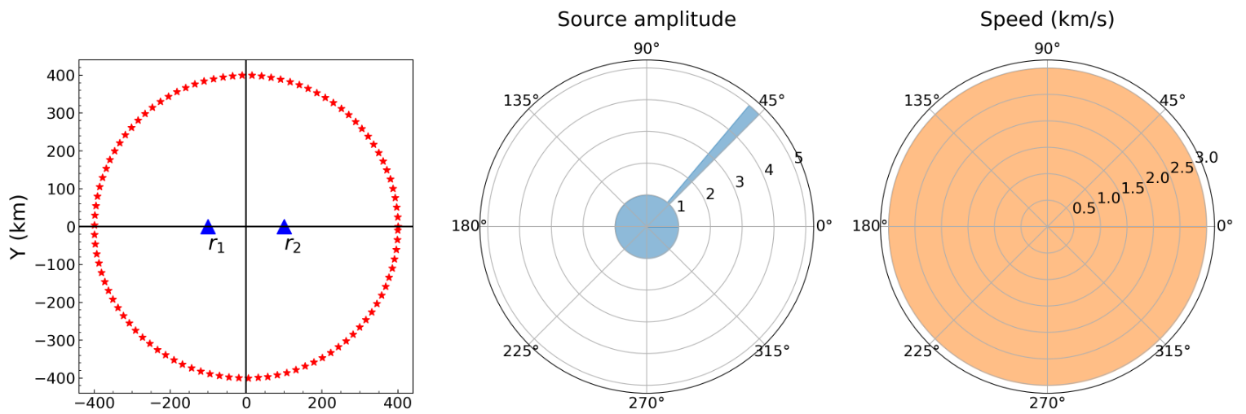
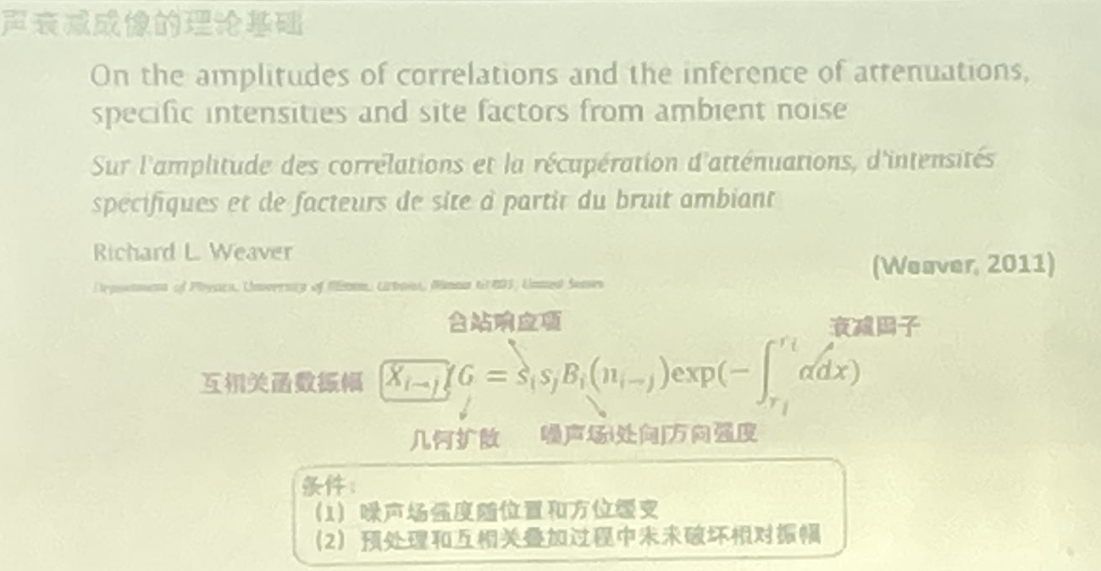
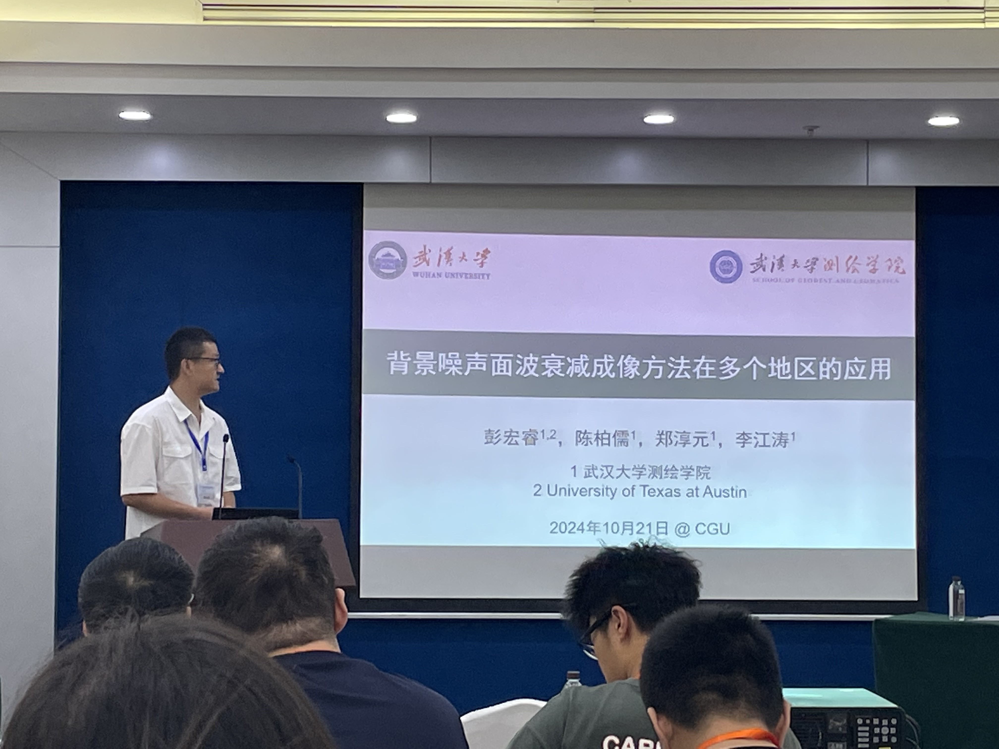
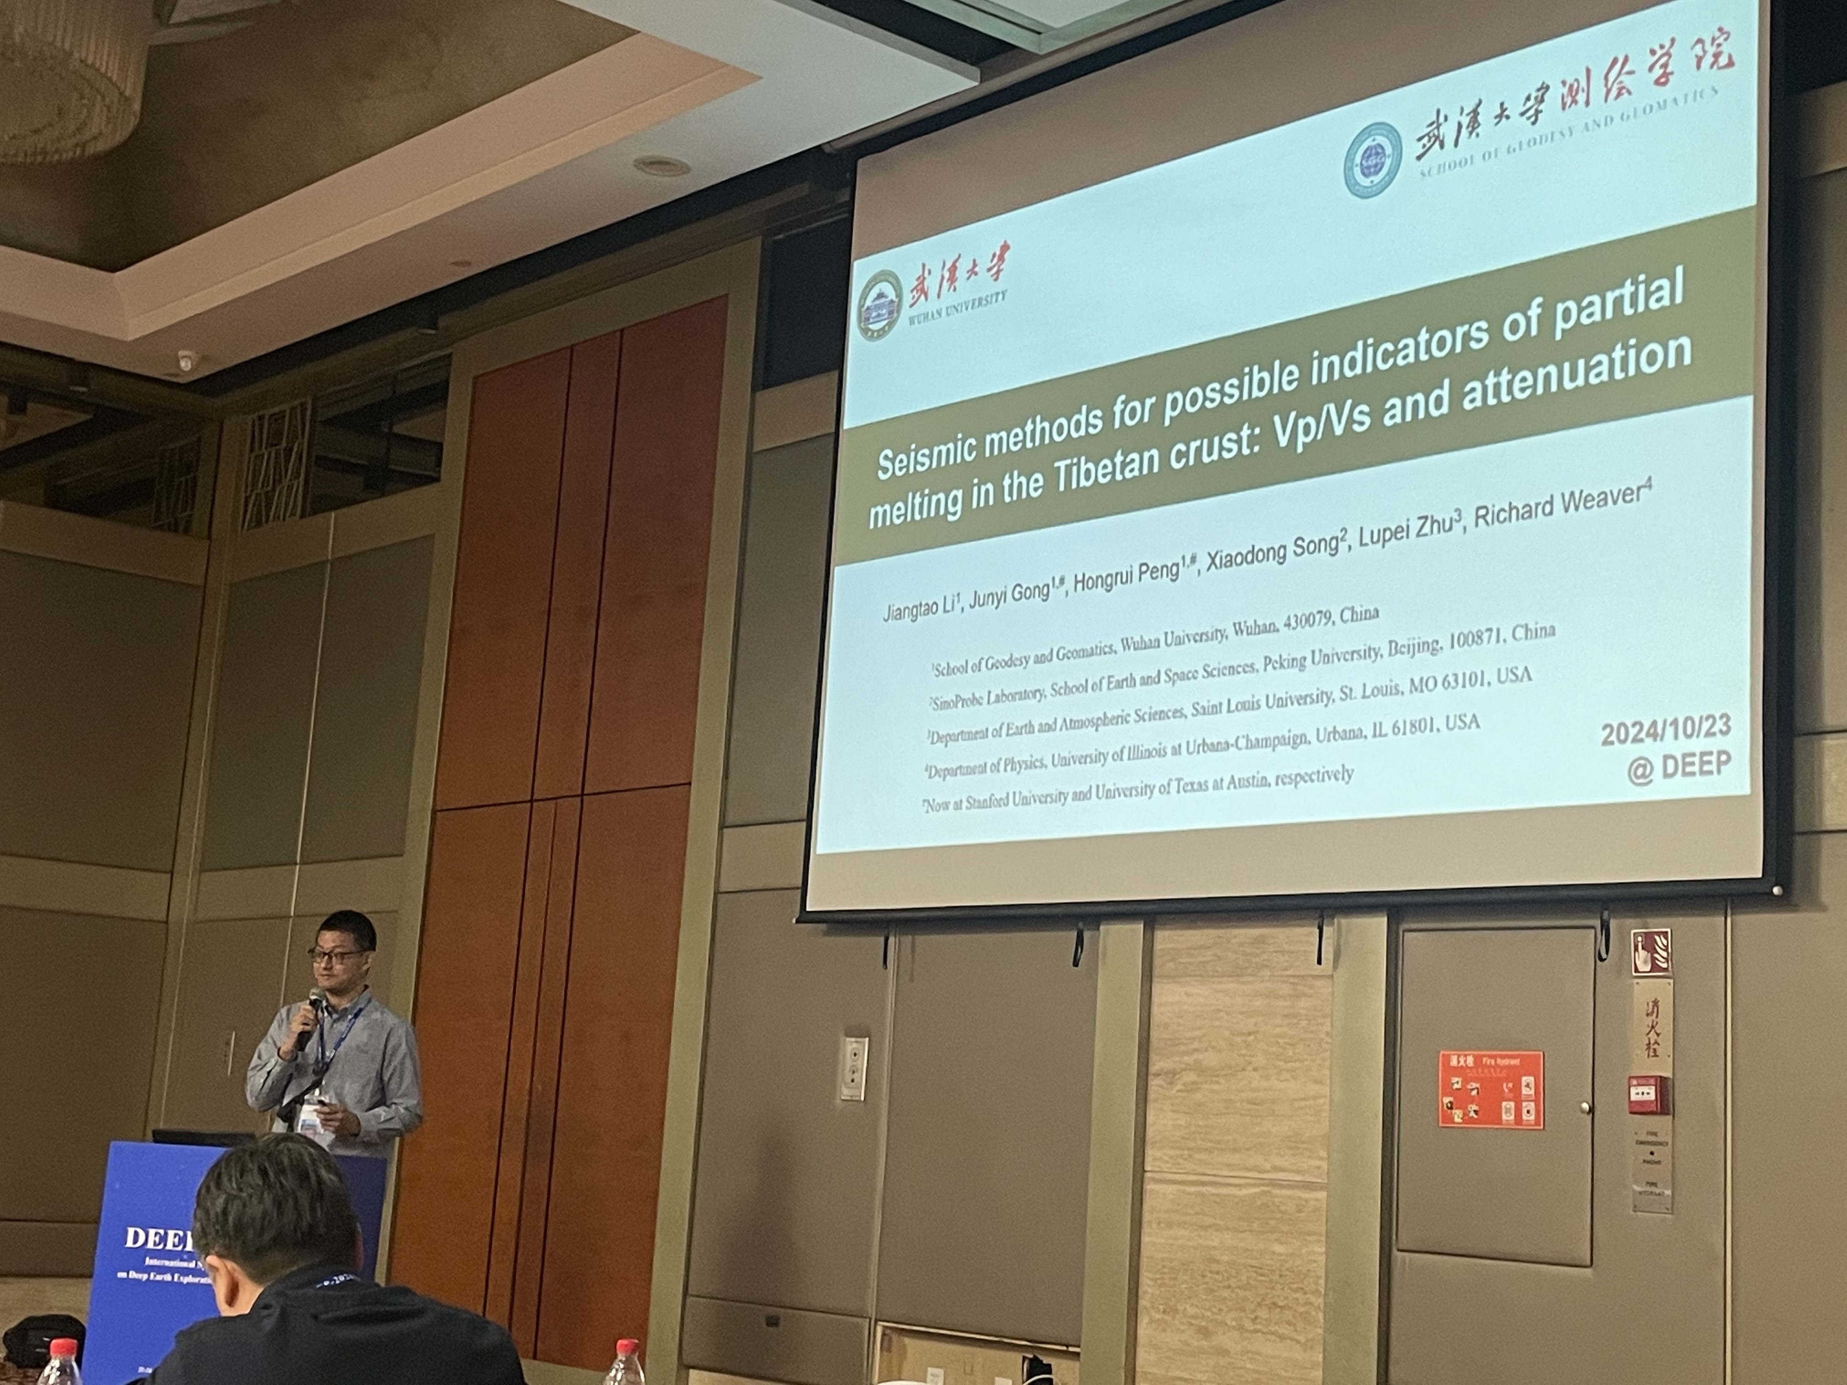
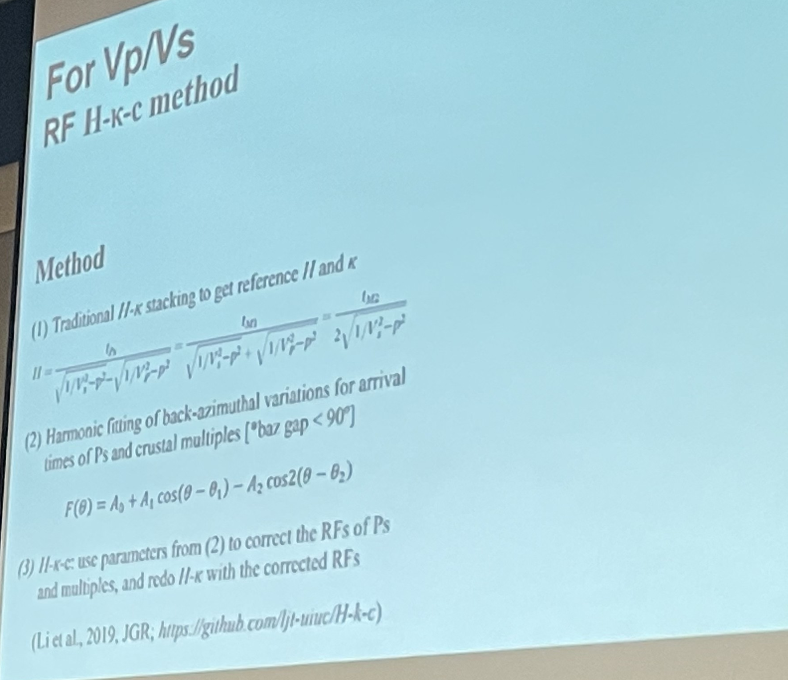
Talks by Topic
Attenuation(?
Ambient Noise --
Receiver Function --
Azimuthal Anisotropy
Virtual-Wave Disperssion?

Slide 10
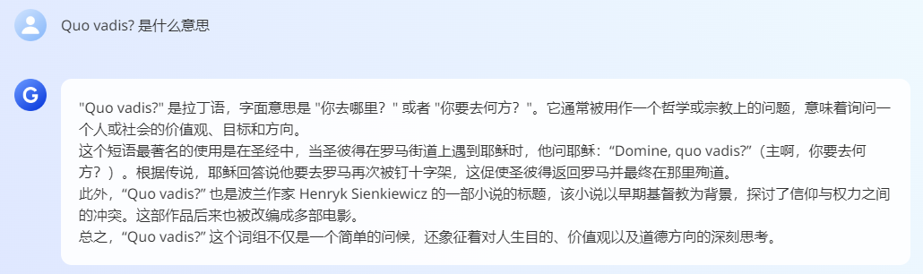
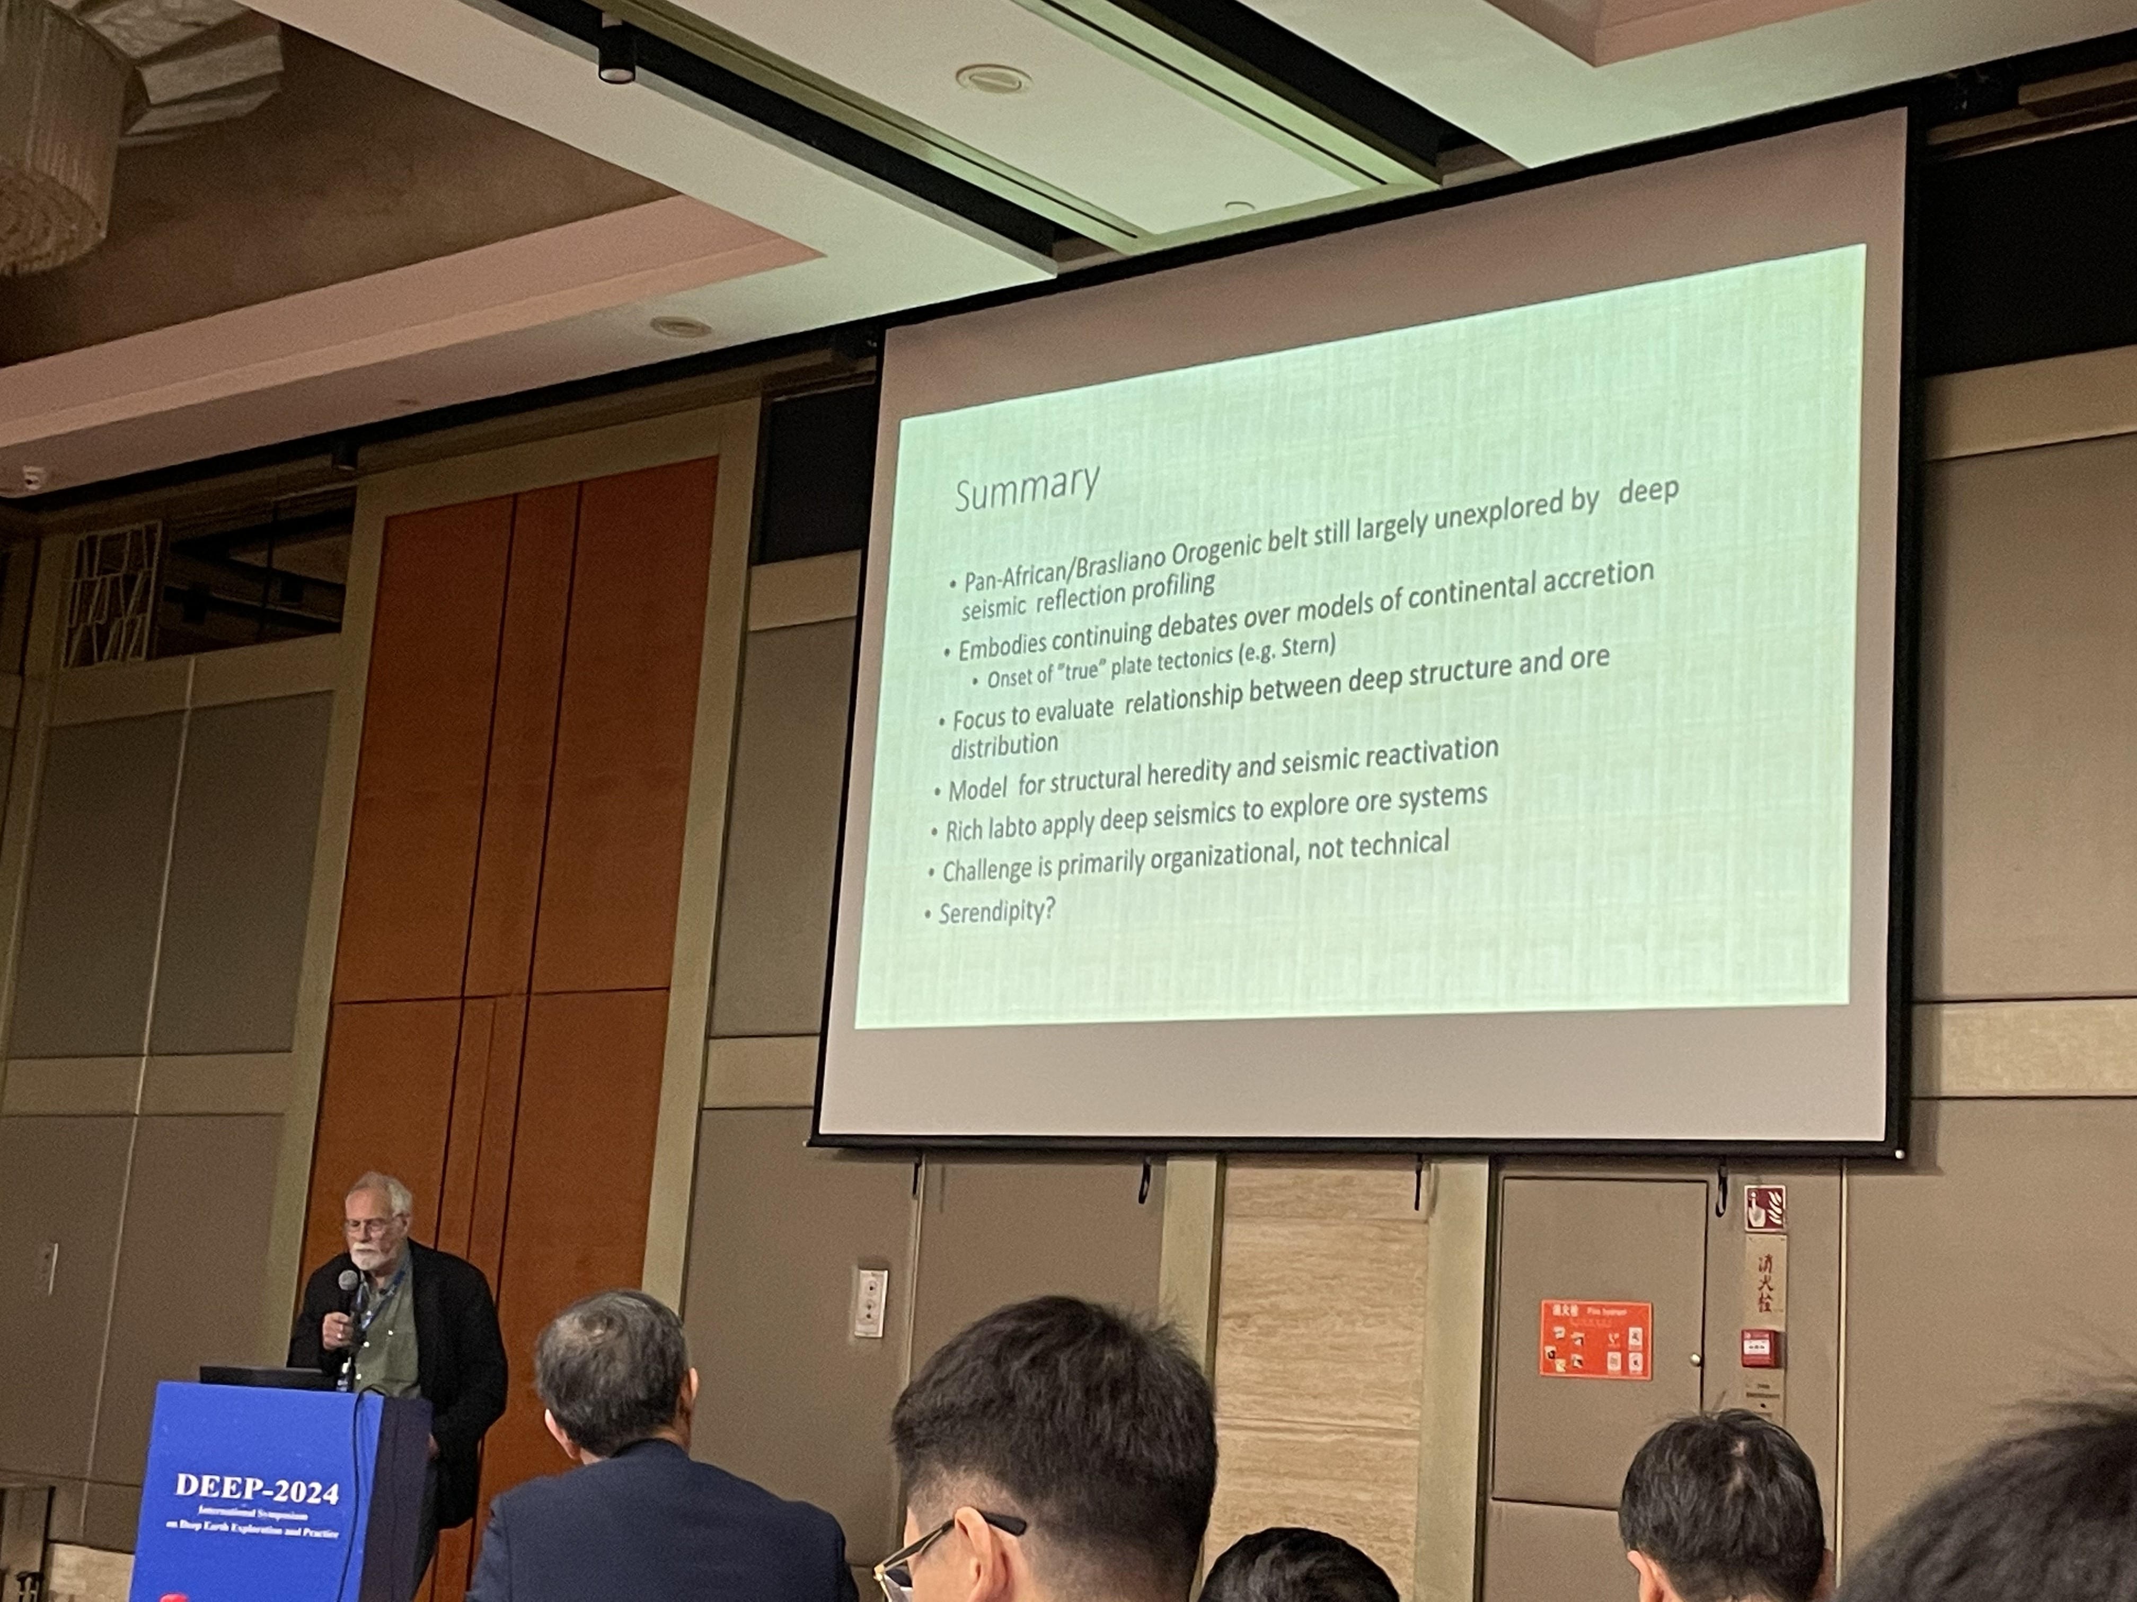
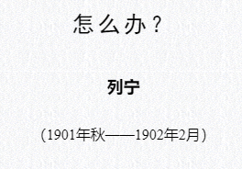
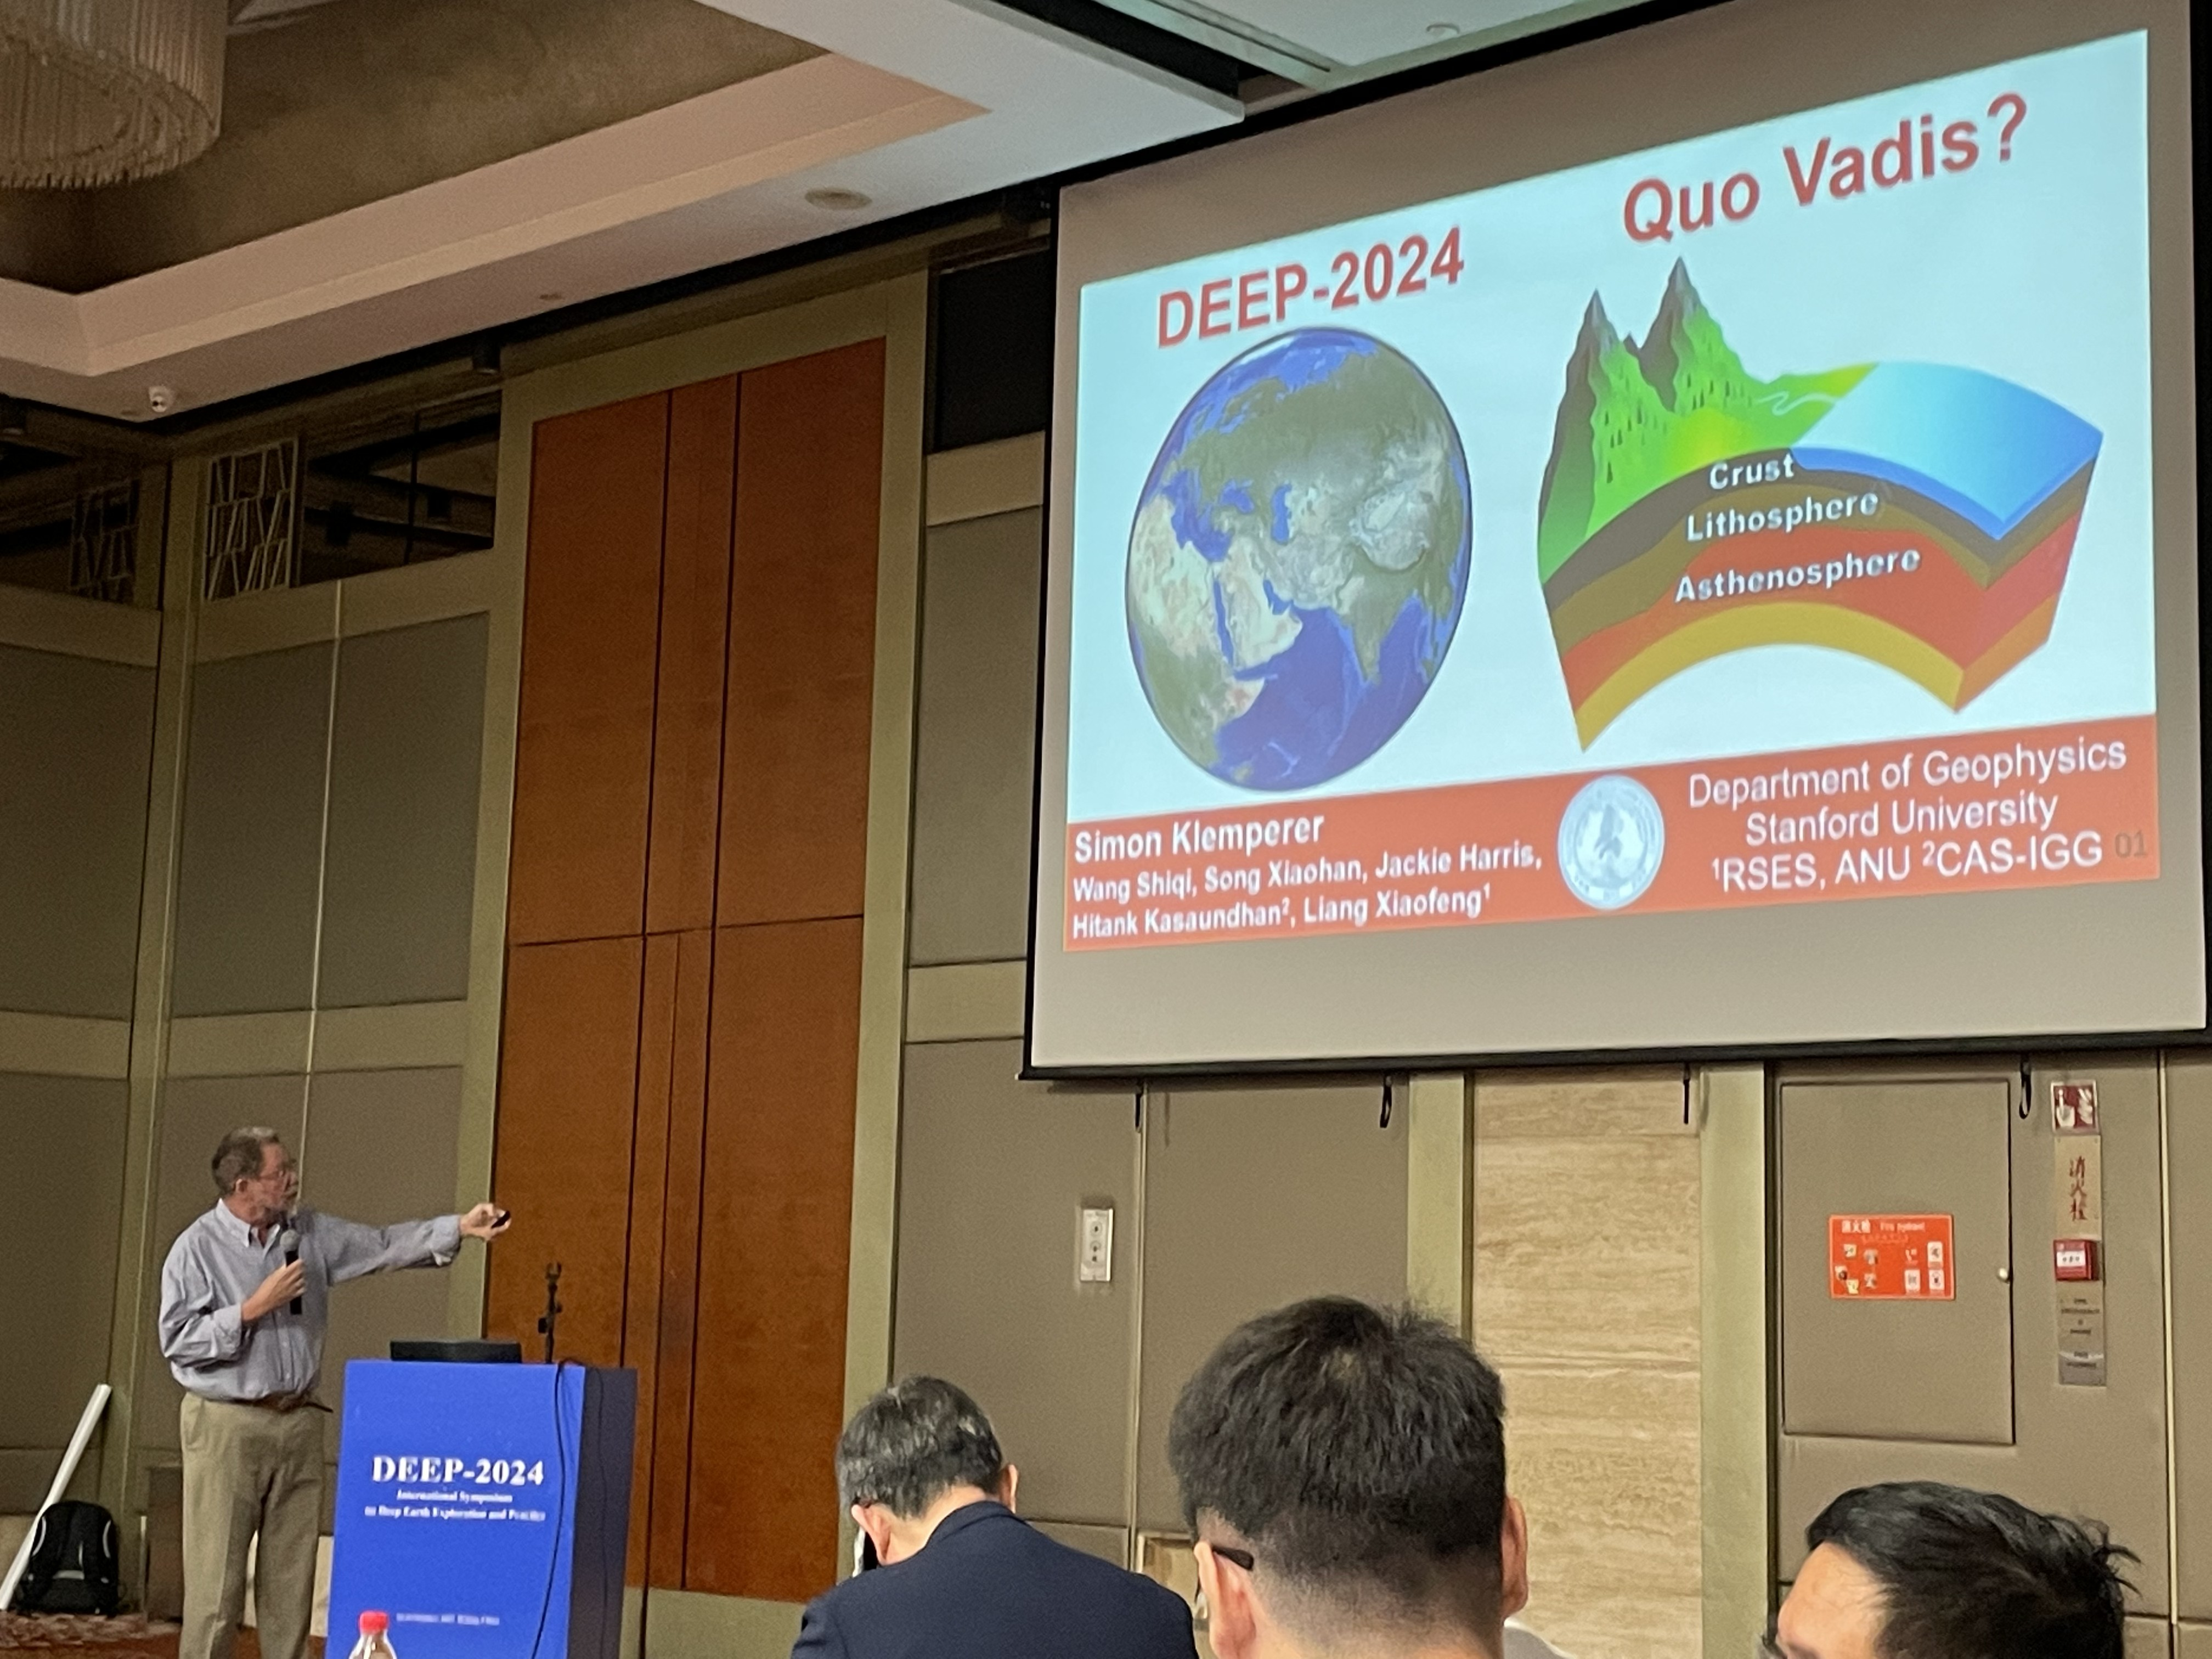
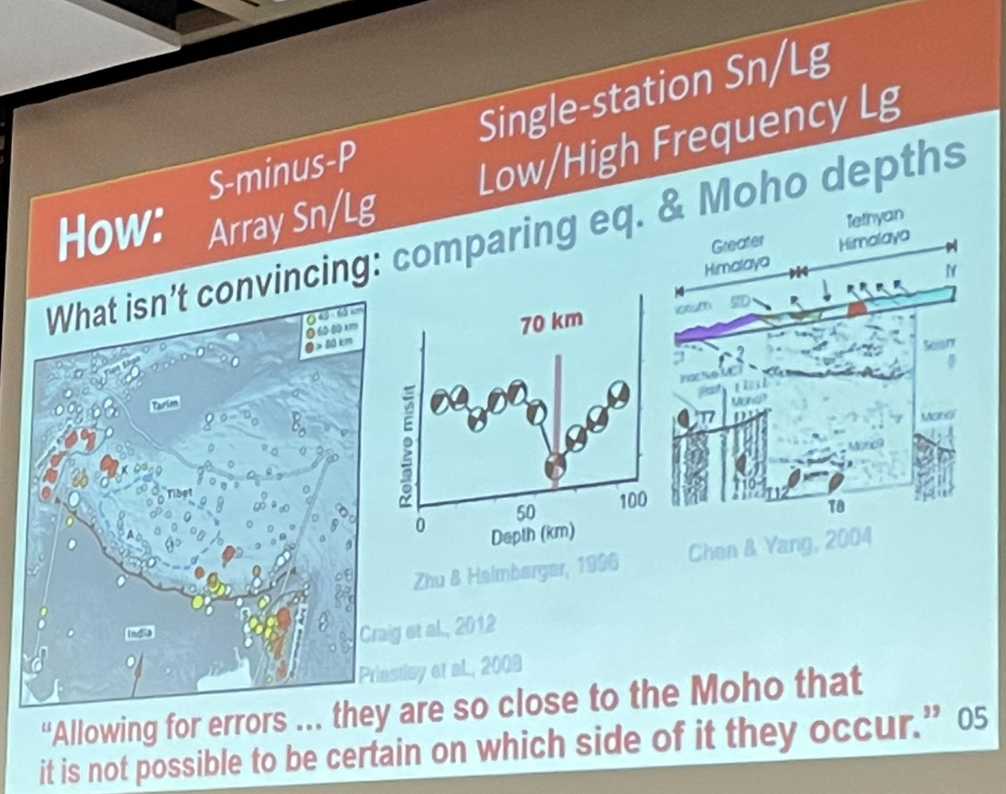
Talks by Topic
Challenge:
Structures remain unexplored
Qualitative? Quantitative?
Serendipity?
“Organizational, not technical”
“Double Moho”?

Slide 11
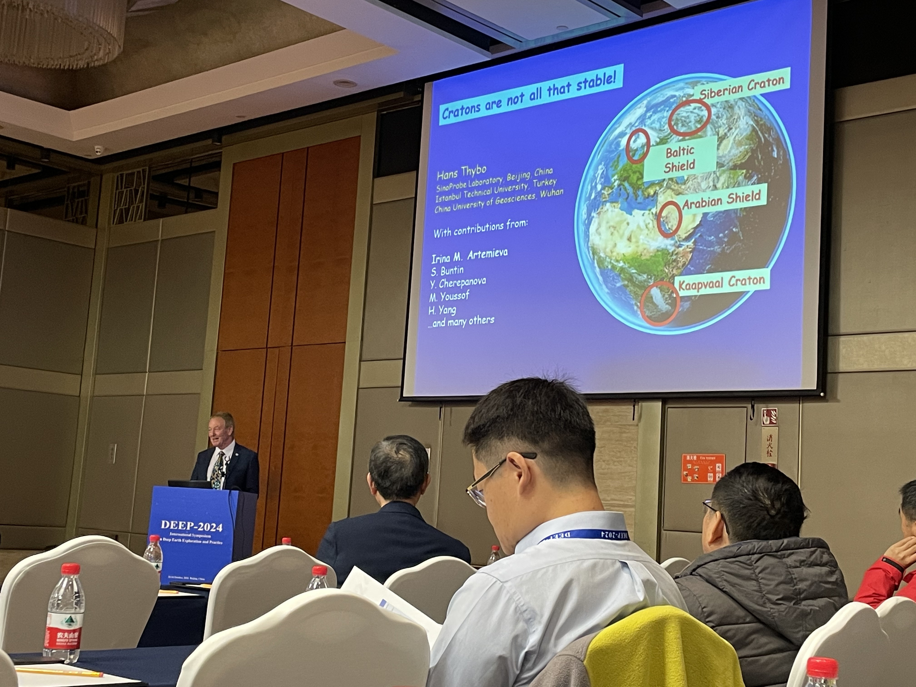
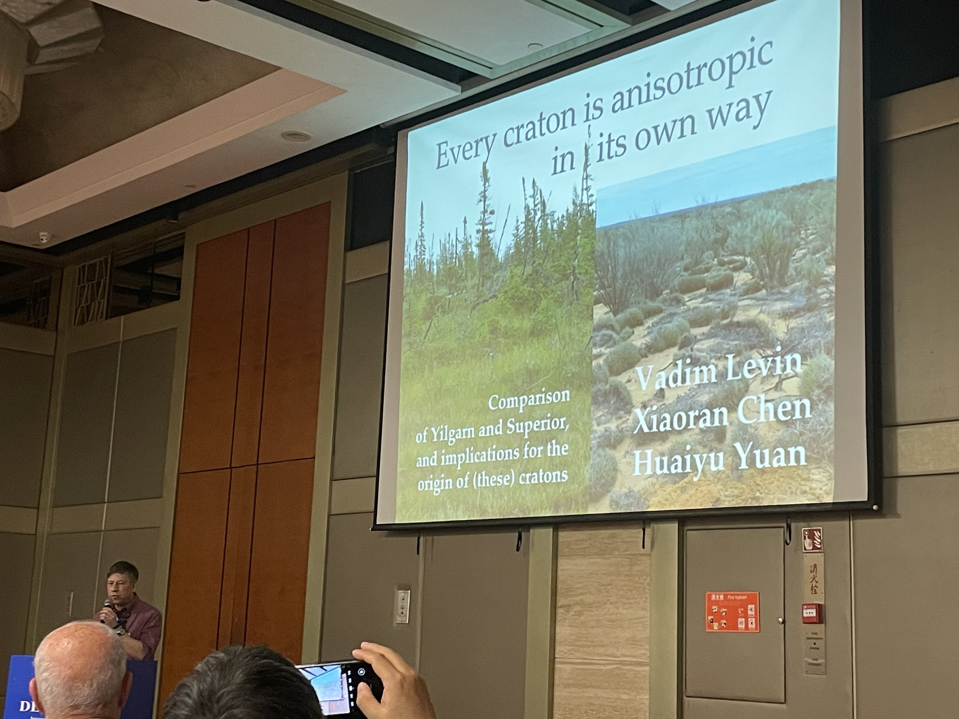
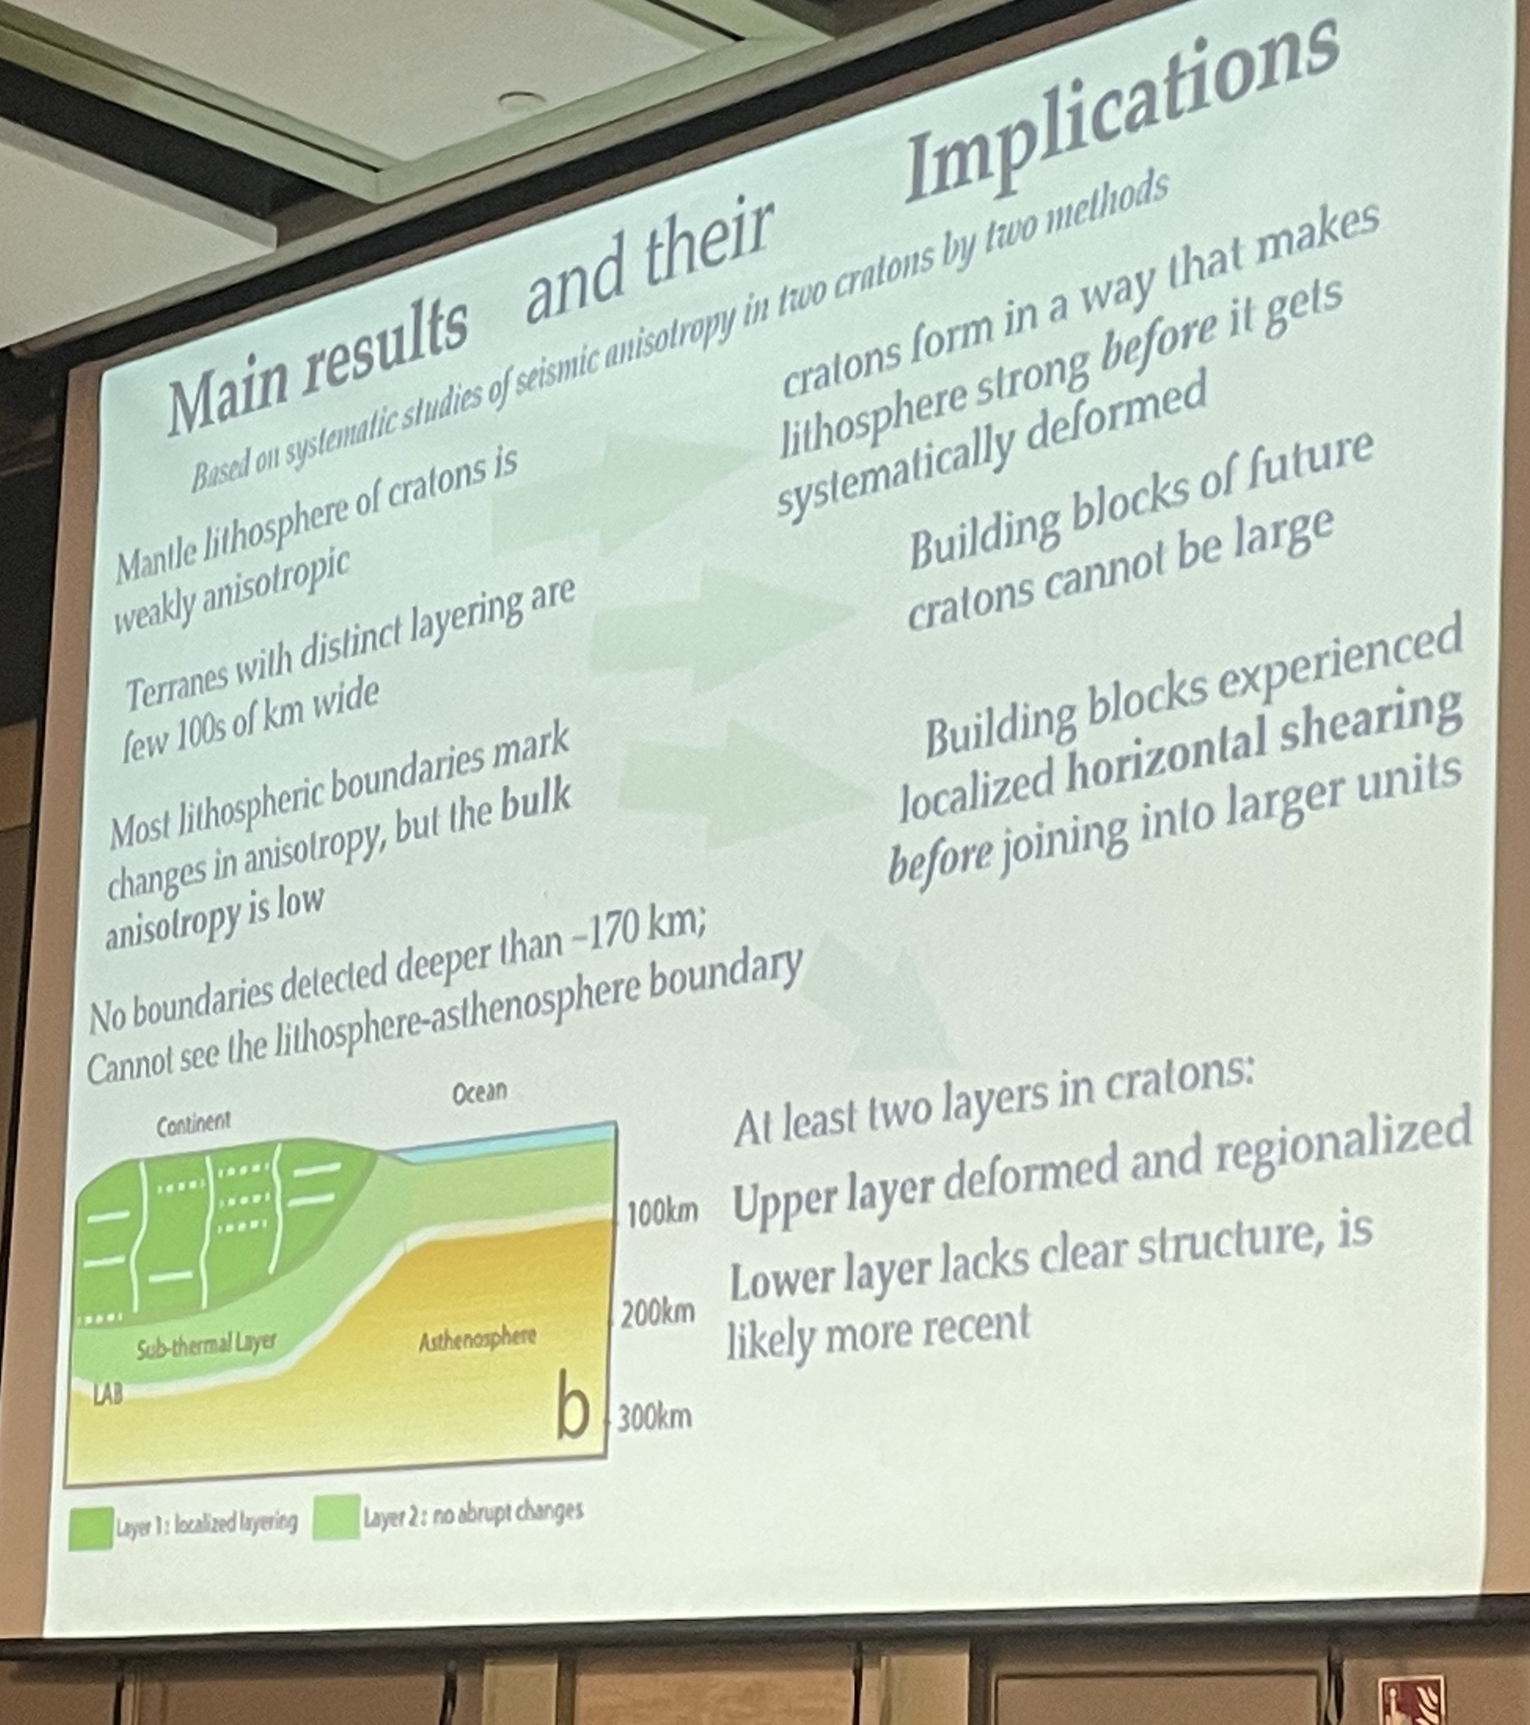
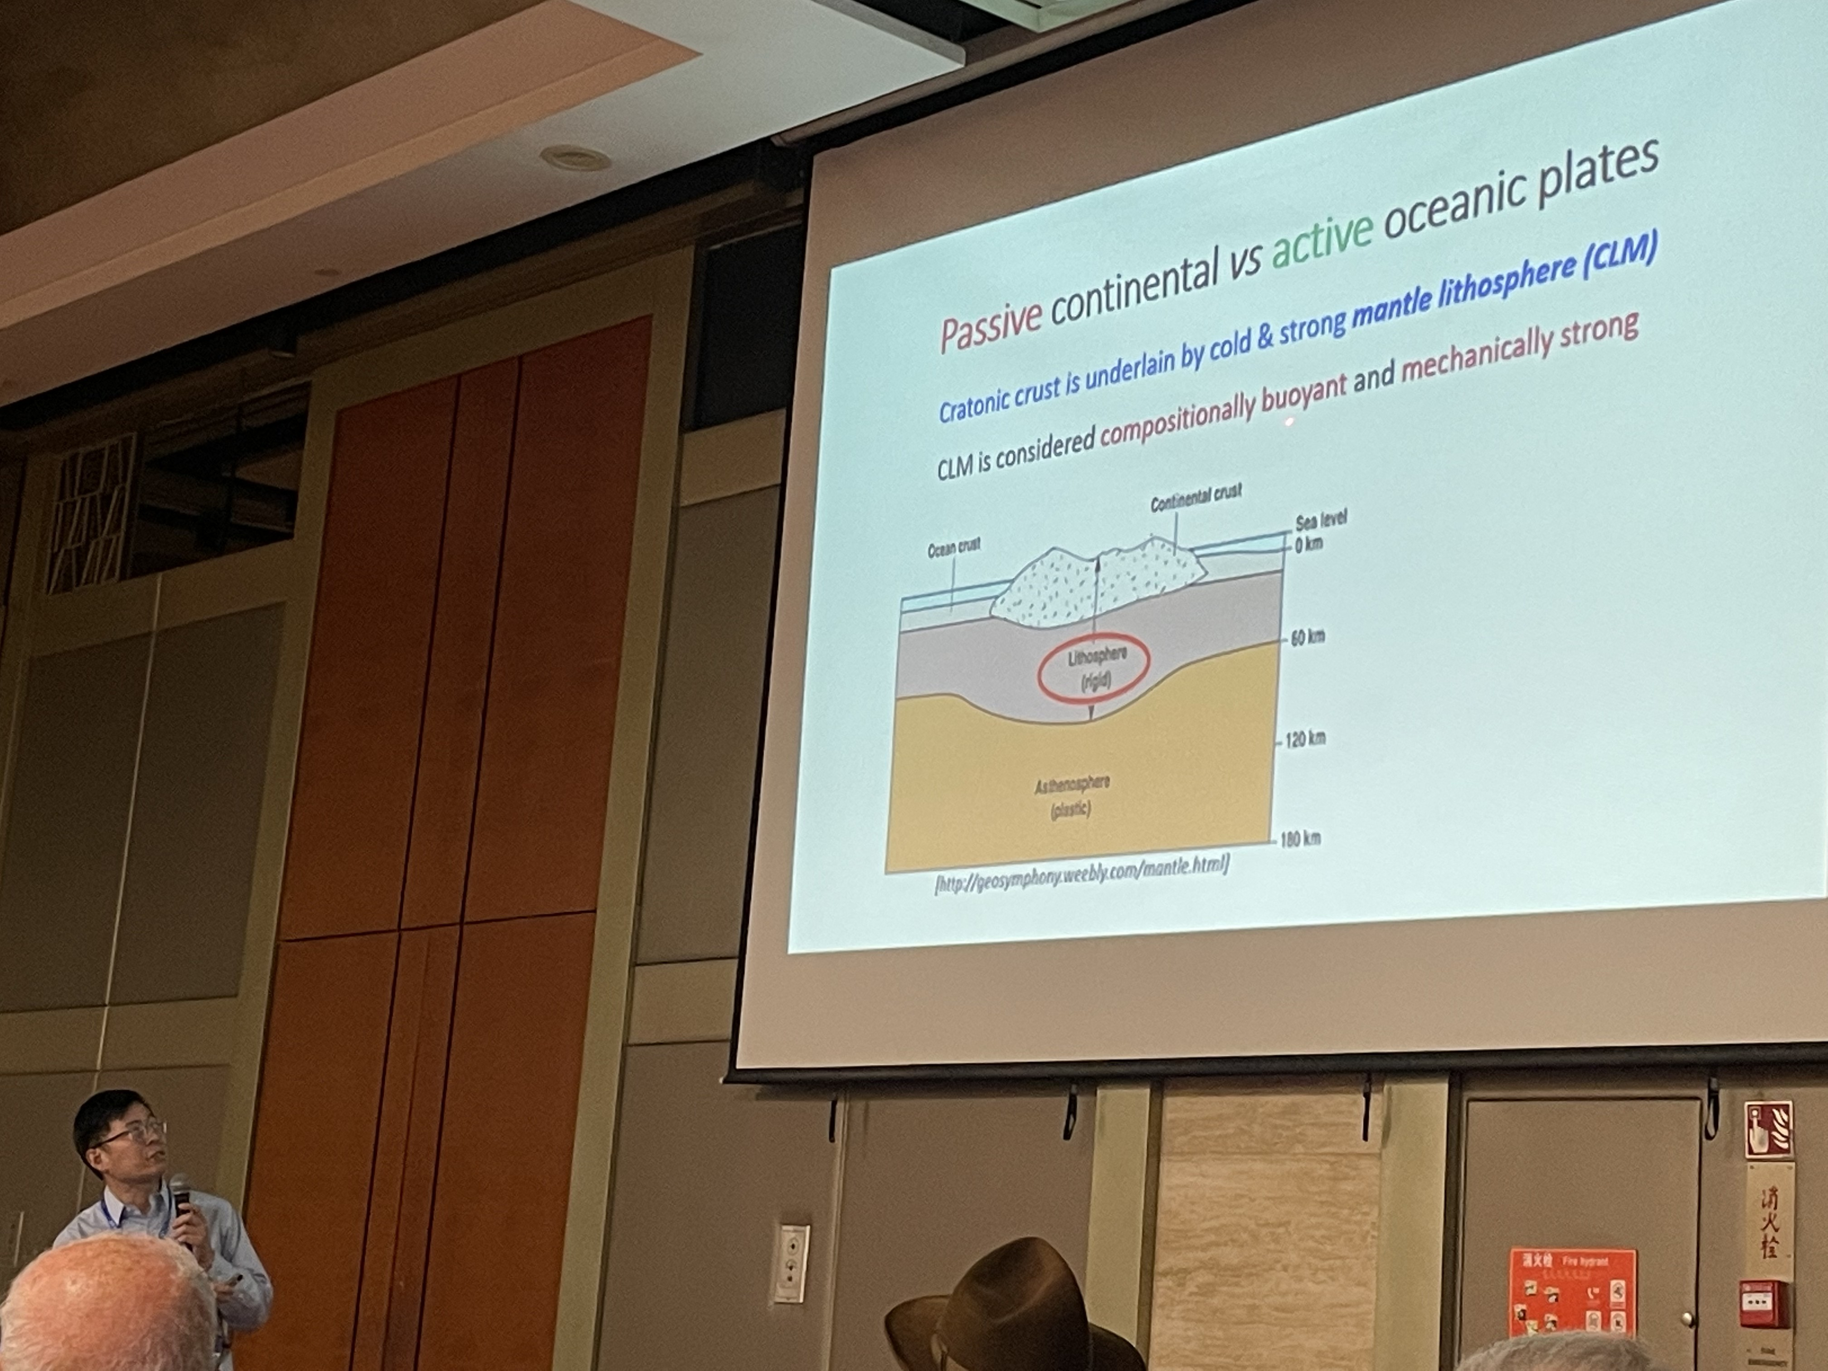
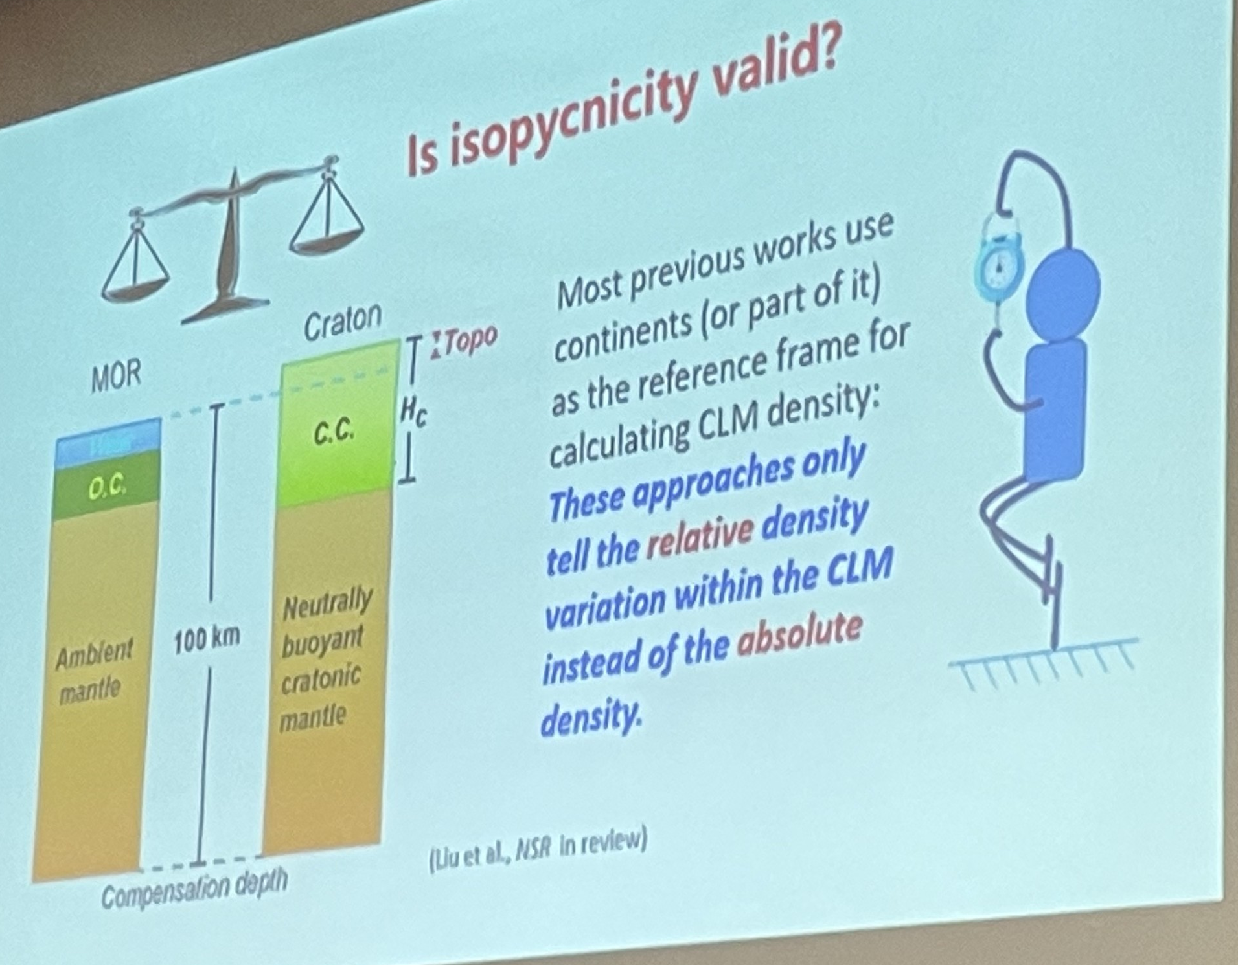
Talks by Topic
Craton Stability
subduction plate? lower boundary? density of CLM?

Slide 12
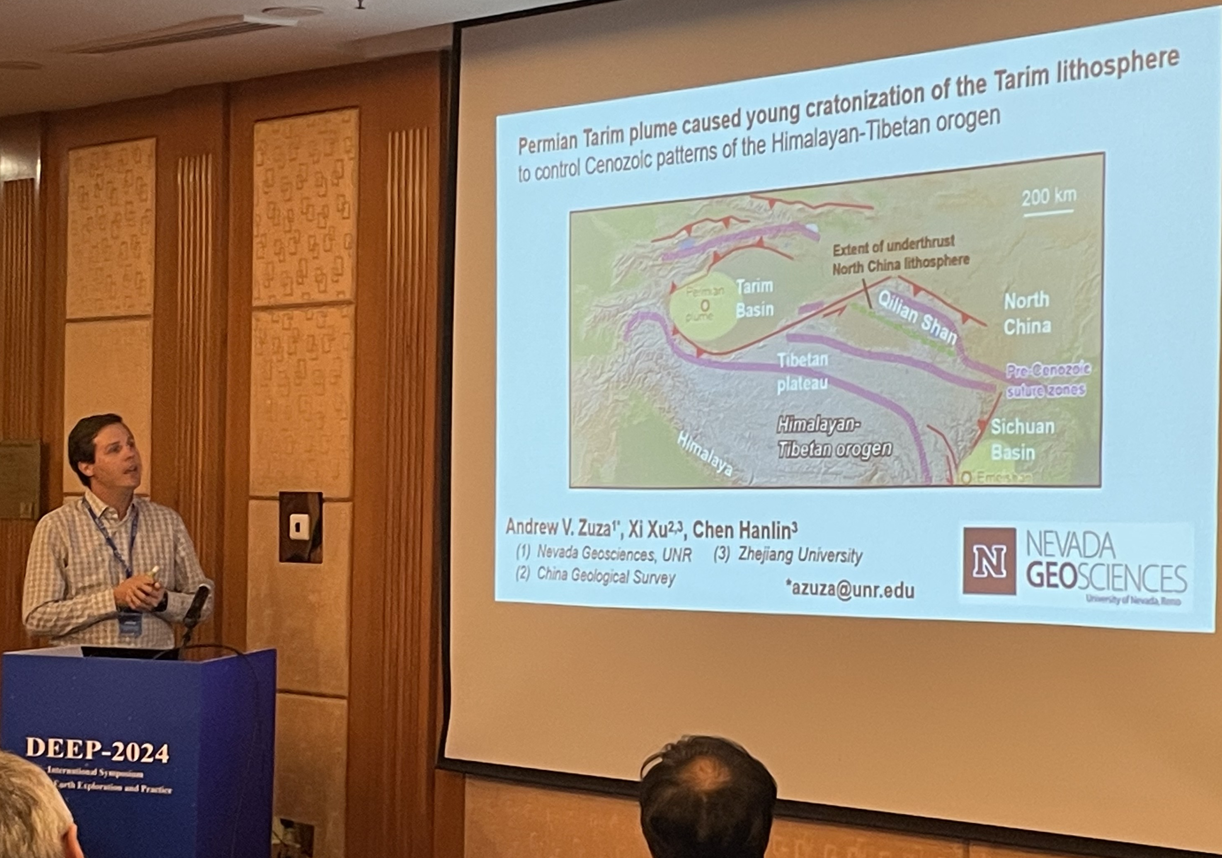
Talks by Topic
Craton Stability: younger craton
plume credits for the young, rigid cylindricity
Sichuan LIP?

Slide 13
Talks by Topic
Orogency and Driven Forces

Slide 14
Talks by Topic
Orogency and Driven Forces

Slide 15
Talks by Topic
Orogency and Driven Forces
bird-like subduction
clockwise rotation

Slide 16
Talks by Topic
Orogency and Driven Forces
No differences(?...

Slide 17
Talks by Topic
13challenge of orogenic belt exploration(brown&Klemperer)
1joint inversion and receiver function(Zhanghaijiang)
3intracontinental orogeny(dong)
3permian tarim plume(zuza)
1upper mantle v-model of western alpine(mao)
3orogenic lithosphere structure(indian guy)
2gravitational potential(indian girl)
3continental breakup and geodynamic process(who?)
3slowing inda-asia convergence or climate forcing(Capitanio)
1attenuation? partial melting?-double moho(li)
3mid-crustal overpressure(vlaha)
3tectonics of indonesia
3craton’s anisotropic(vadim)
1The big program
1FWI(pan)
3Tethys-wind&GDAssimulation(liu)
2geodesy(shen)
1attenuation imaging(li)
3continuous force(hu)
1dense-array(li and li)
3craton stability(hans)
13brazil deep project
13europe deep
3inversion rate(oskin)
inversion attempts-about dense and projects-imaging-double moho-craton stability-force and orogeny

Slide 18
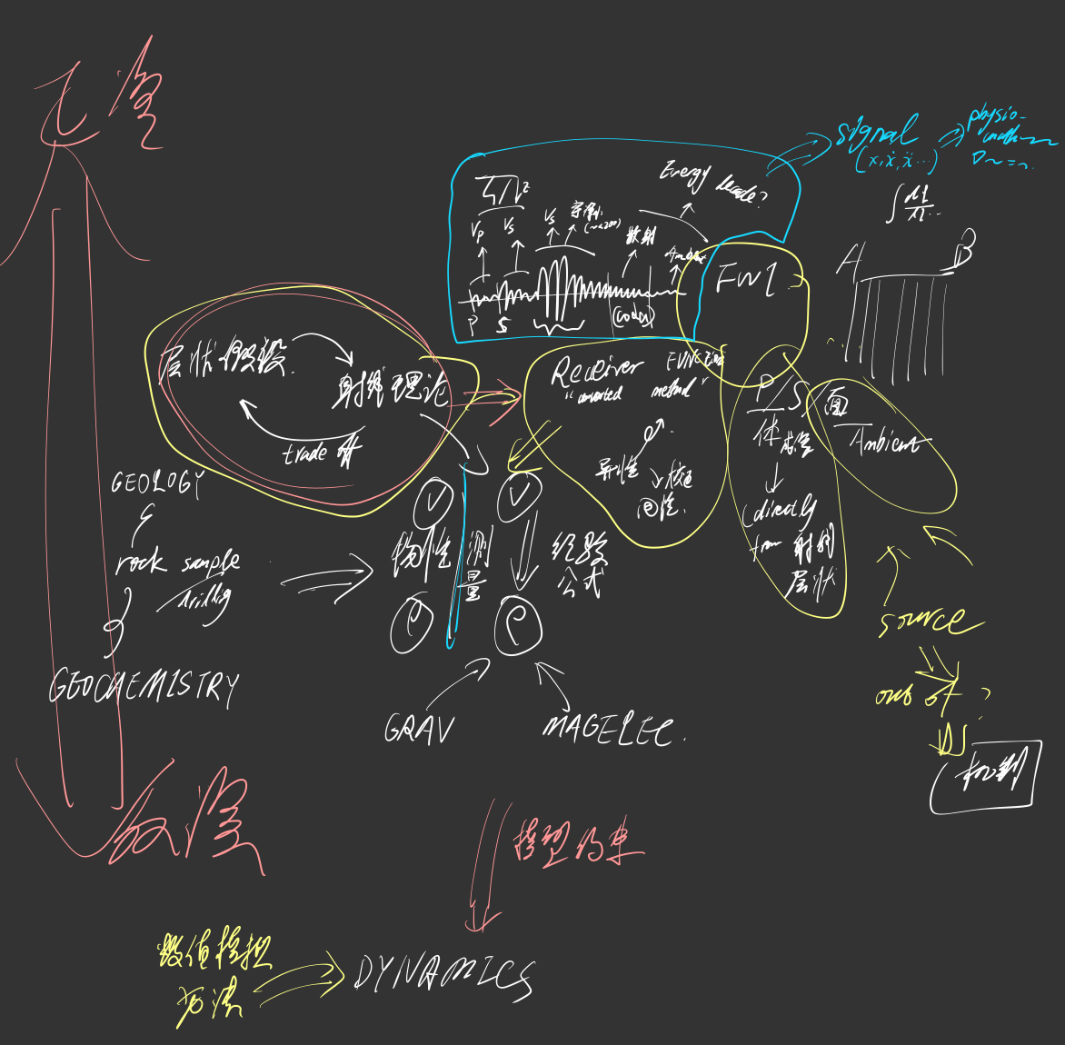
Muses

Slide 19
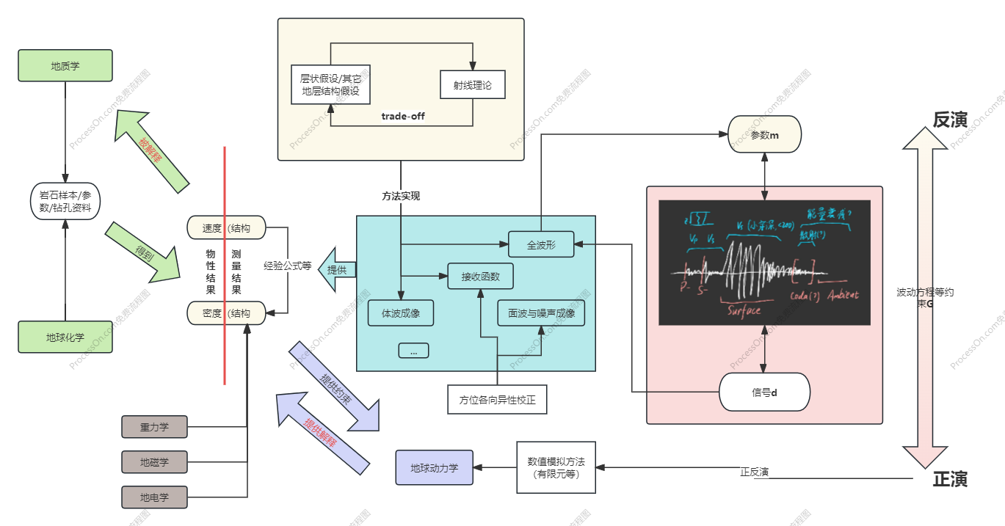
Muses

Slide 20
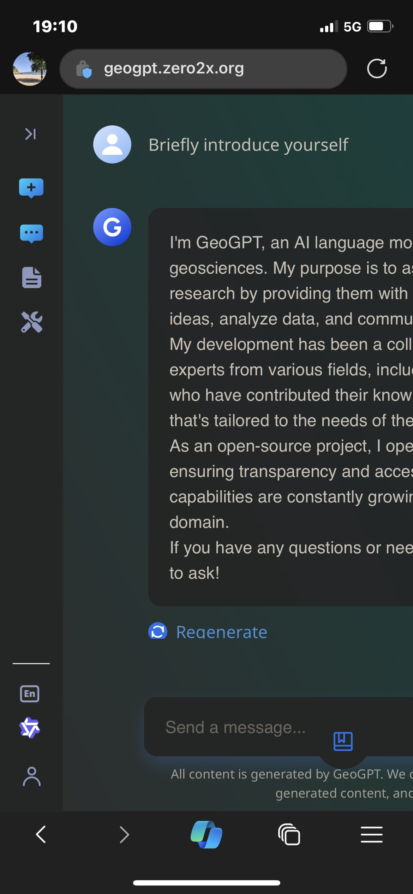
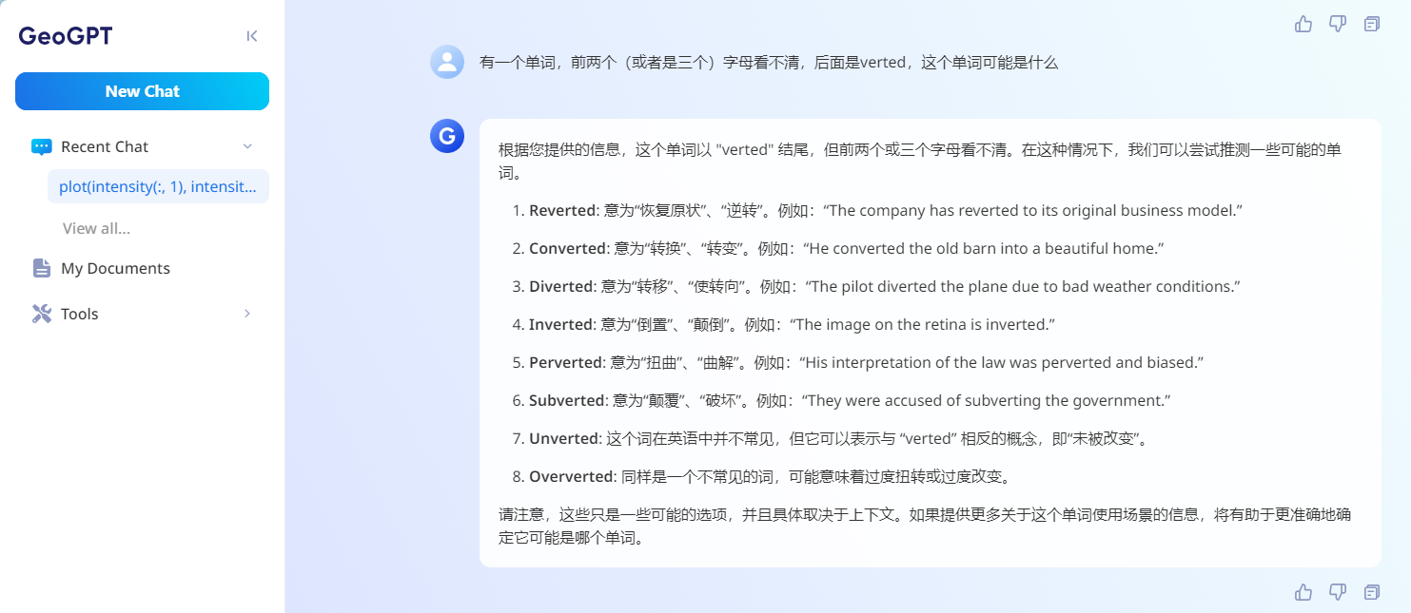
Muses

Slide 21
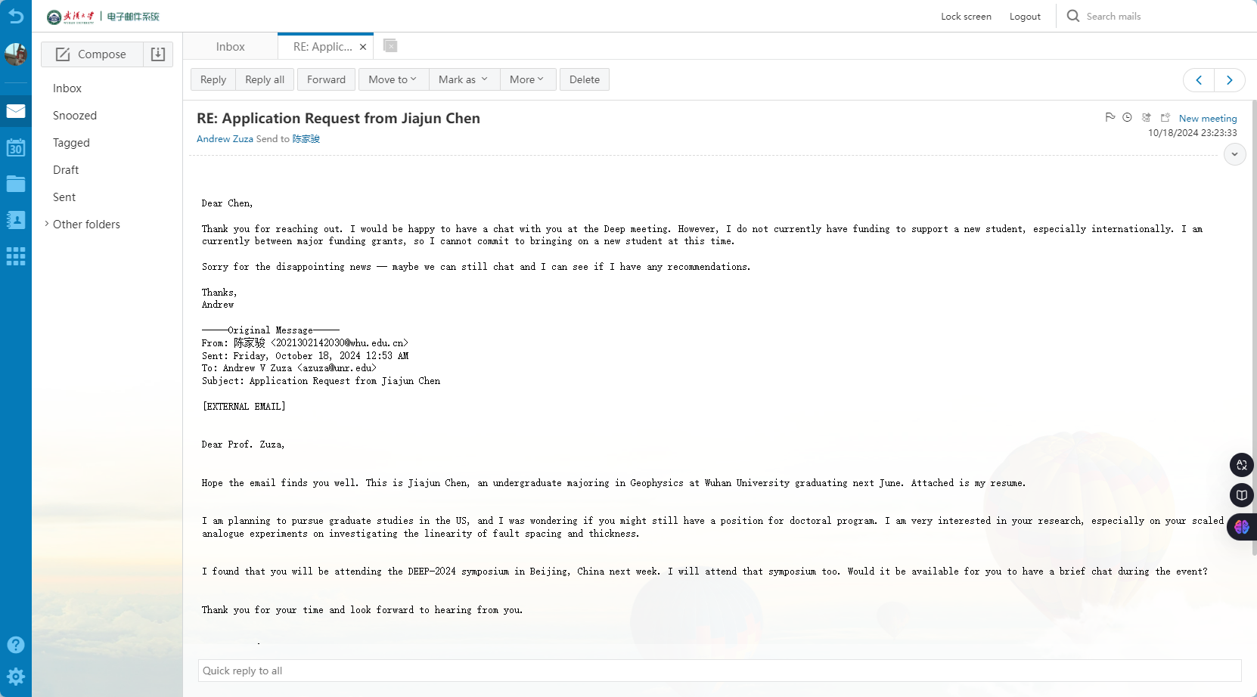
Muses

Slide 22
Slices

Slide 23
Slices

Slide 24
Slices

Slide 25
Slices

Slide 26
THANK YOU FOR LISTENING

